Slide 1





Training on Environmental Regulations for the Vietnam’s Garment Industry
Hợp tác với:
Được hỗ trợ bởi:

Slide 2
INTRODUCTION
FROM IFC & BW
Hợp tác với:
Được hỗ trợ bởi

Slide 3



GENERAL INSTRUCTIONS
To ensure an organized and productive training session for all participants, please observe the following rules:
Participants must keep their cameras and microphones off unless the Master Trainer instructs you to switch it on. This will help us maintain the flow of the event and conserve bandwidth usage.
This session will run for about 4 hours. Breaks are scheduled in between sessions for a quick water/restroom break so that you can avoid leaving during the training proper.
You can also engage with your fellow participants through the Zoom chat.
If you would like to direct any questions to the Master Trainer, you may send them through Zoom’s Chat feature. He/She will address selected questions at the end of the module.
If you would like to speak up and share any insights, please use the "Raise Hand" button and the training coordinate will acknowledge this gesture.
We strongly encourage you to take notes or screenshots of any important information discussed in the presentation.
Today’s session will be recorded for documentation purposes.
In case of urgent matters requiring your attention or presence, please do inform the ASSIST training staff before leaving the virtual training room.
Start/stop video
Show/hide participants list
Start/stop
share screen
Mute/Unmute
Raise hand & reaction buttons
Show/hide chat box

Slide 4
TRAINING OBJECTIVES
This training intends to support Better Work factories to understand, self-assess and be better equipped to meet applicable Vietnamese environmental regulatory requirements. The training will be delivered over four days in a virtual format to representatives from 50 Better Work factories, who will learn how to:
Understand, collect, and use the information required to fulfill national environmental regulatory requirements, using a ‘Guide to Vietnamese Environmental Law for the Garment Industry’.
Assess the extent to which factories’ operations are aligned with applicable national regulations, using a self-assessment tool.
Develop an improvement plan.
The training builds on a pilot project delivered by Better Work in 2017-2018 to 30 factories, which was designed in consultation with brands and other stakeholders, including the Sustainable Apparel Coalition to ensure complementarity with the Higg FEM Index. The tools that will be used and shared during the training have been developed during the pilot and have been updated to reflect the latest applicable regulations.

Slide 5



METHOD
TAKE LEARNER – CENTERED
Encourage maximum participation of learners in teamwork

Slide 6
CONTENT
Introduction of project tools:
  Country Guide to Vietnamese Environmental Law for Garment Industry
  Self-Assessment Tool
Guidance on how to use the project tools
Overview of Vietnam environmental regulations for the Garment sector
Update on new regulations of environmental protection
Higg FEM and Project Tools
Discussion on improvement plans for the factories
Notes:
Edited

Slide 7
AGENDA – LESSON 1
8:00 - 9:00 | IFC/BW Introduction
 | Introduction of the participants
 | General information: Introduction, Content, Methods
 | Part 1. Introduction of training tools (CG&SAT)
9:00 - 9:10 | Tea Break
9:10 - 9:40 | Part 2. Overview of Laws and Sub-Laws
9:40 - 10:10 | Part 3. Pre-activity Assessment
10:10 - 10:20 | Tea break
10:20 - 10:50 | Part 4. Permits
10:50 - 11:20 | Part 5. Water Extraction and Consumption
11:20 - 11:30 | Tea break
11:30 - 12:00 | Discuss and Q&A

Slide 8
AGENDA – LESSON 2
8:00 - 8:20 | Recap the previous section
8:20 - 8:50 | Part 6. Wastewater
8:50 - 9:10 | Part 7. Solid Waste
9:10 - 9:20 | Tea break
9:20 - 9:40 | Part 8. Hazardous Waste
9:40 - 10:10 | Part 9. Air Emission
10:10 - 10:20 | Tea break
10:20 - 10:50 | Part 10. Environmental management system (EMS)
10:50 - 11:20 | Part 11. Climate change - Greenhouse gas (GHG)
11:20 - 11:30 | Tea break
11:30 - 12:00 | Discuss and Q&A

Slide 9
AGENDA – LESSON 3
8:00 - 8:20 | Recap the previous section
8:20 - 9:20 | Part 12. Energy Management
9:20 - 9:30 | Tea Break
9:30 - 10:30 | Part 13. Chemical Handling and Management
10:30 - 10:40 | Tea Break
10:40 - 11:20 | Part 14. Training Tool - Self-Assessment Tool, HIGG FEM 3.0 - The linkages
11:20 - 11:30 | Tea Break
11:30 - 12:00 | Part 15. Discuss proposed improvements to satisfy SAT and raise the HIGG FEM score.

Slide 10
AGENDA – LESSON 4
8:00 - 8:15 | Recap the previous section
8:15 - 9:15 | Discuss challenges when filling SAT and results
9:15 - 9:25 | Tea Break
9:25 - 10:25 | How to develop an improvement plan
10:25 - 10:35 | Tea Break
10:35 - 11:45 | Discuss solutions to improve SAT results and raise the HIGG FEM score.
11:45 - 12:00 | Better Work/ IFC Closing

Slide 11


Note
Valid, with addition/revision
Expired
New updated

Slide 12
Introduction of project tools
Country Guide to Vietnamese Environmental Law
for Garment Industry (Country Guide)
And
Self-Assessment Tool (SAT)
The uses of the project tools
Notes:
Edited

Slide 13
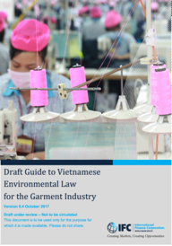
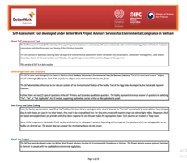
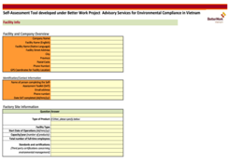
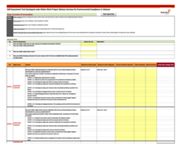
1. PROJECT TOOLS
Country Guide – focused on aspects of Environmental legislation applicable to the Garment Industry.
Self-Assessment Tool (SAT)
– developed to support factories to self-assess if they meet legal requirements

Slide 14
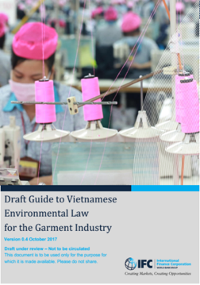
1. PROJECT TOOLS
Country Guide
12 topics
GENERAL ENVIRONMENTAL REGULATIONS
PRE-OPERATION PERMITS AND ASSESSMENTS
ENVIRONMENTAL DOSSIER AND PERMITS
WATER EXTRACTION AND CONSUMPTION
WASTEWATER MANAGEMENT
SOLID WASTE
HAZARDOUS WASTE
AIR EMISSIONS
NOISE AND VIBRATION
ENERGY MANAGEMENT
RESPONSES TO CLIMATE CHANGE
CHEMICAL HANDLING AND MANAGEMENT
Written as a manual.
The contents of the Country Guide are quoted from the provisions of the law / decree / circular and clearly cited.

Slide 15
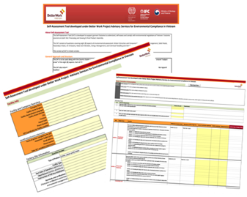
1. PROJECT TOOLS
Self-Assessment Tool (SAT)
11 Sheets
Sheet 1: Introduction SAT
Sheet 2: Facility info
Sheet 3: Permits
Sheet 4: Water Extraction and Consumption
Sheet 5: Wastewater Management
Sheet 6: Solid Waste
Sheet 7: Hazardous Waste
Sheet 8: Air Emissions
Sheet 9: Noise and Vibration
Sheet 10: Energy Management
Sheet 11: Chemical Handling & Management
Written on Excel file
The contents are reviewed in the form of a questionnaire
The regulations are referenced in the Country Guide and FEM of the Higg Index

Slide 16
Overview of Vietnamese environmental regulations for the garment sector
Gap Analysis between FEM and Vietnamese environmental regulations

Slide 17

2. LAW ON ENVIRONMENTAL PROTECTION
Law on environmental protection
No.55/2014/QH13
Law on Water Resources
No.17/2012/QH13
Dec 18/2015/NĐ-CP – EIA, EP plan, environmental protection scheme
Dec
19/2015/NĐ-CP Detailing the implementation of a number of articles of the law on environmental protection
Dec 38/2015/NĐ-CP – On management of waste and discarded materials
Dec 154/2016/NĐ-CP - On environmental protection fee on wastewater
Dec 155/2016/NĐ-CP Penalties for administrative violations against regulations on environmental protection
Dec 80/2014/NĐ-CP - On the drainage and treatment of wastewater
Dec 201/2013/NĐ-CP
Detailing the implementation a number of articles of the law on water resources
Dec 33/2017/NĐ-CP Penalties for administrative violations against regulations on water and mineral resources
Cir 27/2015/TT-BTNMT On SEA, EIA and EP plans
Cir 24/2017/TT-BTNMT - On state of the environment report, set of environmental indicators and management of environmental monitoring data
Cir 36/2015/TT-BTNMT Management of hazardous wastes
Cir 31/2016/TT-BTNMT Providing for environmental protection for industrial clusters, concentrations of businesses, service providers, trade villages, production, commercial and service establishments
Cir 35/2015/TT-BTNMT Providing for the environmental protection of economic zones, industrial parks, export processing zones and hi-tech parks
Cir 27/2014/TT-BTNMT- Regulating the registration for groundwater extraction, form of dossier for issue, extension, modification, re-issue of water resource permit
Cir 26/2015/TT-BTNMT -Regulating detailed EP project, simple EP project

Slide 18




2. LAW ON ENVIRONMENTAL PROTECTION
Law on environmental protection
No.55/2014/QH13
Law on Water Resources
No.17/2012/QH13
Dec 18/2015/NĐ-CP – EIA, EP plan, environmental protection scheme
Dec
19/2015/NĐ-CP Detailing the implementation of a number of articles of the law on environmental protection
Dec 38/2015/NĐ-CP – On management of waste and discarded materials
Dec 154/2016/NĐ-CP - On environmental protection fee on wastewater
Dec 155/2016/NĐ-CP Penalties for administrative violations against regulations on environmental protection
Dec 80/2014/NĐ-CP - On the drainage and treatment of wastewater
Dec 201/2013/NĐ-CP
Detailing the implementation a number of articles of the law on water resources
Dec 33/2017/NĐ-CP Penalties for administrative violations against regulations on water and mineral resources
Cir 40/2019/NĐ-CP
Cir 53/2020/NĐ-CP
Cir 36/2020
Cir 27/2015/TT-BTNMT On SEA, EIA and EP plans
Cir 24/2017/TT-BTNMT - On state of the environment report, set of environmental indicators and management of environmental monitoring data
Cir 36/2015/TT-BTNMT Management of hazardous wastes
Cir 31/2016/TT-BTNMT Providing for environmental protection for industrial clusters, concentrations of businesses, service providers, trade villages, production, commercial and service establishments
Cir 35/2015/TT-BTNMT Providing for the environmental protection of economic zones, industrial parks, export processing zones and hi-tech parks
Cir 27/2014/TT-BTNMT- Regulating the registration for groundwater extraction, form of dossier for issue, extension, modification, re-issue of water resource permit
Cir 26/2015/TT-BTNMT -Regulating detailed EP project, simple EP project
TT 25/2019/TT-Law Env.

Slide 19


3. PRE-OPERATION ASSESSMENTS
ENVIRONMENTAL IMPACT ASSESSMENT REPORT (EIA)
ENVIRONMENTAL PROTECTION PLANS
DETAILED ENVIRONMENT PROTECTION PROJECT
SIMPLE ENVIRONMENT PROTECTION PROJECT
REPORT
ENVIRONMENTAL IMPACT ASSESSMENT REPORT (EIA)

Slide 20
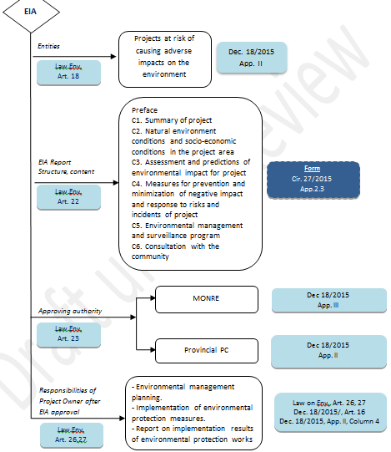
ENVIRONMENTAL IMPACT ASSESSMENT REPORT (EIA)

Slide 21
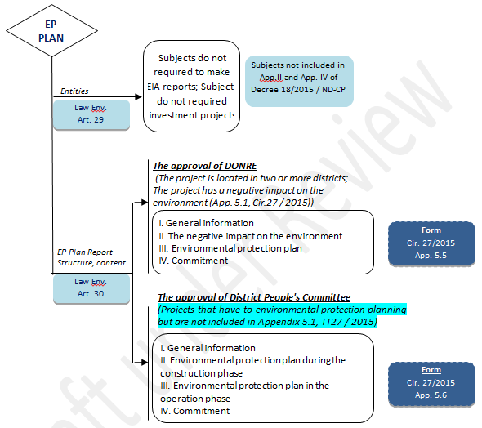
ENVIRONMENTAL PROTECTION PLANS

Slide 22
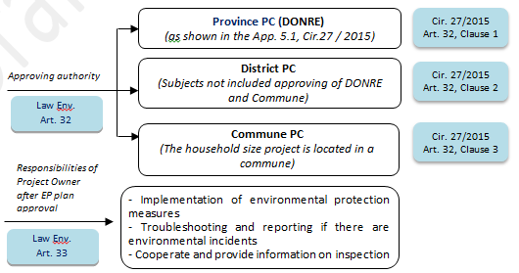
ENVIRONMENTAL PROTECTION PLANS (cont)

Slide 23
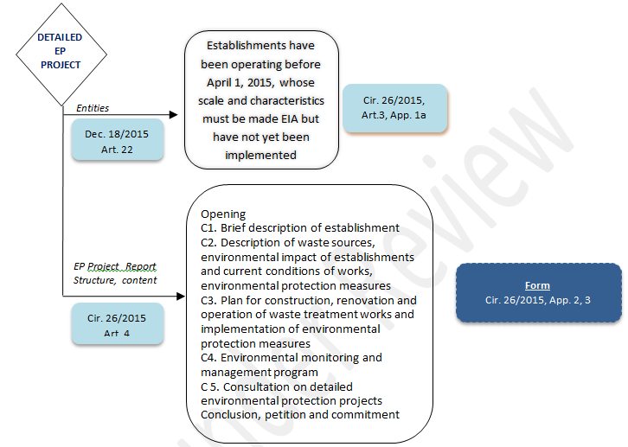

DETAILED EP PROJECT

Slide 24
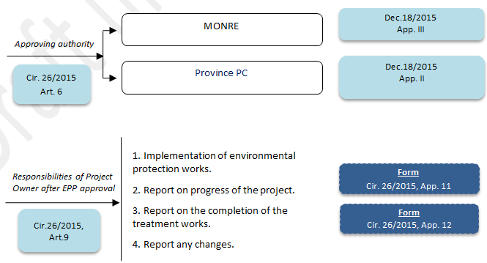
DETAILED EP PROJECT (cont)

Slide 25
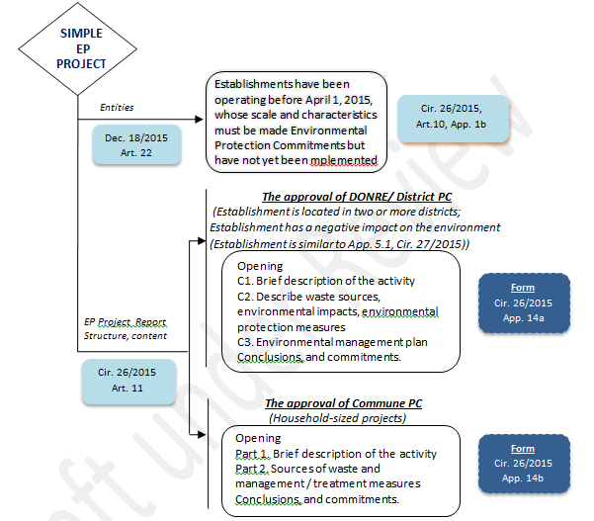
SIMPLE EP PROJECT

Slide 26
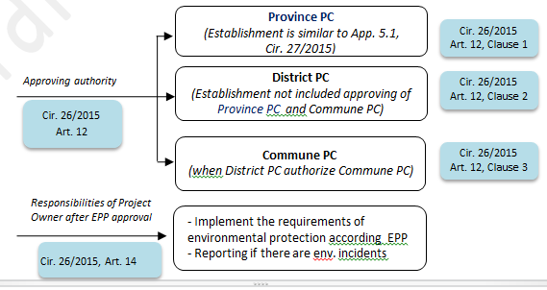
SIMPLE EP PROJECT (cont)

Slide 27

3. PRE-ACTIVITY ASSESSMENT
LIST OF PROJECTS TO BE MAKING IA/ ENVIRONMENTAL PROTECTION PLAN REGISTRATION

Slide 28
ENVIRONMENTAL IMPACT ASSESSMENT REPORT (EIA)

Slide 29
ENVIRONMENTAL IMPACT ASSESSMENT REPORT (EIA)
Changes, supplements some articles of Cir 18/2015/NĐ-CP
Referring to the issue?
Subjects must perform environmental impact assessment
Contents of environmental impact assessment
Make an environmental impact assessment report
Post-approval of environmental impact assessment

Slide 30
ENVIRONMENTAL IMPACT ASSESSMENT REPORT (EIA)
Make an environmental impact assessment report
No project implementation within 24 months
Change the project implementation location compared to the approved EIA;
Supplementing investment items with scale and capacity equivalent to those in the list of App II - Dec 40/2019/ND-CP;
Increase in size, capacity or other changes that lead to environmental protection works are not able to solve the increased environmental problems;
Changing the main product production technology of the project; change the project's waste treatment technology that is likely to have adverse effects on the environment compared to the plan in the decision approving the environmental impact assessment report.
Following the request of the project owner.

Slide 31
ENVIRONMENTAL IMPACT ASSESSMENT REPORT (EIA)
Responsibilities of project owners after EIA approval
Implement the requirements of the decision approving the EIA report.
Planning an environmental management plan of the project and send it to the Commune People's Committee to be publicly posted before starting construction.
According to column 4 of App II, a dossier of request for inspection and certification of completion of environmental protection works must be made (except without dyeing or without washing).
In case of causing environmental incidents, they must stop and promptly report them, and take responsibility for troubleshooting and compensating for damage.
In case a change increases the negative impact compared to the approved EIA but is not enough to have to repeat the EIA, it must be reported in writing and changes can only be made after an approval decision is made.

Slide 32
ENVIRONMENTAL IMPACT ASSESSMENT REPORT (EIA)
Test operation
Construction and installation of waste treatment works
Trial operation
Only put into trial operation when
The waste treatment works have been completed according to the EIA decision.
Completed installation of monitoring equipment and systems
Having operating procedures for waste treatment facilities
Having a dossier of completion of construction waste treatment works
Make and send the test operation plan
EIA
Trial: 3-6 months
20d
30d
Plan submission
Proposal for acceptance
Construct

Slide 33
ENVIRONMENTAL IMPACT ASSESSMENT REPORT (EIA)
Responsibility when operating
Coordinate with management agencies to inspect and supervise the trial operation process;
Organize and monitor results/connect to the internet, transmit data...
Monitoring waste, evaluating efficiency in each treatment stage and waste treatment works. (according to Article 10 of Circular No. 25/2019/TT-BTNMT).
Self-assessment or rent evaluate the treatment efficiency of the project's waste treatment facilities;
Synthesize and evaluate waste monitoring data
Make a report on the completion of the environmental protection work and send it to confirm the completion of the project
If the waste discharged into the environment does not satisfy: Stop/reduce capacity/Renovate, upgrade…
In case of causing environmental problems: stop testing/report. take responsibility for remedial

Slide 34
ENVIRONMENTAL IMPACT ASSESSMENT REPORT (EIA)
If you are subject to a certificate of completion of environmental protection works, but you do not have one, what should you do?
Revise the waste treatment works; in case the waste treatment works fail to meet the technical regulations on waste, they must be rehabilitated or upgraded
Penalized according to regulations. For the case of operation before July 1, 2006 and the cases that are not subject to certification of completion under the Law on Environmental Protection 2014, there is no sanction for the act of not having a certificate of successful completion of environmental protection process according to regulations;
After completing the waste treatment works, they must operate the test and be inspected and certified to complete the environmental protection works

Slide 35
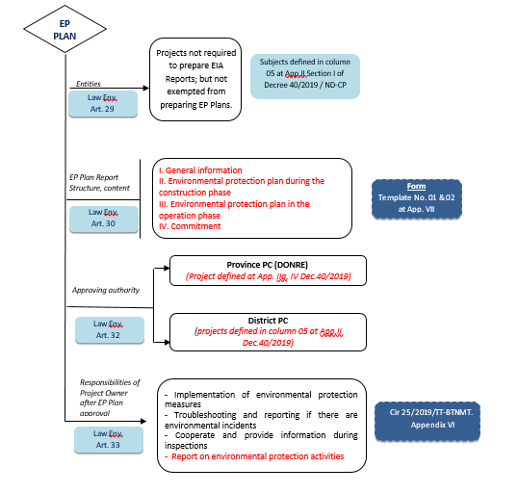
ENVIRONMENTAL PROTECTION PLANS

Slide 36
ENVIRONMENTAL PROTECTION PLANS
Subjects must make plans for environmental protection
Subjects specified in column 5, App. II, Section I of Dec. 40/2019/ND-CP.
Have incurred the amount of waste water from 20 m3 / day (24 hours) to 500 m3 / day (24 hours) or solid waste from 01 tons / day (24 hours) to less than 10 tons / day (24 hours) or gas from 5,000 m3 of exhaust gas/hour to less than 20,000 m3 of exhaust gas/hour (except for objects in column 3, App. II, Section I – Dec.40/2019/ND-CP.

Slide 37
ENVIRONMENTAL PROTECTION PLANS
Making and re-registering the environmental protection plan
Change location
Not implemented within 24 months
Responsibilities after the Environmental Protection Plan is confirmed
The organization implements environmental protection measures according to the certified environmental protection plan.
In case there is a change in the project owner, the new establishment owner is responsible for continuing to implement the environmental protection plan that has been registered and notify to the agency that has confirmed the environmental protection plan of the change.

Slide 38
ENVIRONMENTAL PROTECTION PLANS
How is the environmental protection project replaced?
Projects that have NOT received a decision to approve the EIA/EPS report will be sanctioned according to regulations. In case the project or facility is suitable for planning, the facility must do the following:
If the subject is equivalent to the EP Plan, the EP Plan shall be established.
Objects equivalent to EIA shall prepare an EIA for projects on renovation, upgrading and supplementation of environmental protection works.
Continue to implement and complete waste treatment works, environmental protection measures according to regulations; compile dossiers of inspection and certify the completion of environmental protection works according to regulations.

Slide 39

4. ENVIRONMENTAL DOSSIER AND PERMITS
ESTABLISHMENT OF ENVIRONMENTAL DOSSIER IN PHASES OF THE PROJECT
ENVIRONMENTAL REGULATORY DOSSIER

Slide 40
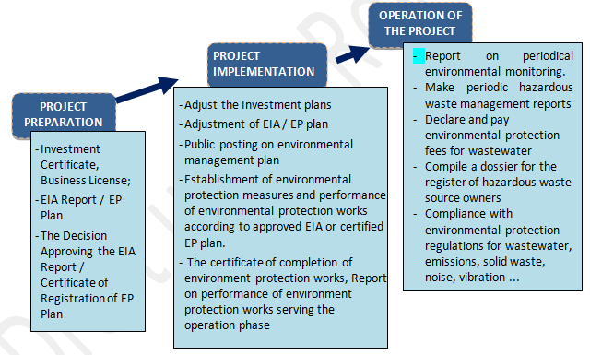
4. ENVIRONMENTAL DOSSIER AND PERMITS
ESTABLISHMENT OF ENVIRONMENTAL DOSSIER IN PHASES OF THE PROJECT

Slide 41
4. ENVIRONMENTAL DOSSIER AND PERMITS
ESTABLISHMENT OF ENVIRONMENTAL DOSSIER IN PHASES OF THE PROJECT
Environmental protection report
Art.37 Cir. 25/2019/TT-Law Env.

Slide 42
4. ENVIRONMENTAL DOSSIER AND PERMITS
ENVIRONMENTAL PROTECTION REPORT
Dossier structure of Environmental protection report: integrated with many periodic environmental reports
Results of works, environmental protection measures
Regarding environmental protection works for wastewater
Regarding environmental protection works for emissions
Regarding solid waste management
Results of overcoming requests of inspection and examination agencies and competent state agencies (if any)

Slide 43
4. ENVIRONMENTAL DOSSIER AND PERMITS
ENVIRONMENTAL REGULATORY DOSSIER
No | List of environmental regulatory dossier, permits and licenses
1 | Investment Certificate, Business License;
2 | The Decision Approving the EIA Report, Certificate of Environmental Standard Registration, Certificate of Registration of EP Plan, or The Certified EP Project
3 | EIA Report, The EP Commitment, The Registration of Satisfaction of Environmental Standards, The EP Plan, or The EP Project

Slide 44
3. ENVIRONMENTAL DOSSIER AND PERMITS
ENVIRONMENTAL REGULATORY DOSSIER
No | List of environmental regulatory dossier, permits and licenses
4 | Master plan drawing, Drainage of Rainwater and Wastewater
5 | Design dossier, Technical demonstration of the wastewater treatment system, Flue gas treatment system (exhaust treatment system), Documents for acceptance of environmental treatment works.
6 | Groundwater Exploitation Permit Surface Water Exploitation Permit Water Bill/ Permit for Discharge of Wastewater
7 | Records for sewage connections.

Slide 45

3. ENVIRONMENTAL DOSSIER AND PERMITS
ENVIRONMENTAL REGULATORY DOSSIER
No | List of environmental regulatory dossier, permits and licenses
8 | Invoices and vouchers on the use of chemicals; electricity bill, etc. in the process of operating wastewater treatment plants, flue gas treatment system (exhaust treatment system)
9 | The Register of Hazardous Waste Generator (HW); Hazardous waste documents; Contracts of Collection, Transportation and Treatment HW; Periodic Reports on Hazardous Waste Management
10 | Contracts for Collection, Transportation and Treatment Industrial Solid Waste, Domestic Solid Waste, Bill and vouchers, Delivery Record

Slide 46
3. ENVIRONMENTAL DOSSIER AND PERMITS
ENVIRONMENTAL REGULATORY DOSSIER
No | List of environmental regulatory dossier, permits and licenses
11 | Report on the results of environmental monitoring periodically
12 | Payment document of environmental protection charges for industrial wastewater
13 | Minutes of inspection, examination of environmental protection and sanctioning decisions (if any).
14 | The certificate of completion of environment protection works, Report on performance of environment protection works serving the operation phase

Slide 47
Higg FEM and VN Legislation
Gap Analysis: PERMITS
Comparison of requirements between VN Law and Higg FEM
VN Legislation
EIA
Water use
Wastewater
Discharge
Emissions
Chemicals
Hazardous waste
Solid waste
Certificate of completion of environmental protection works
The application for the permit
Enviroment Records
Higg FEM
Water use
Wastewater
Discharge
Emissions
Chemicals
Hazardous waste
Solid waste
Others

Slide 48
Conclusion: Gap Analysis
Higg FEM and VN Legislation
Conclude
VN legislation strictly requires records and environmental permits.
Each stage corresponds to different permit requirements:
  Preparation phase: EIA is required
  Implementation phase: Adjustment (if any), certify the completion of the treatment works
  Operation Phase: Included with the Environmental Operating Record
For an enterprise that has all the permits, the environmental treatment works have been completed.
If an enterprise has complied with all environmental permit requirements in accordance with VN Legislation, it also complies with Higg FEM licensing requirements.

Slide 49

5. WATER EXTRACTION AND CONSUMPTION
GENERAL PRINCIPLES
PROHIBITED ACTS
PROTECTION OF WATER RESOURCES
WATER CONSERVATION
ENVIRONMENTAL PROTECTION FOR UNDERGROUND WATER
RIGHTS AND OBLIGATIONS OF ORGANIZATIONS, INDIVIDUALS EXPLOITING, USING WATER RESOURCES
PERMITS FOR WATER RESOURCES
REGISTER, LICENSE OF EXPLOITATION, USE OF WATER
CHARGE FOR GRANTING WATER EXPLOITATION RIGHT
HANDLING ADMINISTRATIVE VIOLATIONS AGAINST WATER RESOURCES

Slide 50

5. WATER EXTRACTION AND CONSUMPTION
GENERAL PRINCIPLES
It is duty of all agencies, organizations, individuals.
The precautions must be taken as the key.
Overcoming, limiting pollution, degradation and depletion of water sources.
PROHIBITED ACTS
To put obstacles unlawfully obstruct flood drainage, water circulation.
To destroy works for protection, exploitation, use, monitoring, supervision of water resources.
To obstruct the basic investigation of water resources, the lawful right of exploitation.
To discharge wastewater into water sources illegally.

Slide 51

5. WATER EXTRACTION AND CONSUMPTION
PROTECTION OF WATER RESOURCES
Activities of exploitation, use of water resources must comply with master plan on water resources approved by competent authorities.
Ponds and lakes containing wastewater, areas containing wastewater must be waterproof, spill proof to ensure that water sources are not polluted.
To implement measures to timely respond to, overcome water resources incidents.
The exploitation and use of water resources, discharging wastewater into water sources have to monitor and supervise the exploitation, use of water and the discharging of wastewater according to regulations.

Slide 52

5. WATER EXTRACTION AND CONSUMPTION
WATER CONSERVATION
To implement the following measures:
Use water rationally.
To have plan to replace, gradually eliminate means, equipment which use outdated technology and consuming large amount of water.
To improve, rationalize the process of using water.
To apply techniques, technologies and advance equipment in exploitation, use of water.
To increase the ability of using recycled water, reusing of water.
To store rain water for use.

Slide 53
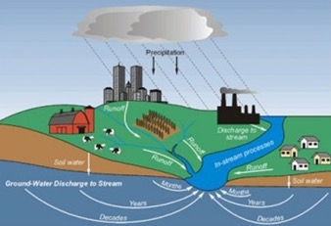
5. WATER EXTRACTION AND CONSUMPTION
ENVIRONMENTAL PROTECTION FOR UNDERGROUND WATER
Take preventive measures against the pollution of underground water.
Abandoned exploration and extraction drill holes must be refilled according to appropriate technical process.
Facilities use harmful chemicals (and radioactive substances) must put in place preventive measures against leakage and spread out to the underground water.
Organizations or individuals who contaminate the underground water will be responsible for dealing with the underground water pollution.

Slide 54
5. WATER EXTRACTION AND CONSUMPTION
PERMITS FOR WATER RESOURCES
Types of water permits include:
Permit for underground water exploration
Permit for exploitation and using surface water
Permit for exploitation and using underground water
Permit for exploitation and using seawater
Permit for discharging wastewater in to water resource

Slide 55

5. WATER EXTRACTION AND CONSUMPTION
PERMITS FOR WATER RESOURCES
Requirements for being issued with permits
Term of permits
Renewal of permits
Modification of permits
Suspension of permits
Revocation of permits
Return of permit, termination of permit validity
Reissuance of permits

Slide 56
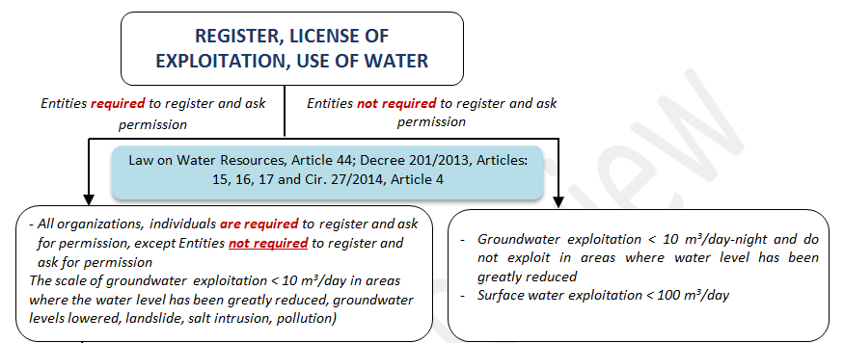
5. WATER EXTRACTION AND CONSUMPTION
REGISTER, LICENSE OF EXPLOITATION, USE OF WATER

Slide 57
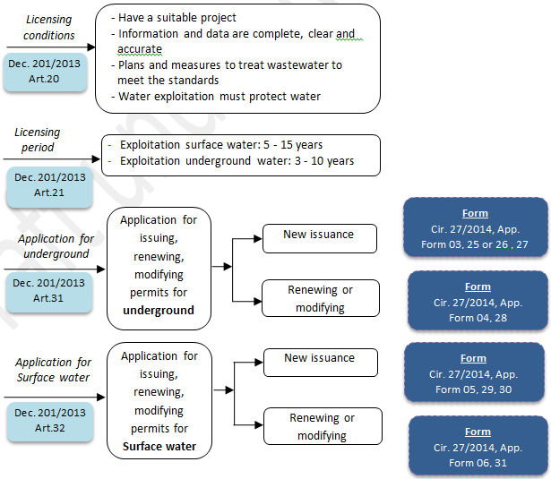
5. WATER EXTRACTION AND CONSUMPTION
REGISTER, LICENSE OF EXPLOITATION, USE OF WATER

Slide 58

5. WATER EXTRACTION AND CONSUMPTION
CHARGE FOR GRANTING WATER EXPLOITATION RIGHT
To pay the charge for granting the water exploitation.
The levy for grant of right to exploit water resources is identified by quality of water sources, types of water sources, conditions of exploitation, scale, time of exploitation, purpose of using water.
HANDLING ADMINISTRATIVE VIOLATIONS AGAINST WATER RESOURCES
Principal penalties:
A warning
A fine
Deprivation of the right to use the permit
Additional penalties
Remedial measures

Slide 59
5. WATER EXTRACTION AND CONSUMPTION
HANDLING ADMINISTRATIVE VIOLATIONS AGAINST
Administrative violations against regulations on water resources include:
Violations against regulations on capacity requirements for formulating schemes, records.
Violations against regulations on monitoring and observation of water resources and discharge of wastewater into water bodies.
Violations against regulations on license.
Violations against regulations on transfer of right to extract water.

Slide 60
5. WATER EXTRACTION AND CONSUMPTION
HANDLING ADMINISTRATIVE VIOLATIONS AGAINST
Administrative violations against regulations on water resources include (cont):
Violations against regulations in license to discharge wastewater into water source.
Violations of regulations on water resource protection.
Violations of regulations on prevention and control of pollution, degradation and depletion of water resources.
Violations of regulations on response to water pollution incidents.
Violations of regulations on land subsidence prevention and monitoring.

Slide 61
Higg FEM and VN Legislation
Gap Analysis: Water extraction and consumption - Water Use
Comparison of requirements between VN Law and Higg FEM
Water extraction and consumption
General issues mentioned as:
General principles,
Protection, conservation…
Rights and obligations
Permits
Register, license of exploitation,
Prohibited acts,
Resolution of environmental violations
Water Use
General issues mentioned as:
Tracking/monitoring
Frequency of Monitoring
Evaluate and understand/ Balance water
Set and targets for improving
Set and manage an implementation plan to improve
Reuse and/or recycle process wastewater
% improvement achieved

Slide 62
Higg FEM and VN Legislation
Gap Analysis: Water extraction and consumption - Water Use
Requirements | VN Law | Higg FEM
Interested in all water supplies
Set a baseline
Understanding / evaluating water users
Set a target reduction of water use
Implementation plan to improve water use | General measures
Estimate water use decreases compared to annual baselines/ consecutive years
Water balance / assessment / in-depth analysis and development of action plan for further improvement
Improvement achieved

Slide 63
Higg FEM and VN Legislation
Gap Analysis: Water extraction and consumption - Water Use
Compliance: Water extraction and consumption - Water Use
Water extraction and consumption
Comply with the general regulations
Ponds and lakes containing wastewater, areas containing wastewater must be waterproof, spill proof
To implement measures to respond, overcome pollution incidents
To monitor and supervise the exploitation and use of water
To Implement measures to conserve water resources
License for exploitation strictly according to regulations
Not violated
Water Use
Water supply records
Water supply diagram
Relevant personnel
Background database
Water balance/Assessing potential for water savings
Cause analysis / opportunities
Objects/ targets
Proposed solution
Implement
Monitoring and maintenance

Slide 64
Higg FEM and VN Legislation
Gap Analysis: Water extraction and consumption - Water Use
Conclusion:
VN legislation has general requirement on water extraction and consumption.
Comparison of water extraction and consumption requirements - Water use between Vietnam Legislation and Higg FEM is not similar because Higg only refers to water consumption.
Difference:
  VN Legislation only refers to general issue.
  Higg FEM requirements are very specific to the water use at the facility.
If a enterprise has complied with all water extraction and consumption requirements in accordance with VN Legislation, it still does not meet the Higg FEM - Level 1 water use requirements because there is a difference of aspects of interest.

Slide 65
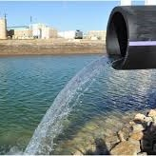
5. WASTEWATER MANAGEMENT
General principles
Prohibited acts
Wastewater treatment system
Collection and treatment of wastewater
Wastewater connection agreement
Discharge wastewater into water sources
Wastewater management
Rights and obligations related to permits of discharging wastewater
Wastewater discharge permits
Transfer of non-hazardous wastewater for treatment
Monitoring of wastewater discharge
Automatic monitoring of wastewater
Depositing, reporting and disclosure of information and data obtained through the environmental monitoring process
National technical regulations
Management treated wastewater
Environmental protection fee on wastewater

Slide 66



5. WASTEWATER MANAGEMENT
GENERAL PRINCIPLES
Wastewater is to be collected and treated in accordance with environmental standards.
Wastewater that contains hazardous elements beyond the regulated limits must be managed in accordance with regulations on hazardous wastes.
Wastewater must be managed through minimization, re-use, collection and treatment meeting environmental standards.
Discharge of wastewater must pay fees
Activities aimed at reducing and reusing wastewater are encouraged.
Non-hazardous liquid waste will only be transferred to the functional facilities for treatment upon written approval of the approving agency
Reduction
Reuse
Collection and treatment

Slide 67
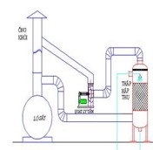
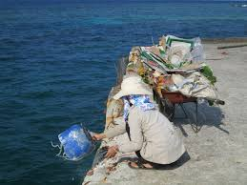
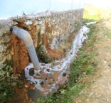
5. WASTEWATER MANAGEMENT
PROHIBITED ACTS
To discharge wastes, rubbish, discharge or leak toxic substances into water sources.
To discharge wastewater untreated or treated but not meeting standards, technical regulations into water sources.
To discharge of toxic exhaust gas directly into the water source, to discharge wastewater into ground; have frauds in discharging wastewater.

Slide 68
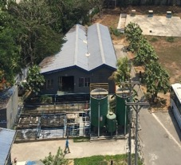
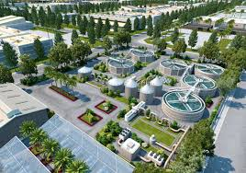
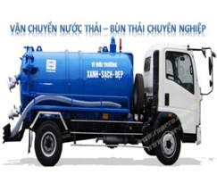
5. WASTEWATER MANAGEMENT
WASTEWATER TREATMENT
Wastewater
Self - treatment
Centralized treatment in industrial parks
Transfer wastewater for treatment

Slide 69
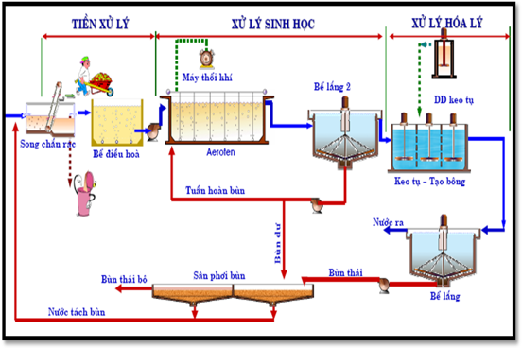
5. WASTEWATER MANAGEMENT
WASTEWATER TREATMENT SYSTEM
Every wastewater treatment system must:
Have a technology process that is suitable
Sufficient capacity
To meet the environmental standards
Drainage outlet
Operation
Monitoring
Data retention.

Slide 70
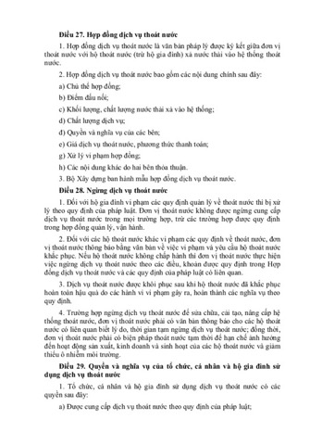
5. WASTEWATER MANAGEMENT
WASTEWATER CONNECTION AGREEMENT
Wastewater in Industrial parks must be treated according to conditions specified in written agreements signed with the owner of the industrial park infrastructure construction and commercial operation project .
Cases exempted from connection:
1. Wastewater treatment meets standard but disadvantageous connections.
2. Excessive reception of centralized wastewater treatment systems.
3. No system of centralized wastewater treatment.

Slide 71
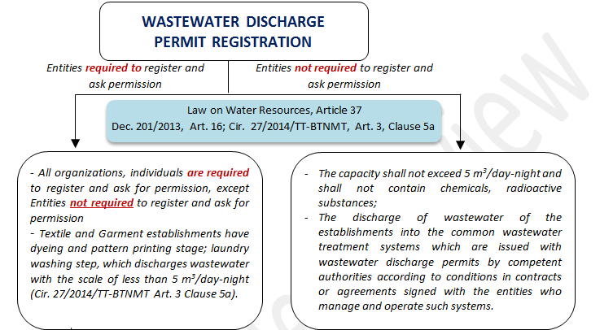
5. WASTEWATER MANAGEMENT
WASTEWATER DISCHARGE PERMITS

Slide 72
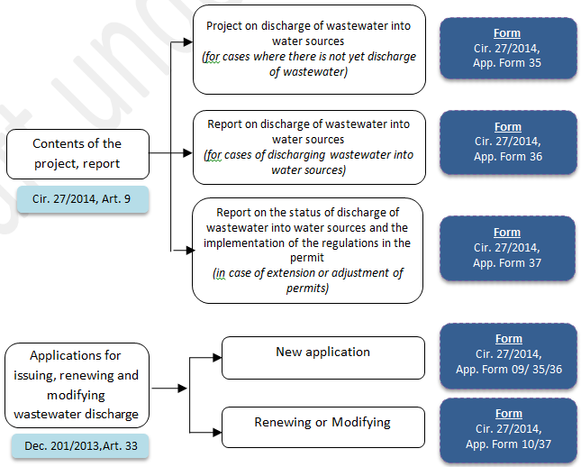
5. WASTEWATER MANAGEMENT
WASTEWATER DISCHARGE PERMITS

Slide 73
5. WASTEWATER MANAGEMENT
NATIONAL TECHNICAL REGULATIONS
STT | Regulation | Note
1 | QCVN 13-MT: 2015/BTNMT | National Technical Regulation on the effluent of textile industry
2 | QCVN 14:2008/BTNMT | National Technical Regulation on domestic wastewater
3 | QCVN 40:2011/BTNMT | National Technical Regulation on Industrial Wastewater
4 | Wastewater standard | Limits for receiving wastewater from EPZ, IZ, IC.

Slide 74
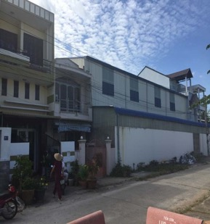
5. WASTEWATER MANAGEMENT
WASTEWATER MANAGEMENT LOCATED OUTSIDE OF AN INDUSTRIAL ZONE
Q ≥ 30 m³/day-night
must keep a logbook of operation of this system which is fully compiled and retained for a period of at least two (02) years
The operational logbook include the following:
Flow volume,
Operational parameters
Monitoring results
Type and amount of chemicals used
Volume of waste sludge produced

Slide 75
5. WASTEWATER MANAGEMENT
WASTEWATER MANAGEMENT LOCATED OUTSIDE OF AN INDUSTRIAL ZONE
Q ≥ 1000 m³/day-night
Automatically and constantly oversee and monitor effluent
Install a separate digital electricity meter
Record all measurement data into the operational logbook

Slide 76
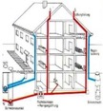
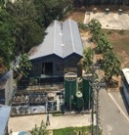
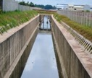

5. WASTEWATER MANAGEMENT
DISCHARGE OF WASTEWATER INTO WATER SOURCES
1. Must have:
  Construction of collection system segregating rainwater and wastewater;
  Wastewater treatment system;
  System of drainage, conduits for wastewater .
2. Must be licensed by competent state agencies.
Cases are exempt from registration:
  Not exceed 5 m³ / day-night, except for facilities of textile dyeing and washing.
  Discharge into the centralized wastewater treatment plant has been licensed.

Slide 77

5. WASTEWATER MANAGEMENT
  Rights:
To discharge wastewater into water sources within prescribed limits.
Being protected by the State for legal rights and benefits.
To be compensated by the State in case the license is revoked before the expiration.
Have right to request compensation as prescribed by law.
Suggest competent state agencies to grant permit for extension, change of expiration, adjust content of permit as prescribed.
Complaining, sueing on acts violating their lawful rights and benefits.

Slide 78

5. WASTEWATER MANAGEMENT
Obligations:
Implement provisions of law
Comply with the contents of permit granted
Implement financial obligations
Ensure wastewater is treated to meet the allowed technical regulations and standards
Not obstruct or cause damage to the lawful discharge of wastewater into water sources

Slide 79
5. WASTEWATER MANAGEMENT
Obligations:
Provide full and honest data, information of discharge of wastewater
Ensure safety, prevention and overcoming polluting water sources
Monitoring and measuring flow, quality
Report of discharge of wastewater
Compensation for damage caused by the unlawful discharge of wastewater

Slide 80
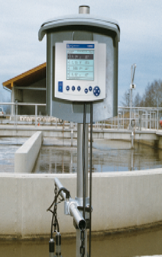
5. WASTEWATER MANAGEMENT
AUTOMATIC MONITORING OF WASTEWATER
Monitoring parameters: flow volume, pH, temperature, COD, TSS and other activity-specific parameters as requested by EIA.
The automatic wastewater monitoring system must include the automatic sampler which is sealed and managed by the Department of Natural Resources and Environment; have attached camera connected to Internet to observe the outlet of the wastewater treatment system and store images taken within the last three (03) months.

Slide 81
5. WASTEWATER MANAGEMENT
AUTOMATIC MONITORING OF WASTEWATER
3. Storage time: a minimum period of three (03) years.
4. Owners shall be responsible for posting and publishing the results achieved from the periodic environmental monitoring process on their websites.

Slide 82

5. WASTEWATER MANAGEMENT
ENVIRONMENTAL PROTECTION FEE ON WASTEWATER
Entities subject to levy: industrial wastewater and domestic wastewater.
Fee rate: Calculated according to discharge loads.
Form: Declaration, assessment of declarations and fee payment
Fee exemption:
Water is re-used and not discharge into the environment
Cooling water which is not any pollutant and is discharged through a separate conduit.
Overflowing rainwater

Slide 83
Higg FEM and VN Legislation
Gap Analysis: WASTEWATER
Comparison of requirements between VN Law and Higg FEM
VN Legislation:
General principles
Prohibited acts
Collection and treatment
Connection and discharge wastewater
Rights and Obligations
Transfer wasterwater for treatment
Monitoring of wastewater discharge
Storage of monitoring results
National technical regulations
Management treated wastewater
Environmental protection fee
Higg FEM:
Waste sources: domestic / industrial WW
Treatment plants: ONSITE + OFFSITE/ Not treated
Track its wastewater volume
Method /the frequency
Wastewater guideline(s)
The final discharge point
Compliance with its permit /agreements
Wastewater Standard
Tested - met all parameters
Back-up plan - emergency situation
Sludge disposed of properly
Zero Liquid Discharge
Information of the offsite WTP
Reuse /recycle process wastewater

Slide 84
Higg FEM and VN Legislation
Gap Analysis: WASTEWATER
Comparison of requirements between VN Law and Higg FEM
Requirements | VN Law | Higg FEM
Waste sources: domestic / industrial WW
Treatment plants: ONSITE + OFFSITE/ Not treated
Track its wastewater volum
Method /the frequency
Wastewater guideline(s)
The final discharge point
Compliance with its permit /agreements
Wastewater Standard
Tested - met all parameters
Back-up plan - emergency situation
Sludge disposed of properly

Slide 85
Higg FEM and VN Legislation
Gap Analysis: WASTEWATER
Comparison of requirements between VN Law and Higg FEM
Requirements | VN Law | Higg FEM
Zero Liquid Discharge
Information of the offsite WTP
Reuse /recycle process wastewater (closed loop)
Wastewater management of enterprise located outside industrial park
Q ≥ 30 m³/day-night The operational logbook
Q ≥ 1000 m³/day-night Automatically and constantly oversee and monitor effluent Install a separate digital electricity meter Record all measurement data into the operational logbook

Slide 86
Higg FEM and VN Legislation
Gap Analysis: WASTEWATER
Conclusion:
VN legislation strictly requires management of wastewater.
There is a similarity in the requirements for wastewater management of Vietnamese law and Higg 3.0
Difference:
  VN Legislation strictly controls wastewater outside industrial park.
  Higg FEM requires the disposal owner to pay attention to the results from the offsite.
  Higg FEM requires facilities to reuse, recycle wastewater specific for closed loop.

Slide 87
Higg FEM and VN Legislation
Gap Analysis: WASTEWATER
Conclusion:
If a enterprise has complied with the requirements of management wastewater in accordance with VN Legislation, it also complies with Higg FEM - level 1
An enterprise wants to achieve Higg FEM - Level 3 only if it does all of the above: offsite & closed loop.

Slide 88

Thank
you
In a partnership with:
Supported by:

