Slide 1





Training on Environmental Regulations for the Vietnam’s Garment Industry
Hợp tác với:
Được hỗ trợ bởi:

Slide 2
INTRODUCTION
FROM IFC & BW
Hợp tác với:
Được hỗ trợ bởi

Slide 3



GENERAL INSTRUCTIONS
To ensure an organized and productive training session for all participants, please observe the following rules:
Participants must keep their cameras and microphones off unless the Master Trainer instructs you to switch it on. This will help us maintain the flow of the event and conserve bandwidth usage.
This session will run for about 4 hours. Breaks are scheduled in between sessions for a quick water/restroom break so that you can avoid leaving during the training proper.
You can also engage with your fellow participants through the Zoom chat.
If you would like to direct any questions to the Master Trainer, you may send them through Zoom’s Chat feature. He/She will address selected questions at the end of the module.
If you would like to speak up and share any insights, please use the "Raise Hand" button and the training coordinate will acknowledge this gesture.
We strongly encourage you to take notes or screenshots of any important information discussed in the presentation.
Today’s session will be recorded for documentation purposes.
In case of urgent matters requiring your attention or presence, please do inform the ASSIST training staff before leaving the virtual training room.
Start/stop video
Show/hide participants list
Start/stop
share screen
Mute/Unmute
Raise hand & reaction buttons
Show/hide chat box

Slide 4
TRAINING OBJECTIVES
This training intends to support Better Work factories to understand, self-assess and be better equipped to meet applicable Vietnamese environmental regulatory requirements. The training will be delivered over four days in a virtual format to representatives from 50 Better Work factories, who will learn how to:
Understand, collect, and use the information required to fulfill national environmental regulatory requirements, using a ‘Guide to Vietnamese Environmental Law for the Garment Industry’.
Assess the extent to which factories’ operations are aligned with applicable national regulations, using a self-assessment tool.
Develop an improvement plan.
The training builds on a pilot project delivered by Better Work in 2017-2018 to 30 factories, which was designed in consultation with brands and other stakeholders, including the Sustainable Apparel Coalition to ensure complementarity with the Higg FEM Index. The tools that will be used and shared during the training have been developed during the pilot and have been updated to reflect the latest applicable regulations.

Slide 5



METHOD
TAKE LEARNER – CENTERED
Encourage maximum participation of learners in teamwork

Slide 6
CONTENT
Introduction of project tools:
  Country Guide to Vietnamese Environmental Law for Garment Industry
  Self-Assessment Tool
Guidance on how to use project tools
Overview of Vietnam environmental regulations for the Garment sector
Update on new regulations of environmental protection
Higg FEM and Project Tools
Discussion on improvement plans for the factories
Notes:
Edited

Slide 7
AGENDA – LESSON 1
8:00 - 9:00 | IFC/BW Introduction
 | Introduction of the participants
 | General information: Introduction, Content, Methods
 | Part 1. Introduction of training tools (CG&SAT)
9:00 - 9:10 | Tea Break
9:10 - 9:40 | Part 2. Overview of Laws and Sub-Laws
9:40 - 10:10 | Part 3. Pre-activity Assessment
10:10 - 10:20 | Tea break
10:20 - 10:50 | Part 4. Permits
10:50 - 11:20 | Part 5. Water Extraction and Consumption
11:20 - 11:30 | Tea break
11:30 - 12:00 | Discuss and Q&A

Slide 8
AGENDA – LESSON 2
8:00 - 8:20 | Recap the previous section
8:20 - 8:50 | Part 6. Wastewater
8:50 - 9:10 | Part 7.Solid Waste
9:10 - 9:20 | Tea break
9:20 - 9:40 | Part 8. Hazardous Waste
9:40 - 10:10 | Part 9. Air Emission
10:10 - 10:20 | Tea break
10:20 - 10:50 | Part 10. Environmental management system (EMS)
10:50 - 11:20 | Part 11. Climate change - Greenhouse gas (GHG)
11:20 - 11:30 | Tea break
11:30 - 12:00 | Discuss and Q&A

Slide 9
AGENDA – LESSON 3
8:00 - 8:20 | Recap the previous section
8:20 - 9:20 | Part 12. Energy Management
9:20 - 9:30 | Tea Break
9:30 - 10:30 | Part 13. Chemical Handling and Management
10:30 - 10:40 | Tea Break
10:40 - 11:20 | Part 14. Training Tool - Self-Assessment Tool, HIGG FEM 3.0 - The linkages
11:20 - 11:30 | Tea Break
11:30 - 12:00 | Discuss proposed improvements to satisfy SAT and raise the HIGG FEM score.

Slide 10
AGENDA – LESSON 4
8:00 - 8:15 | Recap the previous section
8:15 - 9:15 | Discuss challenges when filling SAT and results
9:15 - 9:25 | Tea Break
9:25 - 10:25 | How to develop an improvement plan
10:25 - 10:35 | Tea Break
10:35 - 11:45 | Discuss solutions to improve SAT results and raise the HIGG FEM score.
11:45 - 12:00 | Better Work/IFC Closing

Slide 11


Note
Valid, with addition/revision
Expired
New updated

Slide 12

12. ENERGY MANAGEMENT
RESPONSIBILITIES
ECONOMICAL AND EFFICIENT USE OF ENERGY
IDENTIFICATION OF MAJOR ENERGY USERS
RESPONSIBILITIES OF MAJOR ENERGY USERS
ENERGY MANAGEMENT MODEL
PLANNING ON ECONOMICAL AND EFFICIENT USE OF ENERGY
ENERGY MANAGER
ENERGY AUDIT
INSPECTION OF ECONOMICAL AND EFFICIENT USE OF ENERGY
PROHIBITED ACTS

Slide 13

12. ENERGY MANAGEMENT
Use energy economically and efficiently
No.50/2010/QH12
Decree 21/2011/NĐ-CP - Detailed regulations and measures to implement the law on economical and efficient use of energy
Decree 134/2013/ND-CP - Regulations on sanctioning of administrative violations in the field of electricity, safety of hydroelectric dams, economical and efficient use of energy
Circular 25/2020/TT-BCT
Circular 09/2012/TT-BCT - Regulations on planning, reporting on implementation of plans on economical and efficient use of energy; perform an energy audit
Circular 02/2014/TT-BCT - Regulation of energy-saving and efficient measures for industries
Decision 11/2017/QD-TTg - regulations on mechanisms to encourage the development of solar power projects in Vietnam.
Decisiom 04/2017/QD-TTg List of vehicles and equipment subject to energy labeling and application of minimum energy efficiency and implementation roadmap

Slide 14

12. ENERGY MANAGEMENT
RESPONSIBILITIES
Elaborate and implement annual plans.
Apply standards, technical regulations and norms
Select and apply advanced production management processes and models
Use substitute energies with higher efficiency in production lines.
Apply technical measures and workshop architecture to make the optimal use of energy.
To operate, upgrade and maintain devices and equipment of production lines so as to prevent energy loss
To gradually eliminate devices and equipment that are outdated.

Slide 15
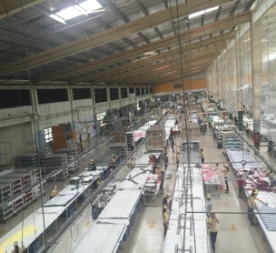
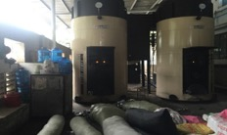
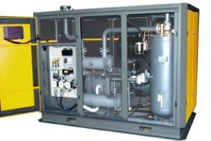
12. ENERGY MANAGEMENT
TECHNOLOGICAL MEASURES
Modernizing lines for production, processing and subcontract production of goods; replacing equipment with outdated technologies and low energy yield
Improving and streamlining the processes of: heat, electricity, and mechanics.
Use high efficiency equipment.
Applying cogeneration technologies to develop additional electric and thermal charges.

Slide 16
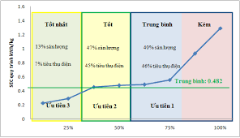
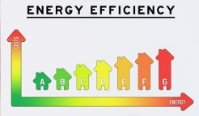
12. ENERGY MANAGEMENT
SPECIFIC ENERGY CONSUMPTION
Specific energy consumption (SEC) shall be determined according to the procedures prescribed.
The SEC of the producer shall be compared with the rated energy consumption (or average energy consumption of the industry) to decide the scope of improvement in energy efficiency.
Xây dựng mức độ cải thiện theo các giai đoạn kế hoạch
Báo cáo các chỉ số hiệu quả năng lượng và mức cải thiện đạt được so với kế hoạch trong các báo cáo năng lượng hàng năm.

Slide 17
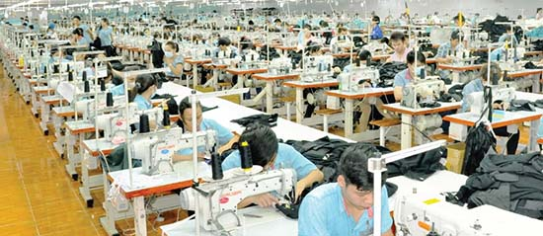
12. ENERGY MANAGEMENT
MAJOR ENERGY USERS
Industrial production establishments, which annually consume energy of a total of one thousand tons of oil equivalent (1,000 TOE) or higher, are considered Major energy users.
1000 TOE

Slide 18
12. ENERGY MANAGEMENT
RESPONSIBILITIES OF MAJOR ENERGY USERS
Fully comply with the regulations of the Law on Economical and Efficient Use of Energy
Appoint energy managers as per the Law on Economical and Efficient Use of Energy
Work out regimes on responsibilities of collectives and individuals involved in the implementation of plans on economical and efficient use of energy;
Once every three years, conduct compulsory energy audit

Slide 19
12. ENERGY MANAGEMENT
RESPONSIBILITIES OF MAJOR ENERGY USERS
Apply energy management models under competent state agencies' guidance
Comply with regulations on economical and energy use efficiency in new construction, renovation and expansion of facilities
Elaborate and implement annual and five-year plans on economical and efficient use of energy in line with their production and business plans, and report to competent local state agencies on the implementation of these plans

Slide 20
12. ENERGY MANAGEMENT
ENERGY MANAGEMENT MODEL
1. Announcement of objectives and policies on efficient energy use
energy users shall apply energy management models
2. Annual and five-year planning
3. Availability of a network and energy managers
4. Regular check and monitoring of energy
5. Energy audit
6. Regular training and retraining on efficient energy use
7. Adoption of reward and discipline

Slide 21
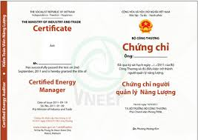

12. ENERGY MANAGEMENT
  ENERGY MANAGER
  Conditions
Holding a college or higher degree in energy or a relevant technical discipline for major energy users in industrial production.
Possessing an energy management certificate granted by a competent agency.
  Responsibility
Shall assist the head of a major energy user in performing tasks.

Slide 22
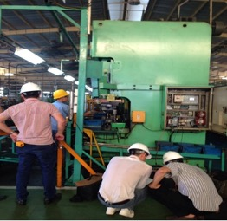
12. ENERGY MANAGEMENT
ENERGY AUDIT
Major energy users shall observe energy audit regulations by conducting audit themselves or by hiring an energy audit institution.
Energy audit covers the following principal jobs::
Surveying, measurement and collection of data on energy use by establishments;
Analysis, calculation and evaluation of energy use efficiency;
Assessment of energy saving potential;
Proposal of measures for energy saving;
Analysis of investment effectiveness of proposed energy saving solutions.
Major energy users shall submit energy audit reports to provincial-level Industry and Trade Departments within 30 days after conducting energy audit.

Slide 23

12. ENERGY MANAGEMENT
Establishments outside the list of major energy users are encouraged to periodically (three years or five years) conduct energy audit and report on their energy use and identify opportunities for energy-saving.

Slide 24

12. ENERGY MANAGEMENT
INSPECTOR
Entities subject to inspection of economical and efficient use of energy have the following rights and obligations:
Provide inspection-related documents to inspection teams and inspectors.
Create conditions for inspection teams and inspectors to perform their tasks.
Comply with handling decisions of inspection teams and inspectors.
Perform other rights and obligations under the inspection law.

Slide 25

12. ENERGY MANAGEMENT
PROHIBITED ACTS
Destroying national energy resources.
Making forgeries or committing frauds to enjoy state incentives for economical and efficient use of energy.
Intentionally providing untruthful information on the energy yield of devices and equipment in energy labeling, inspection, advertising and other activities

Slide 26

12. ENERGY MANAGEMENT
HANDLING VIOLATIONS OF ECONOMICAL AND EFFICIENT USE OF ENERGY
Violation by key energy using facilities on energy audit
Violation of regulation on energy audit
Violation of regulation on thrifty and effective use of energy in industrial production
Violation of regulation on application of energy management model

Slide 27
Higg FEM and VN Legislation
Gap Analysis: ENERGY
Comparison of requirements between VN Law and Higg FEM
VN Law mention:
Apply standards, technical regulations and norms
Choosing to apply advanced production management processes and models
Use highly efficient forms of alternative energy
SEC
Key energy users
Energy manager
Responsibility towards collectives and individuals
Energy audit
Energy management model
Implement annual and 5-year plans
Report on the results of the implementation of the plan
Higg FEM mention:
Keep track of all energy sources
Amount used
Method / frequency
Establish an energy baseline
Highest energy use
Set goals to improve energy use
Define goals (converted to MJ)
Proposal to reduce energy consumption
Implementation plan to improve energy use
Improved energy consumption compared to baseline

Slide 28
Higg FEM and VN Legislation
Gap Analysis: ENERGY
Comparison of requirements between VN Law and Higg FEM
Requirements (Level 1) | VN Law | Higg FEM
Apply standards, technical regulations and norms
Choosing to apply advanced production management processes and models
Use highly efficient forms of alternative energy
SEC
Keep track of all energy sources
Amount of energy used
Method / frequency

Slide 29
Higg FEM and VN Legislation
Gap Analysis: ENERGY
Comparison of requirements between VN Law and Higg FEM
Requirements (Level 2) | VN Law | Higg FEM
Key energy users
Energy manager
Responsibility towards collectives and individuals
Energy audit
Energy management model
Implement annual and 5-year plans
Report on the results of the implementation of the plan

Slide 30
Higg FEM and VN Legislation
Gap Analysis: ENERGY
Conclusion:
Vietnam law has very strict requirements on Energy.
Comparison of Energy requirements between Vietnam Law and Higg FEM is quite similar.
Difference: Vietnam law has more requirements for key energy users such as:
  Have specialist
  Energy audit
  Responsibility towards collectives and individuals
  Report on the results of the implementation of the plan
If enterprises do not have to use key energy, they will only reach Level 1.If enterprises using key energy have fully complied with the requirements of Energy of Vietnam Law, they must also comply with energy requirements according to Higg FEM - Level 2. (no Level 3)

Slide 31
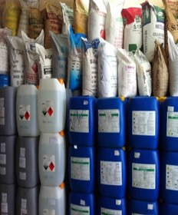
13. CHEMICAL MANAGEMENT
GENERAL PROVISIONS
RIGHTS AND OBLIGATIONS OF ORGANIZATIONS
GENERAL REQUIREMENTS TO ENSURE CHEMICAL SAFETY
CLASSIFICATION AND LABELING OF CHEMICALS
CHEMICAL SAFETY DATA SHEETS (CHEMICAL SDS)
DISPOSAL OF DISCARDED CHEMICALS
PREVENTION, RESPONSE OF CHEMICAL INCIDENTS
SAFETY DISTANCES
HAZARDOUS CHEMICAL, BANNED CHEMICAL, TOXIC CHEMICAL
DECLARATION OF CHEMICALS
SUPPLY OF INFORMATION ON CHEMICALS
REGISTRATION OF NEW CHEMICALS
TRAINING COURSES IN CHEMICAL SAFETY
REPORTING
PROHIBITED ACTS
HANDLING VIOLATIONS

Slide 32

13. CHEMICAL MANAGEMENT
Law on chemical
No.06/2007/QH12
Dec 108/2008/NĐ-CP - detailing and guiding the implementation of a number of articles of the chemical law
Dec 26/2011/ND-CP - Amending and supplementing a number of articles of the government's decree no. 108/2008/ ND-CP
Cir 20/2013/TT-BCT - Stipulating the plan and measures for prevention and response against chemical incidents in industry
Cir 28/2010/TT-BCT - Specifying a number of articles of the law on chemicals and the government's decree no.108/2008/ND-CP
Cir 07/2013/TT-BCT Providing for the registration for use of hazardous chemicals for production of products, goods in the industrial field
Cir 05/2017/VBHN-BCT - Specifying certain articles of law on chemicals and government's decree no.108/2008/ND-CP
Cir 04/2012/TT-BCT - Regulations on the classfication and labeling of chemicals
Cir 40/2011/TT-BCT - On chemical declaration

Slide 33

13. CHEMICAL MANAGEMENT
Rights:
May request suppliers of hazardous chemicals to provide adequate and accurate information on their properties and characteristics, information on their classification and labeling and their chemical safety data sheets.

Slide 34

13. CHEMICAL MANAGEMENT
Obligations:
Abide by regulations on chemical safety management.
Have qualified staff and trained personnel in charge of chemical safety.
Provide periodic training in chemical safety to their laborers.
Provide sufficient, accurate and timely information on chemical safety.
Work out chemical incident prevention and response measures or plans as prescribed.
To update and store information.
Promptly notify upon detection of signs of new hazardous properties.
Abide by inspection requests in the implementation of regulations on chemical safety.

Slide 35
13. CHEMICAL MANAGEMENT
GENERAL REQUIREMENTS TO ENSURE CHEMICAL SAFETY
Requirements for workshops, warehouses
Requirements for packaging
Requirements for storage and transport
Requirements for Extraction
No specific regulations on the requirements to ensure the safety of chemicals for retain, storage and use of chemicals. Only general requirement to ensure safety in production and trading of chemicals.

Slide 36
13. CHEMICAL MANAGEMENT
PREVENTION, RESPONSE OF CHEMICAL INCIDENTS
Elaborate plans
Entities: Contains at least 1 chemical mentioned in Appendix IV of Decree 113/2017 / ND-CP
Approval: State management agencies.
Submission: People's Committees at all levels and Fire Prevention Agency /the management boards of the industrial parks, export-processing zones or economic zones.
Elaborate measures
Entities: not included in the list of Appendix IV of Decree 113/2017 / ND-CP
Approval: Facility self-approval .
Submission: 01 copy of the decision and 01 report on measures to prevent and respond to chemical incidents to the Department of Industry and Trade

Slide 37
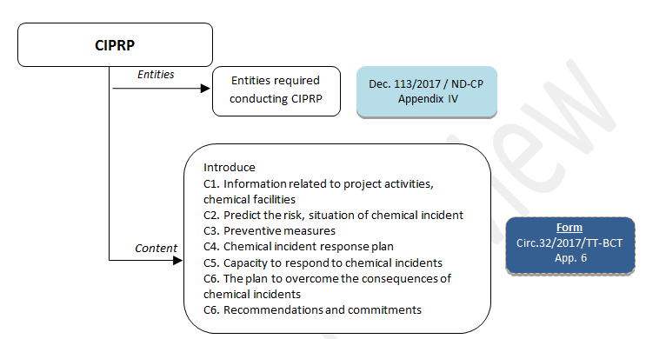
13. CHEMICAL MANAGEMENT
CHEMICAL INCIDENT PREVENTION AND RESPONSE PLANS (CIPRP)

Slide 38
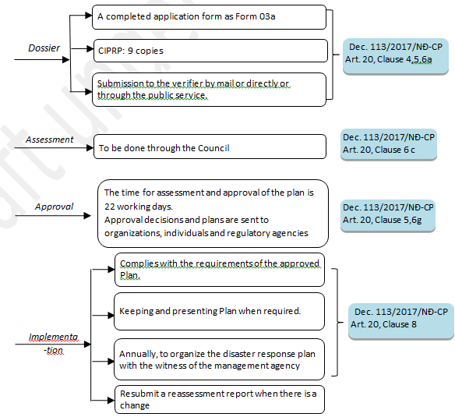
13. CHEMICAL MANAGEMENT
CHEMICAL INCIDENT PREVENTION AND RESPONSE PLANS (CIPRP)

Slide 39
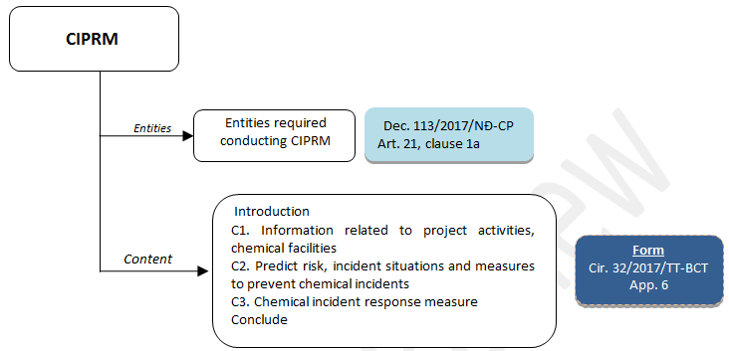
13. CHEMICAL MANAGEMENT
CHEMICAL INCIDENT PREVENTION AND RESPONSE MEASURES (CIPRM)

Slide 40
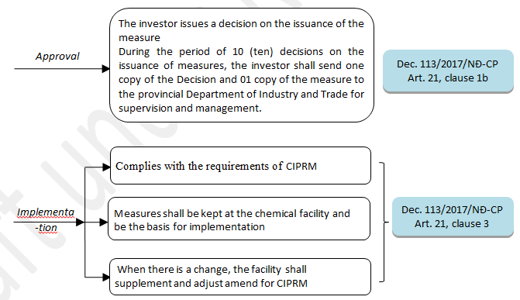
13. CHEMICAL MANAGEMENT
CHEMICAL INCIDENT PREVENTION AND RESPONSE MEASURES (CIPRM)

Slide 41

13. CHEMICAL MANAGEMENT
TRAINING COURSES IN CHEMICAL SAFETY
1. Group 1:
  Heads of factories/stores, divisions and branches; heads of production/trade/technical departments; managers of factories or equivalents;
  Vice heads of factories/stores mentioned in Point a above responsible for chemical safety.
2. Group 2:
  Full-time or part-time officials responsible for chemical safety of factories/stores;
  Supervisors directly overseeing chemical safety.
3. Group 3: Employees directly involving in chemicals.

Slide 42

13. CHEMICAL MANAGEMENT
PENALTIES FOR ADMINISTRATIVE VIOLATIONS AGAINST REGULATIONS ON CHEMICALS AND INDUSTRIAL EXPLOSIVE MATERIALS
ON CHEMICALS AND INDUSTRIAL EXPLOSIVE MATERIALS
Section 2. VIOLATIONS ON THE USE OF CHEMICALS AND HAZARDOUS CHEMICALS FOR PRODUCING PRODUCTS AND GOODS
Article 14. Violations against regulations on safety of hazardous chemicals
Article 15. Violations against regulations on information storage, human resources, and chemical safety training in the use of chemicals and hazardous chemicals
Section 4. VIOLATIONS ON CONTROL SCHEDULE FOR BUYING AND SELLING TOXIC CHEMICALS
Article 21. Violations against regulations on purchase and sale control sheets of toxic chemicals

Slide 43
13. CHEMICAL MANAGEMENT
PENALTIES FOR ADMINISTRATIVE VIOLATIONS IN CHEMICAL WORK
Section 5. VIOLATIONS ON CLASSIFICATION OF CHEMICALS, SAFETY DATA SHEET, DECLARATION OF IMPORTED CHEMICALS
Article 22. Violations against regulations on chemical classification
Article 23. Violations against regulations on chemical safety sheets
Article 24. Violations against regulations on declaration of imported chemicals through the National Portal
Section 6. VIOLATIONS OF CHEMICALS AND PLAN FOR PREVENTION AND RESPONSE OF CHEMICALS
Article 25. Violations against regulations on fulfillment of requirements of plans and measures to prevent and respond to chemical incidents
Article 26. Violations against regulations on storage volume of dangerous chemicals
Article 27. Violations against regulations on formulation of measures and plans for prevention and response to chemical incidents

Slide 44
13. HÓA CHẤT
PENALTIES FOR ADMINISTRATIVE VIOLATIONS IN WORKING CHEMICAL
Section 7. VIOLATIONS ON CONTENTS AND REPORT REGIMES OF CHEMICAL ACTIVITIES
Article 28. Violations against regulations on report content
Article 29. Violations against regulations on reporting regime
Section 9. VIOLATIONS AGAINST REGULATIONS ON CONCENTRATED CHEMICAL AND PREPARATION
Article 43. Violations against regulations on the use of insecticidal and germicidal chemicals and preparations
Article 44. Violations against regulations on transportation of insecticidal and germicidal chemicals and preparations

Slide 45

13. CHEMICAL MANAGEMENT
REPORTING
Duration: Before January 15 every year
Form: The specimen No. 5a provided in Appendix No. 5 of Circular No. 32/2017/TT-BCT
Receiving agency: Department of Industry and Trade /Vietnam Chemicals Agency/ the national database on chemicals.
Immediate reporting: Upon a problem occurs / terminates operation.

Slide 46
Higg FEM and VN Legislation
Gap Analysis: CHEMICAL MANAGEMENT
Comparison of requirements between VN Law and Higg FEM
Requirement (Level 1) | VN Law | Higg FEM
Safety Data Sheets (SDS)
Emergency response plan
Appropriate and operable protective and safety equipment
Chemical hazard signage and safe handling equipment
Well mark, designated chemical storage
Train all employees

Slide 47
Higg FEM and VN Legislation
Gap Analysis: CHEMICAL MANAGEMENT
Comparison of requirements between VN Law and Higg FEM
Requirement (Level 1) | VN Law | Higg FEM
MRSL compliance
Train employees responsible for the chemical management system on (RSLs) and (MRSLs)
Documented process to systematically identify, monitor and verify compliance with all product RSLs/ MRSL
Production chemicals be traced from the manufacturing process back to chemical inventory

Slide 48
Higg FEM and VN Legislation
Gap Analysis: CHEMICAL MANAGEMENT
Comparison of requirements between VN Law and Higg FEM
Requirement (Level 2) | VN Law | Higg FEM
Implementation plan to improve
Implementation plan to reduce the use of hazardous chemicals beyond chemicals specified by regulations
Source Already-approved or preferred chemicals from a positives list beyond chemicals specified by regulations

Slide 49
Higg FEM and VN Legislation
Gap Analysis: CHEMICAL MANAGEMENT
Requirement (Level 3) | VN Law | Higg FEM
Collaborate with brands and/or chemical suppliers to select chemicals for alternatives assessment
Contribute a chemical analysis against human and environmental hazard criteria
Contribute an analysis of lifecycle impacts to this alternatives process
Documented quality assurance (QA) program that includes performance of chemicals
Contractors/subcontractors source already-approved or preferred chemicals from a positives list to replace chemicals not already included in RSL/MRSL
Documented business goals, processes and actions showing commitment to new sustainable chemistry innovation

Slide 50
Higg FEM and VN Legislation
Gap Analysis: CHEMICAL MANAGEMENT
Conclude:
Vietnamese legislation required for chemicals is quite simple
Comparison of chemical requirements between Vietnam Legislation and Higg FEM is very different.
Difference due to Higg FEM has a lot of very high control requirements and very specific.
To achieve Higg FEM - Level 1, the facility needs a lot of effort on RSL-MRSL compliance, then continue the strategy to reach Higg FEM - Level 2, 3.

Slide 51
Project Tool: Self-Assessment Tool (SAT)
How to use SAT

Slide 52
14. PROJECT TOOL: Self-assessment Tool (SAT)
About Self-Assessment Tool
The Self-Assessment Tool (SAT) is developed to support garment factories to understand, self-assess and comply with environmental regulations of Vietnam.
The SAT was based on the Country Guide entitled 'Guide to Vietnamese Environmental Law for Garment Industry"
The SAT consists of questions covering eight (8) aspects of environmental assessment: Water Extraction and Consumption, Wastewater Management, Solid Waste, Hazardous Waste, Air Emissions, Noise and Vibration, Energy Management, and Chemical Handling and Management

Slide 53
14. PROJECT TOOL: Self-assessment Tool (SAT)
General Approach and Structure
The SAT is to be used along with the Country Guide.
The SAT is structured around “subject areas” of the eight (8) aspects.
Each of the aspects has subject areas referenced in the Country Guide.
The SAT also includes references to the relevant sections of the Higg FEM
There are two (2) types of questions in the SAT: Primary and Secondary qualitative questions.
The facility representative must answer all questions by selecting “Yes”, “No”, or “Not Applicable”.
And if needed, supporting explanation can be written or files emailed as proof.

Slide 54
14. PROJECT TOOL: Self-assessment Tool (SAT)
Guidance on Data Entry and Color Coding
First, the facility representative must fill up the "Facility Info" sheet before working on other sheets.
Second, the "Permit" sheet should be completed.
Several input data in both sheets are used in the other sheets, thus these sheets are must to be completed prior to working with the other worksheets.

Slide 55
14. PROJECT TOOL: Self-assessment Tool (SAT)
For data entry, most cells requiring input are colored light yellow.
Responses which are based on multiple choice are provided with drop down response list and the user makes the appropriate choice.
The columns are marked as 'Drop-down'.
Some of the responses in Materiality Check section are linked to the subsequent sections.
Depending on the response, the questions which are not applicable to the facility are dimmed out. The section also has a header line mentioning clearly do not answer.
Columns which require entry of dates are formatted to accept entries in dd/mm/yy.
All other responses will be as free text.
Notes:
Please demonstrate the SAT after this slide.

Slide 56
Project Tools and Higg FEM 3.0

Slide 57
14. PROJECT TOOL AND HIGG FEM 3.0
SIMILARITIES AND DIFFERENCES
SIMILARITIES
Self-assessment tool
Environment, Energy, Chemicals
Similar topics / aspects
DIFFERENCES
SAT:
VN legislation
Assist the Facility to fully control / review the requirements of VN legislation
To ensure compliance with local laws
Higg FEM 3.0:
Developed by the Sustainable Apparel Coalition
To encourage participation in environmental improvement at garment (and footwear) facilities.
Towards sustainable development on a global scale
Notes:
Edited

Slide 58
14. PROJECT TOOL AND HIGG FEM 3.0
ANALYSIS AND ASSESSMENT OF GAP
No | VN Law | Higg FEM | Gap Analysis
1 | Pre-operation Assessments | ✓
2 | Permits | Permits | Not significant
3 | Water Extraction and Consumption | Water use | Significant
4 | Wastewater management | Wastewater | Not significant
5 | Solid waste | Waste | Significant
6 | Hazardous waste | Waste | Not significant
7 | Air emissions | Air emissions | Significant
8 | ✓ | EMS | Gap
9 | Energy management | Energy Use | Significant
10 | Climate change | Greenhouse gas emissions | Significant
11 | Chemical management | Chemical management | Significant
Notes:
Edited

Slide 59
14.PROJECT TOOL AND HIGG FEM 3.0
Self-Assessment Tool (SAT)
The Self-Assessment Tool (SAT) is developed to support garment factories to understand, self-assess and comply with environmental regulations of Vietnam
The SAT consists of questions covering eight (8) aspects of environmental assessment:
  Water Extraction and Consumption
  Wastewater Management
  Solid Waste
  Hazardous Waste
  Air Emissions
  Noise and Vibration
  Energy Management
  Chemical Handling and Management
Notes:
New slide

Slide 60
14. PROJECT TOOL AND HIGG FEM 3.0
Environmental compliance is key to scoring in Higg FEM 3.0
Higg FEM 3.0 do not necessarily reflect the national laws of Vietnam, and it is the responsibility of the individual factory to ensure that they meet all legal requirements and obtain the necessary approvals, permissions and consents related to the environmental impact of their operations.
No such mechanism to understand and assess legal compliance available
Notes:
New slide

Slide 61
14. PROJECT TOOL AND HIGG FEM 3.0
No mechanism in Higg FEM 3.0 to check the various types of permits required
SAT helps in identification of the permits required and in assessing compliances to these permits
Notes:
New slide

Slide 62
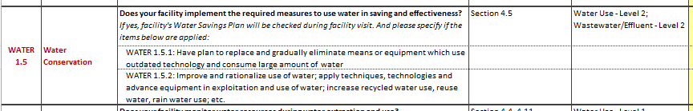
14. PROJECT TOOL AND HIGG FEM 3.0
SAT shows correlation of Higg FEM 3.0 requirements with the regulatory requirements
Example
Notes:
New slide

Slide 63

15. SOLUTION DISCUSS PROPOSED IMPROVEMENTS
Discussion:
What are the solutions? Where are the funding sources? Which to comply with Vietnam Environmental Law and maintain a sustainable management system ?.

Slide 64
15. SOLUTION DISCUSS PROPOSED IMPROVEMENTS
Case study:
A Garment Company has ironing clothes (not washing) outside the industrial zone with the following parameters:
No. | Parameters | Data
1 | Employee | 3600 people
2 | Water use | 13,000 m³/month
3 | Fuel (firewood) | 700,000,000 VNĐ/month
3 | Electricity consumption | 17,500,000 Kwh/year
4 | Boiler | CO exceeds QCVN standard
5 | Wastewater | Overload processing system
6 | Energy | Major energy users
7 | Water price | 17,500 VNĐ/m³
8 | Fuel price (firewood) | 1,600 VNĐ/kg
9 | Electricity price | 1,800 VNĐ/kwh
Notes:
Suggest the case study is shifted after the session on Chemical management. The case study does not match with the topic.

Slide 65
15. SOLUTION DISCUSS PROPOSED IMPROVEMENTS
Case study (cont.)
Equipment status: Replaced: 98% of LED light and 95% of Electronic sewing machine
Boiler: 3 boilers, total capacity: 12 tons, Newly installed steam trapping system, but the condensate recovery tank lost heat.
Environmental permit: No permit for completion on environment protection works.
Water supply: old pipelines, no map.
Environmental monitoring periodically: coping status
Environmental documents/ records: asynchronous
Emissions, wastewater: Exceed QCVN standard
Other
What are the solutions? Where are the funding sources? Which to overcome the above situation and maintain it into a sustainable management system ?

Slide 66

Thank
you
In a partnership with:
Supported by:

