Slide 1

On Your Marks: Trademark and Branding Basics Every Lawyer/Business Should Know
December 6, 2020
Sponsored By: BCBA Intellectual Property Committee

Slide 2
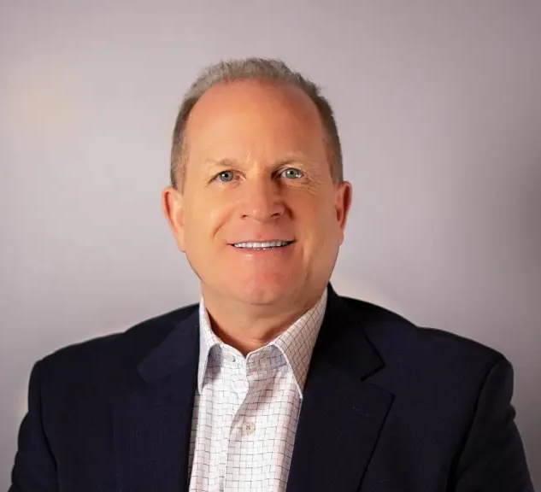

SPEAKERS
Anthony is a the Chair of the BCBA Intellectual Property Committee and a Partner in Santomassimo Davis LLP’s I.P., Litigation and Compliance & Corporate Governance Departments, where he counsels organizations and individuals on a wide range of legal and business issues. He has over twenty-seven years of federal and state court experience specializing in complex commercial and corporate litigation; construction litigation; shareholder and partnership disputes; intellectual property and anti-counterfeiting litigation; and general corporate matters. He has extensive experience handling trademark and anti-counterfeiting cases. He provides strategic counseling involving branding, trademarks, service marks, e-commerce, electronic payment and licensing issues as well as intellectual property portfolio management and anti-counterfeiting.
Anthony J. Davis
Brian is a Senior Counsel in Santomassimo Davis LLP’s Intellectual Property and Litigation Departments where he specializes in trademark law, complex commercial litigation and e-discovery. His practice concentration includes trademark prosecution, intellectual property litigation before the Trademark Trial and Appeal Board of the United States Patent and Trademark Office, as well as U.S. Federal Courts, trademark management of domestic and international portfolios, and licensing and transactional agreements concerning intellectual property. Brian also counsels organizations and individuals on a wide range of legal and intellectual property issues, including contracts, trade dress, unfair competition, copyrights, and e-commerce legal matters.
Brian E. Moffitt

Slide 3

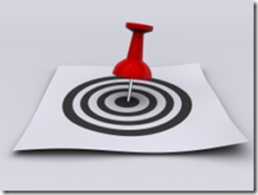
Why are Trademarks Important?
Trademarks are among any business’ most valuable assets and distinguish you from competitors. A company’s trademark and its brand is its reputation. As a business’s reputation grows, the more valuable your brand will be. It is essential to protect your trademarks in order to avoid brand confusion by the purchasing public. This seminar will explain why and how, and delve into topics such as:
Overview of Main Types of IP: trademarks, copyrights, patents, and trade secrets
Importance of focusing on branding and choosing a trademark that is both federally registrable and legally protectable, and highlight key legal factors to consider when choosing a mark (Categories and Strength of Marks)
Creation and maintenance of trademark rights
TM Registration process
Key Branding Practices and Standards
Protecting a trademark against infringement by others

Slide 4


Overview of Intellectual Property: Trademark, Copyright, Patent, and Trade Secrets- What’s the Difference?
Intellectual property is a unique type of property or asset
Intellectual property includes trademarks, copyrights, patents, and trade secrets

Slide 5

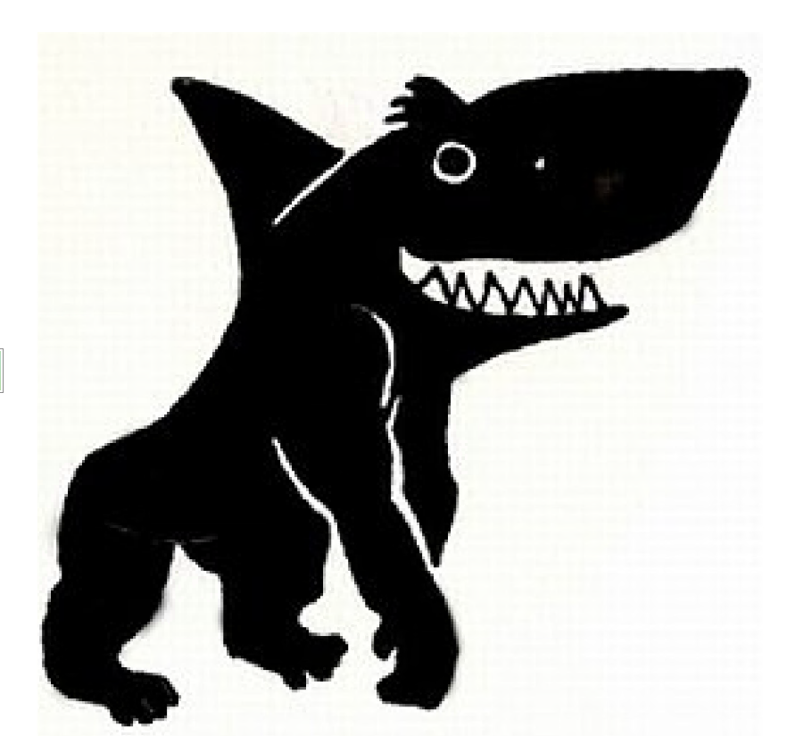
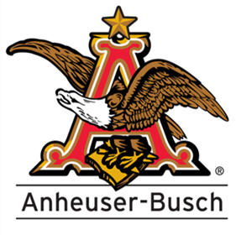
What is a Trademark?
A trademark can be any type of device used to identify the source or origin of a product or service, including:
Words
Phrases
Symbols
Designs
“Non-traditional” elements like sounds, smells, and colors
Trade dress
Notes:
TM is focus of Prestnation

Slide 6
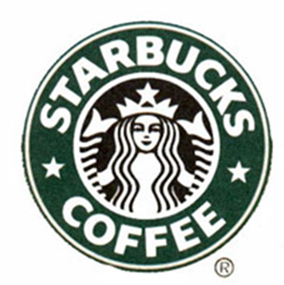
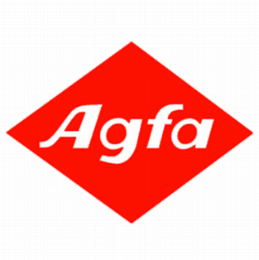
What is a Trademark?
A trademark is a brand name
A trademark protects your brand
Identifies the source of your goods or services
Distinguishes your goods or services from those of your competitors

Slide 7

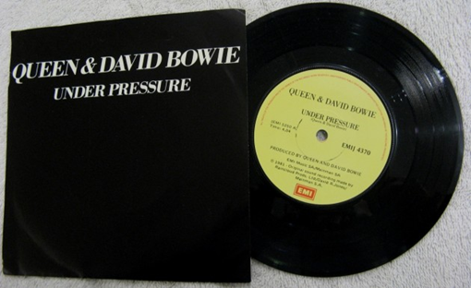

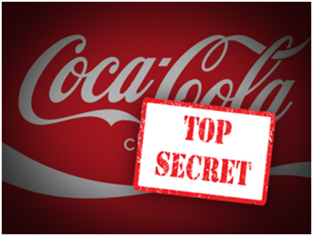
Other forms of I.P.
WHAT IS A COPYRIGHT?
WHAT IS A PATENT?
WHAT IS A TRADE SECRET?
Copyright protects original works of authorship, such as a song, a movie, or a book.
© date
Patents protect inventions.
Trade secrets are company secrets, such as recipes, formulas or techniques used by a company in manufacturing its products.
Notes:
Cite Statutes and give time periods for rights.
Cite NJ Statute on Trade Secrets

Slide 8
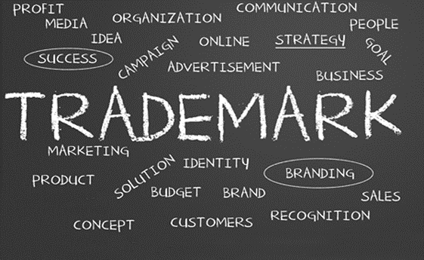
Trademark Definition
A trademark includes any word, name, symbol, picture, drawing, or any combination of these, used to identify and distinguish the goods or services of one seller or provider from those of others, and to indicate the source of the goods or services.
Your trademark is a symbol of your goodwill.
Tells the consumer that the goods or services are of a certain quality and standard.
Trademarks can capture a customer’s attention, and make your business, products and services stand out.
Trademarks can make it easy for customers to find you, as they distinguish your business from your competitors.

Slide 9
Trademark Use and Protection
Trademarks can be weakened and ultimately even lost if you:
Misuse them.
Fail to adequately police infringement and dilution.
Allow others to use them without appropriate restrictions and quality control, or allow misuse.
Be vigilant to make sure that your trademarks remain strong and protected.
To maintain and protect trademark assets, you must:
Use trademarks properly.
Monitor the marketplace for infringements and misuses of trademarks.
Take appropriate action quickly whenever infringements and misuses of trademarks are identified.
Implement appropriate requirements and quality control when permitting others to use trademarks.
Maintain records demonstrating the use, strength, and recognition of trademarks.

Slide 10
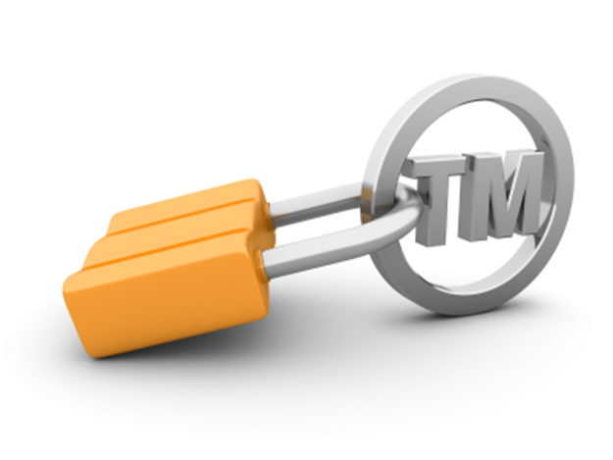
Why protecting trademarks is important?
Trademarks are among a company’s most valuable assets
A trademark is reputation
Protect a trademarks in order to avoid brand confusion by the purchasing public.
TM Owner has the legal right to protect your trademark and stop infringement

Slide 11
Establish Use Guidelines for Trademarks
Advertising – digital and print.
Other promotional materials, such as:
  Social media posts; and
  Email campaigns.
Product packaging.
Consider use guidelines for clients and their employees whenever they use company trademarks, in both internal and external materials in the US, including in:

Slide 12
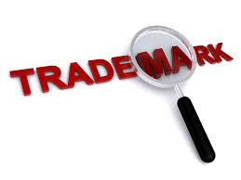
Avoid Improper Use
Using a trademark improperly may:
Diminish its distinctiveness: its ability to distinguish a Company’s products/services from competitors.
Result in the abandonment of trademark rights: the actual loss of a valuable asset.
Invite infringement of a mark by suggesting to others that rights in the mark will not be enforced.

Slide 13
DO Use Trademarks as Proper Adjectives Followed by a Generic Term
DO NOT Use Trademarks in the Possessive Form
Because trademarks are not nouns, they should not be used as possessives unless the trademark itself is in possessive form.
For example:
Correct: We are increasing the advertising budget for Champion sports and leisure wear.
Incorrect: We are increasing Champion’s advertising budget.
Trademarks should be used as adjectives followed by a generic modifier, and not as nouns or verbs.
For example:
Correct: Apple’s Smart phones are popular.
Incorrect: Wegman’s is popular.

Slide 14
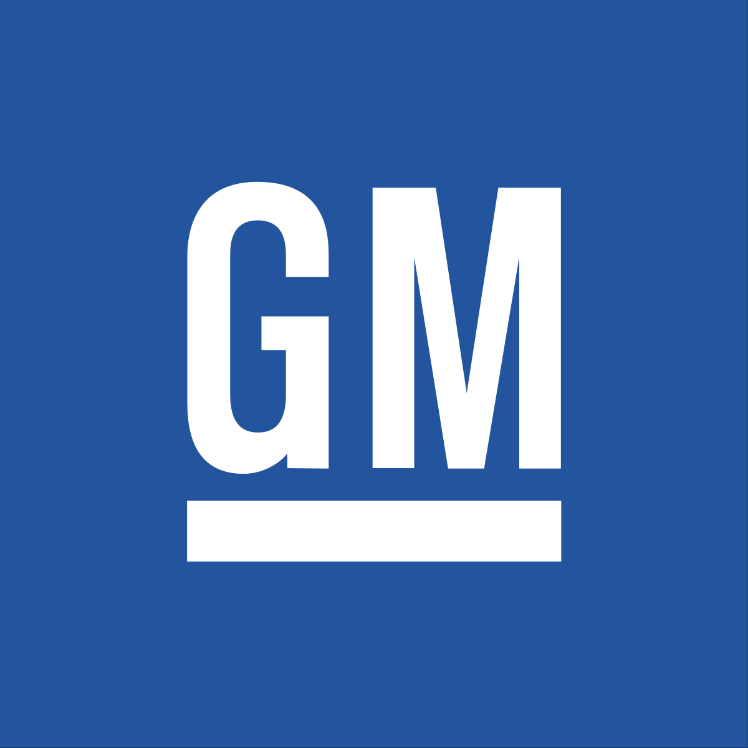
DO Make Trademarks Stand Out
DO NOT Use Trademarks in the Plural Form
Trademarks should be distinguished from surrounding text to emphasize their brand name significance.
Options include:
Presenting the trademark in all capital letters (SAMSUNG).
Capitalizing the first letter of the trademark (Agfa).
Presenting the trademark in bold typeface (Eat Clean Bro).
Presenting the trademark in its logo form ( ).
Because trademarks are not nouns, they should not be used in the plural form unless the trademark itself is in plural form.
For example:
Correct: Our customers enjoy Ford trucks and cars.
Incorrect: Our customers enjoy Fords.

Slide 15
DO Use Proper Trademark Notice Symbols
DO NOT Alter Trademarks
Proper trademark notice symbols should be used with all trademarks.
In the U.S., the proper symbol to use depends on whether the trademark is registered with the U.S. Patent and Trademark Office for specific products or services for which the mark is used.
Trademarks should be used consistently and should not be altered.
For example, do not:
Abbreviate the trademarks:
Change the colors or typeface of a logo trademark:
Add words or design elements to the trademarks:
Hyphenate the marks unless the trademark itself is hyphenated:
Notes:
SM v TM - SEE NEXT SLIDE
No rules on use and location of TM/SM
Look at competitors for examples
Circle R – only if registered. Gold Seal Registration – Add Slide with a Certificate (EMILY)

Slide 16
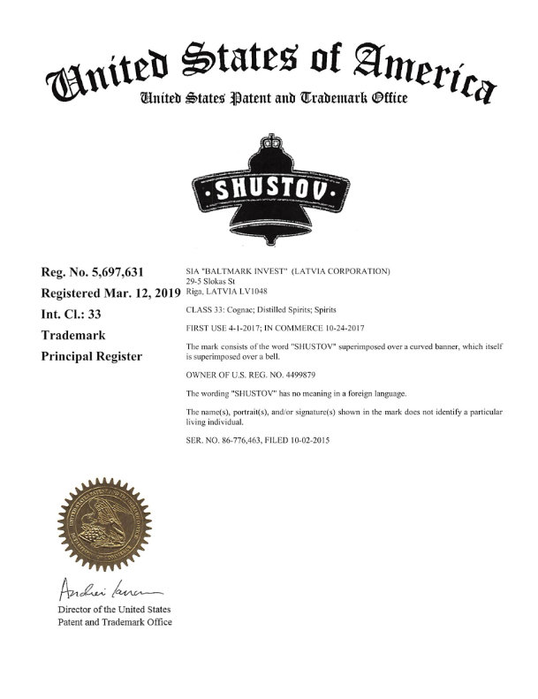
Official TM Registration Certificate issued by USPTO

Slide 17
Trademark Notice Symbols
Stacker 2®
Use the ® symbol ONLY with trademarks that are registered with the US Patent Trademark Office.
  …but only in connection with the specific products and services for which the trademark was registered
The Leafy Basket™
If the trademark is not registered in the US Patent and Trademark Office, use the TM or SM symbol:
  “TM” with trademarks used to identify products or products and services.
  “SM” with trademarks used to identify just services.
Notes:
Application filed – is not registration

Slide 18
DO Adhere to Brand Standards
Brand standards should be established and specify how a Company’s marks should be presented.
They include guidelines about each trademark’s:
Color
Typeface
Size
Appearance of graphic elements
Background

Slide 19
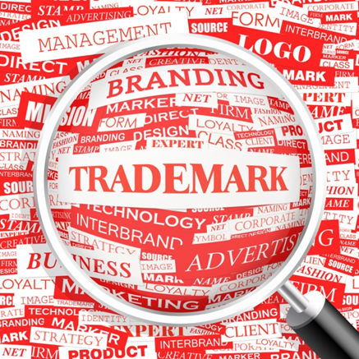
Basics for TM Selection: Strong and Enforceable
Types of Trademarks
Choose a trademark that is both federally registrable and legally protectable
Choose a trademark that is inherently strong and memorable to the consumer.
5 types of trademarks:
Fanciful
Arbitrary
Suggestive
Descriptive
Generic
Notes:
Caselaw has developed these categories
Explain – Spectrum from weak – hard to enforce -- to strong – good for enforcement – SEE Slide ahead
Enforcement – means legal action that stop someone from using and competing with you.

Slide 20

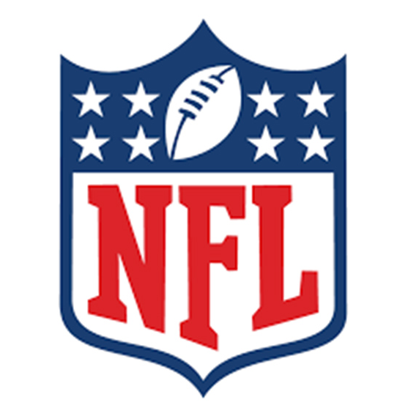

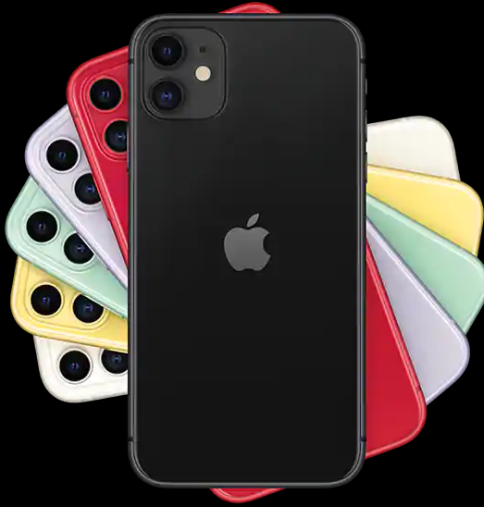


It’s All Between the Ears: The Cognitive Aspects of TMs
Key Concept to Understand TMs:
Apple

Slide 21

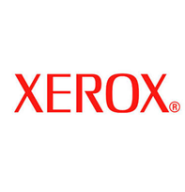
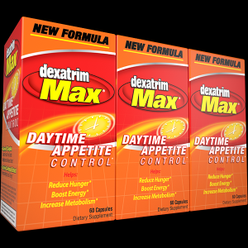
Fanciful

Slide 22
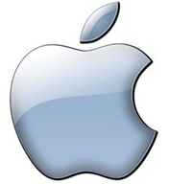
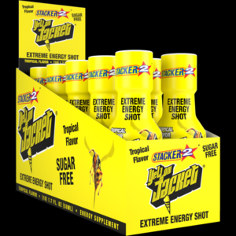
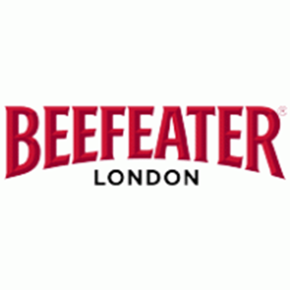
Arbitrary

Slide 23



Suggestive

Slide 24
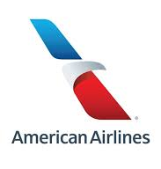
Descriptive
Examples - HOME SAVINGS for banking services, SECURITY CENTER for a storage facility, and SUDSY for cleaning products
It is possible for descriptive marks to “become distinctive” by achieving “secondary meaning”

Slide 25
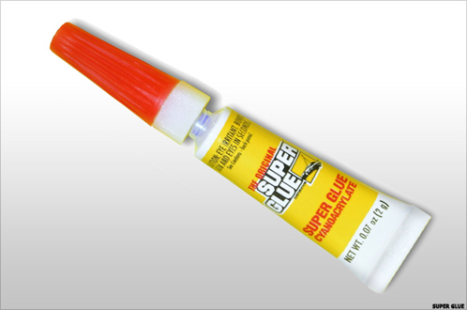
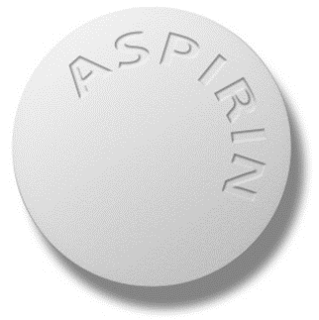
Generic
DRY ICE for an ice substitute
SHREDDED WHEAT for breakfast cereal
SUPER GLUE for an adhesive
ESCALATOR for moving staircases
ASPIRIN for pain relief medication
Notes:
Some of these started as TMs – Aspirin (Bayer) Escalator (Otis) -- victims of Genericization
Ones to watch – Bubble Wrap, Chapstick, Crock Pot

Slide 26

Key Factors for TM Selection
Marks that are fanciful, arbitrary, or suggestive are considered distinctive enough to function as trademarks
Marks that are descriptive or generic do not function as trademarks
Choose marks which are fanciful or arbitrary
Stronger marks
Easier to protect and enforce in the marketplace.
More memorable to the consumer

Slide 27
How are trademark rights obtained?
The Lanham Act –
15 U.S.C. § 1051 et seq.
Trademark rights begin upon:
filing of a use or an intent-to-use federal trademark application; or
use of a trademark in commerce
Federal trademark registration expands rights nationwide
Puts everyone in U.S.A. on notice of your mark and its use in the United States.

Slide 28
Advantages of a federal trademark registration
  A legal presumption of your ownership of the mark and your exclusive right to use the mark nationwide on or in connection with the goods/services listed in the registration (whereas a state registration only provides rights within the borders of that one state, and common law rights exist only for the specific area where the mark is used);
      Public notice of your claim of ownership of the mark;
      Listing in the USPTO’s online databases;
      The ability to record the U.S. registration with the U.S. Customs and Border Protection Service to prevent importation of infringing foreign goods;
      The right to use the federal registration symbol “®”;
      The ability to bring an action concerning the mark in federal court; and
      The use of the U.S. registration as a basis to obtain registration in foreign countries.
Notes:
Comment on Amazon Brand Registration – and Report Infringement

Slide 29
USPTO Trademark Registration Application Process
Trademark Search
A search is necessary in order to determine if another party is using, or has registered or applied to register, a similar mark for similar goods or services
Have a potential new trademark cleared and/or registered prior to investing a large sum of money in the development and/or use of the mark itself
A trademark owned or used by another party does not need to be identical to your mark in order for there to be a likelihood of confusion
Similarly, the goods or services also do not need to be identical – they need only be related goods when used with a similar mark in order for there to be a likelihood of confusion.
Search of the USPTO trademark database
Internet search and search reports from vendor like: www.CORsearch.com
The USPTO does NOT do a search beyond its own database of registrations and applications.
Preparation of a Trademark Application
Two types of applications:
Use-based applications
Intent-to-use applications
  Cannot “reserve” a mark for any reason other than a bona fide intent to use the mark
  Website: www.uspto.gov

Slide 30
A USPTO trademark Registration application consists of:
The mark
Detailed description of the goods or services
International Classification or classes.
Name, address, and state of organization of the trademark owner
  Filing a trademark application in the name of the wrong owner can result in the application being voided and cancelled
  Specimen of the mark being used in commerce
USPTO examination
Publication
Notice of Publication
Mark will appear in The USPTO Gazette for 30 days
Notice of Allowance for intent-to-use applications
Registration
Puts everyone in U.S.A. on notice of your trademark rights.

Slide 31
Maintenance of Trademark Registrations
Trademark registrations initially last 5 years and are renewable.
Declaration of Use is due between the 5th and 6th year after registration
Can be renewed indefinitely, as long as the mark remains in use in commerce
Renewal due between the 9th and 10th year after registration and every ten years thereafter
Also must show the USPTO that the mark continues to be used in commerce. In combination with this Affidavit, a registrant can also file an Affidavit of Incontestability
  The validity of the registered mark
  The registration of the mark
  The owner's ownership of the mark
  The owner's exclusive right to use the mark with the goods/services.
  Subject to certain limited exceptions, such as abandonment, fraud on the USPTO, genericness and priority.

Slide 32
Critical to Protect Trademarks
Guidelines to help ensure that marks remain protected:
Report suspected infringement or misuse to owners and counsel
Do not allow others to use a Company’s trademarks without appropriate internal approval.
Maintain documents and records showing use and promotion/marketing of trademarks.

Slide 33

Report Suspected Infringement or Misuse
What to Watch For:
Any third-party use of a Company’s trademarks or any similar trademarks that you believe may violate the Company’s rights.
Any third-party use of a Company’s trademarks in a generic or descritive sense.
Not reporting suspected infringement or misuse can:
Result in delays that limit legal remedies.
Weaken TMs and may cause their loss.

Slide 34
Do Not Allow Use of Trademarks Without Approval
Require all third-party requests for permission to use trademarks to be subject to license agreement.
Unchecked licensing can erode the strength of trademarks.
Third-party use of trademarks without appropriate license terms and conditions can:
Jeopardize the trademarks rights, lose control of brand.
Expose Company to liability.

Slide 35
Maintain Records Showing Use and Promotion of Trademarks
These documents are important:
In enforcement actions against third parties that infringe or misuse the trademarks.
In connection with registration and renewal of the trademarks.
Key: Sales & Marketing Data ($)
Critical materials to keep include:
Representative samples of product packaging displaying trademarks.
Representative samples of advertising and promotional materials displaying trademarks.
Documents demonstrating sales of Company products and services under Company trademarks in dollars and units.
Market research showing consumer recognition of products, services, and trademarks.

Slide 36
Key Legal Standard for TM selection and enforcement: Likelihood of Confusion
Likelihood of Confusion - foundation of trademark law
  Lanham Act 15 U.S.C. § 1125(a)
To determine whether a Likelihood of Confusion exists between two trademarks, both the marks and the goods or services are compared in their entireties
If Likelihood of Confusion is found between a senior mark and a junior mark, then trademark infringement will be found
Infringer may be enjoined from use and/or registration of their mark
Infringer may be liable for monetary damages in a federal infringement suit
Every Circuit has established a multi-factor test used to evaluate Likelihood of Confusion.
Third Circuit: Interpace Corp. v. Lapp, Inc., 721 F.2d 460, 463 (3d Cir. 1983)

Slide 37
Third Circuit: Likelihood of Confusion Factors - Interpace Corp. v. Lapp, Inc., 721 F.2d 460, 463 (3d Cir. 1983)
The degree of similarity between the marks.
The strength of plaintiff's mark.
The price of the goods and other factors indicative of the care and attention expected of consumers when making a purchase.
The length of time the defendant has used the mark without evidence of actual confusion arising.
The defendant's intent in adopting the mark.
The evidence of actual confusion.
Whether the goods, though not competing, are marketed through the same trade channels and advertised through the same media.
The extent to which the targets of the parties' sales efforts are the same.
The relationship of the goods in consumers' minds because of similarity of function.
Other facts suggesting that the consuming public might expect the prior owner to manufacture a product in the defendant's market or that the prior owner is likely to expand into that market.
Notes:
Give examaples of each factor – cases say no one factor controls and its not simple tally of the factors – every case is unique.

Slide 38
Likelihood of Confusion – Other Key Factors to Consider
The similarity or dissimilarity of the marks in their entireties as to appearance, sound, connotation and commercial impression.
The relatedness of the goods or services as described in the application and registration(s).
The similarity of established, likely-to-continue trade channels.
The conditions under which and buyers to whom sales are made, i.e., “impulse” vs. careful, sophisticated purchasing.
The number and nature of similar marks in use on similar goods.

Slide 39
Examples Likelihood of Confusion
In re Martin’s Famous Pastry Shoppe, Inc., 748 F.2d 1565, 223 USPQ 1289 (Fed. Cir. 1984)
  (holding MARTIN’S for wheat bran and honey bread, and MARTIN’S for cheese, likely to cause confusion)
Weider Publ'ns, LLC v. D&D Beauty Care Co., 109 USPQ2d 1347 (TTAB 2014)
  (holding SHAPES for a variety of beauty salon, day spa, and health spa services likely to cause confusion with SHAPE for magazines where the services are of the type normally featured in the magazines)
Joel Gott Wines LLC v. Rehoboth Von Gott Inc., 107 USPQ2d 1424, 1433 (TTAB 2013)
  (holding GOTT LIGHT for various water beverages likely to cause confusion with GOTT and JOEL GOTT for wine)
Gen. Mills, Inc. v. Fage Dairy Processing Indus. S.A., 100 USPQ2d 1584, 1597 (TTAB 2011)
  (holding composite marks containing the word TOTAL for yogurt and other products likely to cause confusion with the mark TOTAL for ready-to-eat breakfast cereal)

Slide 40
If a Likelihood of Confusion is Present, Then Who Wins – Priority and the “First to Use”
Priority of use of a mark
First to use a mark in commerce is the senior user, and the owner of the mark
Without a federal registration, these rights may be limited to the geographic area in which the mark is being sold and marketed
Exception to the “First To Use” Rule
  Federal intent-to-use trademark application

Slide 41
Protecting a trademark against infringement by others
FEDERAL LAWSUIT
Under the Lanham Act, owner of a federal trademark registration has right to file an action for trademark infringement and unfair competition in federal court
Seek Injunction & Monetary Damages
Exceptional Cases – Legal fees
TTAB PROCEEDING
Notice of Opposition (against pending marks not yet registered)
Petition for Cancellation (against registered marks)
Filed with the USPTO’s Trademark Trial and Appeal Board (TTAB)
  TTAB functions just like a federal court
  Result of a successful TTAB action is denial or cancellation of a trademark registration
  TTAB cannot issue injunctions or award money damages
CEASE AND DESIST NOTICE
Many trademark infringements are innocent and unintentional
Threat of litigation may be enough to convince an infringer to cease their infringing behavior.
Less expensive alternative to litigation
Not required as a condition to lawsuit
Notes:
Injunction is primary relief – equitable focus of court – SEE NEXT SLIDE

Slide 42

Remedies
Trademark infringement remedies are statutory, provided by the Lanham Act. See 15 U.S.C. §§ 1124-1125
A court may award the following remedies:
Injunctive relief – Preliminary and Permanent Injunctions
Monetary damages
  Lost profits of Owner; or
  Infringer’s profits
Special or “Exceptional” Cases:
  Treble damages
  Attorneys’ fees and costs

Slide 43

Contact Us
Santomassimo Davis LLP
www.OGCSolutions.com
Anthony J. Davis, Esq.
office (201) 712-1616 | fax (201) 712-9444
mobile (201) 674-6097
ADavis@OGCSolutions.com
Brian E. Moffitt, Esq.
office (201) 712-1616 | fax (201) 712-9444
mobile (908) 432-6815
BMoffitt@OGCSolutions.com
We want to hear from you!

