Slide 1
2021 DNPs of Color Virtual Commencement Ceremony Networking-Mentoring- Advocacy
Saturday 19 June, 2021
CAPT James LaVelle Dickens, DNP, RN, FNP-BC, FAAN, FAANP
Centers for Medicare and Medicaid Services
United States Public Health Service
U S Department of Health and Human Services

Slide 2
Merlin Olsen’s ethos
“The focus of my life begins at home with family, loved ones and friends. I want to use my resources to create a secure environment that fosters love, learning, laughter and mutual success. I will protect and value integrity. I will admit and quickly correct my mistakes. I will be a self-starter. I will be a caring person. I will be a good listener with an open mind. I will continue to grow and learn. I will facilitate and celebrate the success of others.”

Slide 3
Guiding believes…
Life long learner
TED talks
Journaling/Reflecting
Battle rhythm
Design your Career
Develop a Brand
What’s your Brand?
Share successes of staff, family and friends
Praise in public, correct/punish in private
Life Coach/Executive Coach

Slide 4
What was shared with me…
If you want to see the CHANGE, be the CHANGE!

Slide 5
Leadership
What is Leadership?
“The process by which a person influences others to accomplish an objective.” Akhil Shahani
Redden 3-D Model
Situational demands dictate the management style for effectiveness (Developer, Executive, Bureaucrat, and Benevolent Autocrat)
Tactical Leadership: Concerned with the here and now, with short-term decisions and risk management for immediate gains
Operational Leadership: Guidance that support the values of the organization and its leadership to encourage a culture and behavior patterns that are harmonious

Slide 6
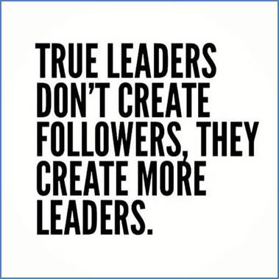
Leaders

Slide 7
Read, Read, Read…
Recommended Reading:
It worked for Me by General Colin Powell
Gung Ho by Ken Blanchard and Sheldon Bowles
Andy Longclaw, a Native – American, three secrets he learned from his grandfather
Spirit of the Squirrel, Worthwhile work ( the importance and value of your work)
The way of the Beaver, Autonomy (no leader, manager or coach) you’re in control of achieving the goal
The gift of the Goose, cheer each other on and maintain a positive attitude (geese seem to be always cheering each other on as they fly in formation, whether they were in the lead during formation or not)
“Too many spirits die at the office door,” Andy stated.

Slide 8
Recommended reading…
The Innovator’s DNA
The Immortal Life of Henrietta Lacks
Crucial Conversations
The Five Dysfunctions of a Team
Strength Finders, Strengths and Leadership

Slide 9
Pearls of Wisdom
Transparency- (be transparent)
Semper Gumby- (always flexible)
You will not be prepared for every scenario (seek counsel Executive staff or Senior staff, have a life coach)
You will no longer be expected to be a participant, you will be expected to lead (conversation, mission, committee, and the Board)
High stakes ‘zero fell mission’ (Air Force One)
Communicate (manage expectations)
Absence of information creates rumors
Strategic communication
Style of communication (verbal/non-verbal)
Develop a battle rhythm
Don’t wait until you have an adverse event (THR DFW)

Slide 10
Pearls cont.
Diversity and Inclusion matters (understand cultural differences )
Crucial Conversations
Dismissals and relief of duty (firing colleagues)
It can be counter-intuitive to be in charge of our Physician counterparts
Challenges with millennials
Stay ready so you don’t have to stop and get ready
Practice like you Play
Lessons Learned
UNMIL
WHO
Medecins Sans Frontieres (Doctors without Borders)
CDC

