Slide 1
Advancing LGBT+ Inclusive Healthcare: Voices from S. Florida
Presented by:
Roberto Roman, PhD, DNP, RN, CMSRN, EBP-C
K.Gattamorta, PhD, Eds
J. De Santis, PhD, ARNP, ACRN, FAAN
J. Ortega, PhD, APRN, ACNP-BC, ENP-BC, FNP-BC, FAAN, FAANP
E. Provencio-Vasquez, PhD, RN, FAAN, FAANP

Slide 2
Objectives
Identify the needs of LGBT+ people when seeking healthcare
Discuss the salient factors of LGBT+ inclusive healthcare.

Slide 3
Background
7.2% of the US population identifies as LGBT+ (Jones, 2023)
4.6% of adults in Florida are LGBT+
Florida ranks #4 for the largest LGBT+ population (World Population Review, 2022)
Notes:
(Jones, 2023) https://news.gallup.com/poll/389792/lgbt-identification-ticks-up.aspx
24.2 million LGBT people in the US.
(Powel, 2022) https://www.hrc.org/press-releases/hrc-and-equality-florida-respond-to-florida-department-of-health-spreading-dangerous-disinformation-about-gender-affirming-care-trans-youth
https://worldpopulationreview.com/state-rankings/gay-population-by-state
California
Texas
NY
Florida 886k LGBT people, Miami 6th largest LGBT city in the US
Illinois

Slide 4
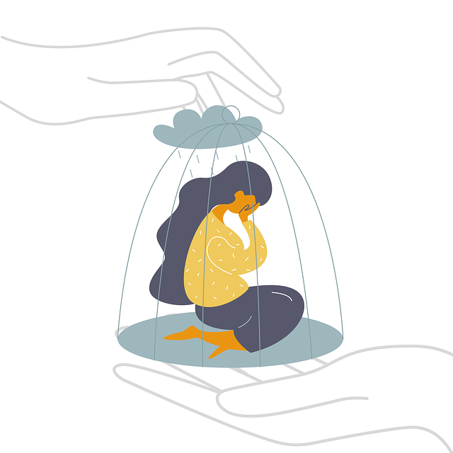
Background
Government Policy
In 2023, 45 anti-LGBT bills were enacted in the US
540 anti-LGBT bills introduced in the US
Florida has been one of the most proactive states advancing anti-LGBT laws.
(Movement Advancement Project, 2022)
Notes:
(Bibi, 2022) https://www.hrc.org/news/florida-senate-passes-dont-say-gay-or-trans-bill-legislation-heads-to-desantis-desk-for-signature-or-veto
https://www.hrc.org/press-releases/weekly-roundup-of-anti-lgbtq-legislation-advancing-in-states-across-the-country-3
Although Florida does not have statewide non-LGBT protections, certain municiplaties do have LGBT protections.
Laws banning gender affirming care for transgender youth: 13
Laws requiring or allowing misgendering of transgender students: 3
Laws targeting drag performances: 2
Laws creating a license to discriminate: 3
Laws censoring school curriculum, including books: 2

Slide 5
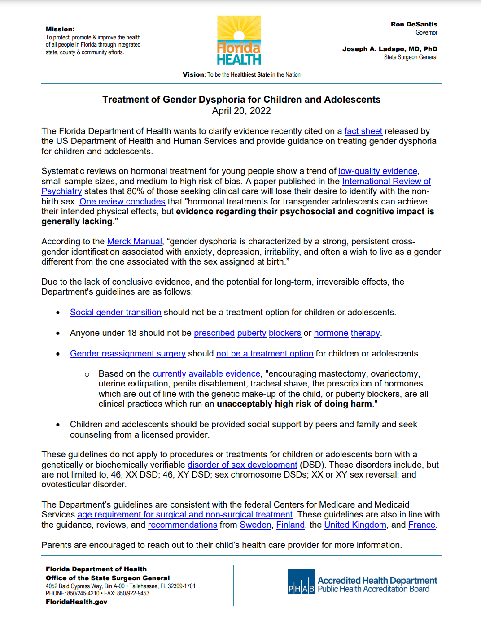
Background
Florida Department of Health is spreading disinformation about gender-affirming care and trans youth:
Detransition rates high
No impact of gender-affirming care
Harmful irreversible surgeries
No benefit of transitioning socially
(Powell, 2022)
Notes:
https://www.floridahealth.gov/_documents/newsroom/press-releases/2022/04/20220420-gender-dysphoria-guidance.pdf?utm_medium=email&utm_source=govdelivery
https://www.hrc.org/press-releases/fact-check-human-rights-campaign-rebuts-florida-department-of-health-disinformation-about-gender-affirming-care-point-by-point

Slide 6
Significance
Stigma and discrimination negatively impact the healthcare-seeking behaviors of LGBT+ people
15% of the LGBT+ population have postponed or avoided necessary treatment
Suicide is the second leading cause of death of LGBT+ young people
Almost 1 in 10 LGBT and 1 in 5 transgender people have been denied healthcare
(Gruberg, Halpin, Mohowald, 2020)
Notes:
(Gonzalez, 2022) https://www.axios.com/mental-health-lgbtq-youth-anti-trans-bills-fd67fa3c-0efa-4301-8083-312f1e28d8aa.html
https://www.americanprogress.org/article/state-lgbtq-community-2020/
85% of youth report that the current legislative climate has negatively affected their mental health
LGBT young people 10-24 y/o (Hedegaard, Curtin, & Warner, 2018)
LGBT youth are 4x more likely to commit suicide (Johns et al., 2019; Johns et al., 2020) https://www.thetrevorproject.org/resources/article/facts-about-lgbtq-youth-suicide/

Slide 7
Significance
Heteronormative assumptions in healthcare create missed opportunities for LGBT+ health needs (Smith & Turrell, 2017)
Medical/nursing curricula provide limited education about LGBT+ health (Ard, 2016)
Healthcare providers often overlook sexual orientation and gender identity when collecting health histories (Suen et al., 2020)
The National Academies (2020) report highlights the lack of LGBT-specific research

Slide 8
LGBT+
Health Disparities
Substance abuse
HIV
Depression
Cancer
Suicide
Notes:
(Ard, 2016)
Limited screening, increased cancers in gay men, transgender
https://bioascend.com/wp-content/uploads/2021/10/05_Addressing-Disparities-in-Cancer-Care-for-Minority-Populations_LGBTQ-Resource-Guide_FINAL.pdf

Slide 9
Research
Question: What are the salient points of LGBT+ perception and expectations of inclusive healthcare that impact the patient experience of individuals who identify as LGBT+?
Method: Qualitative Descriptive Design, 19 Interviews, LGBT+ Adults, living in South Florida, IRB approved by the University of Miami

Slide 10
Results
Demographic Variable |  | n(%)
Age in years m(S.D.) |  | 28.42(16.6)
Gender assigned at birth
 | Female | 10(52.6)
 | Male | 9(47.4)
Gender identity
 | Female | 6(31.6)
 | Male | 5(26.3)
 | Non-binary | 5(26.3)
 | Gender Queer | 1(5.2)
 | Transgender | 2(10.5)
Sexual orientation*
 | Lesbian | 3(15.8)
 | Gay | 6(31.6)
 | Bisexual | 3(15.8)
 | Queer | 4(15.8)
 | Demisexual | 2(10.5)
 | Asexual | 2(10.5)
 | Pansexual | 2(10.5)
Demographic Variable |  | n(%)
Insurance
 | Private | 14(73.7)
 | Public | 5(26.3)
Employment status
 | Unemployed | 5(26.3)
 | Retired | 2(10.5)
 | Part-time | 6(31.6)
 | Full-time | 6(31.6)
College Student
 | Yes | 12(73.7)
 | No | 7(36.8)
County
 | Broward | 5(26.3)
 | Miami-Dade | 14(73.7)
Race*
 | Asian | 4 (15.8)
 | Black | 1 (5.2)
 | Multiracial | 6 (31.6)
 | White (Non-Hispanic/Latin@) | 5 (26.3)
 | White (Hispanic/Latin@) | 5 (26.3)
Hispanic/Latin@ |  | 11 (57.9)
KEY Demographics
Mean age: 28
Diverse sample
Insured
58% Latin@
* Select all that apply

Slide 11
Theme 1: Barriers to accessing healthcare
Lack of Transportation
“I do have to take public transportation and go out of my way for that because that’s what my insurance would pay for”
Bad/No Insurance
“I have to work to afford my medication and my health care expenses and that's just about all I can afford. You know, there's not really much left for anything else but I prioritize you know, the medication and the treatment because it's like, if I don't have my body, I don't have anything else”

Slide 12
Theme 2: Healthcare Experiences
Disclosing
Sexual Orientation
& Gender Identity
Selecting a
Healthcare Provider
Pronouns Matters
He/him
She/her
They/them
Notes:
2. Healthcare experiences
Disclosing sexual orientation and/or gender identity: “Most doctors in Miami that I have, they haven't directly or indirectly brought the subject up about me being gay :
Selecting a healthcare provider: “"I definitely try and get recommendations, especially from people in the queer community”
Pronouns matter: If they asked me [my pronouns], then like, that's a telltale, like, I care about your identity, and I am at least willing to put in the effort to respect it. I mean, if I walk in and they, like, start referring to me as she/her in assuming my name, and assuming my pronouns and things like that, it doesn't necessarily mean it's unsafe, but like, I don't feel safe"

Slide 13
Theme 3: Ideal LGBT+ Inclusive Healthcare
LGBT+
Affirming
LGBT+ Representation
& Symbols of Support
LGBT+ informed
Healthcare Providers
Notes:
3. Ideal LGBT+ inclusive healthcare
LGBT+ affirming environment: Ask about SOGI, respect person, non-judgemental, safe environment, confidential “It's just kind of like health care without assuming automatically that the person that they are helping is a cis-het [cisgender-heterosexual] person" (Participant 3). "It's the queering of all of that. It's understanding [that] white cis-het [cisgender heterosexual] is not the standard"
LGBT+ representation and symbols of support: Highlight LGBT+ providers, add pronouns to HCPs’ nametags, include more LGBT+ marketing/pamphlets “the LGBTQ pin on their uniform. He spoke to us in a way that let us know that we could be open […] We could be very honest with this individual”
LGBT+ informed and educated healthcare providers: LGBT+ cultural competence/humility. Providers should understand language, history, and healthcare needs of LGBT+ community. “I need someone who's going to be pro-LGBT, who's going to go out of their way to work on the specific needs of me as an LGBTQ person […] I go through a lot of things that most patients will never go through, and I can't have a therapist that doesn't understand gender dysphoria”

Slide 14
Policy
Bill # | Title:
CS/HB 1521 | Facility Requirements Based on Sex
CS/CS/HB 1069 | Education (expansion of CS/SB 1557)
CS/SB 1557 | Parental Rights in Education “Don’t Say Gay”
CS/SB 254 | Treatments for Sex Reassignment
CS/SB 1580 | Protections of Medical Conscience
CS/SB 1438 | Protection of Children (Drag Show Ban)
Notes:
https://www.glaad.org/blog/florida-legislature-2023
A bill that would make it difficult or impossible for transgender Floridians to access appropriate restrooms, domestic violence shelters, correctional institutions, or other spaces that match their gender was sponsored by Sen. Erin Grall and Rep. Rachel Plakon.
A bill to criminalize essential health care for transgender youth was sponsored by Sen. Clay Yarborough (R), Sen. Douglas Broxson (R), and Sen. W. Perry (R) in the Senate and Rep. Randall Fine in the House.
A bill that would allow health care providers to discriminate against LGBTQ and other groups of patients was filed by Rep. Joel Rudman and Sen. Jay Trumbull.
A bill that bans any mention of LGBTQ people, history, or issues in school curriculums through the 12th grade was sponsored by Rep. Stan McClain in the House.

Slide 15
Policy
Feel Attacked by our government
“These are things that I feel like are attacking my identity.”
“I guess it's just so my parents are very conservative, right. So we always have like Fox News blaring in the background. And it's just not nice to constantly hear, like Tucker Tucker Carlson and Sean Hannity completely trash, the LGBTQ community and call us, like pedophiles, and adulterers, and like sex offenders and groomers and things like that. I'm actually like getting choked up hearing about it because that's like, not true. Like it's it hurts to think that like, people that don't know me already assume that I'm some kind of way simply because, like, [I’m a lesbian]”

Slide 16
Policy
Change Healthcare Seeking Behaviors
“I definitely think that people are going to not want to come out to their providers, which is also very dangerous, because you should want to be able to seek gender affirming care without fear that you're going to be outed or that you're going to be treated differently and within the state of Florida like I definitely feel as though that's a reality.”
“I think that by demonizing sexual minorities and preventing them from performing drag shows or talking mentioning it in like an elementary school, or wherever it might make them feel less inclined to go seek health care, because if they feel like if so many places are already working against them, then why wouldn't the health care as well?”

Slide 17
Policy
Leave Florida
“I see myself wanting to leave Florida sadly, even though I'm literally getting an [RN] license in Florida. I've see myself transferring out of here working here for a year and then being a travel nurse or something getting out as a queer person, but also, not everyone can leave I don't even know if I can leave so financially wise… like it seems like it's a breeding ground for hate, a breeding ground for disgusting rhetoric”
“Florida is the worst place for me to be out right now. I need to get out as much as I need to just get out. Like oh my god, I was talking about it when my partner. So we need to get out. I need to get out. I want to get out of Florida”

Slide 18
Discussion
Findings congruent with current literature
Creating LGBT+ Inclusive Healthcare spaces is multifaceted
Need more outreach to overcome barriers
Need safe spaces
Need providers that understand the LGBT+ community
Anti-LGBT rhetoric is dangerous
Policy discussions can change healthcare-seeking behaviors
(Roman Laporte & De Santis, 2023)

Slide 19
Conclusion
Increase in anti-LGBT legislation across the US is worsening stigma and discrimination
LGBT+ people face more health disparities than cisgender heterosexual people
Most healthcare settings are not adequately prepared to meet the needs of LGBT+ people
This qualitative descriptive study provided salient points about LGBT+ inclusive care from the perspective of LGBT+ people

Slide 21
References
American Medical Association (n.d.). Advocating for the LGBTQ community. https://www.ama- assn.org/delivering-care/population-care/advocating-lgbtq-community
American Psychiatric Association (2020). Position statement on issues related to sexual orientation and gender minority status. https://www.psychiatry.org/File%20Library/About-APA/Organization- Documents-Policies/Policies/Position-Sexual-Orientation-Gender-Minority-Status.pdf
ANA Ethics Advisory Board. (2018). ANA position statement: Nursing advocacy for LGBTQ+ populations. The Online Journal of Issues in Nursing, (24)1, https://doi.org/10.3912/OJIN.Vol24No01PoSCol02
Ard, K. L., & Makadon, H. J. (2016). Improving the health care of lesiban, gay, bisexual and transgender (LGBT) people: Understanding and eliminating health disparities. The Fenway Institute. https://www.lgbtqiahealtheducation.org/wp-content/uploads/Improving-the-Health-of- LGBT-People.pdf

Slide 22
References
Belgrave, L. & Seide, K. (2019). Coding for grounded theory. In The SAGE handbook of current developments in grounded theory (pp. 167-185). SAGE Publications Ltd, https://dx.doi.org/10.4135/9781526485656
Bibi, E. (2022). Florida Senate passes “Don’t Say Gay or Trans” bill, legislation heads to DeSantis’ desk for signature or veto. https://www.hrc.org/news/florida-senate-passes-dont-say-gay-or-trans-bill- legislation-heads-to-desantis-desk-for-signature-or-veto
The Florida Senate. (2023).Bill List. https://www.flsenate.gov/Session/Bills/2023
Gruberg, S., Halpin, J., Mohowald, L. (2020). The state of the LGBT community in 2020. Center for American Progress. https://www.americanprogress.org/article/state-lgbtq-community-2020/
Hedegaard, H., Curtin, S.C., & Warner, M. (2018). Suicide mortality in the United States, 1999– 2017. National Center for Health Statistics Data Brief, 330, Hyattsville, MD: National Center for Health Statistics.

Slide 23
References
Johns, M. M., Lowry, R., Haderxhanaj, L. T., et al. (2020). Trends in violence victimization and suicide risk by sexual identity among high school students — Youth Risk Behavior Survey, United States, 2015–2019. Morbidity and Mortality Weekly Report, 69,(Suppl-1):19–27.
Jones, J. (2023). U.S. LGBT identification steady at 7.2%. Gallup. https://news.gallup.com/poll/470708/lgbt-identification-steady.aspx
Movement Advancement Project. (2022, April). Florida’s LGBTQ policy tally. https://www.lgbtmap.org/equality-maps/profile_state/FL
National Academies. (2020). New report calls for more comprehensive data on LGBTQI well-being. https://www.nationalacademies.org/news/2020/10/new-report-calls-for-more-comprehensive-data- on-lgbtqi-well-being
National Institute of Health Sexual and Gender Minority Research Office. (2021). Sexual and gender minority health disparities research framework. https://dpcpsi.nih.gov/sites/ default/files/ NIH-SGM- Health-Disparities-Research-Framework-FINAL_508c.pdf

Slide 24
References
Peele, C. (2023). Weekly roundup of anti-LGBTQ+ legislation advancing in states across the country. Human Rights Campaign. https://www.hrc.org/press-releases/weekly-roundup-of-anti-lgbtq- legislation-advancing-in-states-across-the-country-3
Polit, D. F., & Beck, C.T. (2017). Nursing research: Generating and assessing evidence for nursing practice (10th ed.). Wolters Kluwer.
Powell, L. (2022). Fact check: Human Rights Campaign rebuts Florida Department of Health disinformation about gender affirming care point by point. https://www.hrc.org/press-releases/fact- check-human-rights-campaign-rebuts-florida-department-of-health-disinformation-about-gender- affirming-care-point-by-point
Rafferty, J., et al. (2018). Ensuring comprehensive care and support for transgender and gender- diverse children and adolescents. Pediatrics, 142(4). https://doi.org/10.1542/peds.2018-2162

Slide 25
References
Roman Laporte, R., De Santis, J. (2023). Concept analysis: LGBT+ inclusive health care. Advances in Nursing Science. Advance online publication. https://doi.org/10.1097/ANS.0000000000000467
Smith, S. K., & Turell, S. C. (2017). Perceptions of healthcare experiences: Relational and communicative competencies to improve care for LGBT people. Journal of Social Issues, 73(3), 637–657. https://doi.org/10.1111/josi.12235
Suen, Lunn, M. R., Katuzny, K., Finn, S., Duncan, L., Sevelius, J., Flentje, A., Capriotti, M. R., Lubensky, M. E., Hunt, C., Weber, S., Bibbins-Domingo, K., & Obedin-Maliver, J. (2020). What sexual and gender minority people want researchers to know about sexual orientation and gender identity questions: A qualitative study. Archives of Sexual Behavior, 49(7), 2301–2318. https://doi.org/10.1007/s10508-020-01810-y
World Population Review. (2022). What percentage of the population is gay 2022. https://worldpopulationreview.com/state-rankings/gay-population-by-state

