Slide 1
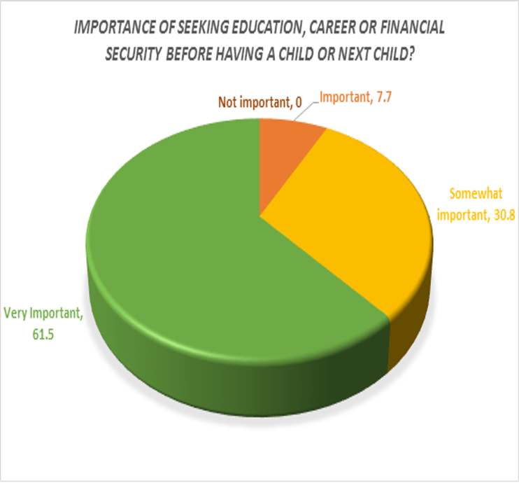
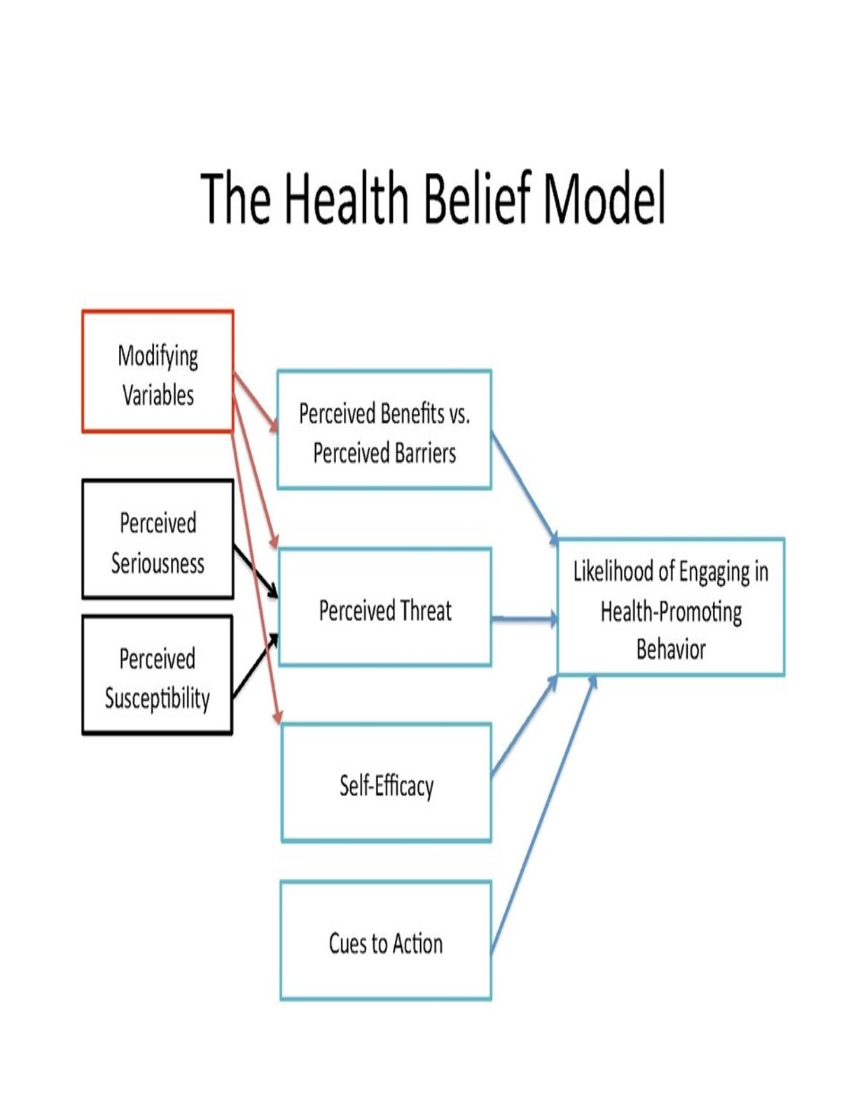
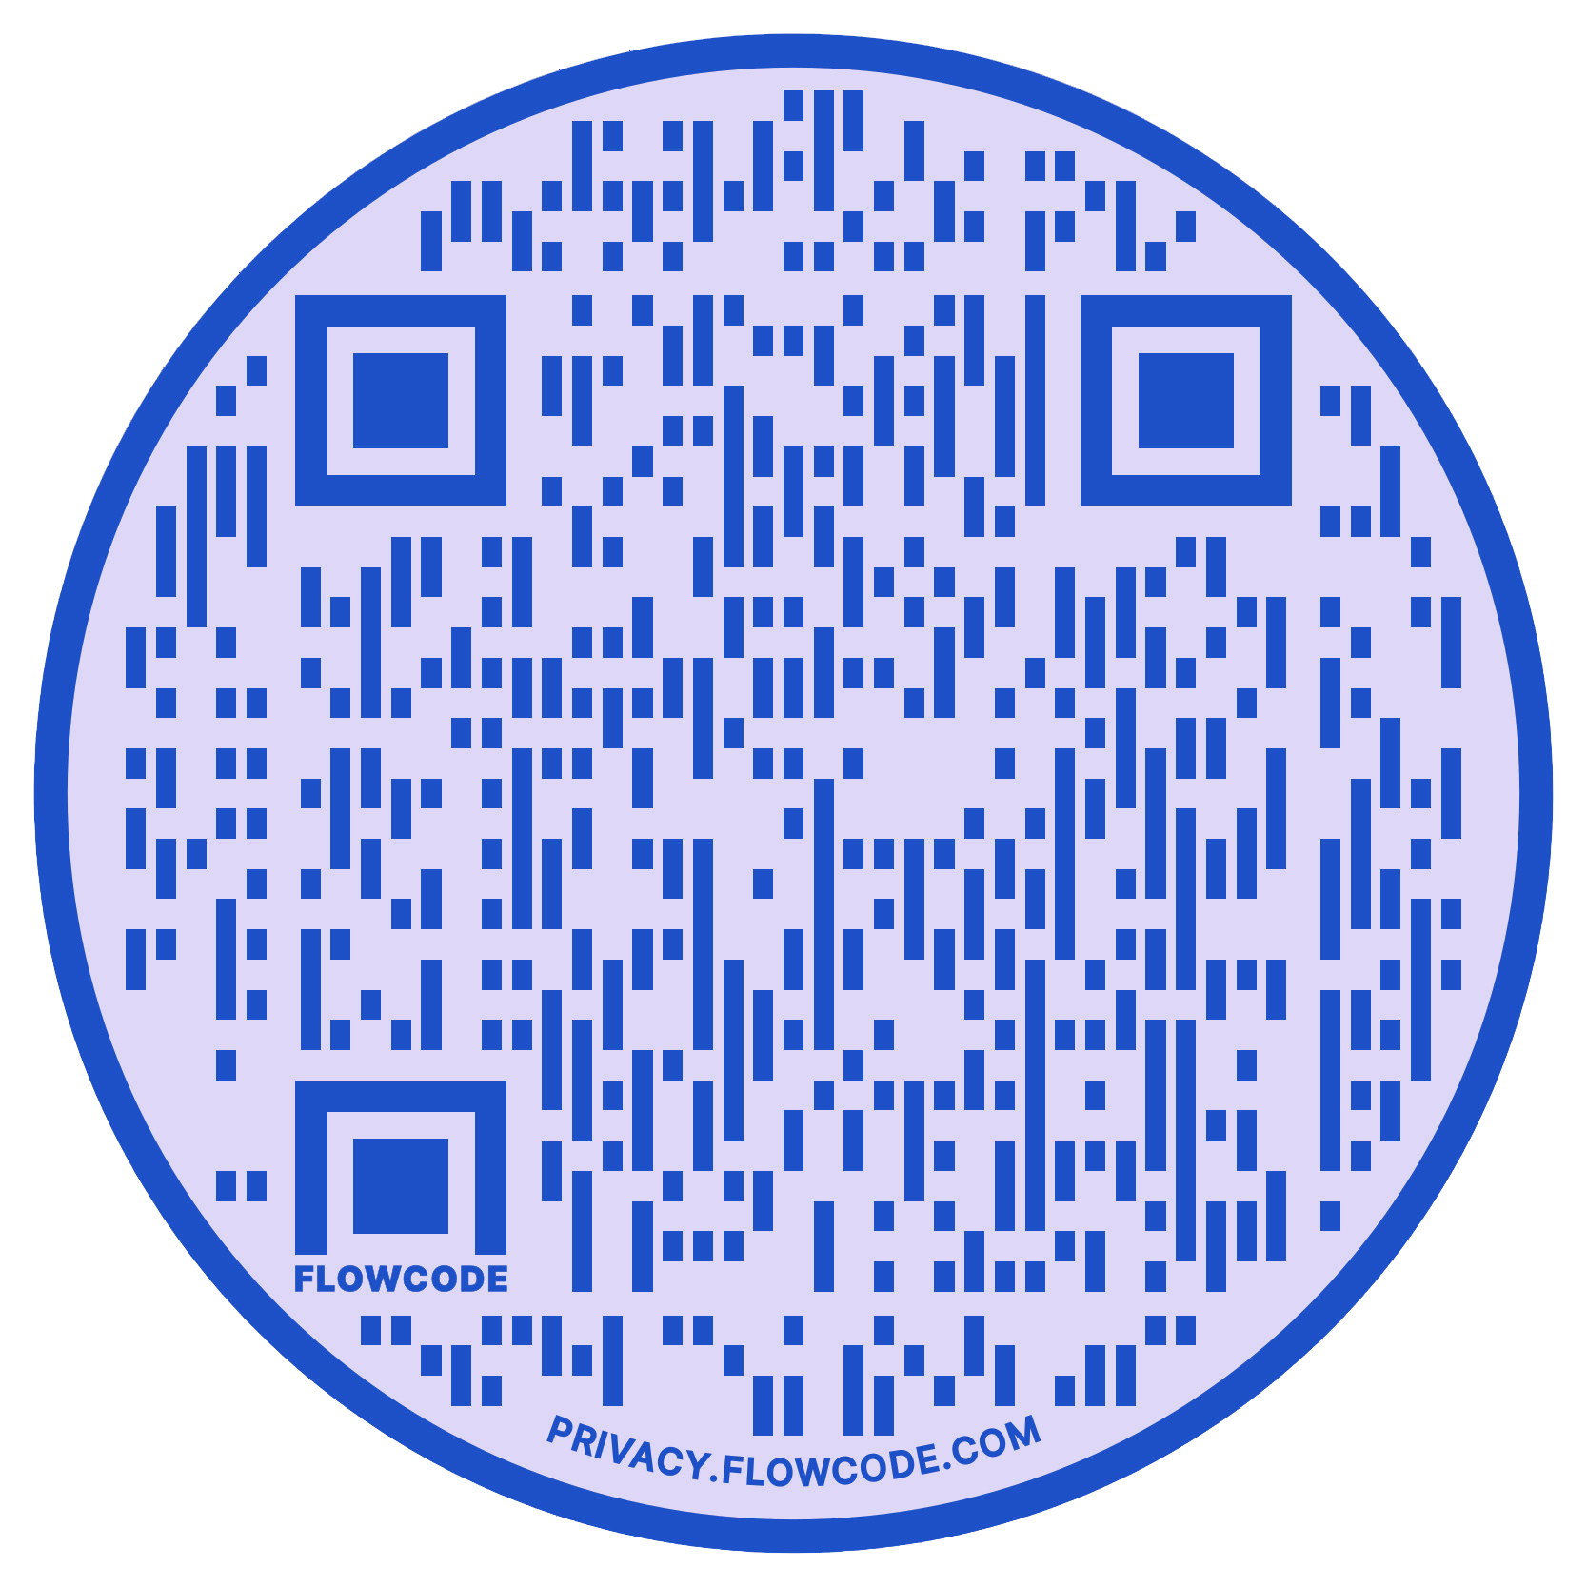
Dreams Matter:
Future Goal Setting and Contraceptive Intent in Adolescent Females
Janet A. Williams, DNP, MSM, CNM
CEO Transitions Women’s Health LLC
Background
The consequences of teen pregnancy, STI’s and risky behaviors have been well documented in the literature^{.1}
A lack of adequate planning can derail even the most mature individual. Adolescent females are at risk when it comes to navigating their most significant life decisions.
Reality TV has glamourized adolescent pregnancy with programs such as “Teen Mom”² “The Secret Life of American Teenage”. ⁸
“Teenagers and smartphones are an unstoppable force.”
Future planning, imagination, exploration, and decision making are necessary for the transition to adulthood.
Two leading health indicators identified in Healthy People 2020 were sexual and reproductive health therefore better access to sexual health services, better education regarding reproductive health, and a reduction of poverty were identified as essential.
There is a need for an integrative approach when educating adolescents about “family planning or life planning”.
Life planning involves thinking about future reproductive, educational, and career goals allow young female adolescents to navigate their paths towards their desired aspirations. ^{2, 3}
Research Question
Does the introduction of a tablet based, contraception education application, when used with a career motivational component over four weeks, influence contraceptive intent in females ages 15-24?
Methods
IRB was approved Einstein College of Medicine
Recruited 51 females ages 15-24 years using a convenience sample via flyers, social media, word of mouth. Criteria: able to read and write English with a minimum sixth-grade education.
Utilized Survey Monkey to distribute and collect their consents.
Each participant was assigned a user code to remain anonymous
Interventions consisted of participants completing the
“Contraceptive Intent Questionnaire” for pre and post testing
distributed utilizing Typeform platform (developed by Dr. Tina
Raine-Bennett) ⁵
“Health-e-you App” an interactive computer application (app) that assesses sexual health risks, knowledge and contraceptive use history, and then provides education contraception
education tool from patients and providers (developed by Dr. Kathleen Tebb) ⁷
“Career Girls Website” (developed by Linda Calhoun)
Significance of Problem ⁹
Risks
Biologic Risks
Hypertensive Disorders
Gestational diabetes
Anemia
Delivery Complications
Consequences
Interrupted education
Postponed entry into workforce
Poverty
Increase infant morbidity and mortality
Psychosocial stress
In what way did this study make you aware of career/ educational possibilities?
Importance of planning ahead
Learned about careers I never knew about
Helped me to learn about birth control
Make me think about decisions and where I see myself in the next couple of years
The survey made me aware of how important school is and not to get distracted, reaching my goal will be much easier.
Conclusion:
Question #20 “Do you think you will get pregnant if you use birth control correctly” was statistically significant the mean difference P=0.025 meaning the intervention changed attitudes for the positive
13 participants completed the study.
61.8% (8) report being sexually active, 38.5% (5) report never being active
Of the 8 sexually active, 75% (6) never utilized any contraception
15.4% (2) of the 13 had a child or children
15.4% (2) of the 8 sexually active had used long acting contraception (LARC)
Implications
Computer based interventions represent a promising approach to health education. Allows for privacy, and learner may proceed at their own pace.
Health providers can utilize mobile education prior to or during office visits to begin the conversations about “life planning”.
Limitations
Small sample size according to the G*Power analysis 27 participants was the minimum. Although 512 were recruited, only 13 completed the study.
Minors were utilized
Use of website needing parental consent
Recruitment and retention of active participants, high drop off rate
Next Steps
Expand this type of program, utilizing the electronic platforms
References and Acknowledgement
jw@transitionswomenshealth.net
Attribution-ShareAlike 3.0 Unported (CC BY-SA 3.0)
In what way did this study make you aware of life planning?
That I should be safe and I shouldn’t be with someone who doesn’t think about our future first.
This study reinforced information about birth control and life planning that I was previously aware but not necessarily actively thinking about
This study helped me to see that planning ahead for using birth control doesn’t have to be a difficult task. I also loved the Career Girl website
This study made me think of real-life situations. As in which birth control I will be on after giving birth and how important it is
It reassured my concerns of avoiding pregnancy before I am established professionally

