Slide 1
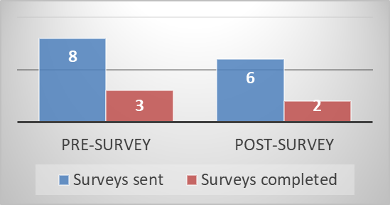
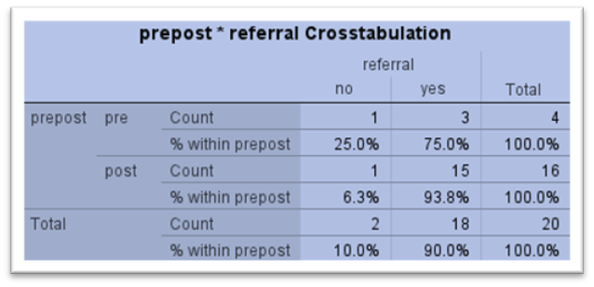
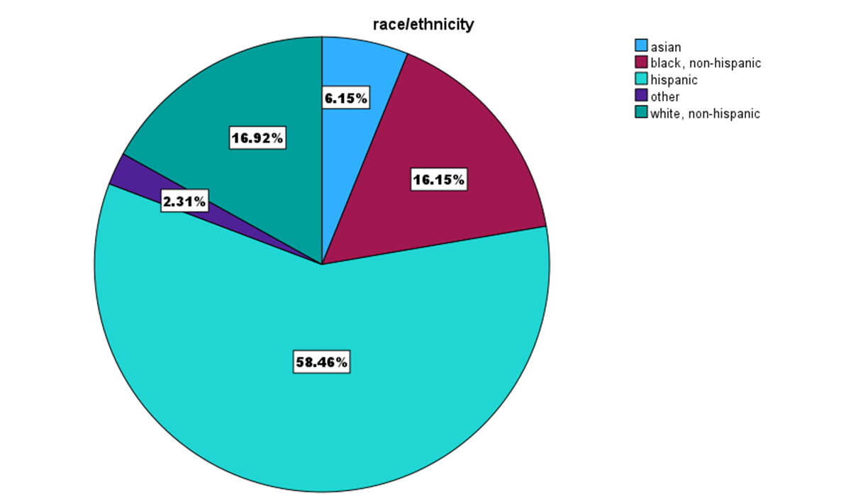
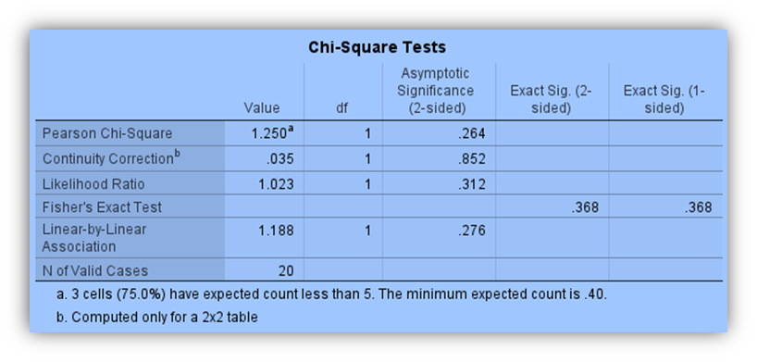
PrEP the way: Standardizing PHQ-9 depression screening in LGBTQ+ patients at sexual health community clinics
Michael Williams, DNP, FNP-BC, Jennifer Jones, DNP, FNP-C
Baylor University – DNPs of Color
1 Louise Herrington School of Nursing Dallas, TX 2 Louise Herrington School of Nursing Dallas, TX
Conclusion
Race/ethic demographics of participants were consistent with population most impacted by new HIV incidence.
Referrals for scores above nine were 5 times greater post- project implementation.
Those who scored higher than a nine increased by 4 fold post- DNP project.
No associated relationship between pre- and post-project implementation.
Background
Depression is a significant and costly health issue in the United States, with healthcare expenses rising from $237 to $326 billion between 2010 and 2018 (Jain et al., 2022)³. Despite this growing financial burden, there is a lack of research on depression's impact on the LGBTQ+ community. LGBTQ+ individuals often face barriers to healthcare, including cultural incompetence, institutional bias, and social stigma- which contribute to depression (Wu & Lee, 2021)⁴.
Depression can be a significant obstacle to medication adherence for HIV-PrEP. Men who have sex with Men (MSM) represent 67% of new HIV diagnoses in 2021, with men, particularly Black/African-American and Hispanic/Latino individuals, experiencing disproportionate rates of 40% and 29%, respectively². PrEP utilization in Texas is below target goals at 28%, emphasizing the need for improved adherence strategies (CDC, 2023)¹. Current literature supports an increased prevalence of depression in LGBTQ+ people, but findings are insufficient in showing a relationship between PrEP adherence and depression, highlighting the issue's complexity.
Purpose
Quality Improvement (QI) project utilizing the PHQ-9 depression screening over three months for LGBTQ+ patients during a PrEP visit at a sexual health clinic to explore if there is an increase in identifying and referring individuals with depressive symptoms who score greater than nine.
Methods
Design: QI model: Plan-Do-Study-Act cycle. Theoretical framework: Lewin’s change theory.
Setting: Sexual health clinic located in two urban cities (Austin and Dallas, TX).
Sample: LGBTQ+ patients who are over the age of 17 and actively engaged in PrEP therapy.
Intervention:
Identified the number of LGBTQ+ patients on PrEP with a PHQ-9 screening in the EMR prior to DNP implementation.
Identified the number of PHQ-9 screenings with a score greater than nine during the 3- month DNP implementation.
(continued)
3. Number of referrals placed to behavioral health based on positive screenings greater than nine in pre- and post-DNP implementation.
4. Evaluation of pre and post staff knowledge on depression and QI project.
Procedures: Screenings performed by front desk, MA, and NP during visit for PrEP care. PHQ-9 screenings completely electronically and on paper.
Tools/Instruments: PHQ-9 questionnaire, chart review of EMR, survey.
Expected Outcomes:
1. Approximately 50% of LGBTQ+ patients screened would have a positive score of greater than nine.
2. At least 80% of patients with positive screenings would have a referral to behavioral health documented in the EMR.
3. Increase knowledge of PHQ-9 screening and QI project.
Analytic methods used to analyze data for findings:
simple percentage for staff survey, number of screenings, and referrals.
Chi-square test for pre and post- implementation comparison of those who score higher than nine and referred to mental health.
Implications
Socio-political events such as Texas laws SB12 and HB900 were passed in 2023, further contributing to depression in LGBTQ+ patients.
DNPs should consider depression screenings in non-traditional settings.
Further research regarding issues surrounding people of color who identify as part of LGBTQ+ community is needed.
Limitations
Time constraints to complete DNP project.
Low staff engagement.
Sampling bias- small sample
Low generalizability to women – cis-gendered Black women are having increased rates in new HIV cases.
Overestimation of those who would score higher than nine.
Next Steps
PHQ-2 and PHQ-9 screening now part of standard of practice.
References or Qr Code
Will attach QR code, reference page attached to email
Acknowledgements OR Qr Code
DNP project team: Eric Taylor and Alexsa Nunez
Center for Health Empowerment: DNP project site
My mother and father: Maralubeth and Roy Williams.
Contact: mwill0614@gmail.com
Figure 2. Pre and post staff educational survey engagement
Table 1. Pre- and post- project behavioral health referrals.
Results
1. When comparing 3-months prior and during project implementation, depression screenings completed increased 3-fold.
2. Only 12% of participants screened for depression scored over nine.
3. . 98.3% of participants who scored above nine were referred to behavioral health.
4. Staff survey response decreased from 37.5% to 33.3%.
Table 2. Chi-square test comparing pre and post referrals.
Figure 1. Racial/ethnic demographic of participants.
p= 0.264. Statistically insignificant.

