Slide 1
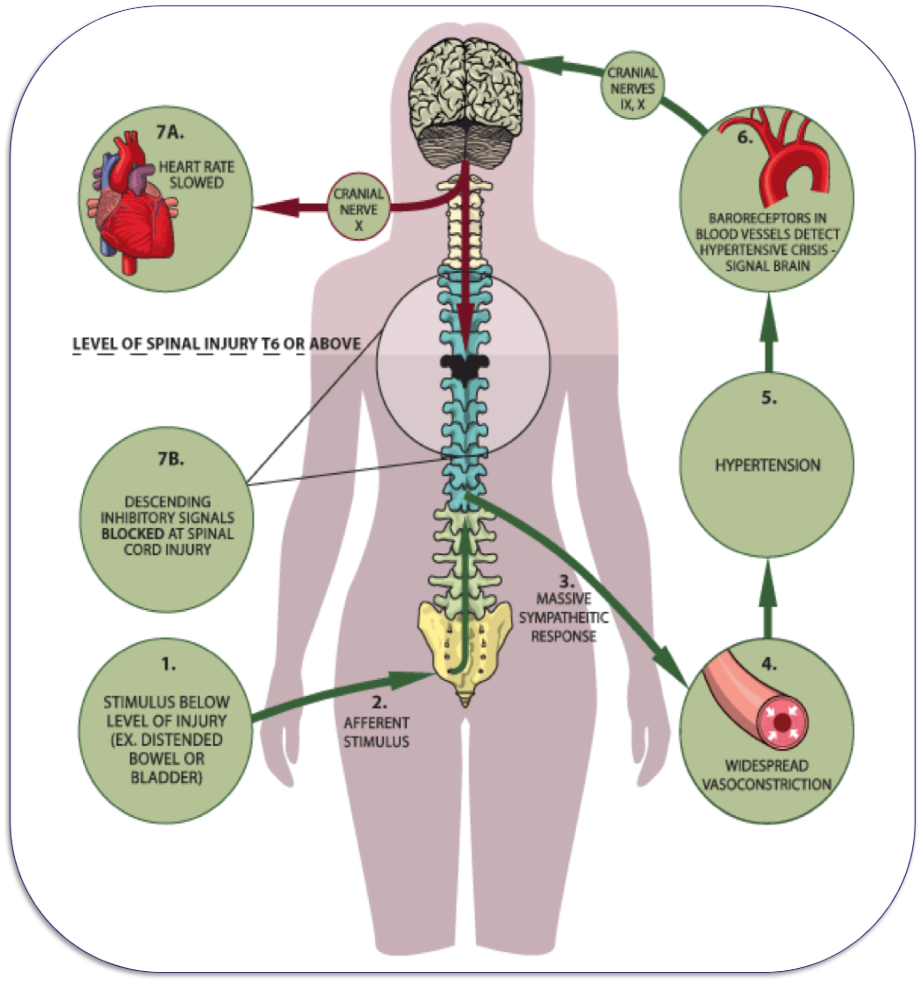
Blazing a Trail for the Improvement of Clinical Knowledge for Spinal Cord Injured Veterans
in a Primary Care Setting
Whitney Thornton, DNP-C, MSN, APRN, AGNP-C, BSN-RN, BSPH
Duke University School of Nursing– DNPs of Color
^{Durham, North Carolina}
Abstract
Scan QR code for information from the National Spinal Cord Injury Statistical Center.
1. Allen, K. J., & Leslie, S. W. (2022). Autonomic Dysreflexia. In www.ncbi.nlm.nih.gov. StatPearls Publishing. https://www.ncbi.nlm.nih.gov/books/NBK482434/?report=reader
2. Chaghari, M., Saffari, M., Ebadi, A., & Ameryoun, A. (2017). Empowering Education: A New Model for In-service Training of Nursing Staff. Journal of Advances in Medical Education & Professionalism, 5(1), 26–32. https://www.ncbi.nlm.nih.gov/pmc/articles/PMC5238493
3. Fyffe, D. C., Williams, J., Tobin, P., & Gibson-Gill, C. (2019). Spinal Cord Injury Veterans’ Disability Benefits, Outcomes, and Health Care Utilization Patterns: Protocol for a Qualitative Study. JMIR Research Protocols, 8(10), e14039. https://doi.org/10.2196/14039
4. Miami Project. (2021). Retrieved July 12, 2022, from https://www.themiamiproject.org/wp-content/uploads/TP_2021_ver_04_Interactive.pdf
5. Milligan, J., Burns, S., Groah, S., & Howcroft, J. (2020). A Primary Care Provider’s Guide to Preventive Health After Spinal Cord Injury. Topics in Spinal Cord Injury Rehabilitation, 26(3), 209–219. https://doi.org/10.46292/sci2603-209
6. Wang, S., Wecht, J. M., Legg Ditterline, B., Ugiliweneza, B., Maher, M. T., Lombard, A. T., Aslan, S. C., Ovechkin, A. V., Bethke, B., Gunter, J. T. H., & Harkema, S. J. (2020). Heart rate and blood pressure response improve the prediction of orthostatic cardiovascular dysregulation in persons with chronic spinal cord injury. Physiological Reports, 8(20). https://doi.org/10.14814/phy2.14617
7. Zone, T. S. C. I. (2016, April 5). Autonomic Dysreflexia is a life threatening condition | Featured, Information. Spinal Cord Injury Zone! https://spinalcordinjuryzone.com/info/16432/autonomic-dysreflexia-life-threatening-condition
The aim of this study is to highlight the importance of educating primary care nurses and other members of the healthcare team on identifying/correcting autonomic dysreflexia in spinal cord injured (SCI) veterans in a primary care setting. Based on a study conducted by the Miami project there are approximately 294,000 United States citizens living with a SCI. Of those, 42,000 are United States veterans.
Spinal cord injury occurs as a result of damage to any part of the spinal cord. In the veteran population, most spinal cord injuries occur as a result from war casualties making them susceptible to autonomic dysreflexia (AD). AD is a potentially life-threatening condition that can occur in patients’ living with a spinal cord injury. Due to the dysregulation of the autonomic nervous system, an increase of at least 20mmHg in systolic blood pressure can occur in patients with a spinal cord injury at or above the level of thoracic six. Most of these patients will be seen in a primary care setting in their lifetime. Unfortunately, most primary care providers lack the confidence and knowledge in recognizing the signs and symptoms of the life-threatening condition, AD in SCI patients.
The empowering education model is an innovative model designed for in-service training of staff to help them hone new professional skills and acquire knowledge by focusing on both self-direction and practicality. Equipping, primary care staff with the knowledge and training of this population could benefit SCI injury patients’ overall quality of life and have lifesaving ramifications.
1. To equip primary care providers with the knowledge and clinical assessment tools to provide evidence-based care to spinal cord injured veterans.
2. Be able to identify/correct the signs and symptoms of autonomic dysreflexia in spinal cord injured veterans using evidence based guidelines.
Continuing education is the driving force and backbone of the medical profession. An in-service training for primary care providers would be key in preparing them to provide care for the spinal cord injured population.
The empowering education model is designed for in-service training of staff to help them hone new professional skills and acquire knowledge by focusing on both self-direction and practicality ².This allows participants to take control of their training while being in a practical setting, primary care ².
The expectation is that staff will view the training as an opportunity for growth and development rather than a mandatory task.
Implementation of CEU credits along with the option of attending the National SCI Conference can be invaluable and provide a professional incentive.
Goal:
Allay patient fears of not being able to access quality care in a primary care setting due to their physical disability
Improve primary care provider confidence in taking care of SCI patients
Prevent unnecessary hospital admissions/readmissions
AD at a Glance
References
Objectives
(Zone, 2016)
References
Solution
Most primary care providers lack confidence and knowledge in recognizing the signs and symptoms of the life-threatening of autonomic dysreflexia in spinal cord injury patients ².

