Slide 1
This is Chess, not Checkers: Changing the Game of Diversity, Equity, and Inclusion (DEI) in Academia and Nursing Practice
Yvette Conyers, DNP, RN, FNP-C, CTN-B, CFCN, CFCS, CNE
University of Maryland School of Nursing
Sheniece L. Martin-Stancil-El, DNP, RN, CNL
University of Rochester Medical Center
DNP’s of Color Conference 2023
Washington, D.C

Slide 2
Learning Objectives
Summarize the impact of a DEI practitioner on health care outcomes
Recognize the intersectionality of DEI in practice and academic settings
Identify best practice strategies of DEI implementation.

Slide 3
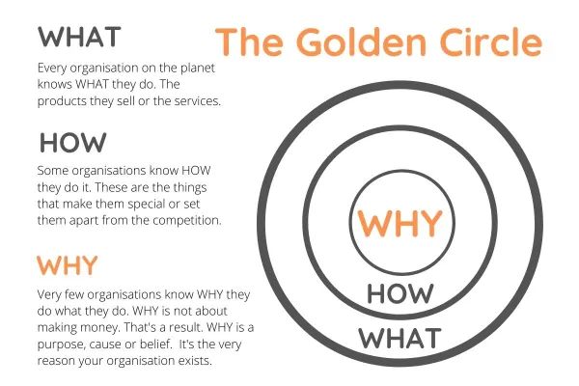
The Golden Circle
Notes:
Briefly introduce the topic and its relevance. Like chess having a deep understanding of the game and outplaying your opponent, requires deep plans and ideas. As in DEI, a strategic plan must be developed and an understanding of how to best utilize your resources
In both chess and DEI, achieving success requires a profound understanding of the game or context. Just as chess players need to outplay their opponents with strategic moves, organizations must develop strategic plans to excel in DEI.
Introduce the concept of the Golden Circle, a powerful framework developed by Simon Sinek.
Explain that the Golden Circle consists of three layers: "What," "How," and "Why."
Discuss how the Golden Circle applies to chess:
"What" (Outer Circle): In chess, this represents the basic rules and pieces on the board.
"How" (Middle Circle): This corresponds to the strategies and tactics used to execute moves effectively.
"Why" (Inner Circle): In chess, the "Why" is the ultimate goal – winning the game.
Transition to the application of the Golden Circle in DEI:
"What" (Outer Circle): In DEI, the what includes policies, practices, and diversity-related initiatives within an organization.
"How" (Middle Circle): This relates to the strategies and actions taken to implement DEI effectively, such as professional development, education, communication.
"Why" (Inner Circle): In DEI, the "Why" is the fundamental commitment to creating a equitable, and inclusive workplace where all belonging
In chess, a player's motivation to win drives their strategic decisions.
In DEI, a clear understanding of the "Why" behind diversity and inclusion efforts motivates organizations and individuals to create lasting change.

Slide 4
“ Of all the forms of inequality, injustice in health is the most shocking and inhumane.”
-Dr. Martin Luther King Jr.

Slide 5
The What?
RN Workforce demographics
U.S Population
2021 National Commission to Address Racism in Nursing
2021 AACN Essentials
Notes:
Content:Present the Racism in Nursing timeline for historical insights.
Explain how historical context reinforces the need for aligned strategic goals.
RN population is comprised of 80.6% White/Caucasian; 6.7% African American; 7.2% Asian; 0.5% American Indian/Alaskan Native; 0.4 Native Hawaiian/Pacific Islander; 2.1% two or more races, 6% of the RN workforce report their ethnicity as Hispanic.
According to a Brookings Institution analysis of 2020 U.S. Census Bureau data, More than 40% of the U.S. population now identify as people of color, with projections pointing to minority populations becoming the majority by 2045. professional nurses must demonstrate a sensitivity to and understanding of a variety of cultures to provide high quality care across settings. According to the National Center for Health Statistics, a lack of diversity in the healthcare workforce is one factor that has contributed to poorer health and higher mortality rates among URM groups.
National commission…a coalition of nursing organizations focused on understanding the impact of systemic racism on nurses of color. Led by the American Nurses Association, National Black Nurses Association, National Coalition of Ethnic Minority Nurse Associations, and National Association of Hispanic Nurses. was formed to look at developing an action-oriented approach to addressing racism in education, practice, policy, and research
AACN Essentials featured concepts associated with professional nursing practice that are integrated within the Essentials. Two related concepts that fit within DEI include structural racism and social justice.

Slide 6
DEI Practitioner's Impact on Healthcare Outcomes
Health equity
Advocacy
Improved Communication and trust
A lack of diversity = poorer health and higher mortality rates
Comfortability
Notes:
1-According to a 2013 report by the National Advisory Council on Nurse Education and Practice (NACNEP), a diverse nursing workforce is essential for progress towards achieving health equity in the United States.
2-nurses who are members of underrepresented minority (URM) groups or disadvantaged populations are more likely to advocate for services and programs in their communities.
3-When nurses are members of the populations they serve, they are better able to improve communication and trust among URM groups. Racial and ethnic nurses are more likely to return to and serve their underrepresented communities, bridge the cultural and linguistic gaps in patient education.
4- Improving nursing diversity strengthens the trust between patients and nurses, which can lead to patients more strongly adhering to nurses’ recommendations.
5-Some patients feel more comfortable when their healthcare providers share their ethnicity, race, and language

Slide 7
Intersectionality of DEI
Academic Nursing Education
Inclusive curriculum
Faculty development
Research and scholarship
Clinical Nursing Practice
Patient-centered care
Inclusive workforce
Health equity
Notes:
Diversity, Equity, and Inclusion (DEI) are pivotal in nursing academia and clinical practice, intersecting in key areas with the need for collaboration.
Patient Experience:
DEI shapes patient experience in academia and practice.
A diverse, inclusive environment builds trust and communication, enhancing patient satisfaction.
DEI education in academia and its application in practice fosters cultural competence and empathy.
Health Workforce Experience:
DEI impacts the healthcare workforce in both settings.
Diverse backgrounds enrich learning in academia and enhance collaboration in practice.
DEI practitioners create inclusive atmospheres in academia and clinical environments.
Population Health:
DEI addresses health disparities across populations, also a AACN 2021 Essential
Academia educates on disparities, while practice applies DEI initiatives to underserved communities.
Collaboration ensures academia's strategies translate into effective interventions.
Patient Outcomes:
DEI influences equitable care and tailored treatment in academia and practice.
Academia's research informs evidence-based practice, while practice uses data to address disparities.
Collaboration applies research insights to enhance patient care.
Data, Research, Quality Improvement:
Both rely on data, research, and quality improvement for DEI.
Academic research informs practice.
Collaboration aligns research findings with practical strategies.
Differences and Similarities:
Academia educates and researches; practice delivers care.
Both aim to improve healthcare equity and patient outcomes.
Importance of Collaboration:
Collaboration bridges academia's knowledge generation with practice's patient-centered care. Insights, research, and best practices from academia inform practical DEI applications, benefiting patients and healthcare professionals.
In summary, DEI's crucial role in nursing academia and practice requires collaboration. This partnership bridges education and practical application, ultimately enhancing patient outcomes, fostering an inclusive health workforce, and improving population health.

Slide 8
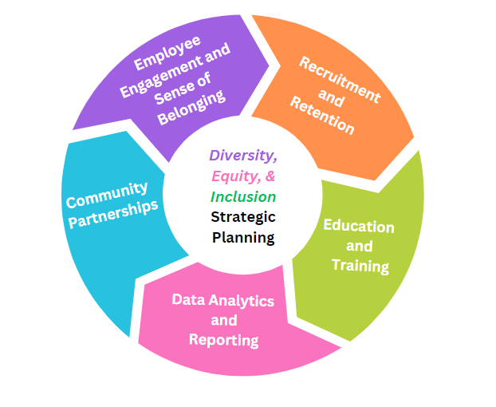
Best Practice Strategies
Notes:
Explain the concept of intersectionality in both practice and academia.
Discuss why considering multiple dimensions of diversity is crucial.
Engagement: fostering a workplace culture where all employees feel valued and included is not just about meeting DEI goals; it's about building a thriving, innovative, and sustainable organization. When individuals from diverse backgrounds are empowered to contribute fully, the entire organization benefits, leading to improved performance, higher retention rates, and a stronger competitive position in the market. Prioritizing employee engagement and a sense of belonging is a win-win for both employees and the organization as a whole.
Recruitment: recruitment is a critical phase of DEI efforts because it shapes the composition of your organization. By implementing diverse and inclusive recruitment practices, such as diverse hiring panels and revised job descriptions, you not only attract a broader range of talent but also create a more equitable and welcoming workplace from the very beginning of the employee journey. These efforts align with the broader goals of fostering diversity, equity, and inclusion in your organization.
Education: Education and training are vital components of DEI strategic planning because they empower employees with the awareness, empathy, and skills needed to contribute to a diverse and inclusive workplace. They are an investment in both personal and organizational growth, fostering an environment where everyone can thrive and contribute their best.
Community Partnerships: Community partnerships are a strategic asset for organizations committed to DEI. They offer fresh perspectives, additional resources, and the opportunity to make a more significant and lasting impact on diversity initiatives. Engaging with external organizations and communities aligns with the principles of inclusivity and collaboration, driving progress and positive change in the broader context of diversity and equity.

Slide 9
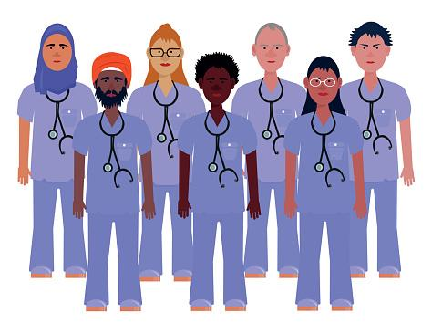
DEI in Academia vs. Nursing Practice
Topic Area | Academia | Nursing Practice
Clinical Education | Health Assessment | Patient Outcomes
Grievances | Judicial Board | Discrimination/Harassment
Affirmative Action | Scotus Decision | Good Faith Efforts
Notes:
Nursing Practice:
Clinical Education:
"In clinical education, we're deeply committed to DEI within nursing. We support, guide, and lead excellence in DEI."
"We act as neutral third parties and advocates, offering support to those facing DEI challenges, promoting service recovery, and preventing further harm."
"Our role includes education development, involving root cause analysis, policy development, and innovative methods like theater to foster empathy."
"We encourage reporting of discrimination, harassment, and racism cases, and we're dedicated to training leaders to promote DEI excellence."
Grievances:
“In addressing DEI-related grievances, we play a pivotal role both internally and externally."
"We facilitate grievance resolution, advocating for those facing discrimination, harassment, or injustices."
"We lead the DEI nursing advisory council, discussing challenges and growth opportunities, specifically looking at how to better care for our marginalized sub-populations"
"Our focus extends to clinical procedural and policy areas that support inclusion and health equity through education and awareness.
Affirmative Action:
"Our commitment to affirmative action promotes diversity and equal opportunities in nursing practice."
"We implement fair hiring practices to level the playing field for individuals from all backgrounds."
"Internally and externally, we promote affirmative action principles to create a diverse nursing workforce. Our goal is to foster an inclusive environment that celebrates contributions from diverse backgrounds, enabling everyone to excel."
"We collaborate with nursing recruitment to ensure fair hiring, contributing to a diverse nursing workforce."
Promotion of Patient Advisory Groups of marginalized populations
In these ways, nursing practice advances DEI through education, support, advocacy, and affirmative action.

Slide 10
Implications for Future Practice and Academia
Role Development and Community Partnerships
“School of Practice “
The Evolving Role of DEI Practitioners
Notes:
Barriers & challenges noted in role activation:
Lack of diversity in nursing and nursing leadership.
Absence of DEI Recruitment and Hiring Training for nursing managers.
Discretionary recruitment, advancement, evaluation policies and procedures.
Staff not having time/location set aside for professional development.
Low retention of Black and Latinx staff.
BIPOC staff have expressed being reluctant in reporting instances of bias, discrimination, and micro/macroaggressions.
Staff burnout and lack of resources.
Siloed DEI efforts.
Lack of inclusion in decision-making
Lack of awareness/ understanding importance of DEI in healthcare
Successes:
implementation of SDOH data collection and reporting
implementation of Nursing Practice advisory council
Revision of welcome guides
Name change of our career advancement name of CAS to Pathway Programs
Pilot of mentoring program for black nurses
senior leadership EDI training
unit based cultural and inclusion champions trainings and council development
unit based awareness of DEI→ increase in visibility via unit DEI boards, an internal website to the nursing office of DEI
inclusion of a DEI representative to sit on all RCA discussions
organizational structure surrounding reporting of grievances to reflect marginalized populations
Launch of nursing practice orientation to include education informing
implementation of skin tone assessments
development of education modules for caring for transgender patients, patients of size, and sickle cell patients
increase in education and awareness of various DEI topics within nursing practice
incorporation of diversity statements on job postings

Slide 11
Thank You
👩‍⚕️Dr. Yvette Conyers, DNP
📧 Yconyers@umaryland.edu
👩‍⚕️Dr. Sheniece L. Martin-Stancil-El, DNP
📧 Sheniece_Martinstancilel@urmc.rochester.edu

Slide 12
References
American Association of Colleges of Nursing. (2021). The essentials: Core competencies for professional nursing education. https://www.aacnnursing.org/Portals/42/AcademicNursing/pdf/Essentials-2021.pdf
American Nurses Association. (2022). Racism in Nursing Report Series. Retrieved from https://www.nursingworld.org/~49c4d0/globalassets/practiceandpolicy/workforce/commission-to-address-racism/racism-in-nursing-report-series.pdf.
National Commission to Address Racism in Nursing (2021). Our racial reckoning statement. https://www.nursingworld.org/practice-policy/workforce/racism-in-nursing/RacialReckoningStatement/
National Academies of Sciences, Engineering, and Medicine (2021). The future of nursing 2020–2030: Charting a path to achieve health equity. Washington, DC: The National Academies Press. https://doi.org/10.17226/25982.

