Slide 1

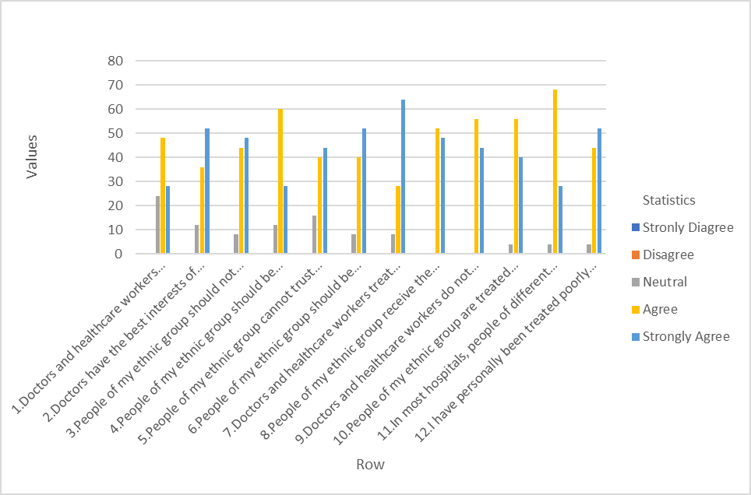
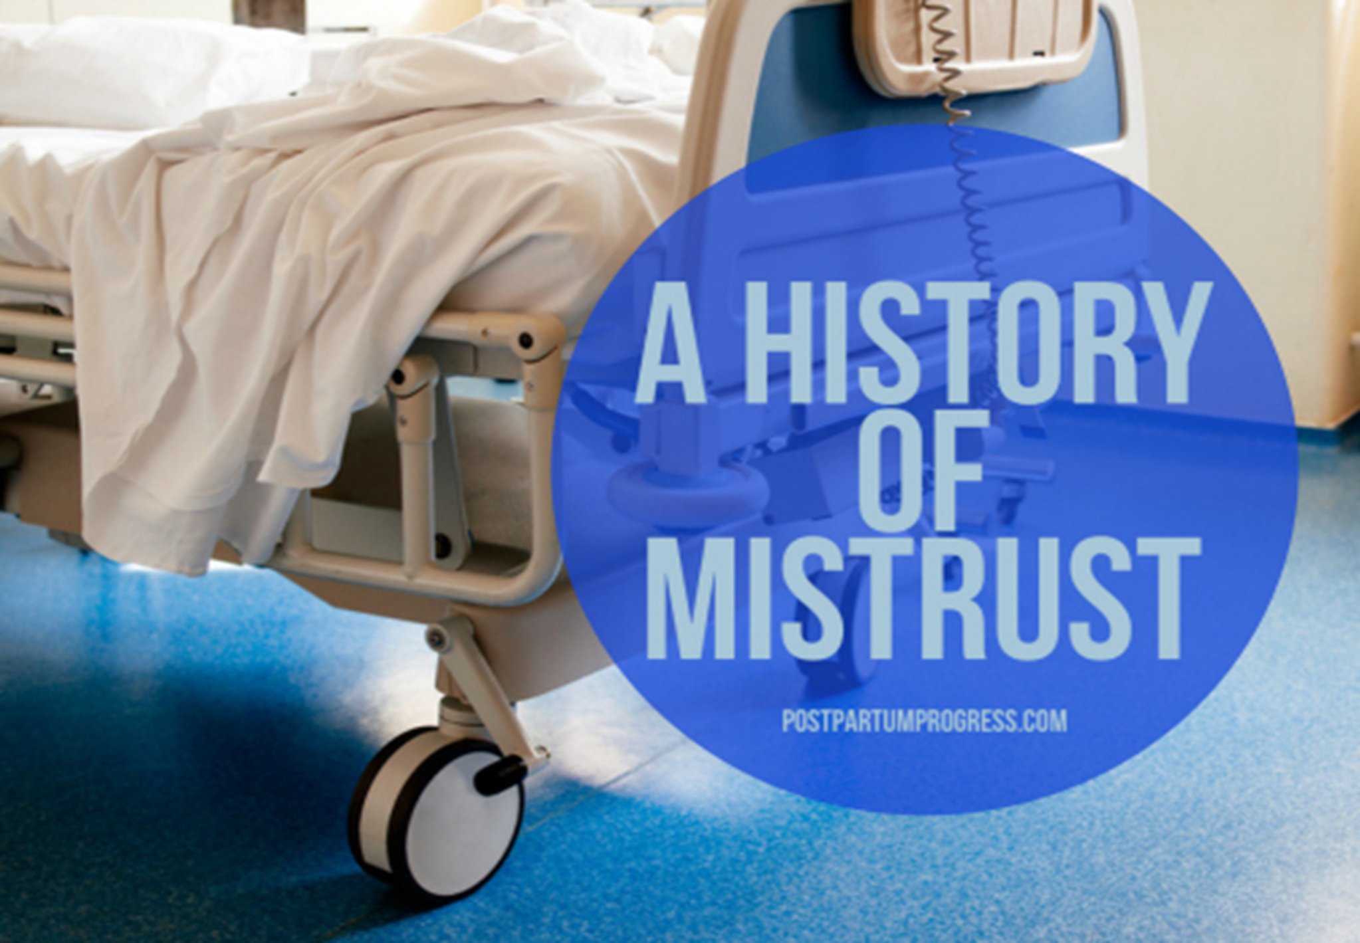


Assessing Medical Mistrust
Dr. Clydie Coward-Murrell MSN, RN
University of North Carolina Wilmington– DNPs of Color
College of Health and Human Services, Wilmington, NC
Background
Trust is one of the most important components of a patient-provider or patient-nurse relationship. Medical mistrust (MM) has led to barriers related to health promotion and prevention, which then equates the need to decrease health disparities among marginalized populations.
Purpose
To increase awareness that medical mistrust is a thriving entity and has proven to have long lasting effects in the African American population.
Research Question
How do African American Adults with mistrust in the health care system perceive health information, compared to current practice influence the receptiveness of health information during the 30-minute patient encounter?
Methods
Design: Descriptive Statistics
Setting: Outpatient Community in Southeastern North Carolina
Sample: African Americans between the ages of 18-64
Intervention: Assessed the clinical issue of MM prior to the patient encounter. Addressed MM during the patent encounter.
Procedures: Assessed Medical Mistrust Pre & Post patient encounter.
Tools/Instruments: Group Based Medical Mistrust Scale, Utilization of the SHARE Approach Tool, and ASK ME 3.
Outcomes: data analysis demonstrated that first the presence of MM is not just a phenomenon, MM is a true clinical issue
The data also provided information that proves that if providers took the time to address this sensitive issue with their patients this could initiate closing the gap of mistrust.
Analytic methods: The utilization of the IBM® SPSS, Frequency and Percentages were used to communicate the findings.
Results
The graph depicts the responses to the GBMMS and proves 2 things,
# 1 each participant has a level of medical Mistrust
# 2 None of the participants Strongly Disagreed nor Disagreed although some participants were neutral on some of the questions.
*** Question 2, Question 6, Question 12 demonstrated a high degree of Medical Mistrust
Implications
An emphasis should be place on an organizations’ initiative to address Medical Mistrust by not only acknowledging this disparity but provide providers and other healthcare workers education on Diversity, Equity, and Inclusion, Implicit Bias, and a historical perspective on how Medical Mistrust remains a problematic clinical issue.
Limitations
Further research is needed
Small sample size
Other marginalized groups were not included
Next Steps
Offer an Intervention for any setting in Hospitals for Transformational Change.
Educate Staff Nurses on how to address their own biases r/t patient care.
Provide tools for faculty to incorporate in the classroom & clinical setting.
QR Code
Acknowledgements
Contact: yourEMAIL@dnpsofcolor.org
Conclusion:
As a result of this project, it can be determined that there remains a high level of Medical Mistrust. Secondly, Inclusive of the provider assessing Medical Mistrust and incorporating an intervention, Medical Mistrust remained present.
Table 1: Relationship of Responses
LIKERT 1. 64 % agreed After completing the Group Based Medical Mistrust Scale in combination with the SHARE Approach, do you feel more comfortable with the Health Information that was provided today?
LIKERT 2. 92 % agreed that they were glad that my provider took the time to address my Medical Mistrust?
LIKERT 3. 84% wish that all of my healthcare providers would take the time to assess my Medical Mistrust.

