Slide 1
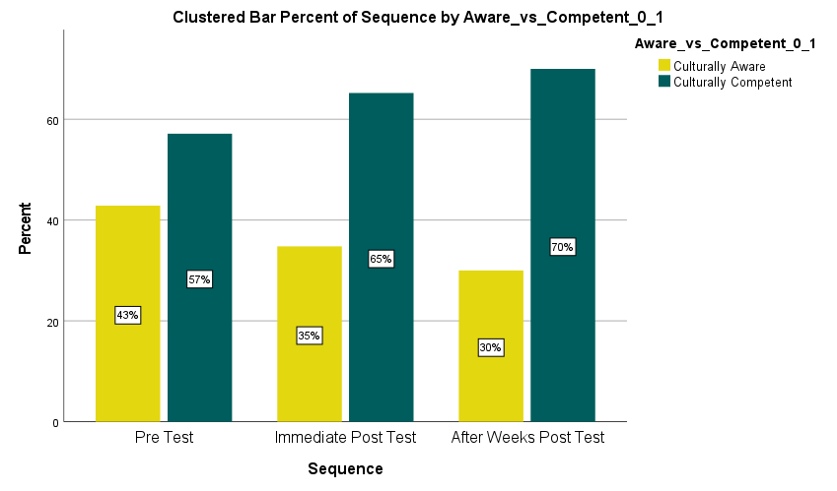
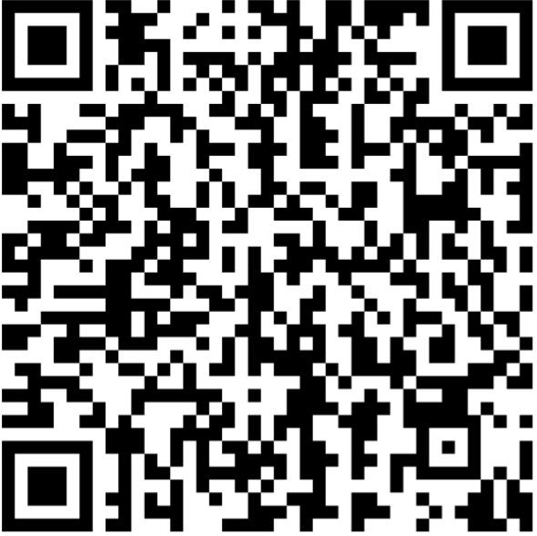
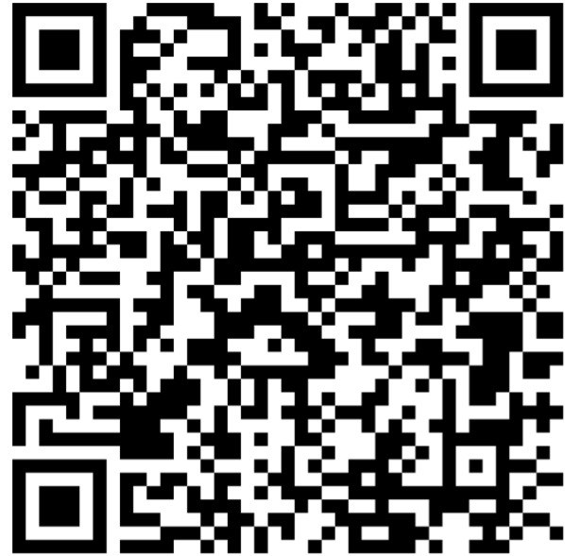
Cultural Competence and Humility Training for Emergency Room Nurses
Charlene C. Hollins, DNP, APRN, FNP-C
Young School of Nursing, Regis College – DNPs of Color
Mass General Brigham, Brigham and Women’s Hospital, Emergency Department, Boston, MA
Background
Encouraging and acknowledging the acceptance of cultural differences is a transparent process of behavioral change.
COVID-19 uncovered existing disparities embedded within our society
Bias and discrimination continue to occur at an interpersonal and institutional level in healthcare (Implicit vs. Explicit)
Groups of people who have consistently faced more significant barriers to health because of their race, ethnicity, or other characteristics that have historically been associated with discrimination and exclusion are negatively impacted by health disparities ²³
Ensuring emergency health care providers possess the skills they need to identify and manage racial and ethical differences in health, beliefs, and behaviors
Research Question
Does cultural competence and humility training change the knowledge and skills of emergency room nurses related to the care of patients from culturally diverse and ethnic backgrounds?
Methods
Project Design: A quantitative, quasi-experimental, longitudinal, pre/post-test with a repeated measure
Sample: A convenience sample of registered nurses in the ED was performed. G*Power recruitment goal of 53. 48 ED RNs voluntarily participated. Participation bias throughout the three sequences. N= (48, 28, 11)
Educational Intervention: ”Ending Racism is Everyone’s Responsibility” 1-hour HealthStream Video Simulation
Measurements: 24-item four-point Likert scale survey- Dr. Campinha-Bacote Inventory for Assessing the Process of Cultural Competemility Among Healthcare Professionals-Revised (IAPCC-HCP) & 7-item demographic survey ⁸
Data Collection: Demographic survey & IAPCC-HCP completed day 1 (pre and post) training and IAPCC-HCP repeated measure 4-6 weeks later ⁸
Data Analysis: Conducted with SPSS. A longitudinal clustered generalized estimating equation (GEE) to control for false inflation of statistical significance was used. Descriptive analysis was used for demographics
Conclusion
Although there was no statistical significance (p=.514), the data revealed a behavioral trend. Participants went from culturally aware to culturally competent throughout the study process. Indicating that culture is a process. There is a need for continuity within nursing competency and practice
Results
“Cultural competence scores were compared across three sequences”
Table 1. Level of Cultural Competence by Sequence
Awareness_vs_Competent Sequence Crosstabulation
 |  |  | Sequence
 |  |  | 1 | 2 | 3
Awareness_vs_Competent | Culturally Aware | Count | 18 | 8 | 3
 |  | % Within Sequence | 42.9% | 34.8% | 30.0%
 | Culturally Competent | Count | 24 | 15 | 7
 |  | % Within Sequence | 57.1% | 65.2% | 70.0%
Total |  | Count | 42 | 23 | 10
 |  | % Within Sequence | 100.0% | 100.0% | 100.0%
Implications
Diversity remains one of nursing's biggest challenges
We must require nurses to acknowledge that individuals belong to different cultures and races better equips them to serve diverse populations
Nurses must acquire a continuous body of cultural knowledge and cross-cultural skills
This clinical significance suggests that modifications to clinical practices ensure a measurable effect of change
Limitations
Novice Researcher
Self reported survey, concerns of accuracy and validity issues
Setting limited to the ED, limiting the generalizability of the nursing population
Convenience sampling leading to under or over representation of participants in the group
Next Steps
Ensure faculty and workforce diversity
Building sustainable policies
Apply business principles that strategically support diversity
Evaluate curricular models of diversity for a global society
Contact: cchollins@gmail.com
Table 2. Level of Cultural Competence by Sequence
References
Acknowledgments
Note: Perceived levels of cultural competence were measured using the IAPCC-HCP survey. The highest range score is 92-96 (represents cultural proficiency), and the lowest range score is 24-47 (represents cultural incompetence)

