Slide 1
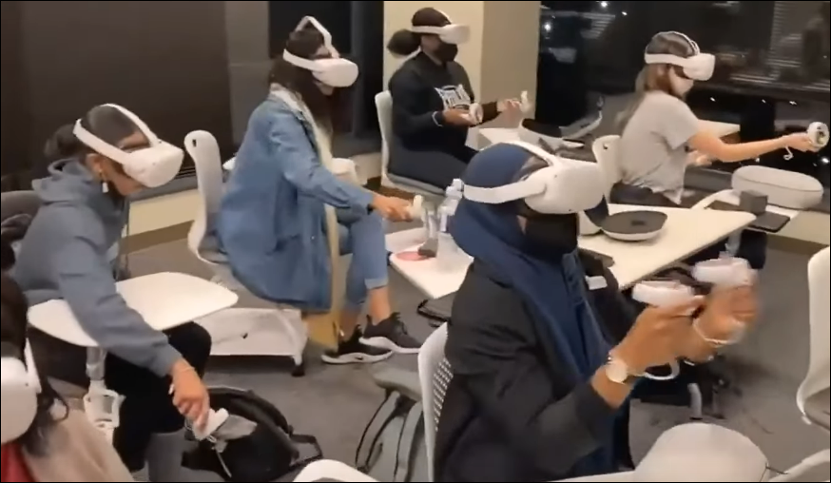
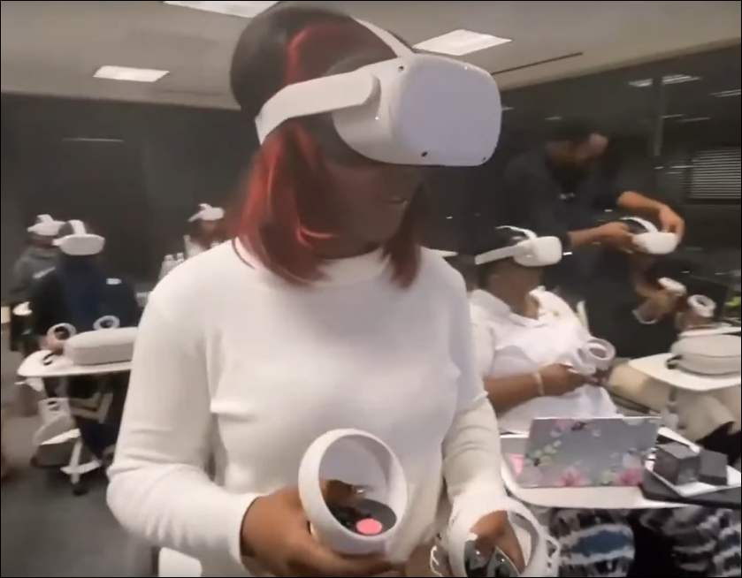
Immersive technologies to facilitate academic success
Elmira Asongwed, RN, MS, DNP¹
¹University of the District of Columbia – BS Nursing, Washington, DC
Background
Significance
An innovative teaching approach to address the challenges of using immersive technologies was piloted.
Brown et al. (2023) describes curriculum integration that is developed with the expertise of nurse educators and educational technologists.¹
Software can be designed for augmented, virtual, mixed, and extended reality on various devices.
Incidence
Technology explosion and generative Artificial Intelligence (AI) are discussed by Choi et al. (2022) as transformative to nursing.²
Duke Learning Innovation (2023) details ChatGPT, Bard, and Workspace functions for positive versus challenging issues for nurse educators.³
Purpose
Complete a pilot study to propose immersive experiences to support student achievement.
Collaborate with instructional designers to develop scenarios and applications based on learner-centered pedagogy.
Methods
Intervention Experiences for Faculty
-Nursing faculty (sample size six) completed workshops and courses workshops related to the Blackboard Learning Management System, digital teaching, online teaching, and immersive technology offered by the University’s Center for the Advancement of Learning (CAL).
-Faculty received CAL funding to complete the Quality Matters (QM) Higher Education (HE) Rubric (2023) and the Applying the QM Rubric Workshop in preparation for redesigned nursing course to receive QM approval.
Hardware and Software Tools
-Faculty used all hardware and software with specific tutorials and demonstrations provided by the Center for Digital Access and Learning (a component of CAL).
-Faculty completed focus groups and surveys to rate learning sessions, hardware, software, and course..
Results
All faculty completed the online learning and Blackboard courses and workshop.
Three faculty (50%) completed both Quality Matters workshops (online two-week sessions).
All course and workshop evaluations rated the CAL learning experiences as excellent.
The Quality Matters workshops were discussed as very time and labor intensive with recommendations to schedule the courses during the summer.
The survey data ranked the hardware with the Oculus Quest scoring higher than the HTC Vive.
The analyses of the focus groups are incomplete, and the themes will be analyzed during fall 2023.
The survey identified two junior level courses preferred to begin integrating immersive technology as pathophysiology and health assessment.
Limitations
The focus group analysis is incomplete and will be analyzed in fall 2023 to support pedagogy decisions.
The small pilot study did not allow generalizability or external validity.
Hardware and software were provided by CAL.
Next Steps
Develop scenario and course integration details based on findings from focus group analyses.
Create tutorial Blackboard modules to orient learners to devices and software.
Submit immersive technology courses to Quality Matters for review and approval.
References
Brown, K. M., Swoboda, S. M., Gilbert, G. E., Horvath, C., & Sullivan, N. (2023). Curricular integration of virtual reality in nursing education. Journal of Nursing Education, 62(6), 364-373.
Choi, J., Thompson, C. E., Choi, J., Waddill, C. B., & Choi, S. (2022). Effectiveness of immersive virtual reality in nursing education: Systematic review. Nurse Educator, 47(3), E57-E61.
Duke Learning Innovation. (2023) AI and teaching at Duke. https://learninginnovation.duke.edu/ai-and-teaching-at-duke-2/#impact
Acknowledgements
The author acknowledges the following:
Dr. Keisha Rollins-Monroe for completing Blackboard and Quality Matters courses, workshops, focus groups and collaborating with instructional designers for pathophysiology and health assessment.
Dr. Sharon F. Beasley, Director of Nursing Education for supporting CAL funding of Quality Matters courses, completing Blackboard courses, and collaborating with instructional designers.
Instructional designer Julian King for supportive and collaborative roles with Blackboard and Quality Matters.
CAL administrator Fatma Elshoboksky for funding Quality Matters courses and supporting the BSN proposal to integrate immersive technology into nursing courses.
Funding resources from the District of Columbia Workforce Investment Council for equipment purchases and student scholarships.
Contact: easongwed@udc.edu
Table 1. Journey to Immersive Technology Integration
Faculty Learning Pathway (2022-2023)
Center for the Advancement of Learning
 | Blackboard Ultra Base Navigation Course
 | Digital Teaching Certification Course
 | Online Learning Certification Course
 | Immersive Technology Workshop
 | Augmented Reality (AR)
 | Virtual Reality (VR)
 | Mixed or Merged Reality (MR)
 | Extended Reality (XR)
 | Quality Matters (QM) Higher Education (HE) Rubric
 | Applying the QM (Seventh Edition, 2023) HE Rubric
Hardware Training
 | Oculus Quest Headsets
 | HTC Vive Focus 3
 | iPads
 | Software Training
 | MergeCube
 | FarSight XR
 | Hypotheses
 | EON XR (3D and 360)
 | ThingLinks's 360 Degree VR Image Editor
Figure 1. Title. Immersive Technology with Oculus headsets and controllers.
Conclusions:
Preliminary findings indicated the highest preference for digital hardware was the Oculus Quest.
Course integration is planned to begin in Fall 2023 with the initial courses of pathophysiology and health assessment.
Implications
One hardware choice provides a consistent resource to utilize with various software and applications for better evaluation of outcomes.
Collaboration between nursing and instructional designers provides insight to develop interventions and resources to support student achievement.
Innovative strategies can be generated from diverse and creative ideas.

