Slide 1
Creating Allies Through Microlearning Podcasts
Becky Carson, DNP, APRN, CPNP-PC/AC
Catholic University of America, Washington D.C.

Slide 2
Speaker Disclosures
This project was funded by the North Carolina Chapter of the National Association of Pediatric Nurse Practitioners’ Dr. Rasheeda Monroe Health Equity Grant.

Slide 3
Learning Objectives
Explain the dissemination of microlearning through podcasting
Summarize provider-level health equity best practices
Appraise a health equity in pediatrics podcast series on its reach and ability to impart practice change

Slide 4
Background
2022 PNP/CPN Demographic Profile:
U.S. Children:
Majority are children of color
51% male
1 in 4 LGBTQ youth identify as non-binary
(PNCB, 2022; Smiley et al., 2020)
Notes:
Gender identity: 95% female, 3% male, 2% nonbinary/other/prefer not to answer
For RNs, women make up 90% of the RN workforce (Smiley et al., 2020).
Ethnicity/race: 79% white, 21% identify as a racial or ethnic minority. Of those, the most common groups were African American (2.5%), Hispanic or Latino (5.4%), and Asian (4.5%).
***
PNPs are White cis-gender females who are most likely caring for children who differ from them in some way.
- In 2020, children of color became the majority of children in the U.S.
51% of U.S. youth are male
1 in 4 LGBTQ youth in a 2020 survey identified as non-binary

Slide 5
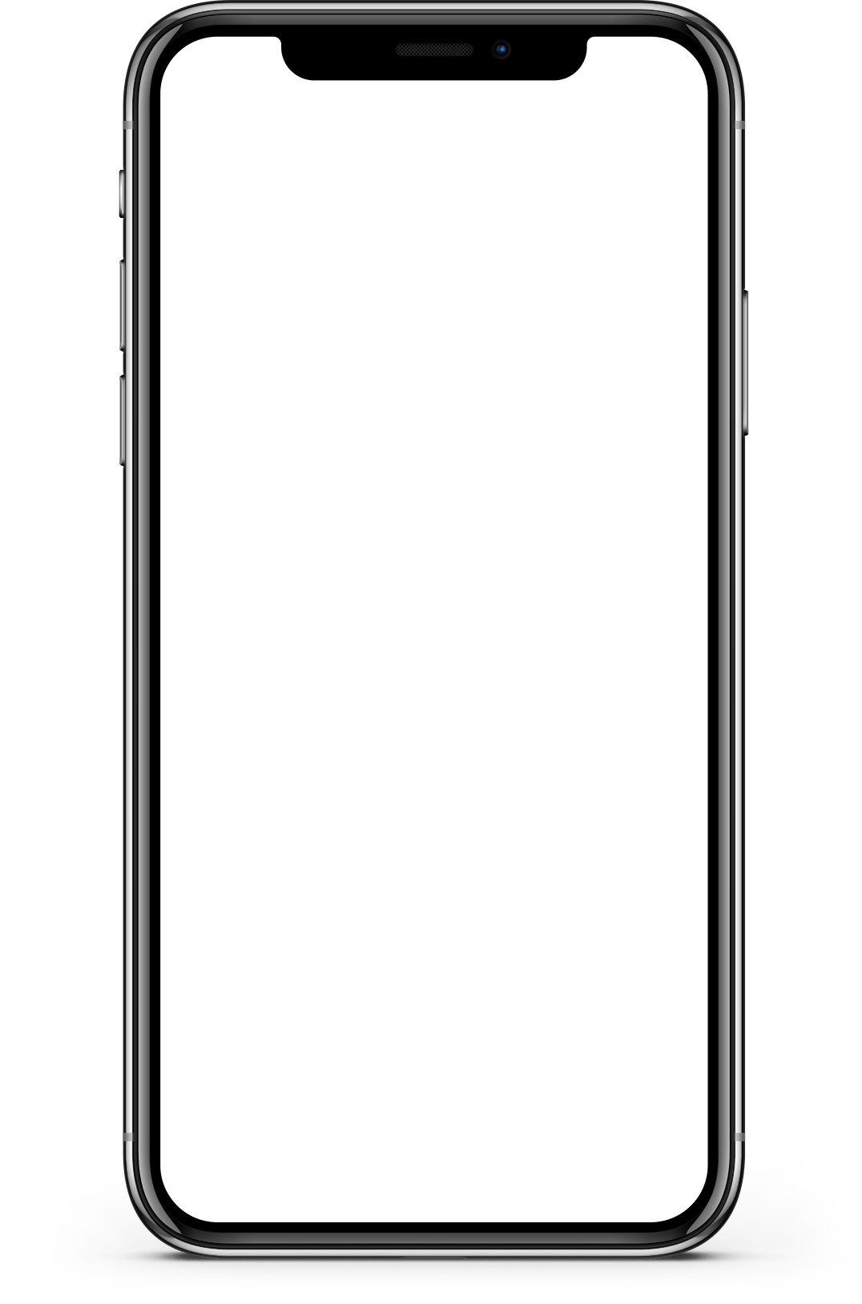
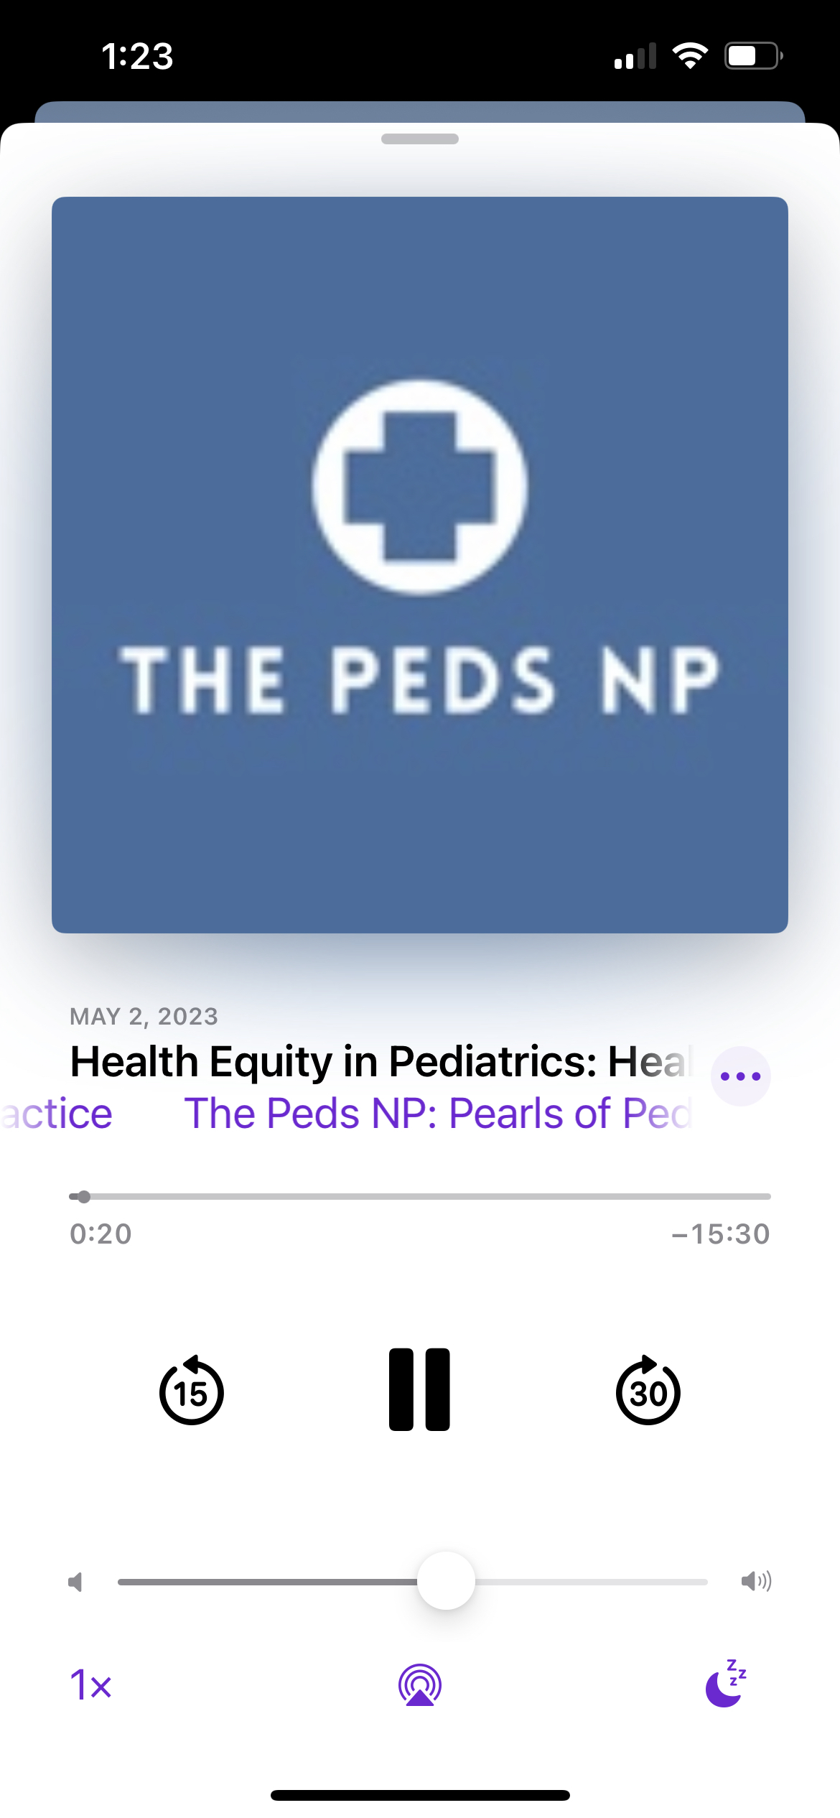
Background: Microlearning Podcasts
The Peds NP*: Pearls of Pediatric Evidence-Based Practice
Focus: Clinical reasoning and application of evidence-based practice
Audience: Peds APRN students (PNP, FNP), novice providers, educators, continuing education
Est. Sept 2020: 68 episodes, ~40,000 downloads
*Available on wherever you get your podcasts
Notes:
Podcasts are well-studied in nursing and medical education literature. They support learning asynchronously, free from the constraints of time and geography.
Microlearning is a style that features a single, focused objective delivered through succinct didactic content, such as a short podcast episode, blogpost, or even social media post.
Health professionals like podcasts because:
They can multi-task (driving, exercise)
they allow post-publication commentary and review of current literature more easily than traditional methods of lectures or reading journal articles
they are entertaining.
But a paucity of literature exists surrounding the use of podcasts to deliver health equity education to providers.

Slide 6
Problem
Children from minority groups face health disparities
Related to race/ethnicity, gender, sexual identity, weight, mental health problems (Cheng et al., 2015)
Adult chronic disease is more likely to develop (Petruccelli, Davis, & Berman, 2019)
PNPs are likely to differ from their patients
Healthcare providers have the same prevalence of implicit bias as the remainder of the population (Fitzgeral & Hurst, 2017)
Unchecked implicit bias leads to differential care (Fitzgeral & Hurst, 2017)
DEI graduate curriculum is not consistent across institutions
It is important and should be standardized (AACN, 2021; IOM, 2003; Jindal et al., 2022)
Notes:
Differential care EXAMPLE:
Children from racial and ethnic minority groups received reduced ordering of narcotic pain control for fractures and appendicitis in the emergency department (Goyal et al., 2015; Goyal et al, 2020).

Slide 7
Methods
Aims
To demonstrate how podcasts can be used to teach health equity best practices for pediatric providers.
Objective
Design
Cross-sectional descriptive study with post-podcast survey
To create a microlearning podcast curriculum focused on health inequity.

Slide 8
Methods
Script:
7 episodes + survey
CUA IRB
DEI Peer Review
Publish:
May-June
2023
Promote
Web support
Survey raffle
Analyze data after 3 months

Slide 9
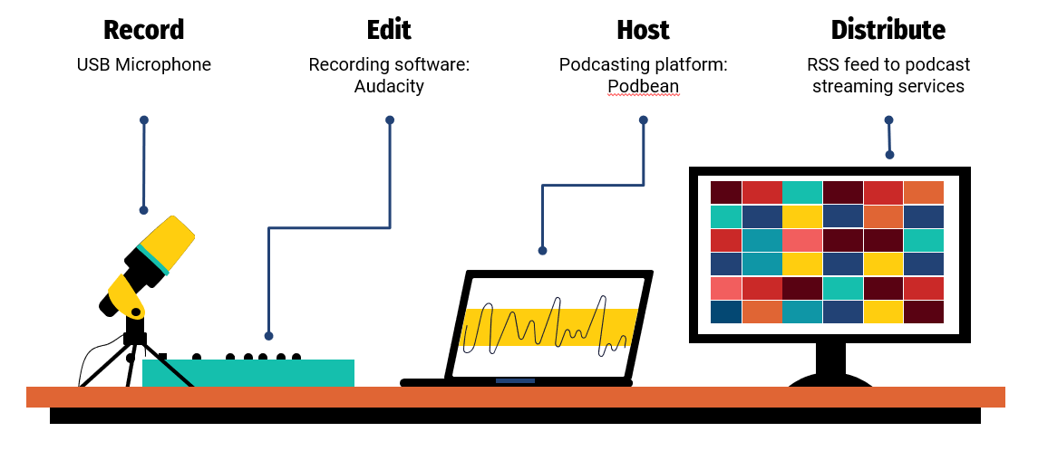
Production of a Podcast

Slide 10
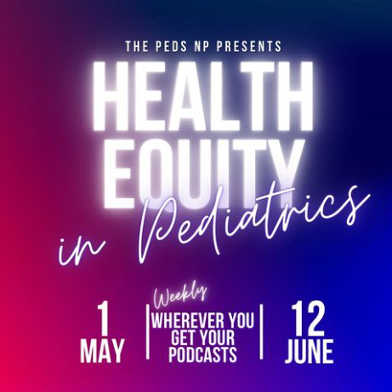
Results
7 episodes (12-21 min, average 16 min)
Focus: The patient-provider relationship to impart change at the individual level to promote health equity
Specific topics related to vulnerable pediatric sub-populations

Slide 11
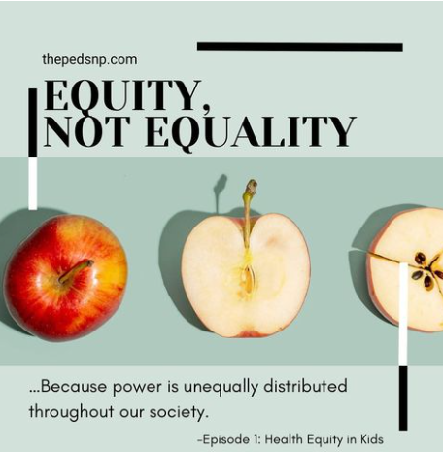
Ep. 1: Health Equity in Kids
Notes:
Best Practices:
Approach every patient with a lens of health equity
Become a partner in the equity care plan, not an authority in health care

Slide 12
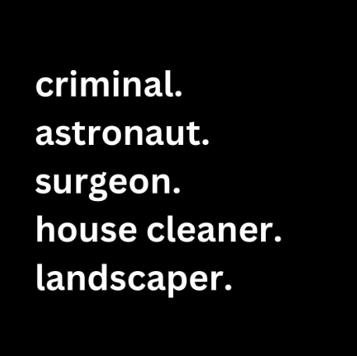
Ep. 2: Identifying Your Implicit Bias
Notes:
Best Practices:
Identify your own biases

Slide 13
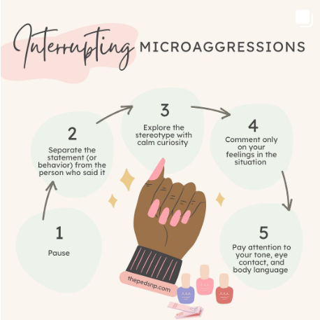
Ep. 3: Interrupting Microaggressions
Notes:
Best Practices:
Use curiosity to confront microaggressions

Slide 14
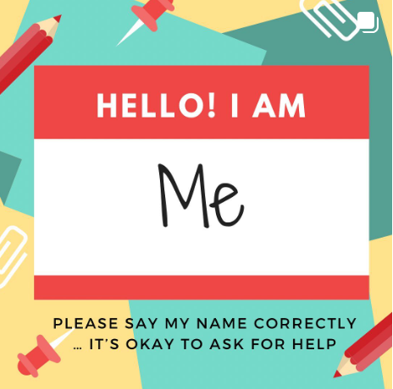
Ep. 4: Say My Name Correctly
Notes:
Best Practices:
Say your patients’ names correctly

Slide 15
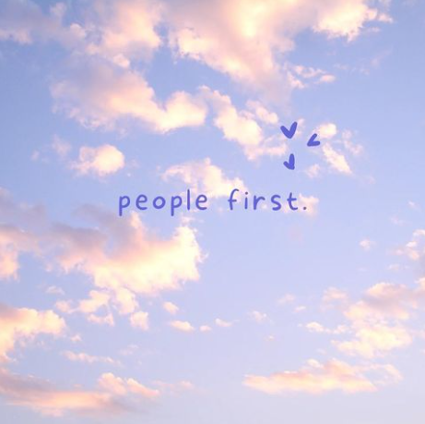
Ep. 5: Weight Bias and the AAP Guideline on Children with Obesity
Notes:
Best Practices:
Use person-first language

Slide 16
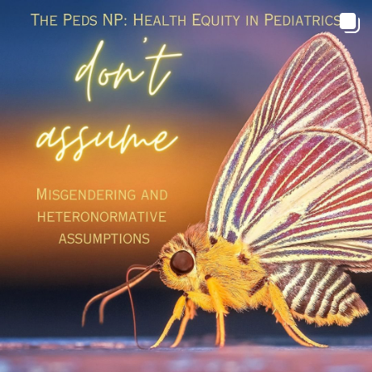
Ep. 6: Misgendering and Heteronormative Assumptions
Notes:
Best Practices:
Don’t assume.

Slide 17
Ep. 7: Mental Health Stigma
Notes:
Best Practices:
Bring mental health into the daylight.

Slide 18
Total downloads: 4,095 in 3 months
Notes:
Episodes were downloaded 4,095 times in the first three months of publication.

Slide 19
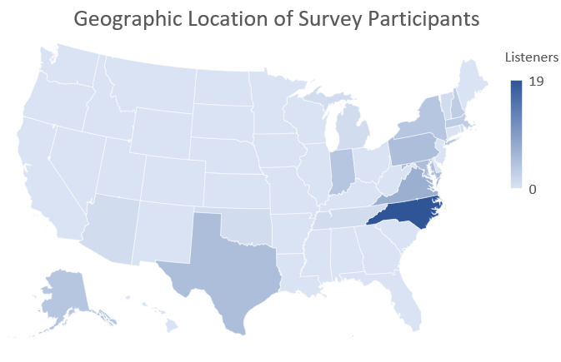
Notes:
The episodes were downloaded in 46 countries, with a majority (93%) being in the U.S. Voluntary survey respondents (n=66) were predominantly from North Carolina (n=19), but also included participants from 17 states and the District of Columbia

Slide 20
Survey Results: Demographics
Other
10.6%
RN
21.2%

Slide 21
Survey Results: Demographics
Other
7.6%
Primary care
39.4%
Education
24.2%
Subspecialty
13.6%
Acute care
15.2%

Slide 22
Survey Results: Knowledge
Topics surveyed affected their patient population (97%)
All participants reported equal or improved knowledge
Average increase of 0.95 (SD=0.87)

Slide 23
Survey Results: Practice Change
The average participant reported “slightly different” practices
90% reported a likelihood that they would change their practice
Avg increase of 2 (SD=0.25)
74% cited the podcast as “very influential” or “extremely influential” in this decision

Slide 24
Survey Results: Qualitative Analysis
Knowledge
- Health equity and barriers to care
- Self-awareness and reflection
- A lens of health equity
Appreciation
- Value
- Offered new perspectives
- Served as a reminder
Change
- Implicit bias/microaggression recognition and mitigation
- Useful/skill acquisition
- Willingness/plan to change
Notes:
3 categories with sub themes

Slide 25
Survey Results: Qualitative Analysis
“The podcast helped me to understand how to identify where health disparities may be for my patients and how identifying/considering them can help provide better care.”
-RN, primary care (Hillsborough, NC)
Notes:
3 categories with sub themes

Slide 26
Survey Results: Qualitative Analysis
“This episode was very helpful when thinking about the new guidelines AND providing sensitive care to patients. Pediatric patients in my experience can be SO sensitive to conversations regarding their bodies. I like how Dr. Carson presented caring for pediatric patients in a caring way while encouraging healthy practices.”
-APRN, primary care (Selma, IN)

Slide 27
Survey Results: Qualitative Analysis
“I confess that I have literally made the same comment about nails. I shall not do this anymore. I will also interrupt microaggressions in a nonconfrontational way. Be curious, not judgmental.”
-Graduate student, primary care (Allen, TX)

Slide 28
Discussion: Individual Impact
An individual provider can make a difference with simple best practices incorporated into daily practice habits
Increased awareness of microaggressions or behaviors that suggest implicit bias
May not eliminate the implicit bias
But individuals can reflect and avoid behaviors that represent bias

Slide 29
Discussion: Systems Impact
Microlearning is
Accessible and inexpensive
Synthesizes concepts from scholarly citations
Ideal for serialized, asynchronous platforms
Content creation is relatively easy and sustainable
Podcasts can be used to teach/standardize health equity concepts

Slide 30
Limitations
Small sample size for survey
Response rate 1.6%
Intentional avoidance of race/ethnicity in survey demographics
Survey studied perception of knowledge gain and desire to change practice
Not pre/post knowledge or measurable patient outcomes
Hawthorne effect possible in survey results
Notes:
although the final health outcomes may not be fully appreciated, the willingness of listeners to change their practice habits after listening to a podcast on health equity bodes well for the possibility of delivering more equitable care to children.
The impact of the podcast was more palpable in the qualitative analysis of quotes that demonstrated strong, influential language

Slide 31
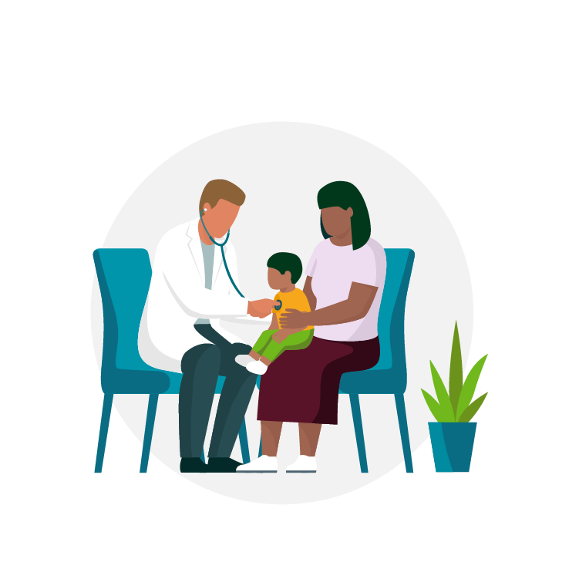
Next steps
Health equity education in other micro-learning platforms
Offer CE credit to increase incentives to listen
National organizations can use podcasts to provide commentary and public discourse on their positions or complex issues
Implicit bias training
Prospective measurement of patient outcomes after listening

Slide 32
References
American Association of Colleges of Nursing. (2021). The Essentials: Core competencies for professional nursing education. Accessible online at https://www.aacnnursing.org/Portals/42/AcademicNursing/pdf/Essentials-2021.pdf
Cheng, T. L., Emmanuel, M. A., Levy, D. J., & Jenkins, R. R. (2015). Child Health Disparities: What Can a Clinician Do?. Pediatrics, 136(5), 961–968. https://doi.org/10.1542/peds.2014-4126
Despres, C., Aguilar, R., McAlister, A., & Ramirez, A. G. (2020). Communication for Awareness and Action on Inequitable Impacts of COVID-19 on Latinos. Health promotion practice, 21(6), 859–861. https://doi.org/10.1177/1524839920950278Marrocco, G. F., Kazer, M. W., & Neal-Boylan, L. (2014). Transformational learning in graduate nurse education through podcasting. Nursing education perspectives, 35(1), 49–53. https://doi.org/10.5480/10-421.1
FitzGerald, C., & Hurst, S. (2017). Implicit bias in healthcare professionals: a systematic review. BMC medical ethics, 18(1), 19. https://doi.org/10.1186/s12910-017-0179-8
Goyal, M. K., Johnson, T. J., Chamberlain, J. M., Cook, L., Webb, M., Drendel, A. L., Alessandrini, E., Bajaj, L., Lorch, S., Grundmeier, R. W., Alpern, E. R., & PEDIATRIC EMERGENCY CARE APPLIED RESEARCH NETWORK (PECARN) (2020). Racial and Ethnic Differences in Emergency Department Pain Management of Children With Fractures. Pediatrics, 145(5), e20193370. https://doi.org/10.1542/peds.2019-3370
Goyal, M. K., Kuppermann, N., Cleary, S. D., Teach, S. J., & Chamberlain, J. M. (2015). Racial Disparities in Pain Management of Children With Appendicitis in Emergency Departments. JAMA pediatrics, 169(11), 996–1002. https://doi.org/10.1001/jamapediatrics.2015.1915
Institute of Medicine (US) Committee on Understanding and Eliminating Racial and Ethnic Disparities in Health Care, Smedley, B. D., Stith, A. Y., & Nelson, A. R. (Eds.). (2003). Unequal Treatment: Confronting Racial and Ethnic Disparities in Health Care. National Academies Press (US).
Jindal, M., Trent, M., & Mistry, K. B. (2022). The Intersection of Race, Racism, and Child and Adolescent Health. Pediatrics in review, 43(8), 415–425. https://doi.org/10.1542/pir.2020-004366
127
Pediatric Nursing Certification Board. (2022). Pediatric Nursing Workforce Report 2022: A Demographic Profile of 53,000 PNCB-Certified Nursing Professionals. https://pncb.org/ sites/default/files/resources/PNCB_2022_Pediatric_Nursing_Workforce_Demographic_ Report.pdf
Petruccelli, K., Davis, J., & Berman, T. (2019). Adverse childhood experiences and associated health outcomes: A systematic review and meta-analysis. Child abuse & neglect, 97, 104127. https://doi.org/10.1016/j.chiabu.2019.104
Smiley, R. A., Ruttinger, C., Oliveira, C. M., Hudson, L. R., Allgeyer, R., Reneau, K. A., Silvestre, J. H., & Alexander, M. (2021). The 2020 National Nursing Workforce Survey. Journal of Nursing Regulation, 12(1). https://doi.org/10.1016/s2155-8256(21)00027-2.

Slide 33
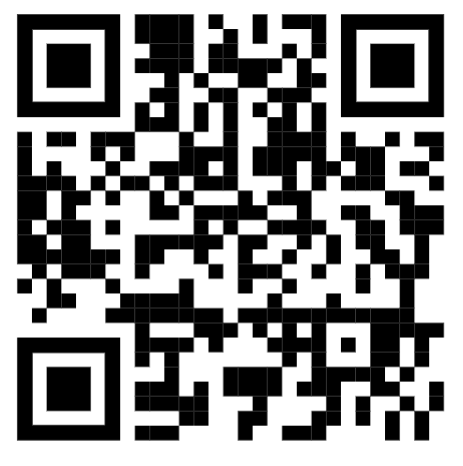
Questions?
Becky Carson
carsonr@cua.edu
www.thepedsnp.com
@thepedsnppodcast
@thepedsnp
Available on:

