Slide 1
Evaluation of a Seizure Action Plan (SAP) in an Outpatient Adult Epilepsy Clinic Lucretia Long DNP, APRN-CNP, FAES Committee Members Lisa Lewis, EdD, MSN, RN, CNE : Chair Staci Reynolds PhD, RN, ACNS-BC, CCRN, CNRN,SCRN, CPHQ: Co-Chair Michelle Webb, DNP, RN, BC-CHPCA: Committee Member Sarita Maturu, DO: Committee Member

Slide 2
Epilepsy: Introduction
Approximately 125,000 new cases of epilepsy are diagnosed annually
30% to 56% of People with epilepsy (PWE) continued to experience seizures
One of the most common neurological disorders
~3.5 million people in the US have epilepsy
Cumulative adjusted lifetime risk: 1.3% to 3.1%

Slide 3
Uncontrolled Seizures
Increased healthcare utilization: 1-5 % annual
ER visits
~ 50% report the need to discontinue
employment due to recurrent seizures
When extrapolating to the US population of epilepsy patients, caregivers annual
costs exceeded $62 billion
Buchhalter, Shafer, Buelow et al, 2021; Penovich, Buelow, Steinberg et al, 2017

Slide 4
Clinical Problem
Psychosocial
Driving
Stigma
Relationships
Education / Employment
Mortality
Suicide
Status epilepticus
Sudden Unexpected Death in Epilepsy Patients (SUDEP)

Slide 5
Perspective and Urgency
Uncontrolled Seizures
Every Hour
8x
Takes more lives than
5
Breast cancer
Increased risk of
premature death³
50,000 vs. 40,290
annually in US^{1,2}
Die of epilepsy related causes¹
1. Epilepsy Foundation Stats and Facts. Accessed June 2015. 2. American Cancer Society – Key Statistics about Breast Cancer. Accessed June 2015. 3. Nevalainen O, et al. Neurology 2014;83(21):1968-1977.

Slide 6
Clinical Problem
Most seizures in patients with epilepsy do not occur in the hospital
Delayed treatment for seizures →
Reduced response to medical therapies, longer seizure duration
Increased risk of brain injury and increased hospital associated mortality

Slide 7
Literature Review
Structured Education in patients with epilepsy:
Improves Comfort with managing epilepsy
Increases epilepsy related Knowledge scores
Increases Medication Adherence
Decreases Seizure Frequency
Reduces Stress
Improves Self Efficacy Scores
Reduces epilepsy related Fear
Leenen, Wijnen, Kessels, Chan, de Kinderen, Evers, van Heugten, & Majorie, 2018; Rush, Hatt, Janke, Ferrier and Tetrault, 2018; Chen et al, 2018; Albert et al, 2019; Tutar, Guven, IsLerDalgic & Duman, 2020; Akdeniz, Ozer & Oncel, 2021

Slide 8
Seizure Action Plans (SAP)
Seizure action plans (SAP) are structured, customized, education tools used to engage patients and caregivers to actively participate in managing their condition (Penovich et al, 2021)
Penovich, P., Glauser, T., Becker, D., Patel, A. D., Sirven, J., Long, L., Stern, J., Dixon-Salazar, T., Carrazana, E., & Rabinowicz, A. L. (2021). Recommendations for development of acute seizure action plans (ASAPs) from an expert panel. Epilepsy & Behavior, 123, 108264.

Slide 9
Purpose To evaluate the use of a seizure action plan in the outpatient adult neurology clinic at The Ohio State University Wexner Medical Center

Slide 10
Project Aims
Aim #1: Evaluate provider use of the SAP in adult patients with epilepsy within 16 weeks of project implementation at The Ohio State University Wexner Medical Center
Aim #2: Evaluate epilepsy knowledge and comfort scores among adult patients and / or Care-partners with epilepsy before and after project implementation

Slide 11
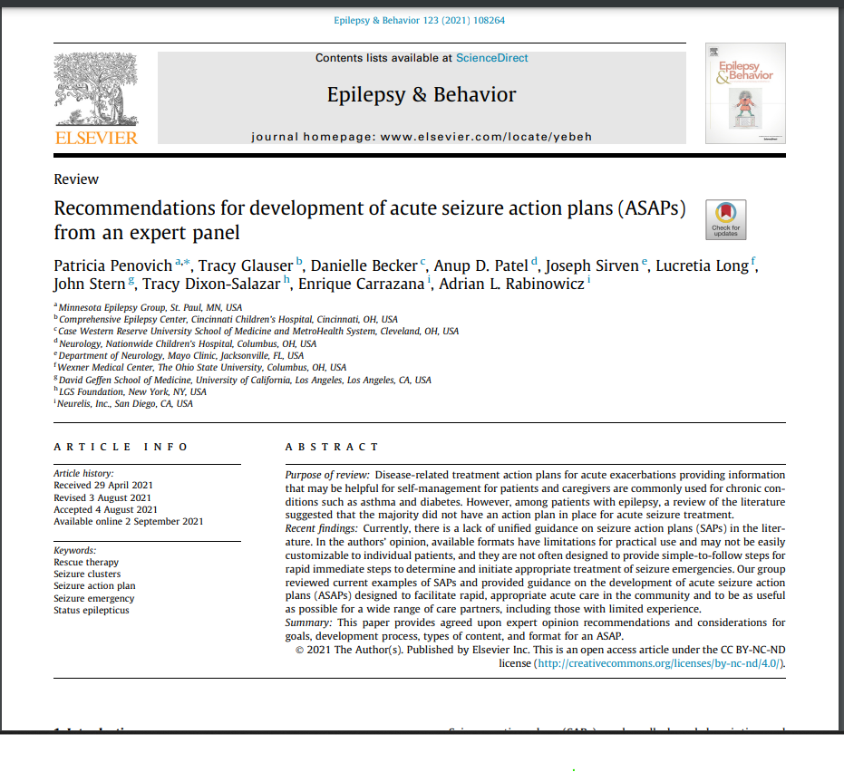
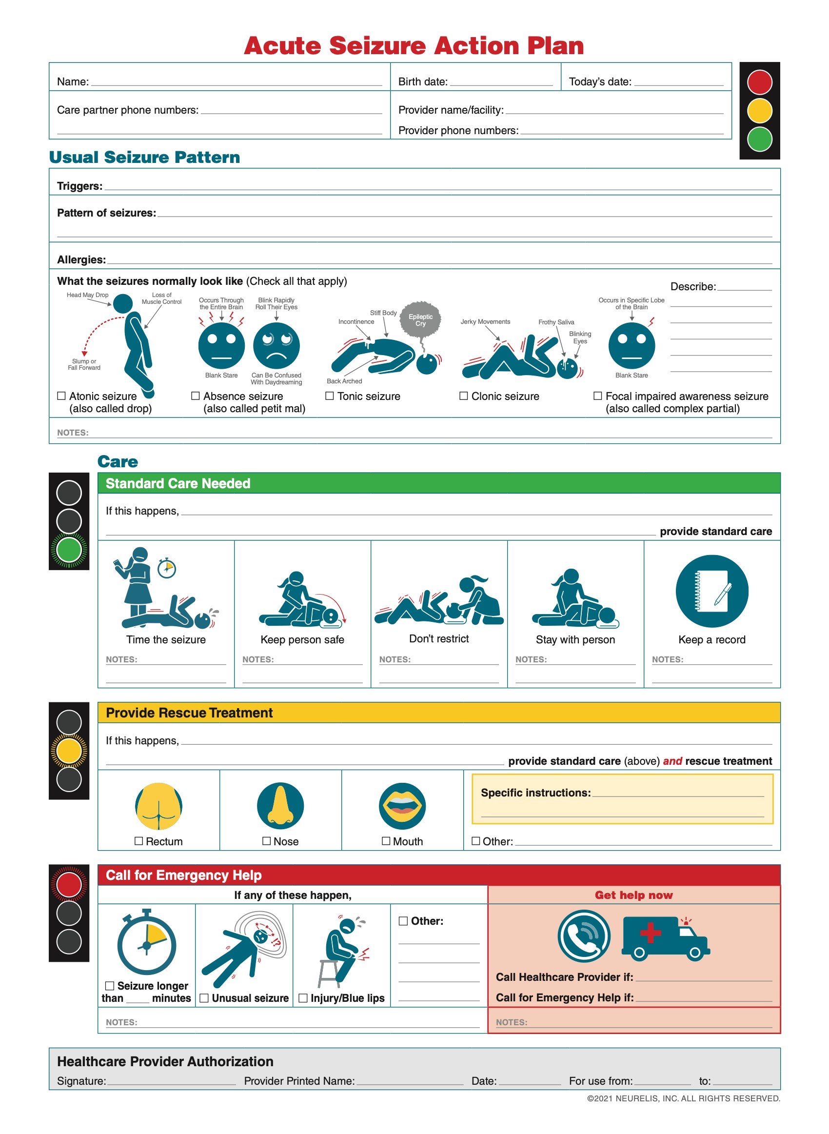
Tool: SAP

Slide 12
Tool: Knowledge and Comfort
Adapted from literature review (MIF) and assessed for face validity by 5 epilepsy experts (10-30 years of experience)
Prior to implementation, five patients reviewed the survey for readability and comprehension.
Survey: 9 items and took less then five minutes to complete
Knowledge and comfort were assessed using a 4-point Likert scale (1=strongly disagree to 4=strongly agree)

Slide 13
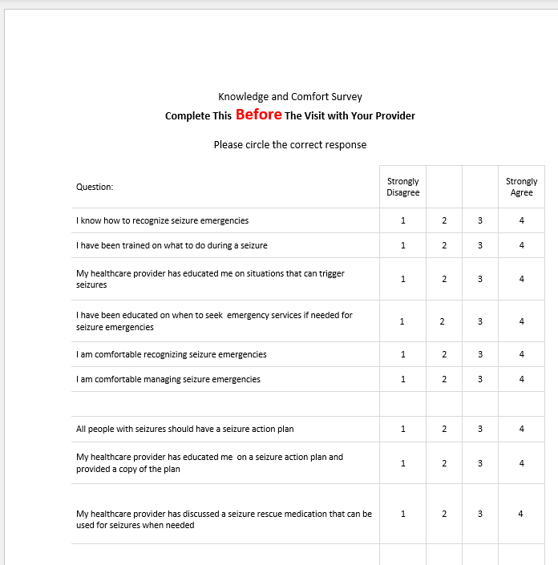
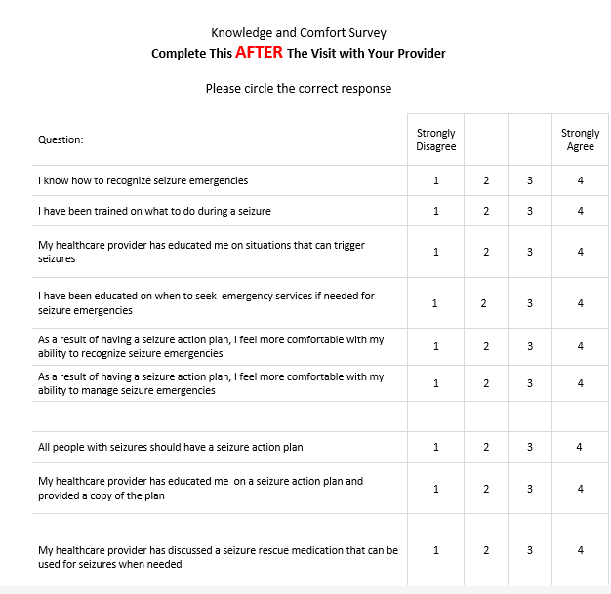
Knowledge and Comfort Questionnaire

Slide 14
Methods :Implementation Flow Chart
Clinic Evaluation Room
Registration
Checkout
Desk
Departure
Patients received SAP Packet
Completed Pre-Survey
Initiated SAP
Departed clinic with SAP
Provider and Patient Collaborated on SAP completion
Completed Post Survey
Clarified SAP questions and concerns
Staff collected Surveys and placed them in a secure file
Copied SAP for patients file and patient distribution

Slide 15
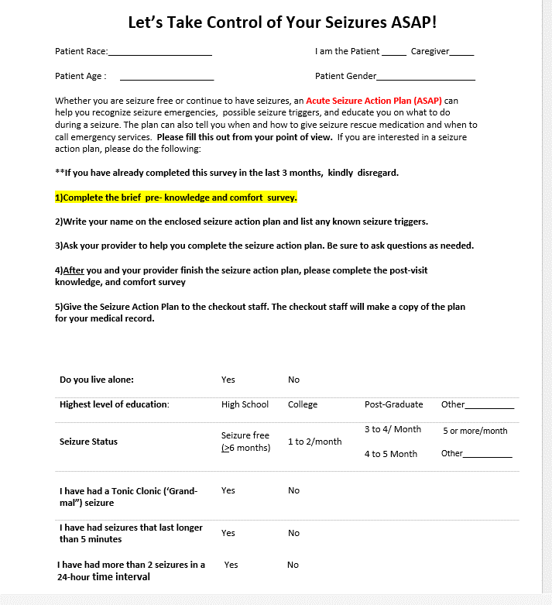
ASAP Packet : Instructions, Demographics, Characteristics

Slide 16
Data Analysis
Provider SAP utilization rates
Weekly (Number of SAPs / Number of eligible patients)
Analyzed using descriptive statistics and a run chart

Slide 17
Data Analysis
Knowledge and comfort Scores
Data were coded into categories of “Yes” or “No” based on the Likert scale responses.
Those who reported Agree/Strongly Agree were coded as “Yes” and those reporting Disagree/Strongly Disagree were coded as “No.”
The percentage was compared at pre and post-implementation using a McNemar test, as data were matched and binomial.

Slide 18
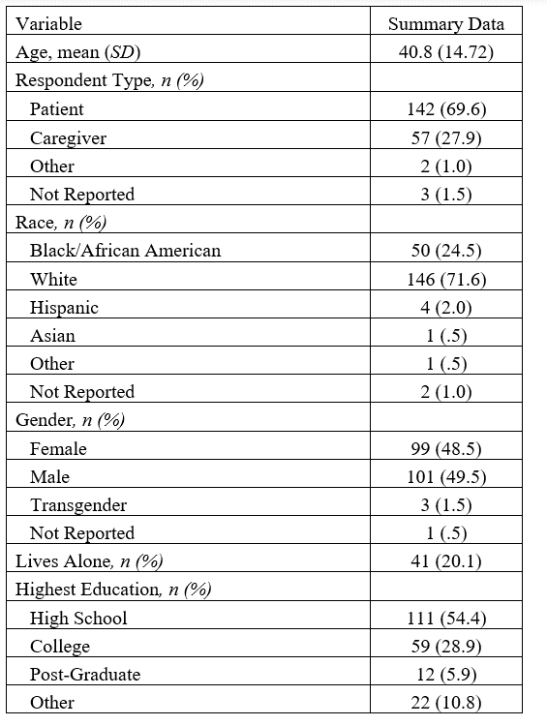
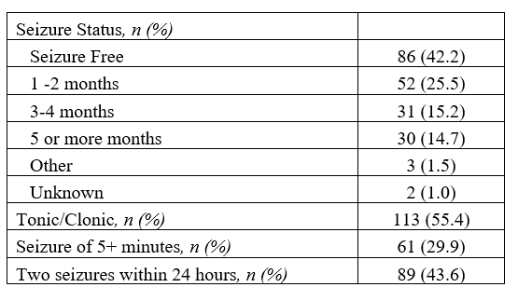
Results: Demographics and Clinical Characteristics

Slide 19
Demographics
N = 204
~70% Patients
~72% White
~78% High school or higher level of education
Sex : Equal distribution
~60 % were not seizure free
~30 to 55%: GTCs, Cluster seizures or Prolonged seizures

Slide 20
RESULTS Aim #1 Evaluate provider use of the SAP in adult patients with epilepsy within 16 weeks of project implementation at The Ohio State University Wexner Medical Center.
Five Providers at four Clinic Sites
The average rate across the 16-week measurement period was
51.4% which exceeds the 50% target rate.
The highest utilization rate occurred during Week 2 (82.4%)
The lowest utilization occurred during Week 10 (33.3%)
Barriers: Time, Provider Perception of SAP relevance, Language (n=1)
Facilitators: 1 Page SAP, Patient Involvement, RN assistance with SAP

Slide 21
Results Aim 1: Average Utilization 51.4%

Slide 22
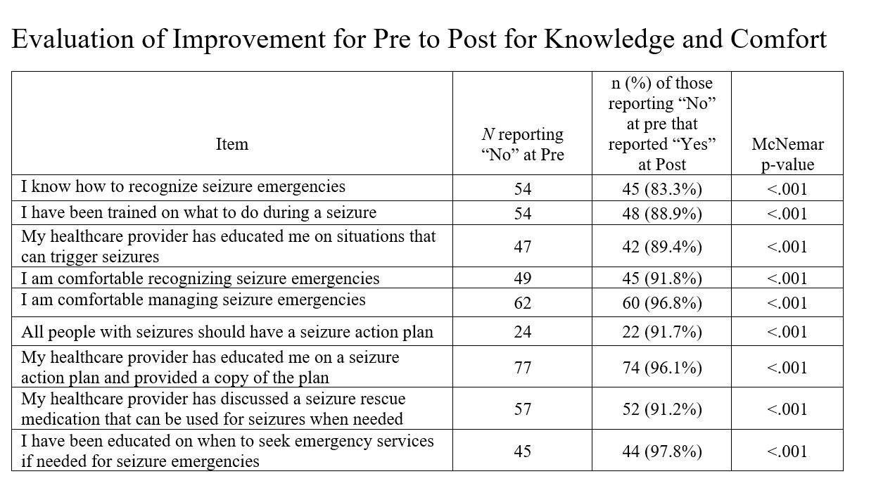
Results: Aim 2 .

Slide 23
Notes:
Extracted from the SAP

Slide 25
Results
At Pre-intervention, 171/195 participants (87 %) Felt that all patients with epilepsy should have SAPs (24/195 did not )
Missing Data points :9 patients 204-9=195
Post-intervention , 98 % (193/195) felt
that all people with seizures should have a SAP.
This was a statistically significant difference McNemar p < .001).

Slide 26
Conclusion
Standardizing Seizure Action plans (SAP) can increase utilization in adult epilepsy care center.
SAPs improve patient and care partner knowledge and comfort of managing seizure emergencies.
Ninety-eight percent of adult patients with epilepsy or care partners felt that all patients with epilepsy should have a SAP.

Slide 27
Sustainability
Dissemination
EMR
APP QOL Clinics
Metrics
Continue to assess Barriers and Facilitators
Updates on Utilization Rates and Outcomes
ER
General Neurology
Primary Care/Inpatient Units
Publication Submission : Neurology Clinical Practice
Local, National and International Meetings:

Slide 28
Thank You!

Slide 29
