Slide 1
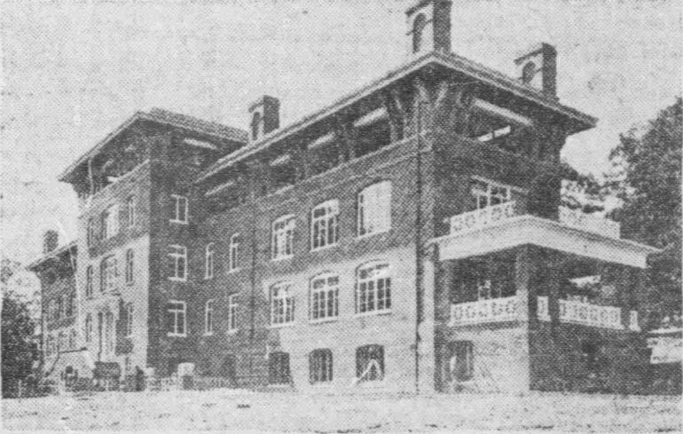
Paths to Prevention: Tuberculosis Awareness in Ethnic Populations
Carmen Sierra, PhD(c), DNP, R.N., CCTN
Rockcreek Tuberculosis Hospital ( demolished)
DC’s TB hospital built in 1908 on the site now occupied by Upshur Park.

Slide 2
No disclosures.

Slide 3
Paths to Prevention: Tuberculosis Awareness in Ethnic Populations
Carmen Sierra, PhD(c), DNP, R.N., CCTN
Rockcreek Tuberculosis Hospital ( demolished)
DC’s TB hospital built in 1908 on the site now occupied by Upshur Park.

Slide 4
Objectives
Stages of Tuberculosis (TB)
TB rates in ethnic populations
Trends by states in U.S.
Interventions
Image from: Collective Commons

Slide 5
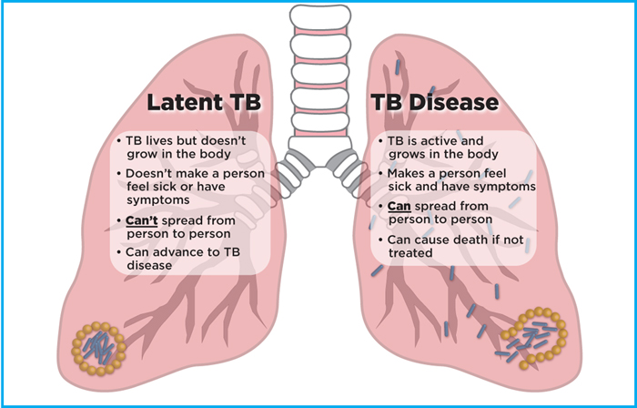
Stages of TB
Latent tuberculosis infection (LTBI)
Active Disease or TB Disease
Image from: Collective Commons

Slide 6
Stages of TB
Asymptomatic
Don’t feel sick
Not contagious
Positive skin test and blood test
May develop TB disease if not treated
Normal chest x-ray
Latent tuberculosis infection (LTBI)
Active Disease or TB Disease

Slide 7
Stages of TB
Cough over 3 weeks
Hemoptysis
Pain in chest
Weakness or fatigue
No appetite, weight loss
Chills, fever, night sweats
Latent tuberculosis infection (LTBI)
Active Disease or TB Disease

Slide 8
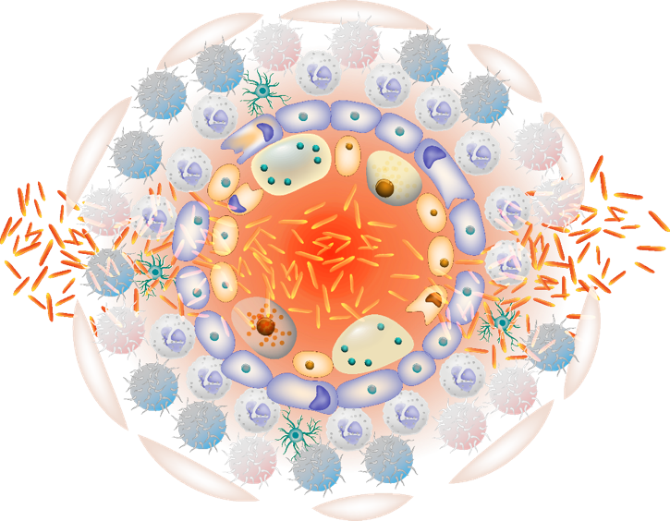
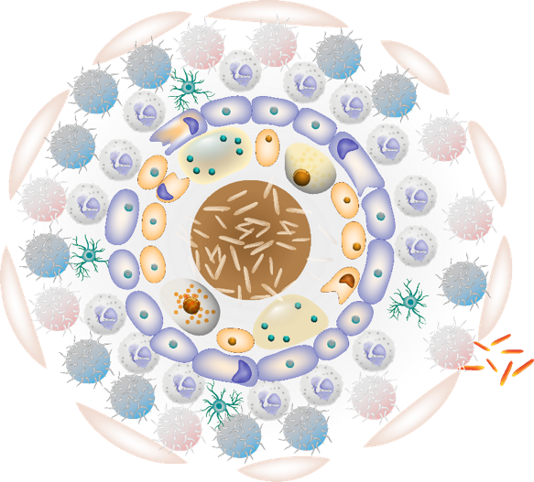
Mycobacterium tuberculosis: Difference of LTBI to Active Mechanism of Transition
LTBI
ACTIVE TB
TNFα
IFNγ
IL-12
IL-1
High bacteria burden requires both CD4 T cells + CD8 T cells
Low bacteria burden
contained by CD4 T cells
Solid Granuloma
Dormant mTb > Active mTb
Caseous Granuloma
Active mTb > Dormant mTb
Getty Images: RF Creative 649384564. Granuloma. Ttsz. iStock.
Notes:
Organized collection of immune cells in the body that forms a response to the presence of mycobacterium tuberculosis, the bacteria that causes TB.
Kidney transplant recipients have a higher risk of TB than the general population, because immunosuppressive therapy impairs microbial
Specifi cytotoxic T-cell response, a key host defense against mycobacterial infection.
Let’s, talk a little about immunology and take a quick look the mechanism of transmission.
Cytokines react to the immune response
Interferon-γ is crucial to immune defense against intracellular pathogens such as M. tuberculosis.
Post-infection, naïve T cells become sensitized to TB-specific antigens and develop into TB-specific effector T cells (CD4 and CD8). TB-specific effector T cells
then migrate to the site of infection and secrete interferon-γ to activate macrophages to more effectively ingest and kill mycobacteria.
Infected patients have TB-specific effector T cells circulating in their peripheral blood. Enables an in vitro detection of interferon-γ.
Cytokines generated by innated immune system
Il-1- acute phase response-produced by the macrophages
Il-12-promotes cd4 T-cell response
Inf-y-interferon gamma- involves in cell death and the inflammatory response
TNF- acute phase of reaction tmor necrosis factor
References
Pai M, Behr MA, Dowdy D, et al. Tuberculosis. Nature Reviews Disease Primers. 2016;2:16076. doi:10.1038/nrdp.2016.76.
Getty Images: RF Creative 649384564. Granuloma. Ttsz. iStock.

Slide 9
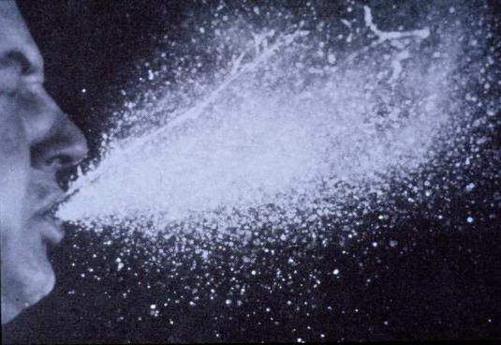
Practice proper sneezing habits!
This Photo by Unknown Author is licensed under CC BY-SA-NC
Notes:
1-10 bacilli may be sufficient to initiate an infection in a susceptible individual

Slide 10
TB rates in United States ( March 23, 2023)
8,300: reported TB cases (provisional) in the United States in 2022 (a rate of 2.5 cases per 100,000 persons).
60: jurisdictions (states, cities, U.S. territories, and affiliated areas) that report TB data to CDC.
Up to 13 million: estimated number of people in the United States living with latent tuberculosis.
The prevalence of latent TB infection varies between certain populations.
More than 80% of TB cases in the United States result from longstanding, untreated latent TB infection.
8.9 million persons with untreated latent TB infection.
Latent TB is not reportable to the CDC.
(https://www.cdc.gov/tb/statistics/ltbi.htm)
Notes:
Before we get into the TB rates in ethnic populations, less look at the rates in general in the country. Latent TB infection is not reported to CDC. CDC currently relies on national prevalence estimates and is exploring systems and methods to determine the best ways to measure prevalence of latent TB infection in the United States in the future.

Slide 11
What is the occurrence of TB at greater levels among certain population groups often referred as?
A. Active Disease
B. Latent tuberculosis infection
C. Health disparity
D. Organized collection of immune cells in the body that forms a response to the presence of mycobacterium tuberculosis, the bacteria that causes TB.

Slide 12
TB rates in ethnic populations
Approximately two-thirds of new cases and
85% of new cases of [multidrug-resistant TB] in the United States are among non-U.S.-born persons.¹
Asian Persons-
In 2021, TB disease was reported in 2,834 Asian persons in the U.S. accounting for 36% of all people reported with TB nationally.²
Hispanic or Latino Persons-
In 2021, TB diseases was reported in 2,410 Hispanic or Latino persons in the U.S. accounting for 30.6% of all people reported with TB nationally.²
Black or African American Persons-
In 2021, TB diseases was reported in 1,420 non-Hispanic Black or African American persons in the U.S. accounting for 18% of all people reported with TB nationally.²
1. (Liu, Yecai, 2022)
2. (https://www.cdc.gov/tb/topic/populations/default.htm)
Other specific populations
Residents of correctional facilities
People experiencing homelessness
International travelers
Infants and young children are more likely than older children and adults to develop life-threatening forms of TB disease.

Slide 13
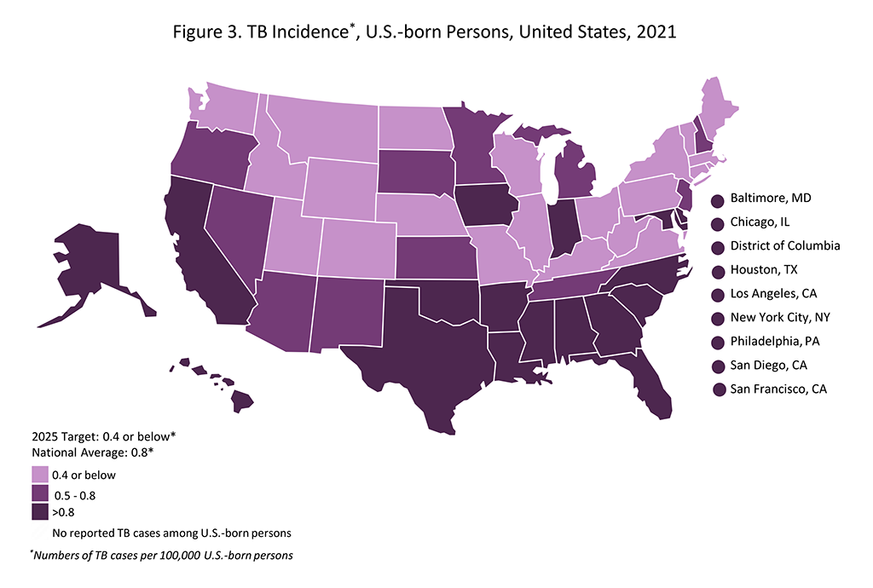
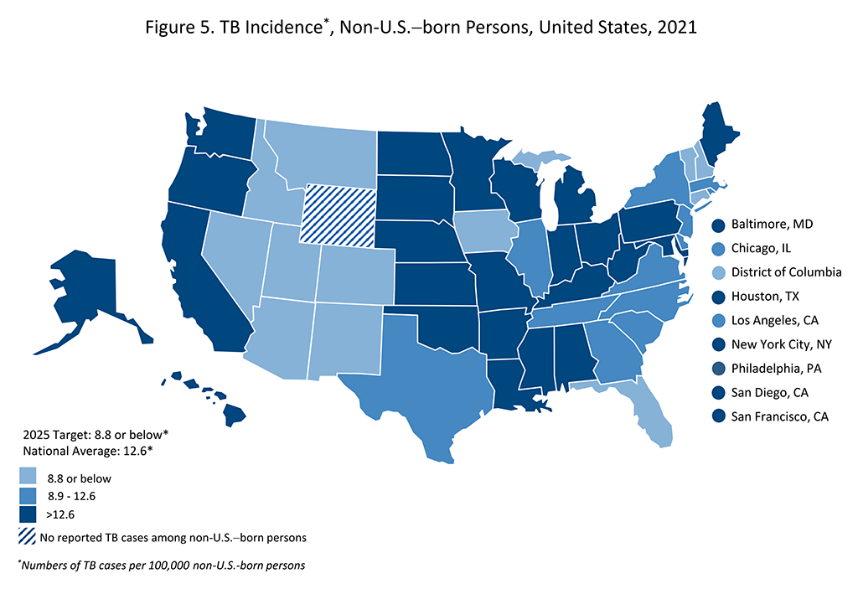
U.S. Trends by States
(https://www.cdc.gov/tb/statistics/indicators/2021/images/Figure-5.png?_=79230?noicon)
Notes:
Alaska and Hawaii are not far behind due to close community settings and higher population of immigrants from TB endemic countries…

Slide 14
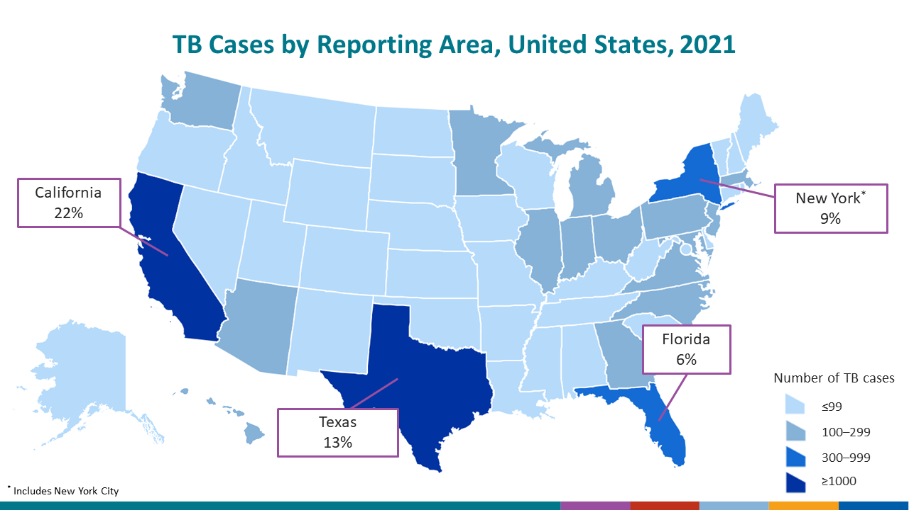
What U.S. states combined reported nearly half of all U.S. TB cases in 2021:
(https://www.cdc.gov/tb/statistics/surv/surv2021/images/Slide6.PNG?_=71753?noicon)

Slide 15
Interventions to combat TB
Enhanced screening
Diagnostic advancements such as interferon gamma release assays (IGRAs)
Target interventions
Improving disparities
Improving access to care
Ensuring appropriate treatment adherence
Identifying at-risk population

Slide 16
Conclusion
Tuberculosis has 2 stages, latent tuberculosis infection ( LTBI) and Active TB or TB disease.
There were thousands of reported TB cases in the U.S.
Millions are living with LTBI and millions untreated LTBI.
Non-US born account for the better part of TB cases.
Asian persons account for 36% of all people with TB, followed by Hispanics and Black persons.
Four states lead in TB cases in the U.S. with California having the highest prevalence.
Screening, targeted interventions, improving access to care are essential interventions to combating in high-risk populations.

Slide 17
Image from: Creative Commons

