Slide 1
Shaping the Future: a systemic focus on early career mathematical scientists
Loyiso G. Nongxa
Professor Emeritus: University of the Witwatersrand
Coordinator: Pathways to a Successful Academic Career Programme

Slide 2
Introduction
Since 1995, there has been a plethora of initiatives launched within the National System of Innovation (mainly by public sector partners) aimed at early career academics;
Question: what are the dimensions that have been addressed by such interventions? For example, transformation in terms of race and gender and ………knowledgebase?;
Are there areas that have, up to now, been neglected?
Voices of Early Career Academics;
An investment in Early Career Academics is an investment into a vibrant future of the National Science System; what obligations does the current leadership have in shaping that future?
Is there a ‘summative’ report that highlights coherence or inconsistencies within or amongst these interventions?

Slide 3
Definitions and definitions
Terminology: (a) early career academics; (b) emerging researchers; (c) early career researchers; (d) next or new generation of academics; (e) early and mid-career researchers (and scholars);
Qualifications: (a) completed a PhD within the last N years where 4 < N < 11; (b) (not) registered for a PhD (or Masters or Honours?);
Age: (a) at most 35 years old; (b) at most 40 years old; (c) no age restriction;
Employer: (a) within the university sector (including postdoctoral fellows?); (b) employed in Government or Industry?

Slide 4
Evolution of ideas about early career academics
1959 Extension of University Education Act: “You are on your own”;
Foundation for Research Foundation Development ratings: 1983 onwards. Introduced P- and Y-ratings;
“Grow Our Own Timber”: 1980s onwards?
FRD Thuthuka Part One (PhD track only?): 1999/2000.
Next Generation of Academics Programme: 2000s Higher Education South Africa;
NRF Thuthuka Part Two: (PhD- and post-PhD tracks)
Black Academics Advancement Programme: 2017/18;
Future Professors Programme: 2020

Slide 5
Evolution of ideas about early career academics
Research Mentoring and Exceptional Early Career Advancement Programme aka Leading Researchers and Scholars Programme: (not yet funded?);
Pathways to a Successful Academic Career Programme: 2020/21;
Universities South Africa Thuso Resources: 2023;
New Frontiers Research Award: Oppenheimer Momerial Trust: August 2023.

Slide 6
Data from 2023 CREST reports
In 2020 there were 528 mathematics academics: (approximately) 61% with a doctoral degree; 40% female. About 42% less than 40 years old and around 67% less than 50 years old.
In 2020 there were 255 statistics academics: (approximately) 45% with a doctoral qualification; 40% female. About 45% less than 40 years old and around 73% less than 50 years old.
Mathematics: In 2020, A-rated mathematicians constituted 1.7%; A- and B-rated (considerable international recognition) constituted 8%; and only 3.6% were deemed ‘promising researchers.
Statistics: In 2020, there were no A-rated researchers in statistics (at present there’s only one); 2.8% were internationally acclaimed; and only 2% were deemed ‘promising’ researchers.

Slide 7
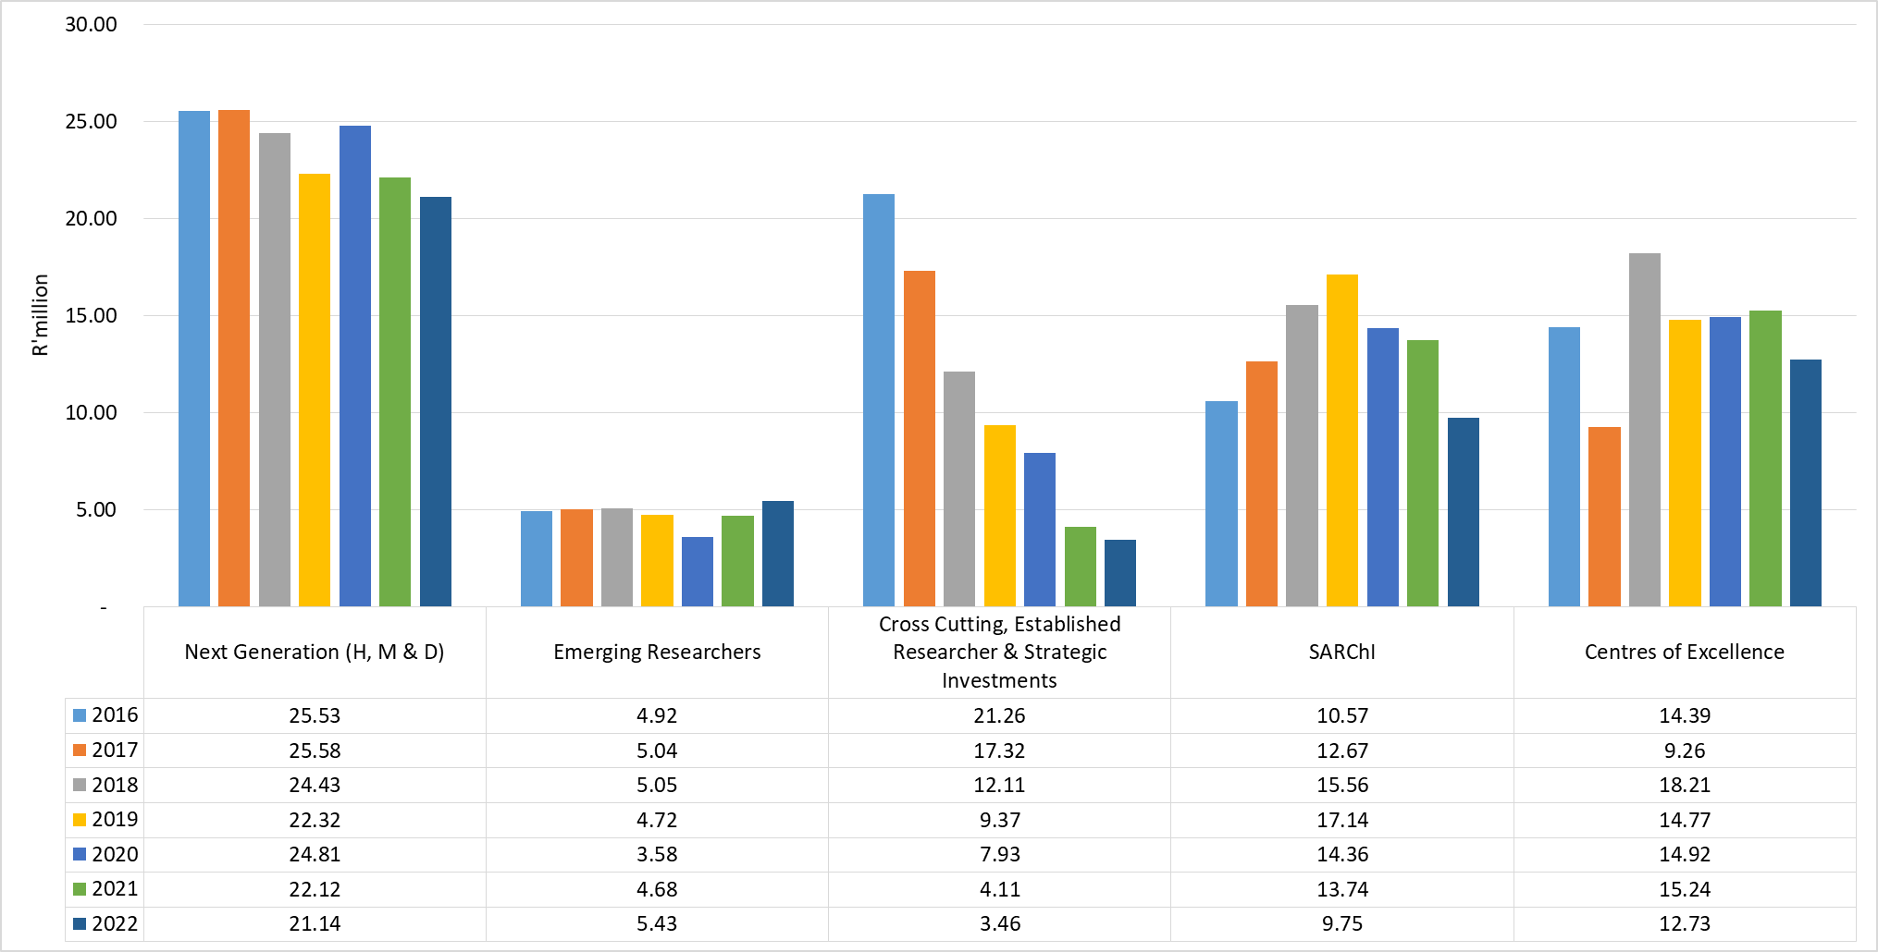
NRF Investment in Mathematics and Statistics:
Researcher Pipeline and Strategic Interventions
Source:
National Research Foundation’s Research and Development Information Platform (RDIP).

Slide 8
From 2023 CREST Reports
Total value of individual statistics grants (2020): R13.5m amongst 30 grant-holders; about 5% allocated to Black statisticians although they constitute 52% of the academic staff complement.
The proportion of academic statisticians with PhDs is 45% which is below the national average of 48% and way below the target set in the NDP of 70% by 2030;
In 2020 the average age at commencement of PhD studies is 33.7 years and average age at graduation was 37.5 years. Average time-to-graduation was 4.7 years.
From 2005 to 2020 the total value of grants was R71 691 848. Of this, 35% was allocated to women; 11% to Black academics; 20% to statisticians less than 40 years old; 77% to three institutions: UCT, UP and SU; and HDIs combined received 5.8% of UCT allocation.

Slide 9
From 2023 CREST Reports
Total value of individual mathematics grants (2020): R42.9 m amongst 53 grant-holders; about 53.5% allocated to Black mathematicians and only 6.3% to women although they constituted 34% of the academic staff complement.
The proportion of mathematicians with PhDs is 61% which is still below the target set in the NDP of 70% by 2030;
In 2020 the average age at commencement of PhD studies was 32.4 years and average age at graduation was 34.9 years. Average time-to-graduation was 4.2 years.
From 2005 to 2020 the total value of grants was R729 884 947. Of this, 8% was allocated to women; 51% to Black academics; 20% to mathematicians less than 40 years old; 71% to three institutions: UCT, SU, Wits and UKZN; and HDIs combined received 11.4% of UCT allocation.

Slide 10
From 2023 CREST Reports
Total value of individual grants (2020): R42.9 m amongst 53 grant-holders; about 53.5% allocated to Black mathematicians and only 6.3% to women although they constituted 34% of the academic staff complement.
The proportion of mathematicians with PhDs is 61% which is still below the target set in the NDP of 70% by 2030;
In 2020 the average age at commencement of PhD studies was 32.4 years and average age at graduation was 34.9 years. Average time-to-graduation was 4.2 years.
From 2005 to 2020 the total value of grants was R729 884 947. Of this, 8% was allocated to women; 51% to Black academics; 20% to mathematicians less than 40 years old; 71% to three institutions: UCT, SU, Wits and UKZN; and HDIs combined received 11.4% of UCT allocation.

Slide 11
From NGA(MaSS) database
Early career mathematical scientists: (a) at most 40 years old; (b) completed PhD within the last 7 years; (c) not yet completed a PhD.
270 responses. 35% were female and 81% Black (74% of African descent).
Highest qualification: 30 with 4-year degree; 116 with Masters and 124 with PhDs. 23 registered for Masters and 86 registered for PhDs. 8 with honours and 12 with Masters not registered.
106 completed PhDs in the last 6 to 7 years;
Questions: (a) what support is required for the 146 registered for higher qualifications to complete their degrees?; (b) what support and/or encouragement is required for those not registered to register?
Around 70 PhD holders are at the lecturer level – what support is required for them to progress to next level within the next 3 to 5 years?
Target: at most 5 years at each academic rank.

Slide 12
From NGA(MaSS) database
Pathways to a Successful Academic Career Programme
3.25 cohorts since 2020 (the 2020 programme had to be discontinued due to COVID lockdown – it was planned to be a residential programme.
85 Fellows in 3 cohorts from 17 universities: 2021, 2022 and 2023;
45 Fellows in Mathematics (pure and applied) and 38 in statistics;
52 males and 33 females.
12 each from NWU and Wits and 10 each from UP and UKZN.
R1 735 000 in discretionary grants;
Two accepted academic positions in UK and US;
4 at the Associate Professor level;

Slide 13
From NGA(MaSS) database
Research interests: work in progress
Bayesian statistics;
Goodness-of-fit;
Survival analysis; Markov chain models
Biplots for compositional data;
Biostatistics: infectious diseases;
Credit risk analysis;
Deep learning: AI in healthcare;
Econometrics and financial statistics;
Parametric and non-parametric analysis;
Statistical modelling;
Etc. etc. etc. etc. etc.
Question: are there any critical gaps, i.e. important research areas not covered?

Slide 14
From NGA(MaSS) database
CHATGBT SUMMARIES
Speakers acknowledge the value of networking within the discipline, with some participants sharing how the program has helped them in building connections and gaining confidence in their academic pursuits.
Speaker 1 and others emphasize the importance of sharing personal academic journeys to inspire and guide early career academics. They discuss the value of learning from the experiences and struggles of more established academics.
The conversation concludes with a discussion on creating a sustainable community among early career mathematical scientists. Ideas include newsletters, information sharing, and maintaining connections beyond the program.
Overall, the discussion reflects a collective effort to enhance the career paths of early career mathematical scientists through shared experiences, discipline-specific programs, active engagement, and community building.

Slide 15
From NGA(MaSS) database
CHATGBT SUMMARIES
Career Advancement and Promotions: Many participants noted that the project contributed to their career advancement, such as aiding in promotions to higher academic positions (e.g., senior lecturer), attending conferences, and gaining recognition in their field.
Networking and Collaboration Opportunities: The project seems to have provided valuable networking opportunities, allowing participants to interact with peers and leading researchers, which they perceived as beneficial for their future career paths.
Research and Academic Contributions: A significant number of responses highlight the project's impact on research capabilities. Participants mentioned developing new research ideas, contributing to their PhD studies, co-supervising students, and enhancing their research outputs.
Overall, the project appears to have had a multifaceted impact, contributing to career advancement, research development, skill enhancement, networking, supervisory roles, and personal growth among the participants.

Slide 16
From NGA(MaSS) database
Research interests: work in progress
Bayesian statistics;
Goodness-of-fit;
Survival analysis; Markov chain models
Biplots for compositional data;
Biostatistics: infectious diseases;
Credit risk analysis;
Deep learning: AI in healthcare;
Econometrics and financial statistics;
Parametric and non-parametric analysis;
Statistical modelling;
Etc. etc. etc. etc. etc.
Question: are there any critical gaps, i.e. important research areas not covered?

Slide 17
Early career mathematical scientists portfolio: 2024 to 2030
Priority One: PhD registration and completion. This will include
M.Sc. Completion by those currently registered;
Pre-doctoral graduate schools to assist with broadenening knowledge and preparing a PhD proposal;
Time-off to write up PhD thesis: staff replacement.
Priority Two: A focus of early career statisticians – completed PhD within last N years. This will include
Academic career development;
Local collaboration networks;
International collaboration networks;

Slide 18
Early career mathematical scientists portfolio: 2024 to 2030
Priority Two: A focus of early career statisticians – completed PhD within last N years. This will include
Mobility: (a) consultation visits to supervisors; (b) visit local and international collaborators; (c) research institutes and instituions to broaden and deepen knowledge in areas of research interests.
Targets:
By 2030 all early career statisticians currently under 4o years old will have completed their PhDs;
Early career statisticians will send no more than five years in each academic category , i.e. no more than 5 years to meet promotion requirements.

Slide 19
Early career mathematical scientists portfolio: 2024 to 2030
Priority Three: develop a more comprehensive database of early career and graduate academic statisticians;
Priority Four: establish an early career statisticians division within SASA and a national early career mathematical scientists forum.

Slide 20
Thank You
NGA(MaSS)@UP: Securing the future of the Mathematical Sciences

