Slide 1
Appointment of Arbitrators by a Blockchain-Based Dispute Resolution Platform : How it works without Recourse to Legal Systems or External Enforcement Machinery
Dr. Bernard Colas, Ad.E
With the assistance of Lyna Ramdane and Diane Forey
CMKZ LLP
International Trade and Business Law
NICArb 2022, November 24, 2022

Slide 2
Focus
Arbitration clauses in smart contracts
Platforms and Rules
Triggering an arbitration procedure
Appointment of arbitrators
By algorithms, the parties or the platform
Enforcement of arbitral award
Smart contract Code amendment or predetermined outcome
How to become an arbitrator

Slide 3
Case study: Parametric Insurance Contract
Blockchain-based insurance contract (flood insurance)
Water detection data is recorded in the blockchain by the connected flood detection device
Self-executing on fulfillment of the conditions:
IF(flood occurs+automated analysis of proofs)THEN (insurer pays 50,000$ to customer)

Slide 4
On-Chain Arbitration Clause
Examples:
IF(dispute)THEN (send to arbitration platform)
“Any dispute, controversy or claim arising out of or relating to this contract, or the breach, termination or invalidity thereof, shall be settled by arbitration in accordance with the Blockchain Arbitration Rules” (CodeLegit)
Depending on the code, arbitration can be triggered :
At the option of one of the parties (more likely)
When certain conditions are satisfied (IF/THEN)

Slide 5
On-Chain Arbitration Platforms
3 types:
Exclusive to professional arbitrators (Jur..)
Open to professionals and technician in code (CodeLegit…)
Open to non-professional arbitrators without experience (Kleros, Bitrated…)
Recourse to a platform of dispute resolution based on the blockchain with binding arbitration award automatically executed by a smart contract

Slide 6
On-Chain Arbitration Rules
Platform use their own rules. To ensure due process, most are inspired from the UNCITRAL Arbitration Rules
Rules and Regulations of the Blockchain Arbitration Society (BAS)
UK Digital Dispute Resolution Rules
UNCITRAL Convention on Electronic Communication in International Contracts of 2007 asserts the validity of on-chain arbitration by allowing for electronic data records and electronic transactions in the arbitration process

Slide 7
Triggering an arbitration procedure
Dispute
Flood occurs without compensation
Errors in coding / Inaccurate data feed
Discrepancies between coding and natural language
Breach of contract / Misrepresentation
Subsequent changes of law / regulation
Initiation of arbitration can be coupled with a code that pauses the performance of the contract
pauseAndSendToArbitrator()

Slide 8
Procedure
Notice of arbitration is sent by the claimant through the contract or the platform
Appointment of arbitrator:
Can be chosen randomly or by algorithms (Anonymous or not) (Kleros)
Appointed by the parties among a panel of arbitrators on the platform (Jur)
Proposed by the platform
Funds are directly located in the smart contract or can be in escrow with the fees
Evidence and proceeding are submitted through the platform automatically delivered to all stakeholders
Arbitrator issue his/her decision and award is enforced

Slide 9
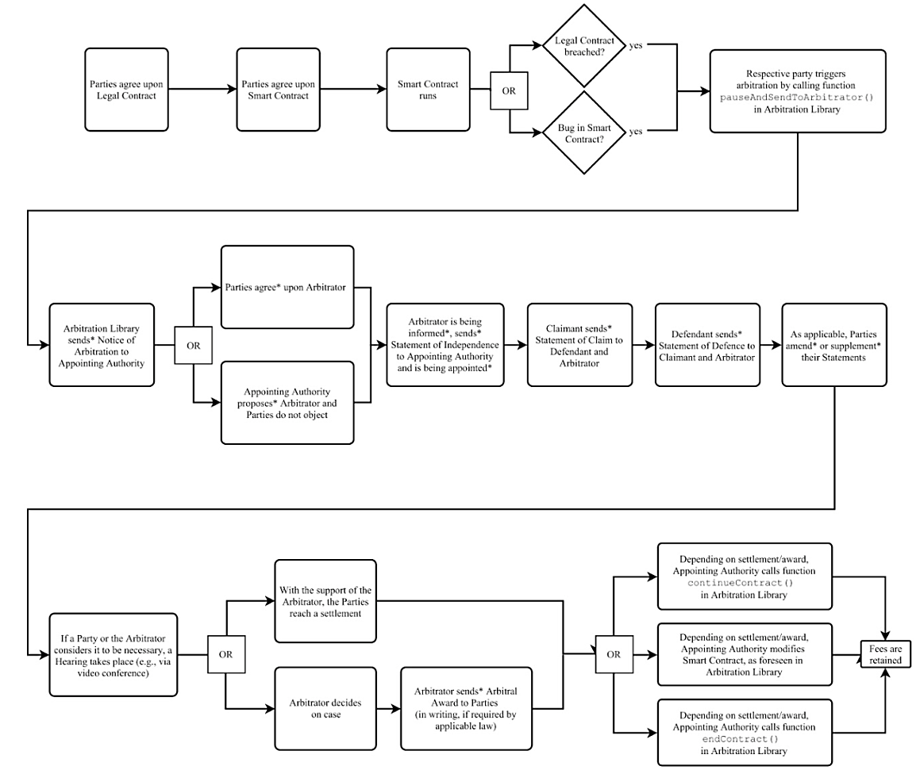
Step-by-step on-chain arbitration
Source: CodeLegit White Paper on Blockchain Arbitration
Notes:
Process of arbitration:
Notice of Arbitration.
The process of arbitration starts with the notice of arbitration sent by the claimant. It does not matter if the parties did not expressly agree to the conduct of arbitration using blockchain. The claimant will be required to create a digital platform using a simple blockchain algorithm. This platform will be duplicated at the respondent’s place of operation so that the arbitration can be conducted smoothly. It’s like a platform where both parties exchange information. Parties can agree to use a single server at either party’s location or have independent servers. This is blockchain. This blockchain is to be provided to all the stakeholders in an arbitration.
Appointment of arbitrator
Once the notice of arbitration has been sent, the appointment of an arbitrator can be done through blockchain. Thus the exchange of documents, emails, and messages, etc. are all recorded automatically and replicated at all stakeholders computers without any involvement of any third party. The case management conference can be done online using a video conferencing facility of blockchain which gets automatically recorded and filed at the computers of all stakeholders in original and this cannot be manipulated. Not just that, calls to parties can also be done using VoIP calling facility and recorded automatically.
The Pleadings
The pleadings including a statement of claim, statement of defense, counterclaims, and reply to counterclaims and further submissions can be submitted online and are automatically served to the parties & the tribunal along with automated acknowledgment. This ensures timely submissions. Any delays will also be penalized in terms of the penalty prescribed by the tribunal or as agreed by the parties. The fear of ex-parte communication will also be mitigated when the procedural orders and communication by the tribunal will be auto-delivered to both parties.
Interim Measures
Interim measures that are sought from courts can be executed on the blockchain if the judicial system of a particular jurisdiction allows for a seamless digital interface with the petitioner's computers. In case of an automated interface with the judicial system, the execution of court orders can also happen immediately provided the jurisdiction’s administrative machinery is using blockchain.
Taking of Evidence & Preparation of Award
The efficiency of blockchain can be seen in evidence taking and award preparation. Submission of witness statements, documents, exhibits, or any other evidence can be done by the parties online and they shall be automatically delivered to all stakeholders. Witness conferencing, cross-examination, and taking of oral evidence can be easily done using video conferencing suites, or even if hearings are done physically, they can still be transferred on blockchain and stacked for procedural integrity. Statements of expert witnesses, oral submission by experts, and expert communications can be recorded on blockchain.
the Award is directly enforced through the oracle in the Smart Contract resulting in automatic transfer of the staked asset or any payment from the Award-debtor’s account to the Award-holder as per the Award.

Slide 10
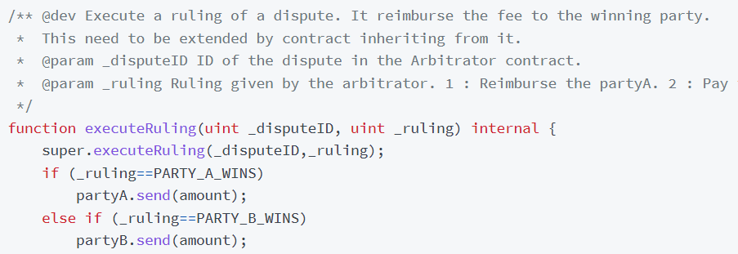
Enforcement of arbitral award
Award is directly enforced through the smart contract:
Contract code grants the arbitrator the access and authority to amend the code of the smart contract, or
Contract code provides a range of outcome to be selected by the arbitrator

Slide 11
How to become an On-Chain Arbitrator
Adapt your knowledge on arbitration rules and procedures to suit on-chain arbitration
Always ensure to respect due process and safeguards and verify the rules of the platform
Join trainings and develop knowledge about code and blockchain to craft an appropriate remedy
Develop expertise for technical disputes (ex. crypto assets) to join specialist pools of arbitrator
Build your reputation : online presence / reviews (viewed by parties)

Slide 12
Take away
Proliferation of smart contracts
e.g. crypto assets, financial services, insurance, Internet of things, supply chains…
Adaptation to tech revolution
Train arbitrators
Adopt rules like UK Digital Dispute Resolution Rules
Partner or create arbitration platforms

Slide 13
Thank you for your attention
Questions?
 | Bernard Colas, LL.D Avocat | Attorney T 514 288-2726 # 241 | bcolas@cmkz.ca 2020, boul. Robert-Bourassa #1920, Montréal, QC, H3A 2A5, Canada
Droit des affaires et du commerce international | International Trade and Business Law

