Slide 1
Smart Contracts
The commercial application of smart contracts and arbitration of smart contract disputes
Gauthier Vannieuwenhuyse
24 November 2022

Slide 2
Outline
Introduction to smart contracts
Commercial applications of smart contracts
Smart contract arbitration
Platforms for smart contract arbitration

Slide 3
Introduction to smart contracts

Slide 4
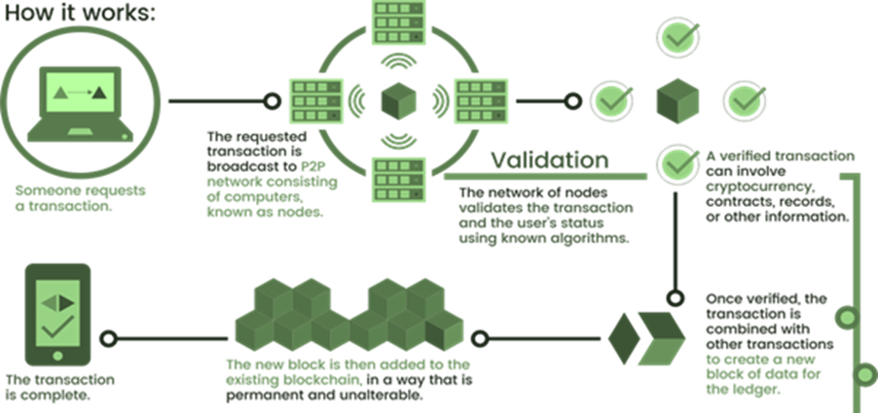
Blockchain
Blockchain technology is a digital, distributed ledger allowing for the transfer of property or information without the use of an intermediary.

Slide 5
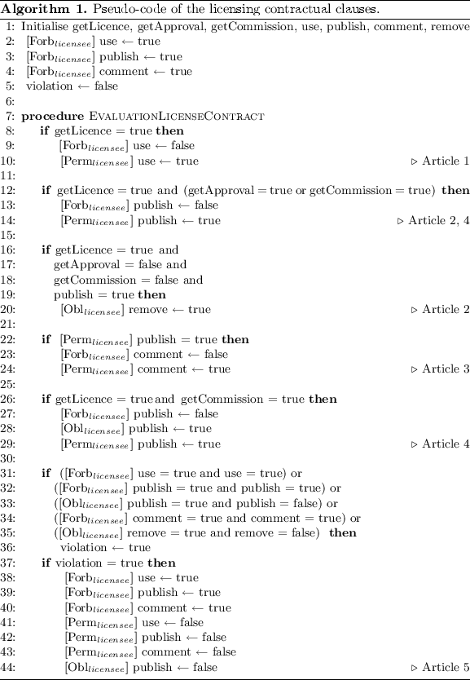
Smart contracts
Smart contract consists of self-executing electronic instructions drafted in computer code, using blockchain technology as a platform.
Programmed based on “if-then” logic
Oracle – an external source, which triggers a particular contractual outcome.
Quote source (optional)

Slide 6
Commercial application of smart contracts

Slide 7
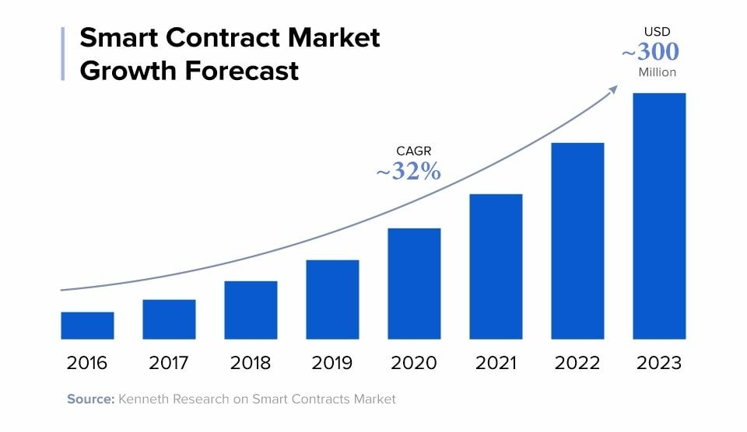
Application of smart contracts
Financial transactions
Peer-to-peer (P2P) cryptocurrency transactions
Decentralised transactions e.g. lending, borrowing and trading on P2P basis

Slide 8
Application of smart contracts (cont’d)
Insurance contracts
Contract stipulates source of data e.g. police reports, claim process is automated
E.g. Fizzy AXA was a type of flight insurance that paid compensation when a flight was delayed for more than 2 hours. Payment made within days of trigger event
Supply chain management
Eliminates procurement agents (P2P payments possible)
Eliminates middlemen in financing (no need for letters of credit)

Slide 9
A detailed example
Smart contracts in the construction industry
Payment
Contract programmed to transfer funds to make progress payments automatically when milestones are reached
Collateral can be held in a crypto wallet to ensure that funds are available for payment
Supply chain management
Automated ordering of materials upon entering a new phase of construction
Data sharing
Contractors and subcontractors can access detailed building plans e.g. which type of nuts and bolts to use
Automatic and immediate updates on changes to plan or delays

Slide 10
Smart contract arbitration

Slide 11
Smart contracts and potential disputes
Reasons for potential disputes
Human error
Bugs disputes
Discrepancies between the contract and its coded version
Functioning of smart contracts
Inaccurate information →invalid contract/no payment
Some concepts can’t be coded
Regulatory issues

Slide 12
Types of smart contract arbitration
In a galaxy not too far away…
Off-chain arbitration
On-chain arbitration
“Traditional” arbitration with humans as arbitrators.
Need for specific rules of smart contract arbitration.
Registration of the decision on a blockchain.
Arbitral tribunal = Oracle
Provide input for action by smart contract
Permit a self-executing arbitral decision
Three forms:
Algorithms as arbitrators:
Resolution based on the analysis of similar transactions/disputes
Central administering authority for arbitrating disputes by the transaction platform.
Delocalised adjudicative proceedings by humans.

Slide 13
Benefits of smart contract arbitration
Benefits of arbitration
Benefits of smart contracts
Flexibility
Decentralized process
Enforceability

Slide 14
Platforms for smart contract arbitration

Slide 15
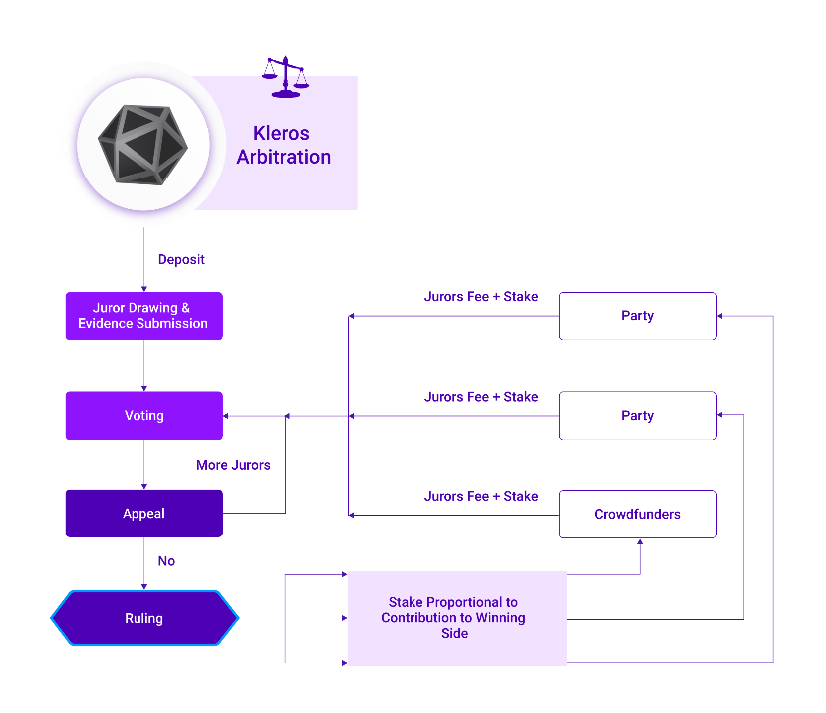
Platforms for smart contract arbitration
Kleros
Decentralised dispute resolution protocol (implemented using Ethereum)
Operating since 2018, more than 1000 cases decided
“Jurors” are crowdsourced
Applies game theory incentives to encourage jurors to decide cases correctly – must stake tokens in order to participate as juror
Other platforms
Aragon (since Nov 2019)
Jur (not operational yet)
Image: Kleros

Slide 16
Legal challenges of smart contract arbitration
Constitutional considerations
Award enforcement
Potential issues: due process considerations, composition of the tribunal, form & content of award
Case study: Kleros award enforced by Mexican court in 2021
Tenancy dispute
Arbitration agreement stipulated that arbitrator should draft a Procedural Order addressed to Kleros, which would then run arbitration protocol to determine dispute
Arbitrator incorporated Kleros decision into arbitral award

Slide 17
www.hoganlovells.com
"Hogan Lovells" ou le "Cabinet" est un cabinet d'avocats international comprenant Hogan Lovells International LLP, Hogan Lovells US LLP et leurs affiliés.
Les termes "associé" ou "partner" désignent un membre ou un associé de Hogan Lovells International LLP, de Hogan Lovells US LLP ou de l’une leurs entités affiliées, ou un employé ou un consultant de statut équivalent. Certaines personnes, désignées comme associés ou partners, mais qui ne sont pas membres de Hogan Lovells International LLP, ne jouissent pas de qualifications professionnelles équivalentes à celles d’un membre.
Pour plus d'information sur Hogan Lovells, les associés et leurs qualifications professionnelles respectives, voir www.hoganlovells.com.
Lorsque des études de cas sont reprises, les résultats obtenus ne constituent pas une garantie de résultats similaires pour les autres clients.
© Hogan Lovells 2018. Tous droits réservés.

