Slide 1
WHY INVEST AND CARRY OUT BUSINESS IN UGANDA
AG. SECRETARY GENERAL UNCCI
OWOMUGISHA BLESSING IMMACULATE

Slide 2
BRIEF ABOUT UNCCI
BACKGROUND
MEMBERSHIP
JURISDICTION
SERVICES
Policy And Structural Representation
Research and market access
Business development and trade facilitation services
Issuance of certificate of Origin
Private Sector Advocacy
Business networking and information dissemination services
Has126 district branches
10 regional offices with Head offices in Gulu, Mbarara, Mbale and Head office in Kampala.
Oldest Private sector Umbrella body and Member owned Business organization.
Membership of 40,000.
multi-sectoral;
Small, medium and large business company component

Slide 3
UGANDA AT A GLANCE
The Top Ugandan Exports to Sudan are;
Over US$357 Million during 2021, according to the United Nations COMTRADE database on international Trade - was last updated on April of 2022.
Coffee, tea, cane, cereal flours, cement and other raw materials
The top exports of Sudan to Uganda are;
Over US $ 86.7 million during 2020, per the United Nations COMTRADE database on International Trade.
Gold, disinfectant among others
land linked country located in East Africa
Uganda’s Popn is of approximately 44 Million people
Uganda shares borders with South Sudan in the north, Kenya in the east, the United Republic of Tanzania in the south, Rwanda in the southwest and the Democratic Republic of Congo in the west.
English is the language of Instruction in the Education system.
It has an area size of 0.241 million sq km. Uganda is the third largest economy in East Africa after Kenya and Tanzania..

Slide 4
WHY INVEST IN UGANDA UGANDA
Common Market for Eastern and Southern Africa (COMESA)
African Continental Free Trade Area (AfCFTA
East African Community (EAC)
Uganda also joined the Common Market for Eastern and Southern Africa (COMESA) free trade area that spans from Libya in the north to Swaziland in the south with over 560m people.
2015, the trading blocs took another massive step towards integration and signed the EAC-COMESA-SADC (Southern African Development Community) Tripartite Free Trade Area, which aims to increase economic cooperation between the three massive organizations.
Uganda was one of 55 African Countries that ratified AFCFTA and a signatory to the free trade area’s initial framework, which aims to harmonize trade liberalization, remove tariffs on 90 per cent of goods and create a single continental market and customs union.
Uganda is a central member of the East African Community (EAC) a home to around 180 million people and one world’s fastest-growing regional economic blocs, and continues to deepen cooperation amongst its members. Its stated goal is the creation of an East African Federation.

Slide 5
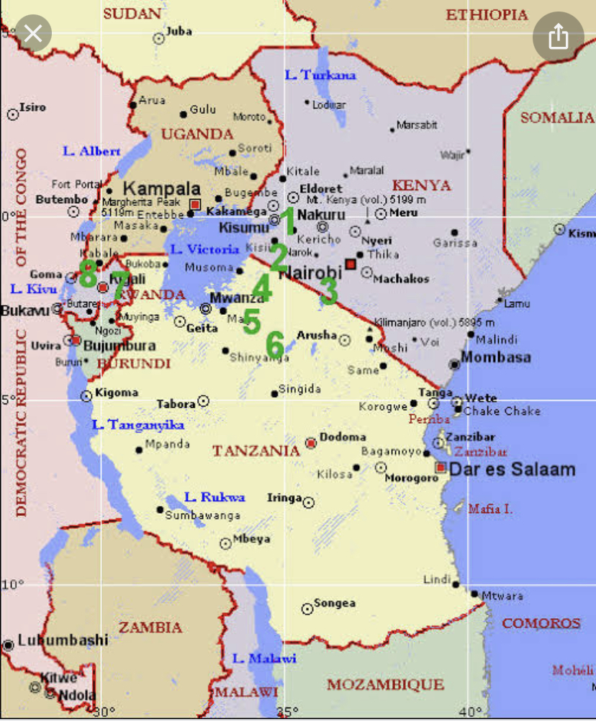
Uganda’s membership of blocs such as the East African Community and COMESA enables it to reach far beyond its home market of 40 million people, while it is also advocating for global market access that Investors from Malaysia can highly benefit from.

Slide 6
INCENTIVIZED EXPORT-BASED BUSINESS
Gov’t has provided various fiscal incentives through the respective tax laws which makes it non -discriminatory and accessible to both domestic and foreign investments.
Attracting mutually beneficial investment
Incentives Include Tax And Duty Exemptions
FREE ZONES
Demonstrated by new legislation to make doing business easier, more efficient and more lucrative for all parties involved through timely business registration, permit acquisition, very minimal capital requirement to investors ( 10,000 dollars) and , operationalized both the physical and online One Stop Center (OSC) that allows investors to get licenses within hours – two days at the most – as well as simplifying a number of regulations and procedures for investment
unrestricted remittance of profit after tax. Under the legislation, investors in designated areas of Uganda enjoy fiscal incentives including exemptions from taxes and duties on Machinery, unrestricted remittance of profit after tax, and VAT exemptions, to name but a few. All these leverage the trade engagement in east and central Africa.
In September 2014, Uganda passed a law authorizing free zones, special economic areas that are now being made available to export-oriented investors.

Slide 7
INVESTMENT INCENTIVES
10 year tax holiday for investor who uses at least 70% of locally sourced raw materials, and employs at least 70% EAC citizens who must take up at least 70% of the wage bill.
100% deduction of training expenditure for Employers who train permanent residents or provide tertiary education not exceeding in the aggregate 5 years
VAT exemptions on the health sector
Tax exemption on importation of Plant and machinery , inputs that cant be locally sourced for agro processing, mining & mineral beneficiation, leather industry
• Carry forward losses and various allowable deductions e.g. construction and set up set backs.
10 year income tax holiday for companies/ industries exporting 80 % of their products
10 year income tax holiday for developers of Industrial Parks (IPs) and free zones (FZs) - at least $ 50 million for foreigners and $ 10m for domestic investors.
10 year income tax holiday for operators of IPs and FZs - at least $ 10 million (foreign) and $30,000 (EAC members)
10 year income tax holiday for businesses outside the IPS and FZs for investments at least $ 10 million (foreign) and $ 30,000 (domestic)
Sector specific incentives especially in agriculture, transport, education, manufacturing and energy sectors.

Slide 8
BRIDGING THE AFRICAN GAP INFRASTRUCTURAL DEVELOPMENT.
3
5
1
Uganda understands that the country cannot unlock the potential of its human and material resources without providing genuinely high-quality infrastructure. To this end, the land-locked nation is currently engaged in a major overhaul of its air, rail, water and road transport sectors
Entebbe International Airport is being prepared to increase the number of passengers it handles each year from the current potential 3.5 million. By the same token, cargo volumes are expected double to 400,000 tones per year over the same period. Hand in hand with greater volume at Uganda’s prime airport.
Close to £1 billion was set aside for continued public works to boost Uganda’s air-transport capacity and make surface movement faster and easier within its own borders and to speed goods towards ports on Africa’s east coast.

Slide 9
Uganda has prioritized international peace and security, calling on others to follow its lead. Conflict entails enormous and multifaceted costs , direct Human suffering and socio economic disruptions
A peaceful and stability environment encourages Business growth and access to a variety of markets and he is an enabler for and outcomes of development.
Countries that are well governed and stable like Uganda better placed to avoid the horrors of conflict and overcome the obstacles of development.

Slide 10
THE POPULATION OF UGANDA
Uganda has one of the youngest world people in World that accounts for approximately 41.6 million people. Over 75% of this population are young people between the age of 18 to 35 years.
This population is very beneficial to the growth and development of the business sector not only in Uganda but across Africa in the following ways
.
Provision of skilled, trained, educated and affordable labor for the investor s in factories, industries, Agricultural Implementation, mining among others.
Provision of ready market for the produced goods across Africa

Slide 11
Uganda is covered by over 37,000 SQ.KM of fresh water bodies that harbor rare species and exuberant flora. L. Victoria is one of the largest water bodies and R. Nile the longest. The Water bodies are very beneficial for tourism, fishing activities and also as mode of transport. These fresh water bodies connect Uganda to very many surrounding African countries that make inter-country trade very conducive
THE PEARL OF AFRICA IN LINE WITH TOURISM AND LAND SCAPE
In additional, its gifted with gorillas, chimpanzees and big five of lions, leopards, elephants, rhinos and buffalo to zebras, giraffes and hippos. Remarkably, it is a home to 11 per cent of the world’s known bird species.
Uganda is the Bridge that leverages the trade of almost all the African Countries and presents a very unique opportunity for the investors to be a part of the growth and business development and access to Africa

Slide 12
THE OIL AS A DRIVE FOR THE DEVELOPMENT OF ECONOMIES IN AFRICA
Uganda is soon to join the club of oil-exporting nations, but the country’s leadership realizes that the long-term future lies in creating sustainable infrastructure to provide clean energy for generations to come. Major new hydroelectricity projects are set to power the needs of a growing economy and bring the whole nation onto the grid.
The imminent switching on of two hydro plants in a country where more than 80 per cent of the energy generated comes from renewable sources and discovery of petroleum in the Lake Albert Rift Basin in northwestern Uganda, and advanced plans to both export and refine crude oil has made Uganda outstanding and a target of many nations in line with Business Operations and create a lot of business opportunities.
Uganda is constructing the 1,445-kilometre East Africa Crude Oil Pipeline to the Tanzanian port of Tanga, the $3.5 billion pipeline has joined the Uganda National Oil Company, Tanzania Petroleum Development Corporation, China’s CNOOC Group, France’s Total and the UK’s Tullow Oil as investors.
The 600-megawatt (MW) Karuma and 183MW Isimba hydroelectric facilities effectively double Uganda’s energy capacity at a stroke, allowing for increased rural electrification and boosting Uganda’s industrialization drive. The extra power helps keep costs low for manufacturers and other intensive energy users

Slide 13
THANK YOU AND WELCOME TO INVEST IN THE PEARL OF AFRICA.

