Slide 1

Presented by Aaron Tembo
Legal Counsel & Board Secretary

Slide 2


Presentation Outline
An overview of the Zambia Qualifications Authority
The National Qualifications Framework
Prohibition from employment or enrollment of persons with unverified qualifications

Slide 3
Legal Mandate
ZAQA is a Statutory body under the Ministry of Education.
Established by the ZAQA Act No.13 of 2011 which has been Repealed and Replaced by ZAQA Act No.8 of 2024
Statutory Instrument No.4 of 2018

Slide 4
Primary Role of the Zambia Qualifications Authority
Custodian of ALL Zambia Qualifications and Reference point for Foreign Qualifications
Registration of Qualifications on the NQF
Maintain a database of Learner Achievement records in Zambia
Verification and Evaluation of Qualifications
Implementation and maintenance of the National Qualifications Framework (NQF)
Ensure that Standards and registered qualifications are internationally comparable
Develop National Occupational Standards
Develop Level Descriptors and NQF Policies

Slide 5
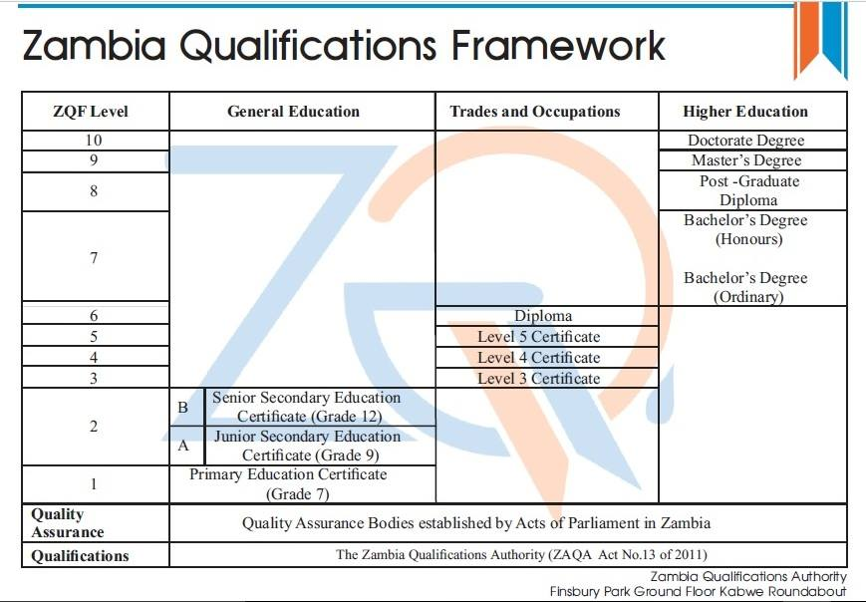

Slide 6

ZQF LEVEL DESCRIPTOR DOMAINS
Foundational Competence
Reflexive Competence
Practical Competence

Slide 7
LEVEL DESCRIPTORS
Foundational
Competence
Based on knowledge, Knowledge is what a graduate comprehends and assimilates
Simple topic to Multidisciplinary
Practical
Competence
Based on Skills developed
Reflexive
Competence
Application of knowledge and Skills
General or Specialized
Concrete to abstract
Combination of depth and breath of knowledge
Autonomy, Responsibility, Accountability
Predictable VS Un predictable, Known VS Unknown, Routine VS none routine
Cognitive and creative skills
Technical Psychomotor, dexterity etc.
Communicational Skills
Interpersonal Skills

Slide 8
Prohibition of employment, appointment or enrollment without verification of qualification
Section 29 of the Act makes it an offence to employ a person whose qualifications are not verified by the Authority.
Section 29 also makes it an offence to enroll a person in a higher education institution or an institution registered under the TEVETA Act of 1998 if that person’s qualifications are not verified by the Authority.

Slide 9
Penalty
A person who contravenes section 29 of the Act is liable upon conviction to a fine not exceeding one hundred thousand penalty units or to imprisonment for a term not less than one year or to both.
Who is liable to prosecution? The offence is committed by the body corporate or incorporate. However, where the offence is committed with the knowledge, consent or connivance of the director, manager, shareholder or partner, that director, manager, shareholder or partner is liable in their individual capacity.

Slide 10

Verification of Qualifications: How to Apply
The public can access services for verification of qualifications from the ZAQA website www.zaqa.gov.zm.
The process is undertaken online from start to finish. Once finalised an electronic certificate is issued, the electronic certificate is downloadable, and has a QR code which can be scanned for confirmation of the certificate in real time.
ZAQA is required to verify local qualifications within 14 days and 60 days for foreign qualifications.
Verification exercise is a once off process.

Slide 11

REGISTERED OFFICE
Ground Floor, Finsbury Park, Kabwe Roundabout
Lusaka
Tel: +260 211 843050/ 843052/ 843053
Mobile: +260 963 922 730/ 0956 037 185
WhatsApp: 0972 559 301
Email: info@zaqa.gov.zm
Website: www.zaqa.gov.zm

Slide 12

Thank you!

