Slide 1
WE ARE KSM
Making a Difference

Slide 2
We have Grown
Founded 3rd June, 2011
Zambia’s No.1 HR Solutions Provider
Now in Kitwe – to service Copperbelt Clients
Making a Difference

Slide 5
We are Your
HR Business Partner

Slide 7
BIG THANK YOU TO OUR CLIENTS

Slide 8
OUR 2023 – 2024 JOURNEY
HR MINING INDABA

Slide 9
OUR 2023 – 2024 JOURNEY
HR INDABA

Slide 10
OUR 2023 – 2024 JOURNEY
STUDENTS’ EXPO

Slide 11
Those that are set free
….
Are
free indeed!

Slide 12
OUR 2023 – 2024 JOURNEY
THANKING GOD AND CEEBRATING ZAMBIA AT 60

Slide 13
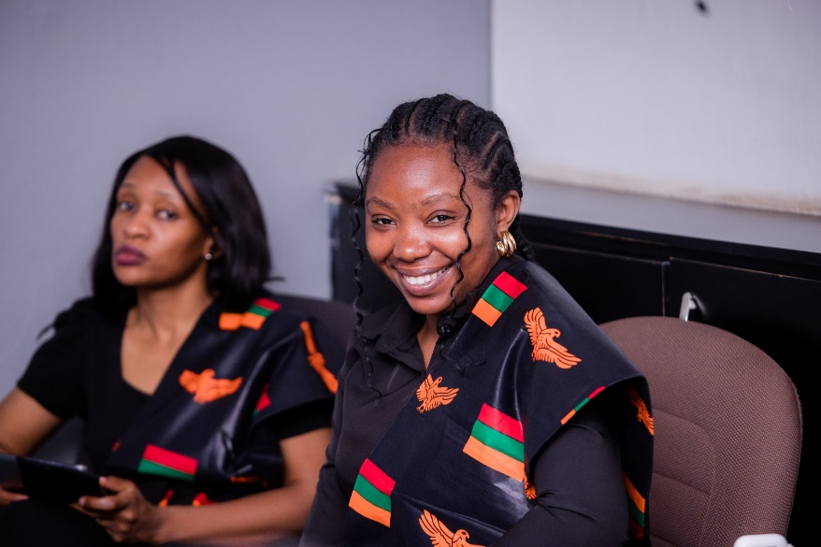
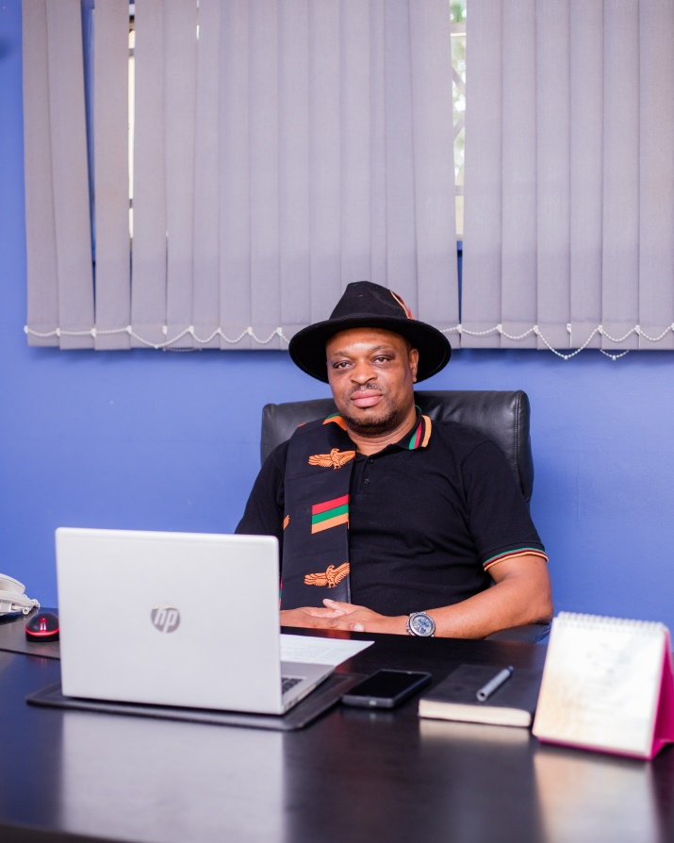
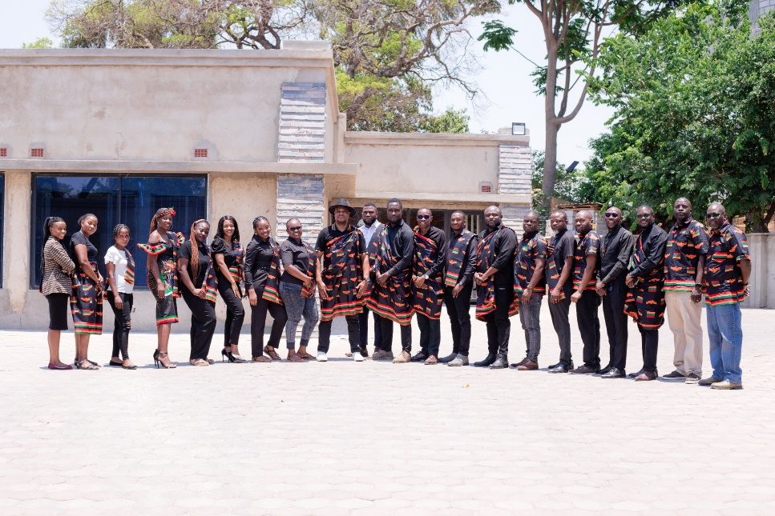
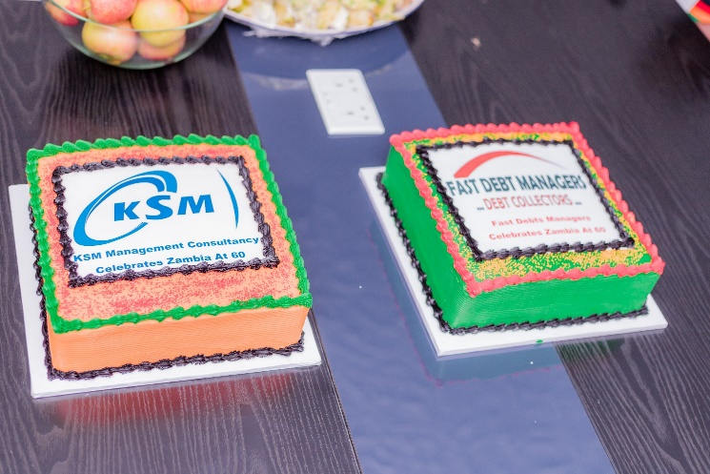
Independence Celebrations
PROUDLY ZAMBIAN

Slide 14
WE ARE KSM – thank you
Making a Difference

