Slide 1
TMAP – International Tax Summit
Ease of Doing Business in ASEAN
29 August 2024

Slide 2
ASEAN - Overview
Ease of Doing Business
Attracting FDI
Q&A

Slide 3
ASEAN - Overview
01

Slide 4
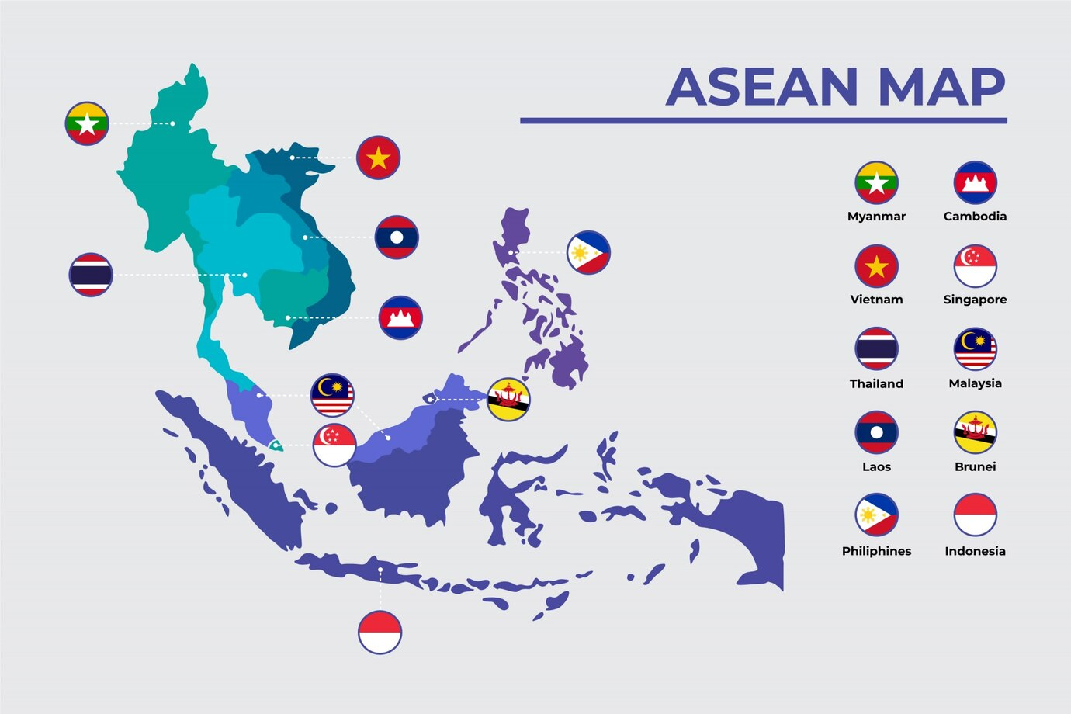
ASEAN - Overview
Market
Population
GDP
Trade data
680 million
US$ 3.8 trillion
Total export
~ US$2.0 trillion
ASEAN 23%
China 15%
USA 15%
EU 9%
Japan 7%
680million
USD 3,810 billion
Total import
~US$ 1.9 trillion
China 23%
ASEAN 22%
Japan 7%
USA 7%
EU 6%
Designed by Freepik
Notes:
As of 2023, the population of the Association of Southeast Asian Nations (ASEAN) is estimated to be over 680 million people. This figure includes the populations of the ten member countries: Brunei, Cambodia, Indonesia, Laos, Malaysia, Myanmar, the Philippines, Singapore, Thailand, and Vietnam.
ASEAN is the third-largest economy in Asia and the fifth-largest in the world. Being among the most sizable emerging markets globally, the bloc possesses considerable consumption potential. This makes the ASEAN region critical for China to tackle problems caused by its weak domestic demand and overcapacity in production.
The trade data from 2022 shows 69% of export are going to these 5 territitories and65% of imports are coming from the same top 5 territories

Slide 5
Ease of Doing Business
02

Slide 6
EASE OF DOING BUSINESS
World Bank - Ranking
Publication of World bank
Assess the absolute level of regulatory performance
Score on indicators reflects the economy’s regulatory performance
Indicators:
Starting a business
Dealing with construction permits
Getting electricity
Registering property
Getting credit
Economy | Global Rank
Singapore | 2
Malaysia | 12
Thailand | 21
Brunei Darussalam | 66
Vietnam | 70
Indonesia | 73
Philippines | 95
Cambodia | 144
Lao PDR | 154
Myanmar | 165
Protecting minority investors
Paying taxes
Trading across borders
Enforcing contracts
Resolving insolvency
Notes:
Last publication was in 2020:
The ease of doing business score helps assess the absolute level of regulatory performance over time. It captures the gap of each economy from the best regulatory performance observed on each of the indicators across all economies in the Doing Business sample since 2005. One can both see the gap between a particular economy’s performance and the best performance at any point in time and assess the absolute change in the economy’s regulatory environment over time as measured by Doing Business. An economy’s ease of doing business score is reflected on a scale from 0 to 100, where 0 represents the lowest and 100 represents the best performance. For example, an ease of doing business score of 75 in Doing Business 2019 means an economy was 25 percentage points away from the best regulatory performance constructed across all economies and across time.
Starting a business Dealing with construction permits Getting electricity Registering property Getting credit Protecting minority investors Paying taxes Trading across borders Enforcing contracts Resolving insolvency

Slide 7
EASE OF DOING BUSINESS
Taxes
Economy | Overall ranking
Singapore | 7
Thailand | 68
Malaysia | 80
Indonesia | 81
Brunei Darussalam | 90
Philippines | 95
Vietnam | 109
Myanmar | 129
Cambodia | 138
Lao PDR | 157
Assessing the types of taxes, administrative burden of paying taxes and complying with post filing procedures
Taxes and contributions that are government mandated
Ranking is based on outcome from tax experts applying a set scenario and assumptions to arrive at the total tax and mandatory contributions due
Same information set is used to determine the time spent on the recurring ﬁlings and payments to comply with tax laws
Notes:
World Bank Doing Business records the taxes and mandatory contributions that a medium- size company must pay in a given year as well as measures of the administrative burden of paying taxes and contributions and complying with postfiling procedures. The project was developed and implemented in cooperation with PwC. Taxes and contributions measured include the proﬁt or corporate income tax, social contributions and labor taxes paid by the employer, property taxes, property transfer taxes, dividend tax, capital gains tax, ﬁnancial transactions tax, waste collection taxes, vehicle and road taxes, and any other small taxes or fees.
Doing Business measures all taxes and contributions that are government mandated (at any level—federal, state or local) and that apply to the standardized business and have an impact in its ﬁnancial statements. In doing so, Doing Business goes beyond the traditional deﬁnition of a tax. As deﬁned for the purposes of government national accounts, taxes include only compulsory, unrequited payments to general government. Doing Business departs from this deﬁnition because it measures imposed charges that affect business accounts, not government accounts. One main difference relates to labor contributions. The Doing Business measure includes government-mandated contributions paid by the employer to a requited private pension fund or workers’ insurance fund. It includes, for example, Australia’s compulsory superannuation guarantee and workers’ compensation insurance. For the purpose of calculating the total tax and contribution rate (deﬁned below), only taxes borne are included. For example, value added taxes (VAT) are generally excluded (provided that they are not irrecoverable) because they do not affect the accounting proﬁts of the business—that is, they are not reflected in the income statement. They are, however, included for the purpose of the compliance measures (time and payments), as they add to the burden of complying with the tax system.
Paying Taxes, a study from PwC and the World Bank Group, was published annually from 2006 to 2019 using data from the World Bank Group's Doing Business Study. In September 2021, the World Bank announced that it has discontinued Doing Business and therefore the Paying Taxes data on this page is not current and will only be retained for reference, but will not be updated going forward.
Paying Taxes provided 15 years of data and comparative analysis on the tax systems in 191 economies to help governments and businesses understand how their tax systems compared on the global stage and to help tax administrations learn from others.
The structure of a country’s tax code is a determining factor of its economic performance. A well-structured tax code is easy for taxpayers to comply with and can promote economic development while raising sufficient revenue for a government’s priorities. In contrast, poorly structured tax systems can be costly, distort economic decision-making, and harm domestic economies.
Many countries have recognized this and have reformed their tax codes. Over the past few decades, marginal tax rates on corporate and individual income have declined significantly across the Organisation for Economic Co-operation and Development (OECD). Now, most OECD nations raise a significant amount of revenue from broad-based taxes such as payroll taxes and value-added taxes (VAT).[1]
Not all recent changes in tax policy among OECD countries have improved the structure of tax systems; some have made a negative impact. Though some countries like the United States and France have reduced their corporate income tax rates by several percentage points, others, like Colombia, have increased them. Corporate tax base improvements have occurred in Portugal, while the corporate tax base has been made less competitive in Belgium. The United States, the United Kingdom, and Chile are phasing out temporary improvements to their corporate tax bases.
The COVID-19 pandemic has led many countries to adopt temporary changes to their tax systems. Faced with revenue shortfalls from the downturn, countries will need to consider how to best structure their tax systems to foster both an economic recovery and raise revenue.
The variety of approaches to taxation among OECD countries creates a need to evaluate these systems relative to each other. For that purpose, we have developed the International Tax Competitiveness Index—a relative comparison of OECD countries’ tax systems with respect to competitiveness and neutrality.
The ranking of economies on the ease of paying taxes is determined by sorting their scores for paying taxes. These scores are the simple average of the scores for each of the component indicators, with a threshold and a nonlinear transformation applied to one of the component indicators, the total tax and contribution rate. The threshold is deﬁned as the total tax and contribution rate at the 15th percentile of the overall distribution for all years included in the analysis up to and including Doing Business 2015, which is 26.1%. All economies with a total tax and contribution rate below this threshold receive the same score as the economy at the threshold.
The threshold is not based on any economic theory of an “optimal tax rate” that minimizes distortions or maximizes efficiency in an economy’s overall tax system. Instead, it is mainly empirical in nature, set at the lower end of the distribution of tax rates levied on medium-size enterprises in the manufacturing sector as observed through the paying taxes indicators. This reduces the bias in the total tax and contribution rate indicator toward economies that do not need to levy signiﬁcant taxes on companies like the Doing Business standardized case study company because they raise public revenue in other ways—for example, through taxes on foreign companies, through taxes on sectors other than manufacturing or from natural resources (all of which are outside the scope of the methodology).
Doing Business measures all taxes and contributions that are government mandated (at any level—federal, state or local) and that apply to the standardized business and have an impact in its ﬁnancial statements. In doing so, Doing Business goes beyond the traditional deﬁnition of a tax. As deﬁned for the purposes of government national accounts, taxes include only compulsory, unrequited payments to general government. Doing Business departs from this deﬁnition because it measures imposed charges that affect business accounts, not government accounts. One main difference relates to labor contributions. The Doing Business measure includes government-mandated contributions paid by the employer to a requited private pension fund or workers’ insurance fund. It includes, for example, Australia’s compulsory superannuation guarantee and workers’ compensation insurance. For the purpose of calculating the total tax and contribution rate (deﬁned below), only taxes borne are included. For example, value added taxes (VAT) are generally excluded (provided that they are not irrecoverable) because they do not affect the accounting proﬁts of the business—that is, they are not reflected in the income statement. They are, however, included for the purpose of the compliance measures (time and payments), as they add to the burden of complying with the tax system.
Doing Business uses a case scenario to measure the taxes and contributions paid by a standardized business and the complexity of an economy’s tax compliance system. This case scenario uses a set of ﬁnancial statements and assumptions about the transactions made over the course of the year. In each economy tax experts from a number of different ﬁrms (in many economies these include PwC) compute the taxes and mandatory contributions due in their jurisdiction based on the standardized case study facts. Information is also compiled on the frequency of ﬁling and payments, the time taken to comply with tax laws in an economy, the time taken to request and process a VAT refund claim and the time taken to comply with and complete a corporate income tax correction.
The International Tax Competitiveness Index
The International Tax Competitiveness Index (ITCI) seeks to measure the extent to which a country’s tax system adheres to two important aspects of tax policy: competitiveness and neutrality.
A competitive tax code is one that keeps marginal tax rates low. In today’s globalized world, capital is highly mobile. Businesses can choose to invest in any number of countries throughout the world to find the highest rate of return. This means that businesses will look for countries with lower tax rates on investment to maximize their after-tax rate of return. If a country’s tax rate is too high, it will drive investment elsewhere, leading to slower economic growth. In addition, high marginal tax rates can impede domestic investment and lead to tax avoidance.
According to research from the OECD, corporate taxes are most harmful for economic growth, with personal income taxes and consumption taxes being less harmful. Taxes on immovable property have the smallest impact on growth.[2]
Separately, a neutral tax code is simply one that seeks to raise the most revenue with the fewest economic distortions. This means that it doesn’t favor consumption over saving, as happens with investment taxes and wealth taxes. It also means few or no targeted tax breaks for specific activities carried out by businesses or individuals.
As tax laws become more complex, they also become less neutral. If, in theory, the same taxes apply to all businesses and individuals, but the rules are such that large businesses or wealthy individuals can change their behavior to gain a tax advantage, this undermines the neutrality of a tax system.
A tax code that is competitive and neutral promotes sustainable economic growth and investment while raising sufficient revenue for government priorities.
There are many factors unrelated to taxes which affect a country’s economic performance. Nevertheless, taxes play an important role in the health of a country’s economy.
To measure whether a country’s tax system is neutral and competitive, the ITCI looks at more than 40 tax policy variables. These variables measure not only the level of tax rates, but also how taxes are structured. The Index looks at a country’s corporate taxes, individual income taxes, consumption taxes, property taxes, and the treatment of profits earned overseas. The ITCI gives a comprehensive overview of how developed countries’ tax codes compare, explains why certain tax codes stand out as good or bad models for reform, and provides important insight into how to think about tax policy.
Due to some data limitations, recent tax changes in some countries may not be reflected in this year’s version of the International Tax Competitiveness Index.
2023 Rankings

Slide 8
Attracting FDI
03

Slide 9
Attracting FDI
Deciding to enter foreign markets
Reason to enter foreign market:
opportunities to reduce manufacturing costs
opportunities to reach out to new markets to grow revenue
Factors contributing to successful entry in foreign markets:
language capability
knowledge of local market
ability to manage regulatory environment

Slide 10
Attracting FDI
FDIs in markets
Economy | Global Rank | Starting a business | Protecting minority investors | Paying taxes | Trading across borders
Singapore | 2 | 4 | 3 | 7 | 47
Malaysia | 12 | 126 | 2 | 80 | 49
Thailand | 21 | 47 | 3 | 68 | 62
Brunei Darussalam | 66 | 16 | 128 | 90 | 149
Vietnam | 70 | 115 | 97 | 109 | 104
Indonesia | 73 | 140 | 37 | 81 | 116
Philippines | 95 | 171 | 72 | 95 | 113
Cambodia | 144 | 187 | 128 | 138 | 118
Lao PDR | 154 | 181 | 179 | 157 | 78
Myanmar | 165 | 70 | 176 | 129 | 168
More FDI will help to contribute to growth of GDP
Countries will benefit to score high on indicators in regard to the regulatory performance

Slide 11
Q&A
04

Slide 12
Q&A
??

Slide 13
Gene Kwee
Partner, Head of Tax APAC
135 Cecil Street
#10-01
Singapore 069536
Tel: +65 6224 4022 ext. 1324
gene.kwee@mazars.com.sg

