Slide 1
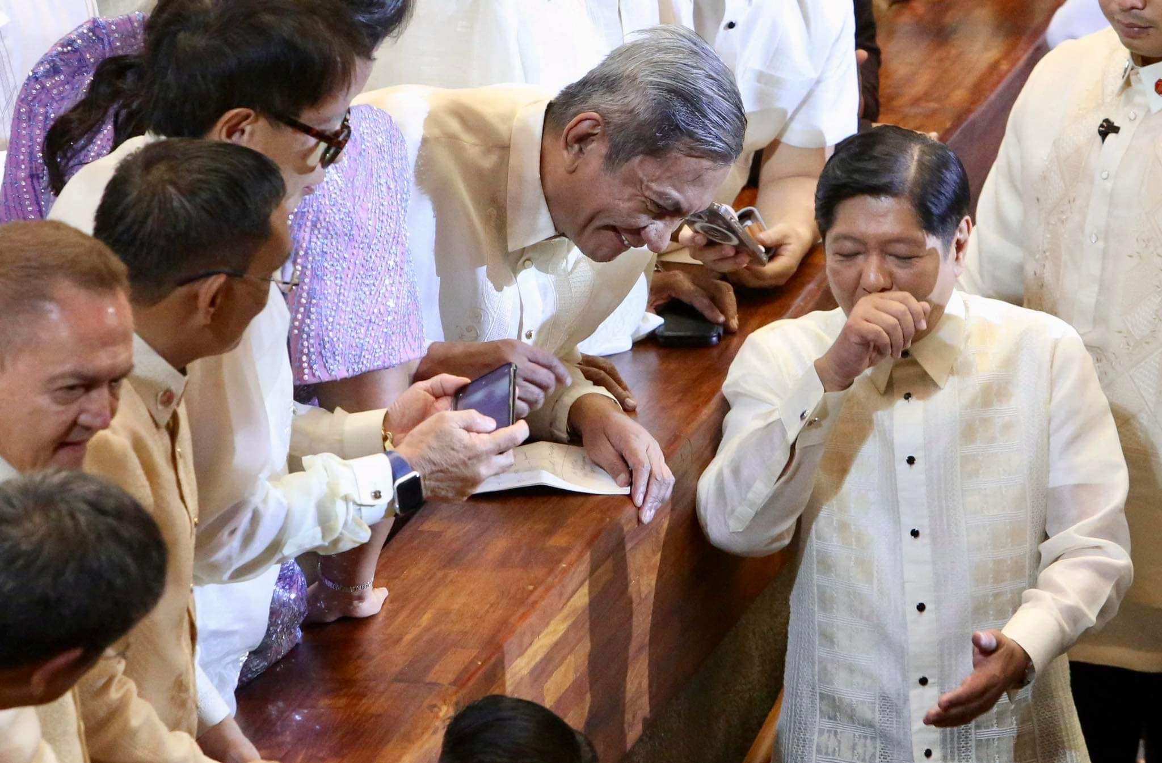
A more robust capital market: Rebuilding economic momentum to 7-8% in 2024 onwards
ECONOMIC POLICY NOTES
Rep. Joey Sarte Salceda
Capital Market Reforms in the Philippines

Slide 2
Cost of capital in the Philippine is very high
 | Moody's rating | Default Spread | Country Risk Premium | Equity Risk Premium | Total Country Risk Premium (2023) | Total Country Risk Premium (2013) | Improvement | Corporate Tax Rate
Philippines | Baa2 | 2.04% | 2.89% | 7.89% | 10.78% | 13.76% | 2.98% | 25.00%
Malaysia | A3 | 1.28% | 1.82% | 6.82% | 8.64% | 9.40% | 0.76% | 24.00%
Indonesia | Baa2 | 2.04% | 2.89% | 7.89% | 10.78% | 12.36% | 1.58% | 22.00%
Vietnam | Ba2 | 3.22% | 4.57% | 9.57% | 14.14% | 22.00% | 7.86% | 20.00%
Thailand | Baa1 | 1.71% | 2.43% | 7.43% | 9.86% | 10.60% | 0.74% | 20.00%
Singapore | Aaa | 0.00% | 0.00% | 5.00% | 5.00% | 5.50% | 0.50% | 17.00%
We now only beat Vietnam among ASEAN 6 for cost of capital, but Vietnam has very strong momentum, as seen in improvement to its risk premium.

Slide 3
Capital market sophistication is low
 | Shorting allowed | Cheapest Index Fund Fee | ETFs | Options trading of index
Philippines | No | 1.00% | 1 | No
Malaysia | Yes | 0.10% | 15 | Yes
Indonesia | Yes | 0.45% | 46 | Yes
Vietnam | No | 0.76% | 1 | No
Thailand | Yes | 0.50% | 11 | Yes
Singapore | Yes | 0.09% | 60 | Yes
The Philippine Stock Exchange is also the least sophisticated stock market in the region, with the most expensive service fees.

Slide 4
Very few options for investors

Slide 5
Taxes on capital markets also very high
We now only beat Vietnam among ASEAN 6 for cost of capital, but Vietnam has very strong momentum, as seen in improvement to its risk premium.

Slide 6
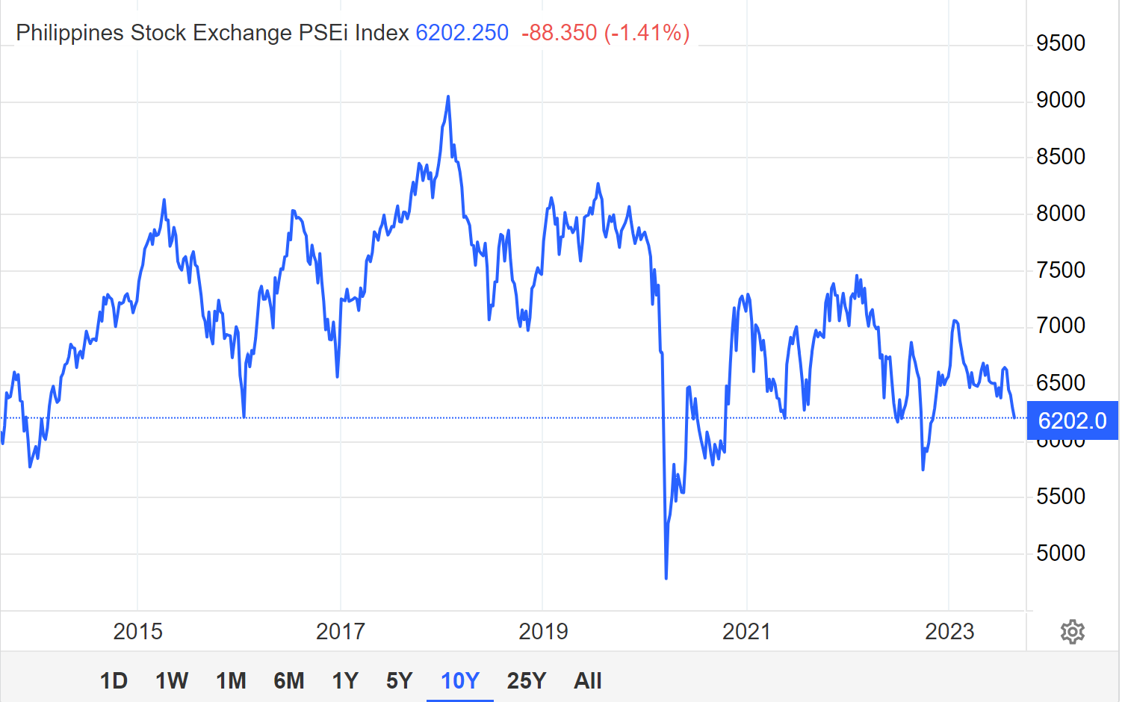
STT is increased from 0.5 to 0.6%

Slide 7
The increase in the STT from 0.5 to 0.6 percent coincided with a 14.8 percent loss in value of the PSE Index. Since the increase in the STT in January 1, 2018, the PSEI has lost 27.7 percent of its value.

Slide 8
Very low insurance penetration rate

Slide 9
How to build a strong capital market
Reduce friction costs – especially taxes
Reduce barriers and costs to investor entry and exit, and provide incentives to entry
Increase available investor options

Slide 10
Features of the Capital Market Efficiency Promotion Act
Reduces the stock transaction tax from six-tenths of one percent (6/10 of 1%) to one-tenth of one percent (1/10 of 1%)
Classifies options and derivatives as stocks for tax purposes

Slide 11
Features of the Capital Market Efficiency Promotion Act
Lowers the dividends tax rate for non-resident aliens from twenty five percent (25%) to ten percent (10%) to harmonize with the cash and property dividends rate

Slide 12
Features of the Capital Market Efficiency Promotion Act
Reduces the documentary stamp tax on policies on property insurance, fidelity bonds and other insurance policies from 12.5% of the premium charged to the following rates:
Range of coverage | Tax Rate
< ₱100,000.00 | Exempt
>₱100,000.00 to < ₱300,000.00 | ₱20.00
>₱300,000.00 to < ₱500,000.00 | ₱50.00
>₱500,000.00 to < ₱750,000.00 | ₱100.00
>₱750,000.00 to < ₱1,000,000.00 | ₱150.00
>₱1,000,000.00 | ₱200.00

Slide 13
Features of the Capital Market Efficiency Promotion Act
Lowers the final tax rate for Philippine Charity Sweepstakes Office (PCSO) and lotto winnings from twenty percent (20%) to ten percent (10%);
Reduces the documentary stamp tax on ticket cost on PCSO lotto and horse-race betting from twenty percent (20%) to ten percent (10%); and

Slide 14
Features of the Capital Market Efficiency Promotion Act
The bill allows the Secretary of Finance to define collective investment schemes, which are “any arrangement whereby funds are solicited from the investing public and pooled together for the purpose of investing, reinvesting, or trading in securities or other assets or different classes thereof as allowed under the law.”
This will allow the public to invest in smaller units of shares in large, currently illiquid investments such as real estate.

Slide 15
Why CMEPA over PIFITA
The CMEPA is more responsive. The CMEPA does not include an increase in the dividends tax from 10% to 15%. This would discourage the holding of dividend-paying stocks, which tend to be safer and more mature; this would also disproportionately hurt pension funds and senior citizens, which tend to invest in dividend-producing stocks rather than growth-oriented stocks, which typically do not pay dividends.
The CMEPA also does not include the provision reducing the tax on interest income (from 20% to 15%), where the Committee does not see a clamor for a tax reduction.
The CMEPA is shorter than the PIFITA, and deals with fewer sectors, which could expedite its deliberation

Slide 16
THANK YOU.

