Slide 1
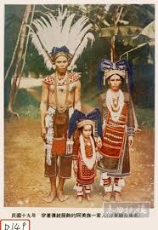
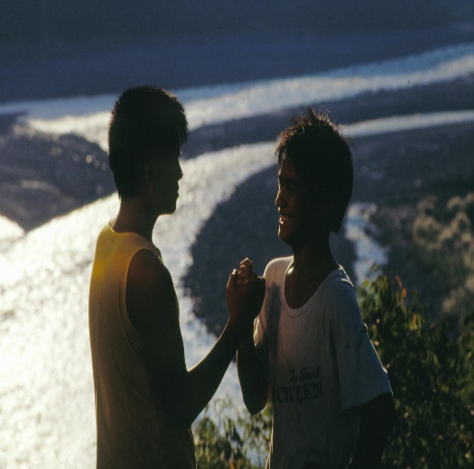
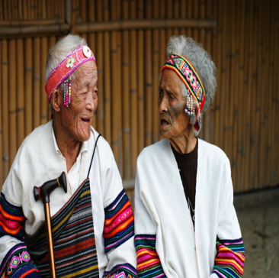
Ethnic Dialogue & Experience Sharing: How Taiwan promoted Indigenous Cultural Safety
Lih-chen Ke
Section Chief
Office of Health & Social Welfare
Council of Indigenous Peoples (CIP)
Notes:
Hi, everyone, I’m glad to be here and speak with you today. I would like to thank the PRIDoC 2022 for giving me the opportunity to share my experience with you.
It is entitled:
Ethnic Dialogue & Experience Sharing: How Taiwan promoted Indigenous Cultural Safety

Slide 2
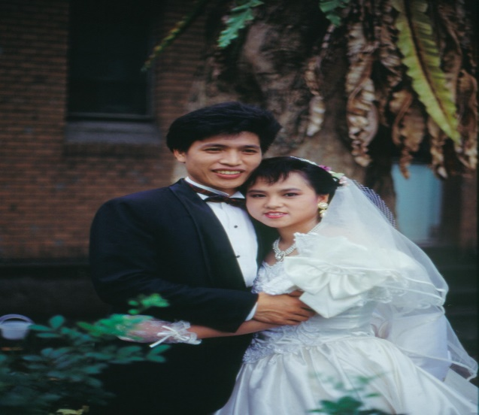
About Me
MS in Health Education from University of Florida (UF)
BS in Nursing from National Taiwan University (NTU)
Member of Shanfu (an Indigenous Services Team at NTU)
Cardiac Nurse, Taipei Veterans General Hospital
Associate Researcher, Institute of Public Health of Taiwan Province
Section Chief,
Department of Health (DOH),
Ministry of Health and Welfare (MOHW)
Section Chief,
Council of Indigenous Peoples (CIP)
A Bunun Mother
Notes:
First of all, a little bit about my background…
After obtaining my BS in Nursing from National Taiwan University (NTU), I was awarded a government scholarship to earn my MS in Health Education from University of Florida (UF).
My first encounter with the Indigenous Peoples was during my undergraduate years at NTU, when I joined Shanfu, an Indigenous Services Team, tutoring for Bunun students in Haiduan (Haitutuan) Township of Taitung County.
I found Indigenous peoples admirably happy-go-lucky by nature. My heart went out to them, so much so that I decided to pursue a career in Public Health simply because I wanted to improve well-being for Indigenous peoples, who are either my friends or my students.
Eventually, I married into Bunun Tribe; my husband was then an elite youth and we were soon blessed with two daughters. In a word, among the roles I played in life, the most important one is a Bunun Mother.
This is a picture of my husband's Tribe.

Slide 3
Outline
 | President Tsai's Indigenous Peoples Policy
 | Cultural Safety Policies for Taiwanese Indigenous Peoples: An Overview
 | Ongoing Efforts
 | Sharing Personal Stories
 | Conclusion
Ⅰ
Notes:
Here’s my Outline. Step by step, I will walk you through how Taiwan has been implementing its Cultural Safety Policies for Taiwanese Indigenous Peoples.

Slide 4
President Tsai's Indigenous Peoples Policy
After taking office, on Taiwan's first Indigenous Peoples' Day (August 1, 2016)
Apologized to Indigenous Peoples on behalf of the government
Establish the Presidential Office Indigenous Historical Justice and Transitional Justice Committee
Notes:
After taking office, on Indigenous Peoples' Day (August 1, 2016) President Tsai Ing-wen apologized on behalf of the government to Taiwanese Indigenous Peoples—for four hundred years of exploitation of Indigenous Peoples—while also announcing plans to establish and personally chair the meetings of the Presidential Office Indigenous Historical Justice and Transitional Justice Committee, in order to get the ball rolling and moving towards a thorough understanding of Taiwanese Indigenous Peoples, which can facilitate the implementation of the Indigenous Peoples Policy and help achieve the goal of “making Indigenous peoples mainstream.”

Slide 5
9 Proposed Initiatives
Pursue Transitional Justice
Recognize the Sovereignty of Indigenous Peoples
Recognize Indigenous Peoples’ Right to Autonomy & Self-determination
Protect Indigenous Peoples’ Land Rights through Legislation
Job Guarantee to secure tens of thousands of new job opportunities
Establish Indigenous Peoples’ Educational Systems
Heed Indigenous Peoples' access to Health Services to Close the Health Inequalities Gap
Grow support network between urban and rural Indigenous Peoples
Respect the Pingpu ethnic group's self-identity
Notes:
President Tsai attaches great importance to Indigenous peoples and has proposed 9 specific initiatives—as listed above—among which, my PowerPoint presentation focuses on “Heed Indigenous Peoples' access to Health Services to Close the Health Inequalities Gap.”

Slide 6
Cultural Safety Policies for Taiwanese Indigenous Peoples
National Ten-year Long-term Care Plan 2.0: The Indigenous Peoples Chapter (2017-2026)
Incorporating Indigenous Cultural Sensitivity Training
Adding 3-hour Basic Training Course designed for all care workers
Including a 14-hours On-the-job Training Program designed for professional care workers, social workers and medical staff
Course content and course instructors are provided by Council of Indigenous Peoples (CIP)
Notes:
At the end of 2016, the Executive Yuan promulgated National Ten-year Long-term Care Plan 2.0 (2017-2026), which for the first time included a special chapter—the Indigenous Peoples Chapter—which, under increasing pressure from all sides, pays close attention to Indigenous Subjectivity by incorporating Indigenous Cultural Sensitivity Training, adding a 3-hour Basic Training Course designed for all care workers as well as a 14-hours on-the-job training program designed for professional care workers , social workers and medical staff, so that long-term care workers can be equipped to provide culturally and linguistically appropriate health care.
As such, Council of Indigenous Peoples (CIP) is responsible for providing course content and course instructors.

Slide 7
3-hour Basic Training Course
Course Goals & Learning Objectives:
Understand the definition and importance of Cultural Sensitivity
Understand the importance of Cultural Safety in Health Care for Indigenous Peoples
Understand standard practices of Culturally Appropriate Health Care and how to deliver them
Design best practices of Culturally Appropriate Health Care
Instructional videos from online and live courses are made available for care workers.
Notes:
On December 19, 2017, the Ministry of Health and Welfare (MOHW) announced the plan to implement a Care Worker Training Program, adding to its core courses a 3-hour course entitled, Introduction to Cultural Safety in Health Care for Indigenous Peoples.
In view of building cultural sensitivity into health care training, the Ministry of Health and Welfare (MOHW) announced its plans to implement a Care Worker Training Program with 60-hour core courses including a 3-hour course, Introduction to Cultural Safety in Health care for Indigenous Peoples.
Course Goals & Learning Objectives:
Understand the definition and importance of Cultural Sensitivity
Understand the importance of Cultural Safety in Health care for Indigenous Peoples
Understand standard practices of Culturally Appropriate Health care and how to deliver them
Design best practices of Culturally Appropriate Health care
Instructional videos from online and live courses are made available in order to make learning more accessible for care workers.
In order to provide the much needed instructors for the Long-term Care Workers Training Program, the Council of Indigenous Peoples (CIP) must conduct at least 250 training sessions per year to train 108 training instructors.
To constantly ensure quality training for care workers, the course content was designed based on expert panel consensus.
The core content is identical with the said online courses, while being enriched by each instructor’s own cultural experience in health care.

Slide 8
Introduction to Cultural Safety: Course Content
Getting to know Taiwanese Indigenous Peoples
Invaded & Colonized history
Current Situation
Health Inequities in Indigenous Peoples
Factors Affecting their Health Status
Disparities in Average Life Expectancy and Mortality Rates between Indigenous and National Population
How to deliver Culturally Safe Care
It takes real training to cultivate cultural sensitivity.
Self-awareness, Empowerment & Advocacy
Case Sharing
Notes:
The core content summarized here aims to achieve the course goals & learning objectives.
Being a training instructor myself, I have attended twenty or so training sessions in which most trainees were non-Indigenous.
Based on my experience, the training courses have generated remarkably good Ethnic Dialogues.
In fact, although they are living on the same land, to most non-Indigenous people, Indigenous peoples are strangers.
Most non-Indigenous people still have deep-seated stereotyped impressions about Indigenous peoples. For example, Indigenous peoples are often stereotyped as people who enjoy drinking alcohol, rarely save money, sing like an angel, play sports like a pro...and so on, …
Most non-Indigenous people have only a vague idea of colonization of the Indigenous peoples, they don't have a clue about disparities in average life expectancy between Indigenous and national population, and they know nothing about Indigenous education gap or unemployment issues.
As people typically discussed history from a mainstream perspective, the Indigenous peoples have always been considered as “the Others” since Indigenous peoples have no written languages.
In what follows, I am going to share with you a few PowerPoint slides from my training sessions.

Slide 9
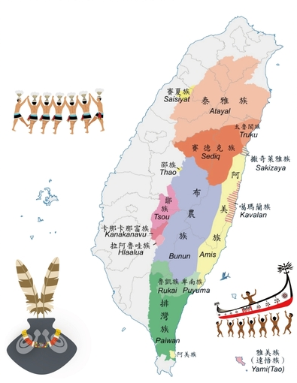
Taiwanese Indigenous Peoples: Current Situation
Number of Ethnic Groups: 16
Population: ~581,000 (2.5%)
Languages:
Austronesian languages
Geographic Distribution:
25 Plains Indigenous Areas
30 Mountain Indigenous Areas
Number of Tribes: 737
Notes:
Most non-Indigenous people in Taiwan have only a very vague idea of the Taiwanese Indigenous Peoples’ Current Situation.
That’s why I'm using this Map of Taiwan to illustrate the situation:
At present, there are 16 Indigenous ethnic groups (officially recognized) in Taiwan. Approximately 581,000 Taiwanese Indigenous Peoples account for 2.5% of the total population Taiwan.
Formosan languages belong to the same Austronesian language family as New Zealand, Hawaii and the Pan-Pacific Islands. For example, if Taiwanese Indigenous Peoples count from 1 to 10, rest assured that several numbers are counted in the same way as Austronesian language family members elsewhere.
Traditional Areas: Most indigenous groups live around the Central Mountain Range, in the East Rift Valley or the East Coastal Area.
In terms of administrative regions, in addition to 30 Mountain Indigenous Areas, there are 25 Plains Indigenous Areas (townships, county-administered cities and districts).
In terms of gregarious settlements, there are approximately 737 tribes.
Nearly half of the Indigenous population has migrated to non- Indigenous areas for education and employment opportunities.
More and more attention is being paid to the right to health for urban Indigenous Peoples as well as their cultural heritage.

Slide 10
Factors Affecting Health Status among Indigenous Peoples
10
High percentage of elderly people in the tribal communities due to urban migration of young and/or middle-aged adults
Low income and high rates of divorce/single-parent families
Remote places with inconvenient transport
High disease & mortality rate
Poor health outcomes due to lack of culturally sensitive health care
Low level of education
Source: Prof. Chao-Kuang Lin (NYCU)
Notes:
Let’s take a look at the Factors Affecting Health Status among Indigenous Peoples listed here.
I think similar Factors Affecting Health Status can be found among people in other countries as well.

Slide 11
Disparities in average life expectancy
between Indigenous and national population
(2011–2020)
Age
Notes:
Considering the disparities in average life expectancy between Indigenous and national population from 2011 to 2020, we can see the gap was being narrowed a tiny bit year in, year out.
Specifically, a gap of 8.58 years in 2011 was narrowed to 7.66 years in 2020—a reduction of 0.92 years in ten years' time.
We still have a long way to go before our objectives can be met.
I am objectively talking about hard data and statistics here. But things are drastically different and heart-rending when I consider the issue from a personal point of view.
For instance, the tribal children I’ve known from my university years were all younger than I.
And when I randomly picked up the old photos I took with my Indigenous students, every single picture was telling me to mourn for one or another Indigenous friend who had passed away.
I was tutoring 10 tribal children at that time, and , as of today, 4 of my Indigenous students are no longer with us here on earth.

Slide 12
The top 10 Causes of Death:
comparing standardized mortality rates
between Indigenous and national population (2020)
Age Standardized Mortality Rates (per 100,000 Population for Deaths)
Notes:
In terms of all the top 10 causes of death, mortality rates of Indigenous Peoples are consistently higher than the national population; among the top 10 causes of death, the largest gaps of mortality rates are from chronic liver cirrhosis and accident injuries.
(Chart data to be confirmed)

Slide 13
Social Determinants of Health Inequities in Indigenous Peoples
Commissioned by the Ministry of Health and Welfare (MOHW) and conducted by the Institute of Health Equity (IHE) at University College London (UCL), a research shows:
The right to health of Indigenous Peoples is being violated due to inappropriate political, economic and institutional factors of the country.
Why did President Tsai Ing-wen apologize to
Indigenous Peoples?
https://www.president.gov.tw/NEWS/20603
Notes:
Based on the above chart, understandably, the root causes of Health Inequities in Indigenous Peoples are not individuals.
Commissioned by the Ministry of Health and Welfare (MOHW) and conducted by the Institute of Health Equity (IHE) at University College London (UCL), a research shows:
The right to health of Indigenous Peoples is being violated due to inappropriate political, economic and institutional factors of the country.
When President Tsai Ing-wen apologized on behalf of the government, she began by stating the reason why she was apologizing to Indigenous Peoples.
This is why: Social Determinants of Health Inequities in Indigenous Peoples.
We are used to looking at a problem from a mainstream perspective, so much so that our society lacks Indigenous Peoples' Perspectives.

Slide 14
Me ►Taiwanese
VS
My husband ►Indigenous People
Notes:
First, let’s look at the picture on the left: In a typical wedding ceremony where wedding cakes are indispensable for a typical Taiwanese mainstream society, the bride wears a western style white wedding dress and pose for wedding photos.
Now, let’s look at the picture on the right. It’s a scene from the traditional wedding ritual of our Bunun tribe: People are slaughtering a wedding pig to share with all tribal members.
As deep manifestations of culture, these pictures speak volumes.
When she was a little girl, my second daughter used to find the traditional wedding ritual entirely unappealing because it’s so very unromantic.
Growing up, she gradually became aware of the cultural heritage importance for our Bunun Tribe, and now, to my great delight, she’s willing to embrace the traditional wedding ritual.
When the occurrence of two or more cultures coming into contact with each other, there’s no such thing as the first being better than the second because there’s so much we need to learn in order to understand each other.
Just because you’re Indigenous doesn’t necessarily mean you’re culturally sensible. Everyone needs to learn. It takes some real training to cultivate cultural sensitivity.

Slide 15
Ongoing Efforts
Draft Amendment to come: “Measures for Training, Certification, Registration, and Continuing Education Requirements for Long-term Care Workers”
Indigenous Health Act (Draft)
Notes:
Following the promulgation of National Ten-year Long-term Care Plan 2.0 (2017-2026), the government announced “Measures for Training, Certification, Registration, and Continuing Education Requirements for Long-term Care Workers,” which failed to live up to the expectations of the Indigenous Peoples Chapter.
On the other hand, in order to live up to the expectations of the Indigenous Peoples Chapter, some changes are being made to the 14-hours On-the-job Training Program designed for professional care workers, social workers and medical staff.
Also, a decade ago, the Medical Association for Indigenous Peoples of Taiwan (MAIPT) started its push for legislation related to health promotion program in the Taiwanese Indigenous tribes to support academic researches on Taiwanese Indigenous Peoples, promote the exchange between the MAIPT members and other international organizations focused on the health issues of Taiwanese Indigenous Peoples, and organize meetings related to the health of Taiwanese Indigenous Peoples.
Considering all the above facts, we know that, under increasing pressure from all sides, Taiwan has been, step by step, implementing its Cultural Safety Policies for Taiwanese Indigenous Peoples.

Slide 16
Sharing Personal Stories
A Very Difficult Journey:
Tribal children’s pursuit of professional success and happiness in a city far away from home
Indigenization ≅ Self-awakening
How I cultivated Cultural Sensitivity by moving through different phases of Culture Shock while working at the CIP
Notes:
Looking back on the tribal children I first met with, I remember how we college students and the tribal children themselves both felt that leaving home to pursue professional success in a city was the way to go, …
My husband, too, worked hard while taking various exams far away from home. Leaving their tribe, living in the urban jungle, having a stable job, earning more money, the tribal children always had a vague sense of loss... (Connecting to the Spirit of the Land), so they still enjoyed getting together and talking—in their tribal language—about folks back home and those good old days.
Then, after a child was born (in the urban jungle), their tribe became farther and farther away. As time went by, the tribal children (now a Father or a Mother) gradually realized that it’s quite impossible for them to take root in the city.
Consequently, the only way to go was going back to their tribe and breathing in that sweet smell of the land—it tastes so much like home. But, already, these tribal children were entering the second half of their life.
I had always thought I understood the Indigenous Peoples—until I started working for Council of Indigenous Peoples (CIP) in 2010. I began having an acute sense of the traumatic effects of colonization on generations of Indigenous peoples. As a matter of fact, it’s a form of “Discrimination and Microaggressions” on the part of health professionals who used to emphasize “helping” the Indigenous peoples to improve their health.
Personally, I see the process of Indigenization as a process of Self-awakening, especially in the case of non-Indigenous people.
In her speech on the 25th anniversary of the Council of Indigenous Peoples (CIP) this year, President Tsai Ing-wen pointed out that the Council of Indigenous Peoples (CIP) shall continue to be the steering force behind “making Indigenous peoples mainstream,” so that various government agencies can become more culturally sensitive towards ethnic groups.
Thanks to the Council of Indigenous Peoples (CIP), government agencies and public administration the government take into account the needs of the Indigenous peoples, while learning to respect and understand the Indigenous perspectives.
Providing professional training for civil servants who are familiar with Indigenous affairs is another key contribution of the Council of Indigenous Peoples (CIP) over the past 25 years.
In the past few years, more than 400 “Indigenous Tribal Culture Health Station” have been established across the country. My team—coworkers from Office of Health & Social Welfare at the CIP—are the driving spirit behind project planning. Together, we’ve been nurturing our plants of “Cultural Care,” which are gradually blooming.

Slide 17
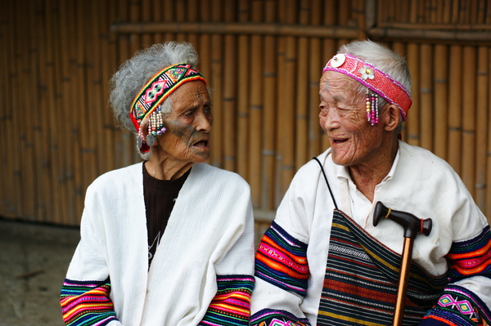
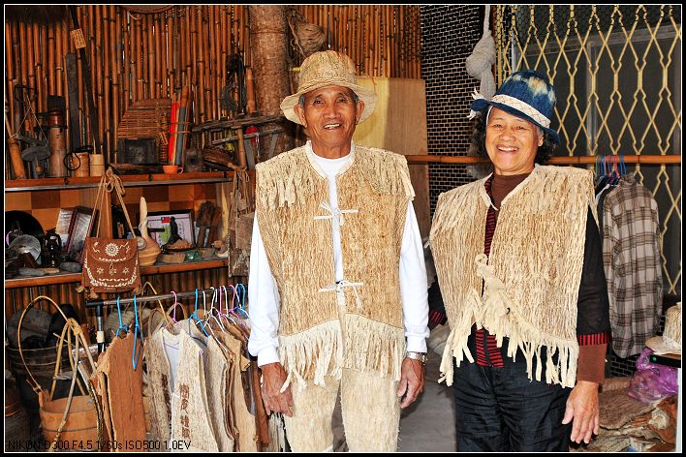
Conclusion
People-oriented
Keep them company with your love.
Deliver care with all your heart.
Notes:
I love the theme of the conference—Connecting to the Spirit of the Land.
Similarly, our Introduction to Cultural Safety in Health Care for Indigenous Peoples aims to revive concepts and ideas that are People-oriented.
People may come in all shapes, sizes and colors, but we all born into a human body, and therefore, we all need Culturally Safe Health Care.
Thank you very much for listening!

