Slide 1
What Lego Can Teach Us About Digital Transformation

Slide 2
70%
Notes:
At the end of 2018 I left the digital agency I started 13 years earlier to start a new journey, a journey inspired by a question
That question was, what the heck do we mean by digital transformation?
Boston Consulting Group reports that more than 70% of all digital transformations fail

Slide 3
We live in a time of exponential possibility
Notes:
The world feels uncertain, but the truth is we live in a time of exponential possibility. This is true because of remarkable technological advancements – specifically computing – post World War II. Most innovations and improvements in industry are linear, but the innovation and improvement in processing power, storage capacity, and connectivity have been astonishing.

Slide 4
Notes:
Technology exists that can help us to address climate change and scarce energy resources. To drive sustainability and look after the planet.

Slide 5
Notes:
Technology exists that can help us address societal challenges, personal privacy, identity, communication and fake news.

Slide 6
Notes:
Technology to solve and address a multitude of health issues, or at least to fast-track research and scientific progress in this regard.

Slide 7
Notes:
Technology exists to solve economic challenges, address inequality, drive financial inclusion, to improve the world of money and transactionality.

Slide 8
Notes:
Technology exists to radically transform the efficiency and productivity of many of our businesses in such a way that empowers and enables people rather than replaces them.

Slide 9
Why isn’t technology solving our problems?
Notes:
This happens because of a gap between…
Now, this is ok when things are going swimmingly but when the going gets tough.

Slide 10
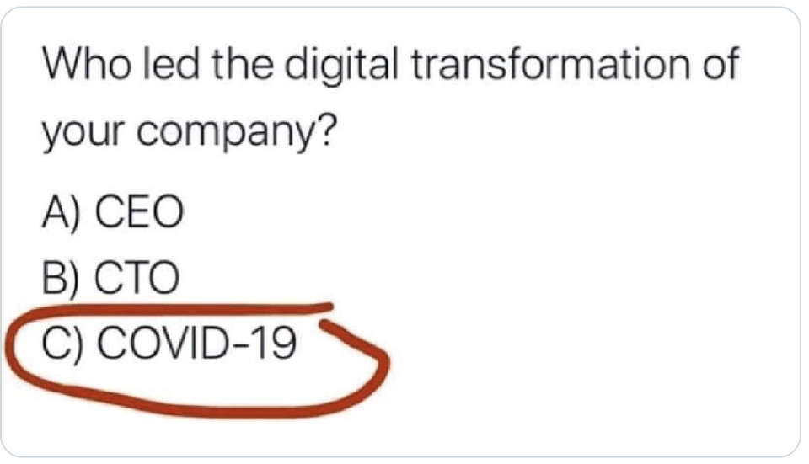
Notes:
Not wanting to dismiss the obvious human tragedy of COVID, it was fascinating watching which organisations adapted well to such unprecedented levels of disruption, and why?
It seemed to me that being digitally transformed meaned being the kind of organisation that was adaptable enough to not only survive discomfort, but to thrive in it
That adaptability was a function of people’s attitudes toward change, which was a function of culture, which was ultimately a function of leadership. The capacity of any organisation to truly transform comes down to the quality of its leadership

Slide 11
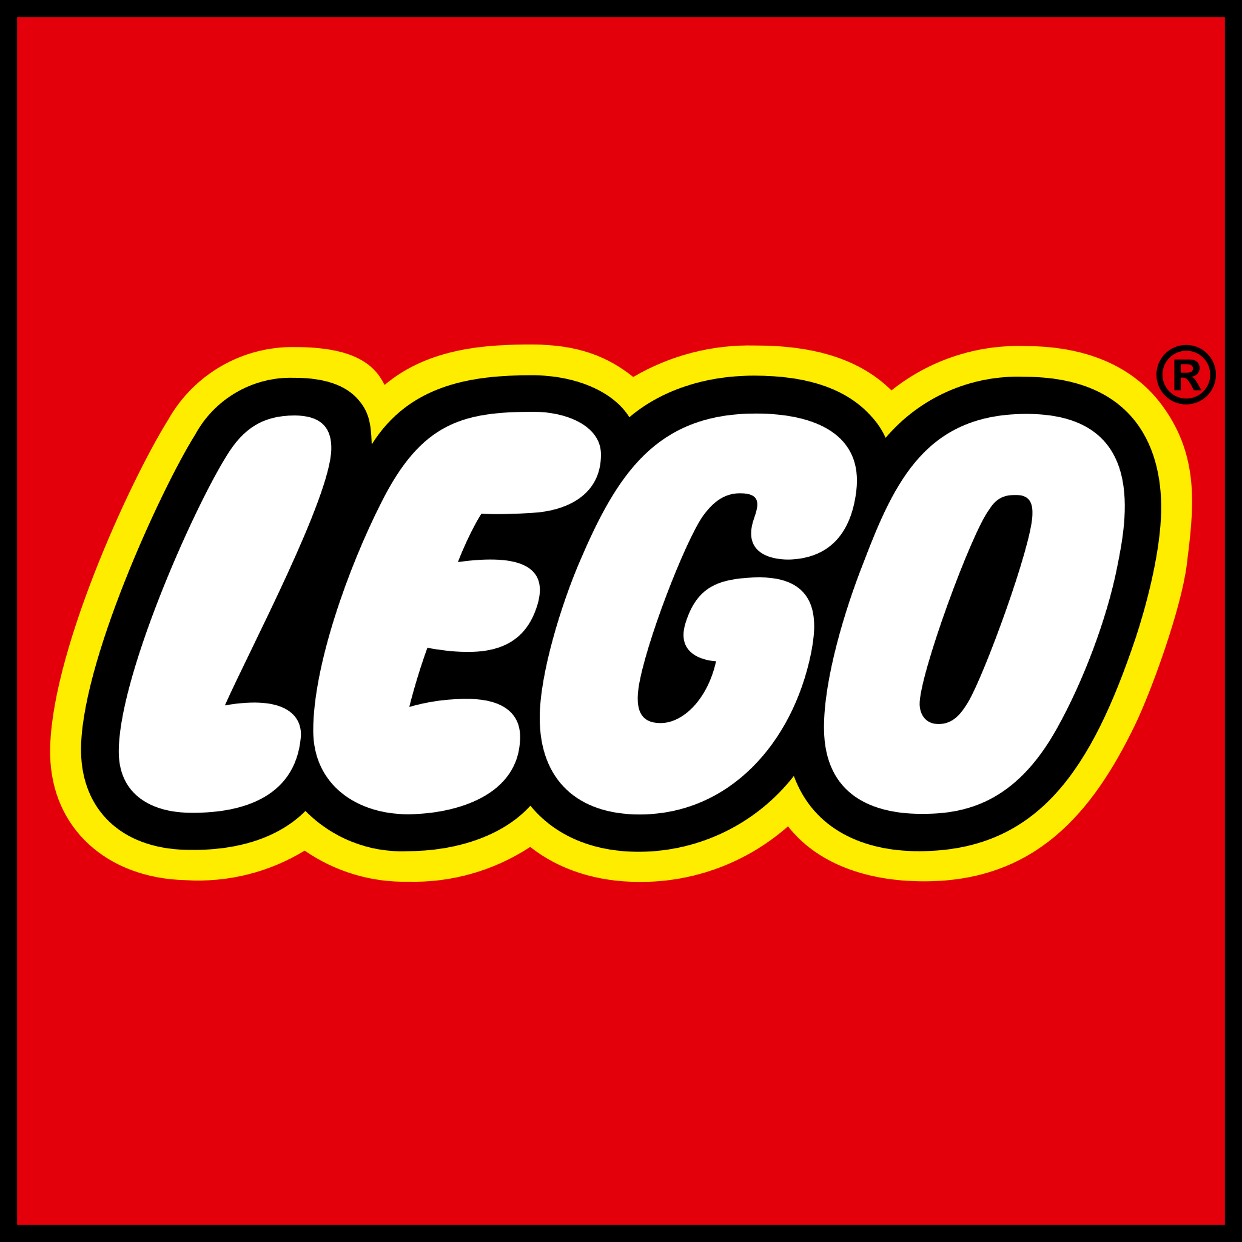

Slide 12
Lego Today
Still a privately owned, family-controlled group
In 2015 overtook Ferrari as the world’s most powerful brand
Outscores Disney, Rolex, Ferrari, Microsoft, Levi Strauss, Netflix, Adidas, Bosch and Intel in reputability
The most profitable toymaker in the world
The number of Lego people in circulation exceeds the number of actual humans on the planet

Slide 13
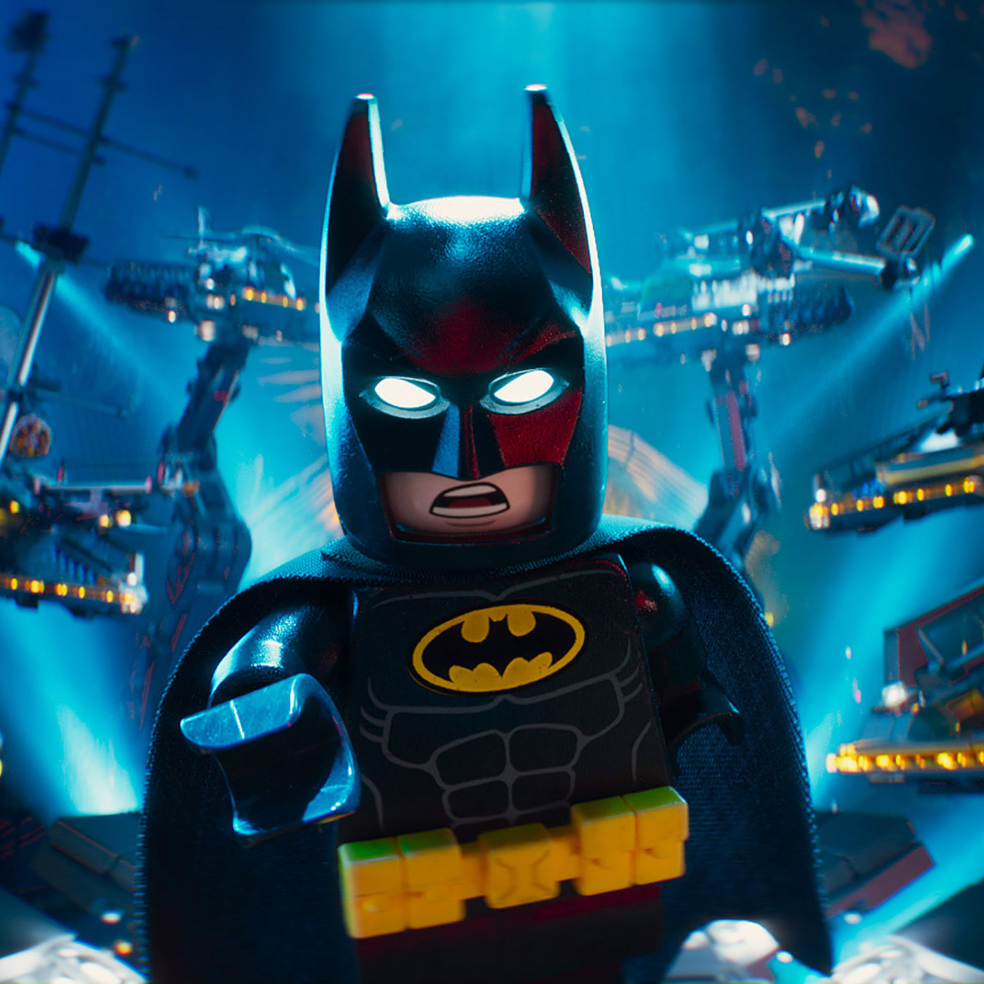
Lego Today
The Lego Batman Movie, a follow-up to 2014’s wildly successful The Lego Movie, outperformed Batman v Superman: Dawn of Justice in 2017 to such a degree that DC Comics faced the genuine problem of audiences overwhelmingly preferring the Dark Knight in his pompous and plastic version rather than Ben Affleck’s portrayal.

Slide 14
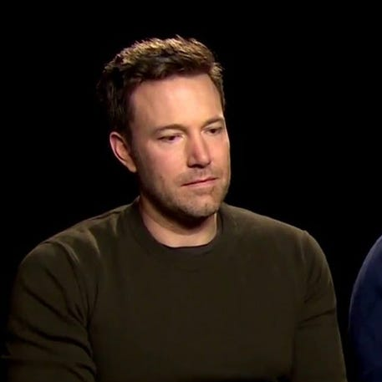
Lego Today
The Lego Batman Movie, a follow-up to 2014’s wildly successful The Lego Movie, outperformed Batman v Superman: Dawn of Justice in 2017 to such a degree that DC Comics faced the genuine problem of audiences overwhelmingly preferring the Dark Knight in his pompous and plastic version rather than Ben Affleck’s portrayal.
Notes:
But speaking of sadness,

Slide 15
1932 1958 1988 1998 2003

Slide 16
1932 1958 1988 1998 2003

Slide 17
1932 1958 1988 1998 2003

Slide 18
1932 1958 1988 1998 2003

Slide 19
1932 1958 1988 1998 2003
Notes:
1932 – founded in Billund, Denmark
1958 – launched the brick that would be DNA of their business for decades to come
1988 – patent protection law suit
1998 – posted first loss
2003 – 30% year on year loss and almost a billion dollars in debt

Slide 20
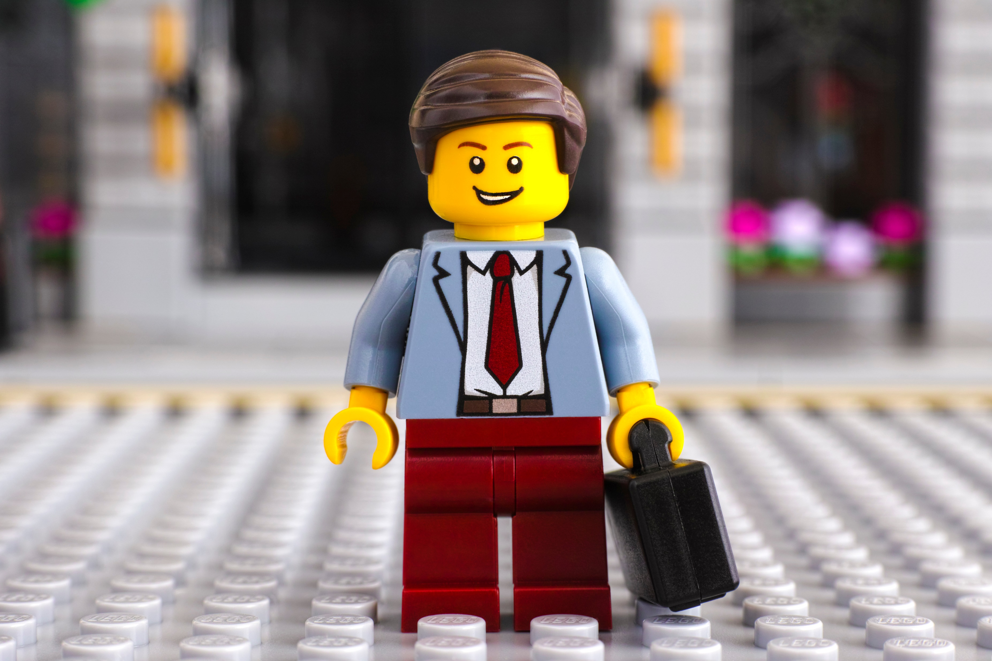
LESSON 1 Your worst nightmare could be your greatest gift
Notes:
Patent protection for the iconic brick expired in 1988
Competition like TYCO, HASBRO MEGA BLOKS and video games, and the changes of 1989…
Our past success is no guarantee of future success.
Sometimes innovation is stopping doing the old things.

Slide 21
LESSON 2 Sometimes “innovation” backfires
Notes:
LEGO opened theme parks, explored video games and TV
SKUs went from 6000 in 1997 to 14000 in 2004
11000 suppliers – more than twice the amount of Boeing
In 2003 the LEGO group reported an operating loss of $228 million dollars on just over $1B in sales. Cash flow was negative, and the end was nigh.

Slide 22
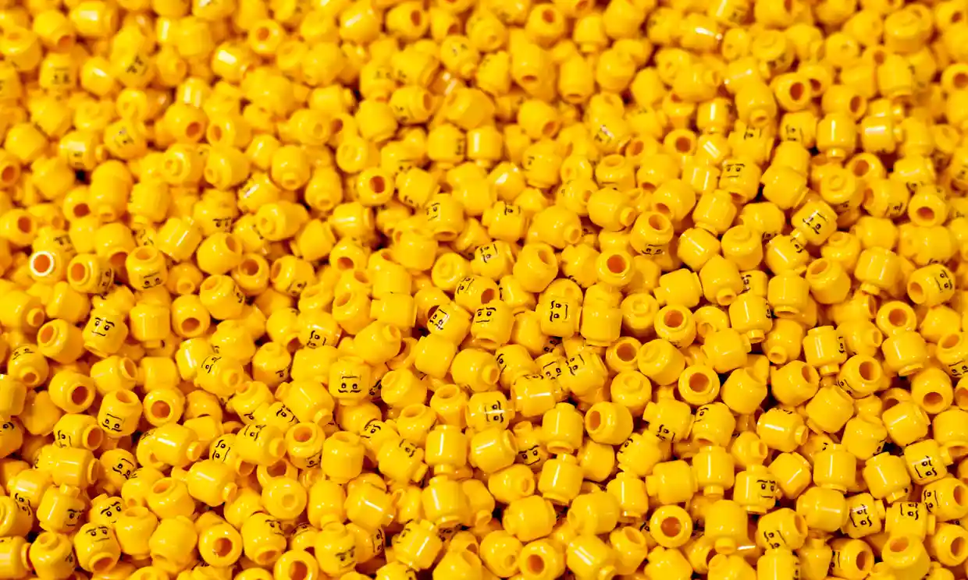

Slide 23
LESSON 3 Real change relies on maverick leadership
Notes:
“The greater good”
The timeframe paradox

Slide 24
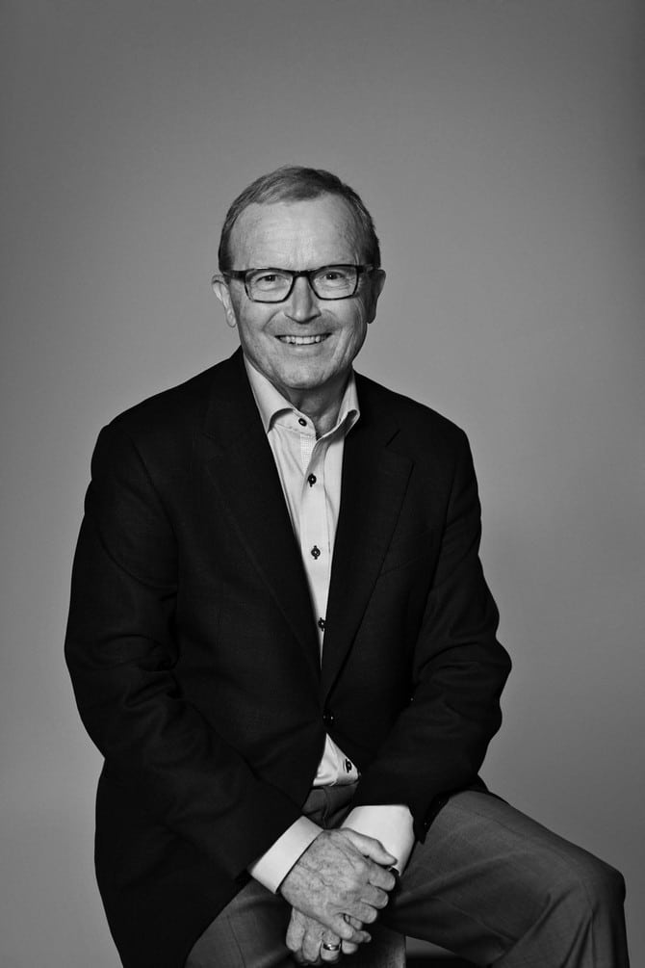
Kirk Kristiansen
Notes:
Mr Kristiansen is prepared for the fact that Lego’s winning streak could come to an end. According to Mr Knudstorp, he has a saying: “As a family owner, if you want to own something for 150 years there will always be another crisis.”
In early 2004, Kjeld Kirk Kristiansen then owner of the group and a member of the founding family, invested a substantial portion of his personal wealth into the dying company, and stepped down as CEO.
Kjeld once said that “Children mean everything to us. Children and their development. And this must pervade everything we do.” He married Camilla Kristiansen and had their first child was born in 1978, a daughter which they named Sofie Kirk Kiaer Kristiansen.

Slide 25
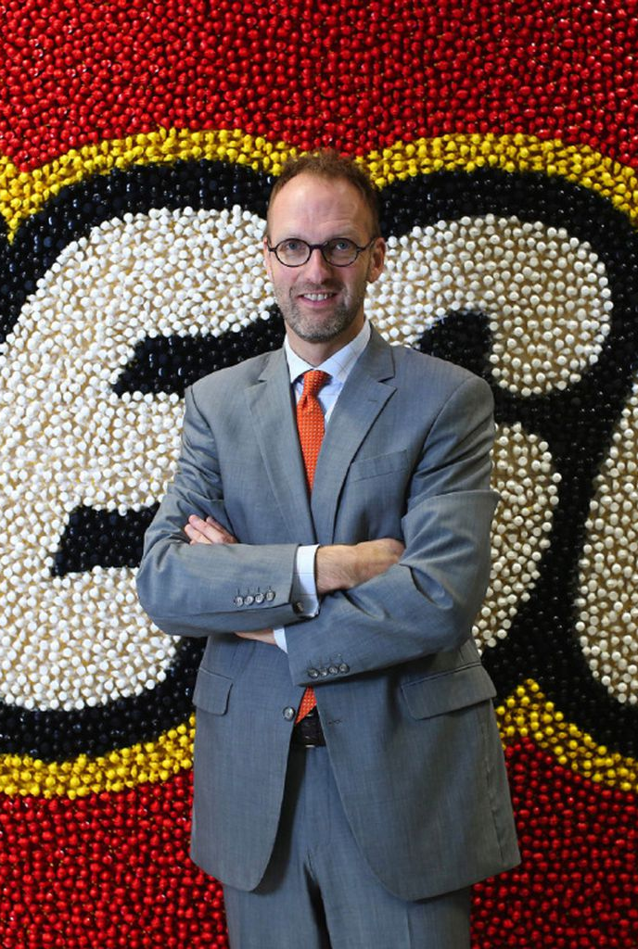
Jorgan Vig Knudstorp
Notes:
Jorgan Vig Knudstorp was 35 when he joine the business, with no executive experience, from McKinsey.
Many of the groups supply chain issues grew out of their commitment to innovation
Putting technology on top of broken business processes doesn’t fix them – it amplifies the brokenness
Mr Knudstorp adopted a strict focus on cash, selling off peripheral businesses such as theme parks and video games, and cutting the number of parts Lego made. Foreign outposts were scaled back or closed down.
e also encouraged interaction with Lego’s fans, something previously considered verboten. Far from killing off Lego, the internet has played a vital role in allowing fans to share their creations and promote events like Brickworld, adult Lego fan conventions.

Slide 26
LESSON 4 Absolutely nothing beats the basics
Notes:
Digitisation and putting technology on broken business processes

Slide 27
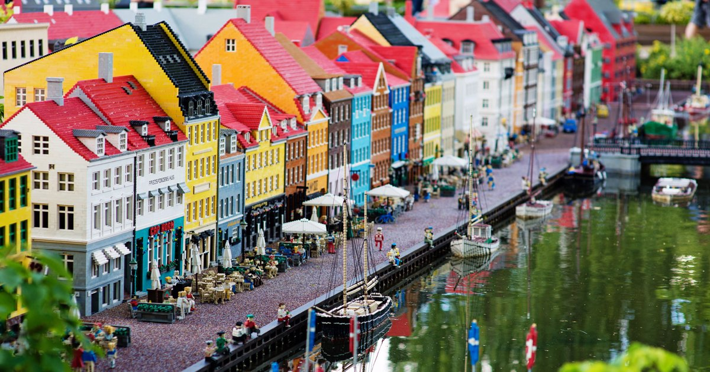

Slide 28
LESSON 5 Real change takes more time than we’d like
Notes:
Explain transformation
Implementing LEGO’s Group’s enterprise platform (integrating supply chain, HR, finance and other core competencies) took nearly a decade, but management now point to those systems as being a huge development. It also bred a culture of continuous improvement.

Slide 29
LESSON 6 No more digital strategy
Notes:
Digital is something you do, or something you are?
Clearer goals – better management
2015 blog post
Streamlined decision-making
Direction for future IT development
Global collaborative culture

Slide 30
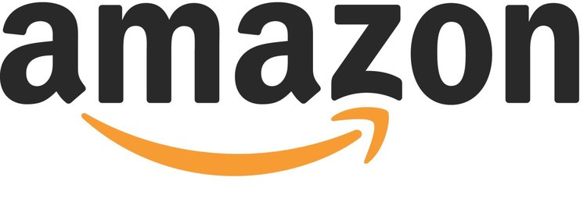
Notes:
Watch what you spend, don’t overstay your welcome, and never get into a car with a stranger. Now there’s an app for all of those

Slide 31
LESSON 7 Clean the bathroom before you throw a house party

Slide 32
LESSON 8 Your customers are on your side
Notes:
He also encouraged interaction with Lego’s fans, something previously considered verboten.
Lego launched its own crowdsourcing competition: originators of winning ideas get 1% of their product’s net sales, designs that so far include the Back to the Future DeLorean time machine, the Beatles’ Yellow Submarine and a set of female Nasa scientists.

Slide 33
LESSON 9 Coopetition beats competition

Slide 34
LESSON 10 Narrow the gap between what you promise and what you deliver
Notes:
Social media was a big opportunity
The company’s consumers and customers were potentially outpacing LEGO’s own employees in the demand of digital services and in imagining digital opportunities
A culture of data-driven decision-making
Bring your people along with you

Slide 35
Thank you and play well
mikestopforth.com

Slide 36
Sources
https://www.bcg.com/publications/2020/increasing-odds-of-success-in-digital-transformation
https://www.theguardian.com/lifeandstyle/2017/jun/04/how-lego-clicked-the-super-brand-that-reinvented-itself
https://www.ft.com/content/476acab8-c11c-11e6-81c2-f57d90f6741a
https://luxatic.com/kjeld-kristiansen-and-the-lego-heritage/

Slide 37
“Every time you grow, you are hiding your problems. Growth is like sugar-coating your problems,”
Most companies make product where it’s cheapest then ship it. Not Lego. “It’s much more costly for us to lose a sale,” he said.

