Slide 1
Welcome: Real Business WestPoint Private Client Group
We believe the “bounce-back” will be greater than the “set back” and we want business owners to be in the best position possible to move ahead.
What comes next for your business environment?
Are you ready for it, and are you ready to capture new opportunities?
Notes:
GR to start, welcome everyone and thank Ken for hosting
-great things are on the horizon as we emerge from the pandemic, we are passionate about planning and for the closely held business owner now is the time to check all of your “gauges” on the dashboard to see if there are any changes small to large you want to make
-We are going to present some statistics and real examples (stats and stories) of what those gauges are, what they mean to you and how that can lead to a strong set of action items so that nothing falls by the wayside as you keep your business growing.
-The adage, work ON your business, not just in it, has NEVER been more important than now.
-We would encourage you to keep a running list from today’s session of key thoughts, questions and ideas that you will pursue next as a result of our time together.

Slide 2
For your consideration…
By starting, buying, or owning a business, you have set yourself on a path.
This path is leading you and your business toward an “eventual” exit.
There will come a time when this valuable asset will change hands.
You will cease to be the owner, by force or by choice.
How successfully that transition happens is entirely up to you.
Notes:
SE:
-You have heard the phrase, life is a journey not a destination. Well that is certainly true for the business owner.
-Imagine a map that is tailored just for your business. There was a time, date and maybe a place where this very important journey started.
-But where does the path lead, and is it clear?
-Along the way, certainly you have increased the value. If you converted it to cash today, do you know what it is worth? Would anyone pay you what you think its worth, and would that be enough?

Slide 3
Systematic Value Extraction©
The conscious effort to grow your business in a manner that efficiently converts ownership into personal financial freedom and peace of mind
This brings up several important questions:
Therefore…how much does it cost to be you?
How much is enough?
How attractive are you to potential successors? (internal readiness)
How ready are you to ask for 5 to 10X multiples? (external readiness)
Notes:
SE
-Let’s be very specific about this: We have instituted a process for our clients called
Systematic Value Extraction
-Put another way: “How much does it cost to be you?”
If you were to sell it, how much is enough? (story on the initial offer for IG, at $1B that was turned down)
-We are excited to share with you an assessment, led by you, that will reflect on your “attractiveness” to potential successors, which is really a measure of external readiness). Keep in my this isn’t me or Gerald saying what we think; this process begins at home! This is led by you and fostered by you.
-The second and equally important is the readiness index, which is a measure on your internal readiness, again led by you and fostered by you.

Slide 4
Your Unique Vision with Our Systematic Approach
DISCOVER
Every 90 Days
PREPARE
DECIDE
Personal, Financial, Business Assessments
Business Valuation
Prioritize Action Plan
Personal & Financial Planning
Business Improvements
Master Plan
Grow
with confidence
or
Exit
with confidence?
De-Risking
Systematic Value Extraction©
The conscious effort to grow your business in a manner that efficiently converts ownership into personal financial freedom and peace of mind

Slide 5
Discussion: What would you imagine are the typical readiness or preparedness issues?

Slide 6
Exploring the State of Owner Readiness™
Primary Research Conducted by EPI:
To poll, measure, and analyze the current market conditions that affect an owner’s ability to successfully transition their business with exit planning considerations
76% of owners plan to transition over the next 10 years (representing 4.5 million businesses and over $10 trillion in wealth).
49% have no transition plan.
More than 70% of businesses that are put on the market do not sell.
Only 30% of family-owned businesses transition to the second generation and only 12% survive to the third.
Notes:
The Exit Planning Institute’s Northeast Ohio Chapter partnered with Grant Thornton, PNC Bank, and the Ohio Employee Ownership Center at Kent State University in 2013 to conduct a survey of business owners. The goal of the survey was to ask business owners a set of questions around a broader and larger issue: How effectively (if at all) have you planned for the inevitable exit from your business?

Slide 7
Are you familiar with all of your transition options?
Readiness Data
^{© 2016 Exit Planning Institute}
Notes:
Starting from the top of the decision tree:
Are you familiar with what choices you might have before you?

Slide 8
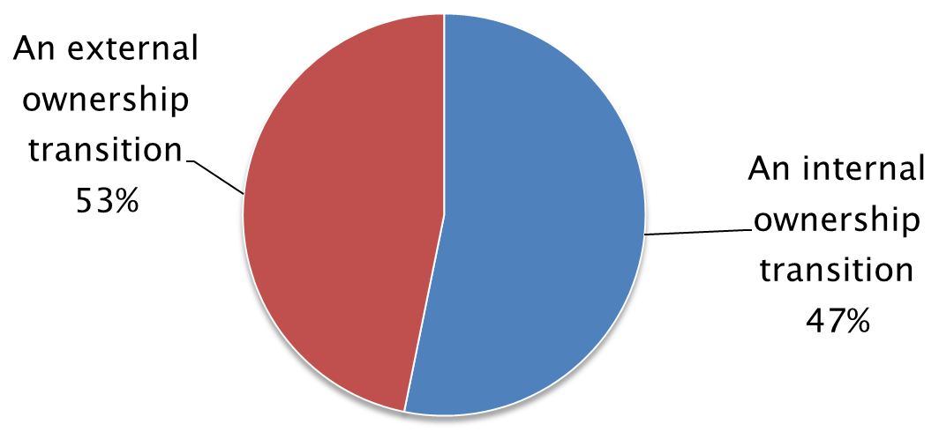
What type of ownership transition are you planning?
Readiness Data
^{© 2016 Exit Planning Institute}
Notes:
If only 30% listed are sold, what happens to those who don’t actually sell?

Slide 9
What best describes how you are planning on transitioning?
Readiness Data
^{© 2016 Exit Planning Institute}
Notes:
Of those interviewed, the largest portion was “not sure.”
#2, a 3rd party sale or transfer
#3, internal, family succession

Slide 10
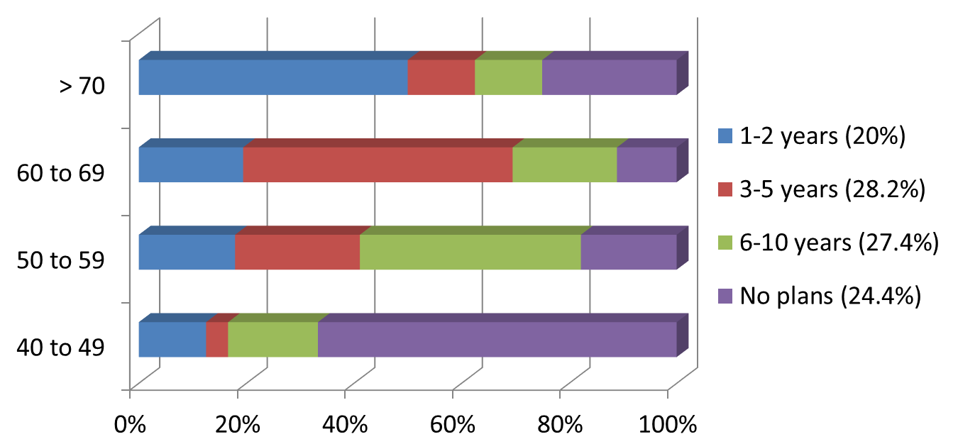
When are you planning to transition the company?
Readiness Data
^{© 2016 Exit Planning Institute}
Notes:
GR: 60 miles car journey example. When I leave determines how fast and SAFE I must drive.
Put another way, how much runway does this plane have to really take off? Answer: the more time the better. (7 to 10 years)

Slide 11
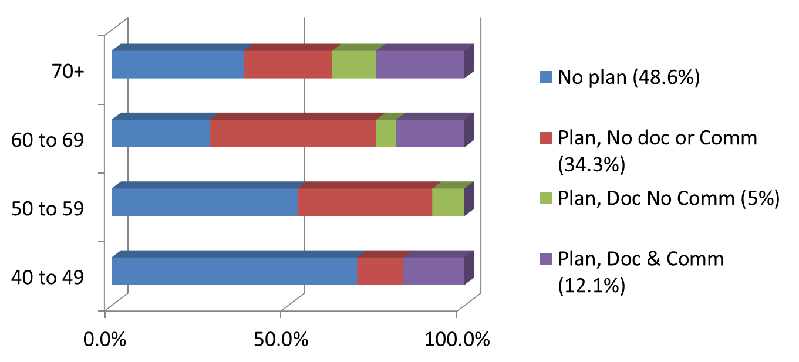
What best describes your companies transition plan?
Readiness Data
^{© 2016 Exit Planning Institute}
Notes:
SE: It does seem that time plays into this, but there is still too much blue for the 70+ crowd to not have a plan.

Slide 12
Common Personal Readiness Issues
Loss of Identity and Lack of Support
No Goals and Objectives Post Transition
No Considerations to Passions Outside of Business
No Advisory Board or Formal Transition Team
No Contingency Plan(s)
Shareholders or Family Members Not on the Same Page
Forced Generational Transfer
Readiness
Issues
^{© 2016 Exit Planning Institute}
Notes:
SE:
List the 5 D’s (death, disability, divorce, debit & departure)
Story on the middle of the night departure…

Slide 13
Common Financial Readiness Issues
Owners with High Income Needs
Income Requirements Post Transition
Needs vs. Wants
Financial Plan Does Not Consider the Value of the Business or Overstated Opinion of Value
Net Proceeds Analysis
Tax Planning
Risk Sensitivity Considerations
Financial Plan Aligned with Personal Plan
Readiness
Issues
^{© 2016 Exit Planning Institute}
Notes:
How much does it cost to be you? Can you afford to sell and live off the proceeds in the manner you have become accustomed to?
It’s not what you sell it for, it’s what you get to keep. Will the IRS become an unintended beneficiary in your plan ?

Slide 14
Common Business Readiness Issues
Tangible vs. Intangible Factors
EBITDA Historical vs. Projected vs. Addbacks
Valuation Multiple Considerations
Is the Business Bankable?
Creditability of Financial Information
Ability to Forecast and Its Predictability
Management Succession
Customer Base and Concentration
Ownership Group or Partners at Odds?
Readiness
Issues
^{© 2016 Exit Planning Institute}
Notes:
Read through the above

Slide 15
Being Ready to Exit WITHOUT Having to Sell. Is It Possible?
(Moving from Owner Operator to Owner Investor)
Pushes the Overall Team to Best-in-Class Performance
Serves as a Contingency Plan
Non-Solicited Offers Do Happen
Increase Annual Income and Value
Readiness
Benefits
^{© 2016 Exit Planning Institute}
Notes:
Consider the following scenario:
Your business is doing so well, you can go to your favorite remote travel location for 3 to 6 months, and the business doesn’t miss a beat? Why would you sell?
You must have a great team, and this would allow you to move from owner/operator to owner/investor.

Slide 16
The Four C’s
Human Capital: the Talent of Your Team
Structural Capital: the Value of Your Infrastructure
Social Capital: Your Culture and Brand
Customer Capital: Relationships that Are Deep, Long Term and Contractual
Readiness
Issues
^{© 2016 Exit Planning Institute}
Notes:
These are the key forms of capital that a business must pay attention to:
Human: if you have strong talent someone will place a high value on that, plus if they are really strong they are NOT overly dependent on you to be successful.
Structural: best practices that can be purchased and repurposed, getting it out of
your head only!
Social: Culture, brand and the way your work? If you had to answer the question, “what is your secret sauce?” what would the answer be…
Customer: how strong are those relationships and are they transferrable, (Steve and his dad)

Slide 17
Call to Action
Take the attractiveness and readiness survey.
We will look at the results, and have a discussion.
Schedule a Vision Session.
Notes:
Bring up the surveys for show and tell, ready for questions…
Thank you and good night!
Drop the mic!

