Slide 1
POLARIS ADVISORS
2023
polarisadvisors.net
CONFIDENTIAL
polarisadvisors.net

Slide 2
POLARIS ADVISORS
Building an Unshakable Marketing Plan through Storyselling.
POLARIS ADVISORS
2023
polarisadvisors.net
CONFIDENTIAL

Slide 3
POLARIS ADVISORS
BUILDING AN UNSHAKABLE MARKETING PLAN
Agenda
9:00 am: Consumer psychology
9:10 am: The power of story
9:15 am: Building the foundation of your marketing plan
9:50 am: Next steps
Q&A: Open discussion
polarisadvisors.net
CONFIDENTIAL

Slide 4
POLARIS ADVISORS
People by products and services only after they read words that make them want to buy.
polarisadvisors.net
CONFIDENTIAL

Slide 5
POLARIS ADVISORS
Survive & Thrive
2. Conserve Calories
polarisadvisors.net
CONFIDENTIAL

Slide 6
POLARIS ADVISORS
If you confuse, you’ll lose
polarisadvisors.net
CONFIDENTIAL

Slide 7
POLARIS ADVISORS
Story is a sense making tool.
polarisadvisors.net
CONFIDENTIAL

Slide 8
POLARIS ADVISORS
Build Your Story
POLARIS ADVISORS
2022
polarisadvisors.net
CONFIDENTIAL

Slide 9
POLARIS ADVISORS
The Character
The hero of your story wants what?
polarisadvisors.net
CONFIDENTIAL
Notes:
When you highlight your client’s desire, they enter into the story your brand is telling.

Slide 10
POLARIS ADVISORS
The Problem
What is preventing them from being financially successful?
polarisadvisors.net
CONFIDENTIAL
Notes:
You keep a prospective client’s attention when you zero in on their biggest problems that have them on the search for a financial advisor.

Slide 11
POLARIS ADVISORS
The Guide
If your client is the hero of the story, that makes you the guide.
polarisadvisors.net
CONFIDENTIAL
Notes:
How do you and your brand show up to position yourself as the guide?

Slide 12
POLARIS ADVISORS
The Plan
What are the easy-to-follow steps you give clients to reach success?
polarisadvisors.net
CONFIDENTIAL
Notes:
Prospects need to know how they can move forward or they won’t move forward.

Slide 13
POLARIS ADVISORS
The Call to Action
What do you want your prospective clients to do?
polarisadvisors.net
CONFIDENTIAL
Notes:
If you don’t call people to action, they won’t take action.

Slide 14
POLARIS ADVISORS
Success
What does success look like for your clients after working with you?
polarisadvisors.net
CONFIDENTIAL
Notes:
Cast the vision of what your clients lives could look like if they use your services.

Slide 15
POLARIS ADVISORS
Failure
What does failure look like for your clients if they don’t work with you?
polarisadvisors.net
CONFIDENTIAL
Notes:
What are some real and likely consequences for not doing business with you?

Slide 16
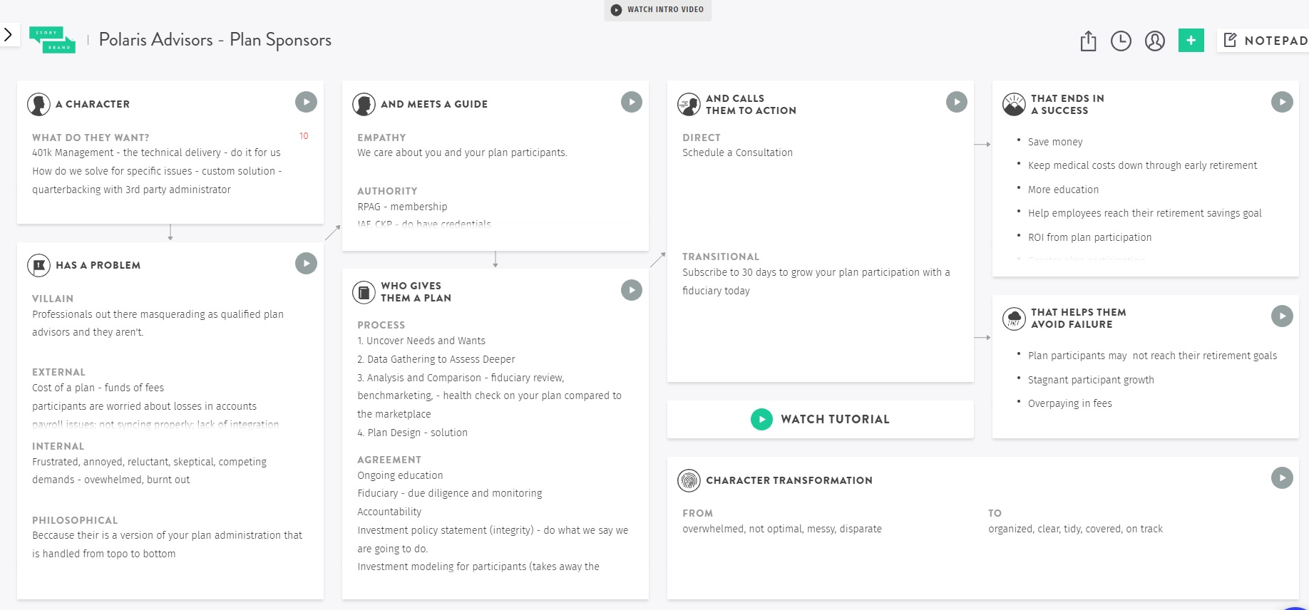
POLARIS ADVISORS
Polaris Advisors Storybrand
polarisadvisors.net
CONFIDENTIAL

Slide 17
POLARIS ADVISORS
POLARIS ADVISORS
Next Steps
2022
polarisadvisors.net
CONFIDENTIAL

Slide 18
POLARIS ADVISORS
Next Steps
What you can do from here to build the unshakable foundation of your marketing plan and win more business.
1.
Read Building a Storybrand and Marketing Made Simple by Donald Miller
2.
Create your brandscript that will help you clarify your message.
3.
Update marketing materials so that everywhere prospects interact with your brand reflects a new clear and powerful message.
polarisadvisors.net
CONFIDENTIAL

Slide 19
POLARIS ADVISORS
Questions?
You can reach out to Lisa Hinz at Lisa.Hinz@LPLFinancial.com
polarisadvisors.net
CONFIDENTIAL

Slide 20
POLARIS ADVISORS
Thank You
POLARIS ADVISORS
2022
Camp Hill Office:
4000 Market Street
Camp Hill, PA 17011
(717) 775-8061
info@polarisadvisors.net
polarisadvisors.net
Securities and Advisory services offered through LPL Financial, a Registered Investment Advisor. Member FINRA & SIPC.
polarisadvisors.net
CONFIDENTIAL

Slide 21
POLARIS ADVISORS
Disclosures
Securities and Advisory services offered through LPL Financial, a Registered Investment Advisor. Member FINRA & SIPC.
Content in this material is for general information only and not specific advice or recommendations for any individual. There is no assurance that these techniques are suitable for all investors or will yield positive outcomes.
polarisadvisors.net
CONFIDENTIAL

