Slide 1
Systems Thinking For State Early Learning Leaders
tools and strategies to WORK effectively with collaborators to achieve outcomes for young children

Slide 2
BECAUSE …
Your system…ANY system is perfectly designed to produce the results you are obtaining. (Adapted)

Slide 3
Being systems thinkers

Slide 4
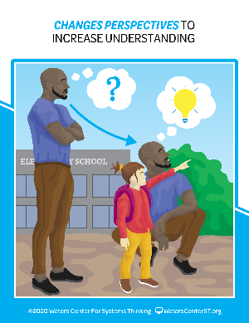
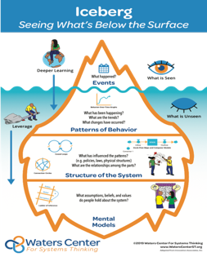
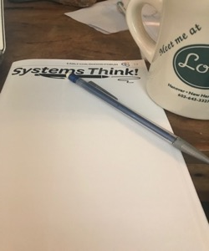
Seeing SELF as an instrument of change
Habits and tools of systems thinkers

Slide 5
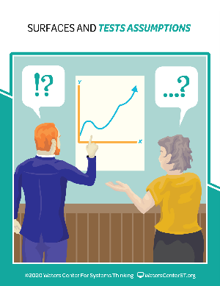
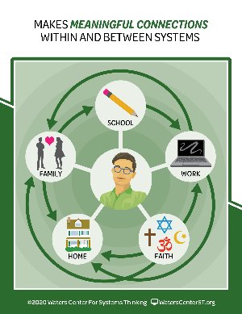
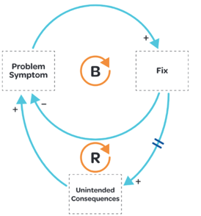
Mastering the skills of “ADAPTIVE LEADERSHIP”
Habits and tools of systems thinkers

Slide 6
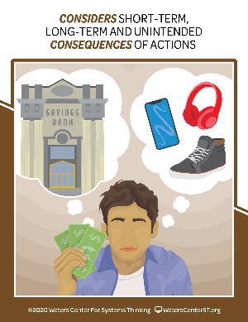
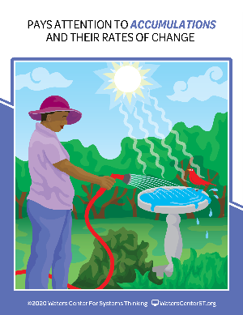
Being RESULTS-BASED and DATA-DRIVEN
Habits and tools of systems thinkers

Slide 7
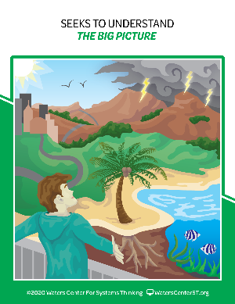
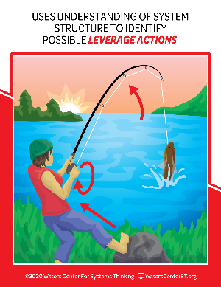
Being powerful COMMUNICATORS and COLLABORATORS
Habits and tools of systems thinkers

Slide 8

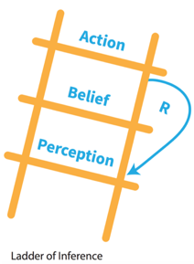
IDENTIFYING and ACTING on disparities
Habits and tools of systems thinkers

Slide 9
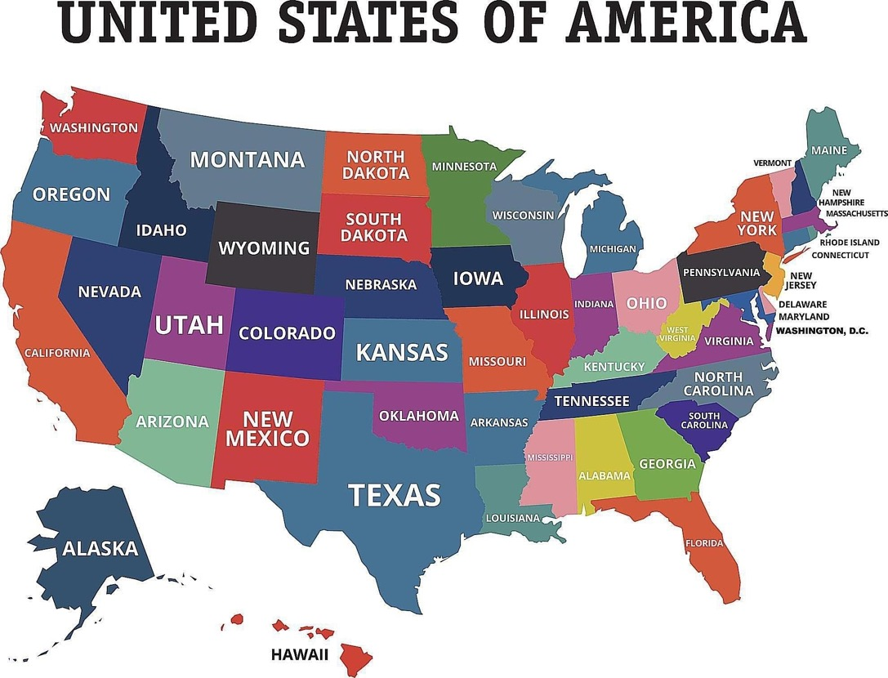
MAP SLIDE (LA Reach)

Slide 10
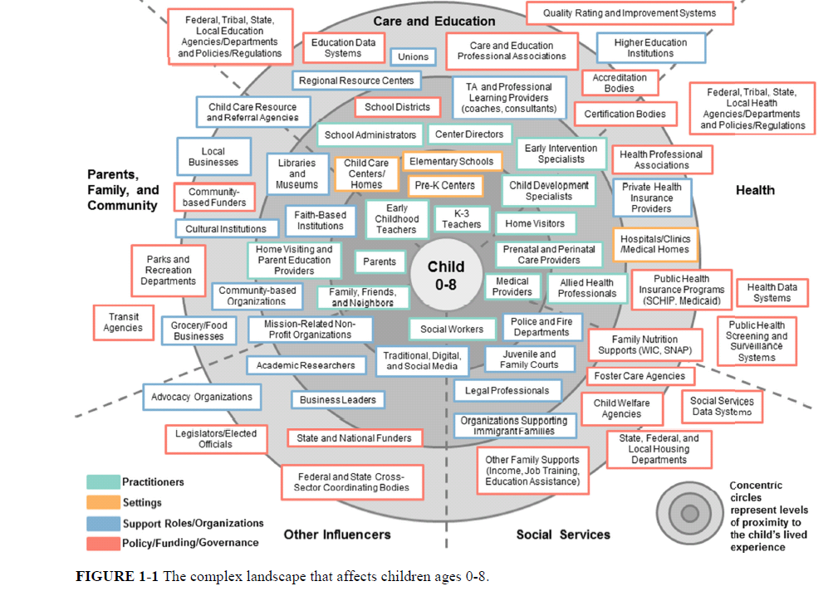

Slide 12
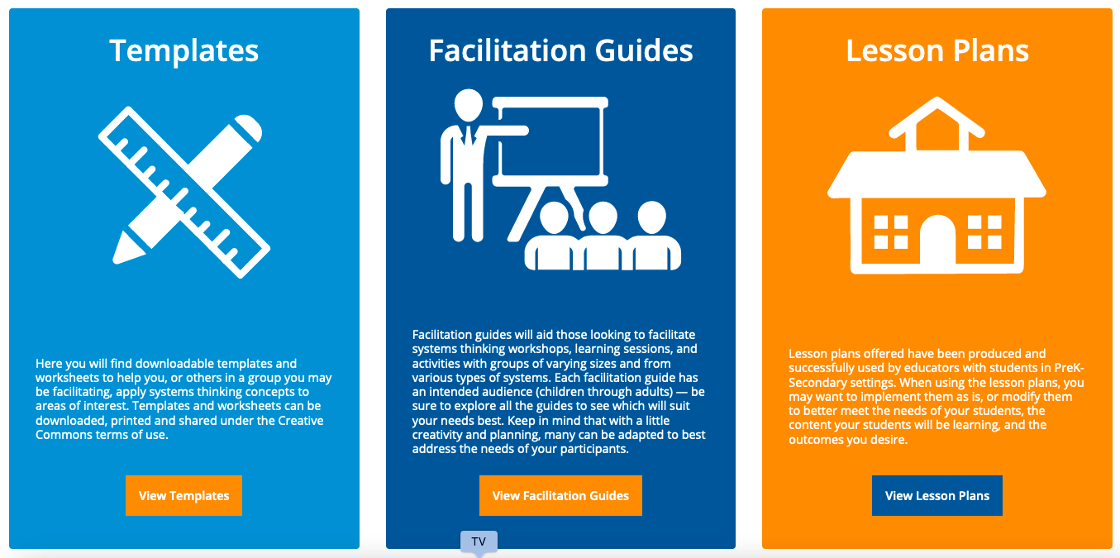
https://thinkingtoolsstudio.waterscenterst.org/resources/

Slide 13
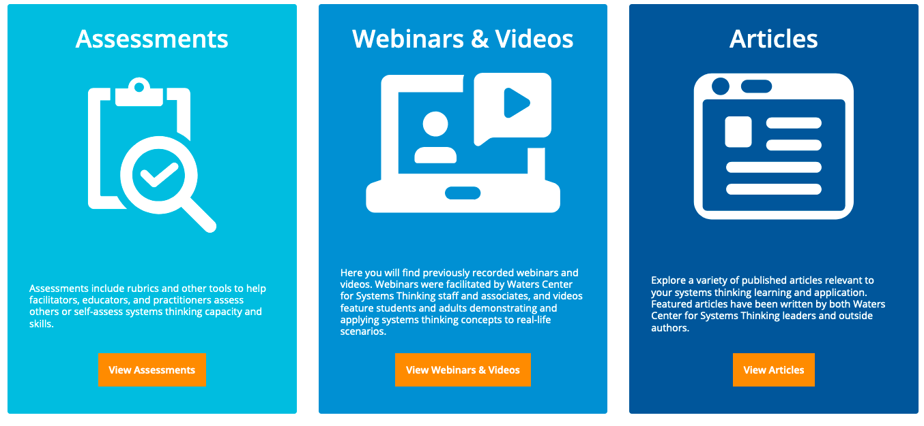
https://thinkingtoolsstudio.waterscenterst.org/resources/

Slide 14
Have more questions? Tag any one of us or all!
Tracy Jost – tjost@nieer.org
Demetria Joyce – djoyce@bankstreet.edu
Sandy Little – autigersx3@gmail.com
Heather Lucas – lucash@michigan.gov
Nicole Madore – nicole.madore@maine.gov
Jana Martella – jana.martella@gmail.com

