Slide 1



Department of Transportation
Usec. Roberto C.O. Lim
Spanish Chamber of Commerce in the Philippines
ECONOMIC BRIEFING
March 20, 2024

Slide 2

PRESIDENTIAL DIRECTIVE, DOTr’S THRUST
Comfortable
PRESIDENTIAL DIRECTIVE - SONA 2022
Affordable
Accessible
FULL SPEED AHEAD!
DOTr’s
THRUST
Comfortable, Accessible,
Safe, Sustainable, Affordable
TRANSPORTATION
Sustainable
Safe

Slide 3
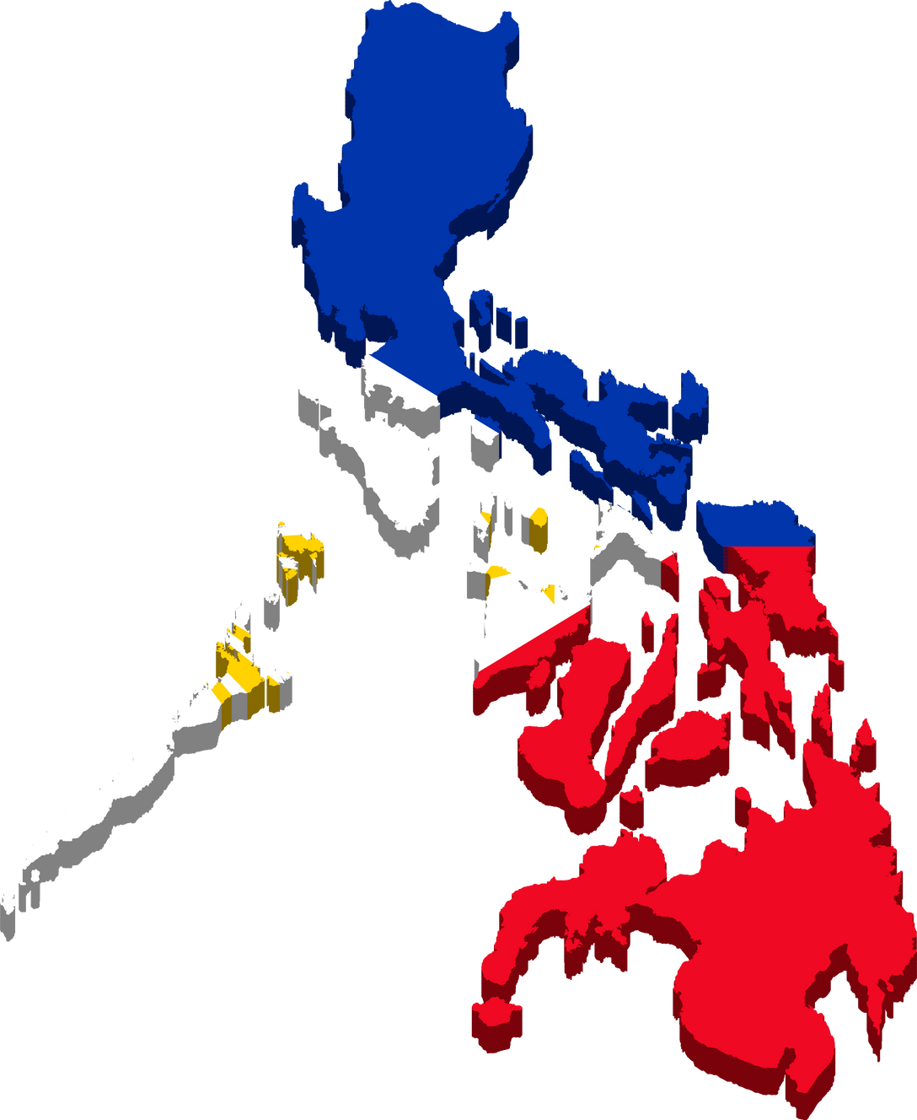

PHILIPPINES IS AN ARCHIPELAGO
Three (3) Island groups: Luzon, Visayas, and Mindanao.
PHILIPPINE MAJOR AIRPORTS
  Ninoy Aquino International Airport
  Clark International Airport
  Laoag International Airport
  Mactan–Cebu International Airport
  Kalibo International Airport
  Puerto Princesa International Airport
  Davao International Airport
  Iloilo International Airport
  Bohol-Panglao International Airport
7,641
Islands
90 airports nationwide;

Slide 4
DOTr PLANS AND PROGRAMS
NAIA Public-Private Partnership Project
3 DECADES +
6 ADMINISTRATIONS IN THE MAKING
CAPITAL INVESTMENTS
  ₱88 billion within first 6 years
    ₱122.3 billion for the entire 25-year Concession Period
EXPECTED AIRPORT IMPROVEMENTS
  Increased passenger capacity from 35mppa to 62mppa
  Increased Air Traffic Movements (ATMs) to 48 ATMs per hour
  Digitalization of passenger processing and airport operations
  Improved passenger experience and retail options
NEXT STEPS
  March 18, 2024 - Signing of Concession Agreement
  September 11, 2024 or earlier - O & M Start Date

Slide 5
DOTr PLANS AND PROGRAMS
Development of GREATER CAPITAL REGION (GCR) Airports
GCR FORECAST PASSENGER DEMAND
120 million passengers in 2035
New Manila (Bulacan) International Airport
Ongoing Land Development - 80% Progress rate
Phase 1 Start of Operations - 2029
Phase 1 Capacity - 35 Million Passengers Per Annum
Total Project Cost - ₱ 735 Billion

Slide 6
DOTr PLANS AND PROGRAMS
REGIONAL AIRPORTS PPP
AIRPORTS | PASSENGER VOLUME (2023) | PTB EXISTING CAPACITY | RUNWAY LENGTH (m) | UPDATES
LAGUINDINGAN | 1,990,201 | 1.6 mppa | 2,100 | Ongoing Comparative Challenge period. Invitation to Submit Comparative Proposal was published on 22 February 2024
BOHOL-PANGLAO | 1,653,868 | 2.0 mppa | 2,500 | Ongoing Negotiations with Original Proponent Negotiations to be completed by May 21, 2024
ILOILO | 2,330,053 | 1.2 mppa | 2,500 | Updated requirements submitted by Original Proponent following effectivity of PPP Code Negotiations Period is ongoing
PUERTO PRINCESA | 1,703,975 | 2.0 mppa | 2,600
KALIBO | 952,994 | 2.0 mppa | 2,500
DAVAO | 3,844,895 | 2.0 mppa | 3,000 | Updated requirements submitted by Original Proponent following effectivity of PPP Code Ongoing evaluation by DOTr and CAAP of the submission
SIARGAO | 552,838 | 0.45 mppa | 1,347 | Ongoing project development
BUSUANGA | 594,526 | 0.5 mppa | 1,225 | Ongoing project development
BICOL | 662,580 | 2.0 mppa | 2,500 | Ongoing project development
Note: Considered Passenger Movements for both International and Domestic Operations

Slide 7
DOTr PLANS AND PROGRAMS
Locally-Funded Projects - General Appropriations Act (GAA)
₱14 billion budget under FY 2024 GAA
LUZON | VISAYAS | MINDANAO
Laoag Airport | Kalibo International Airport | New Zamboanga International Airport
Vigan Airport | Iloilo International Airport | Bukidnon Airport
Candon Airport | Catbalogan Airport | Mati Airport
Tuguegarao Airport | Borongan Airport | M’lang Airport
New Manila International Airport | Maasin Airport | Tandag Airport
Ninoy Aquino International Airport | Tacloban Airport | Surigao Airport
Puerto Princesa Airport | Camotes Airport | Jolo Airport
Pag-asa Island Airport |  | Camiguin Airport
Daet Airport |  | Central Mindanao Airport
Bacon Airport |  | Butuan City Airport
San Fernando Airport
Busuanga Airport

Slide 8
DOTr PLANS AND PROGRAMS
Official Development Assistance (ODA) -
Export–Import Bank of Korea (KEXIM)
NEW DUMAGUETE AIRPORT
LOCATION | BACONG, NEGROS ORIENTAL
PROJECT COST | P17.05 BILLION
CAPACITY | 2.45 MPPA
STATUS | SITE ACQUISITION- ONGOING CIVIL WORKS – TARGET COMMENCEMENT IN 2025

Slide 9
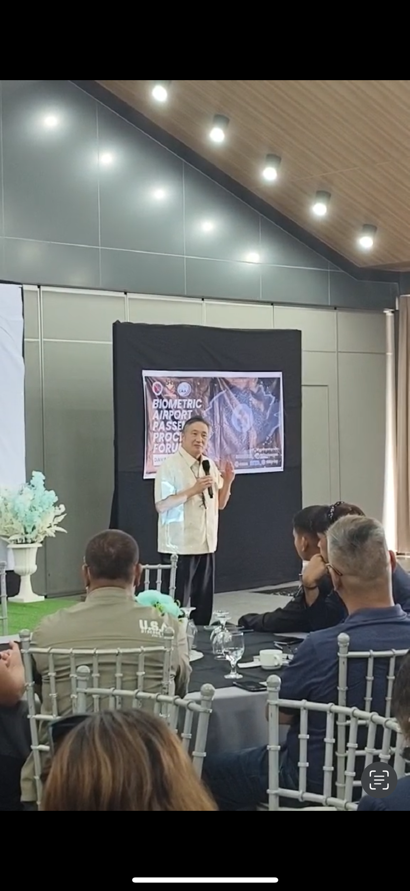
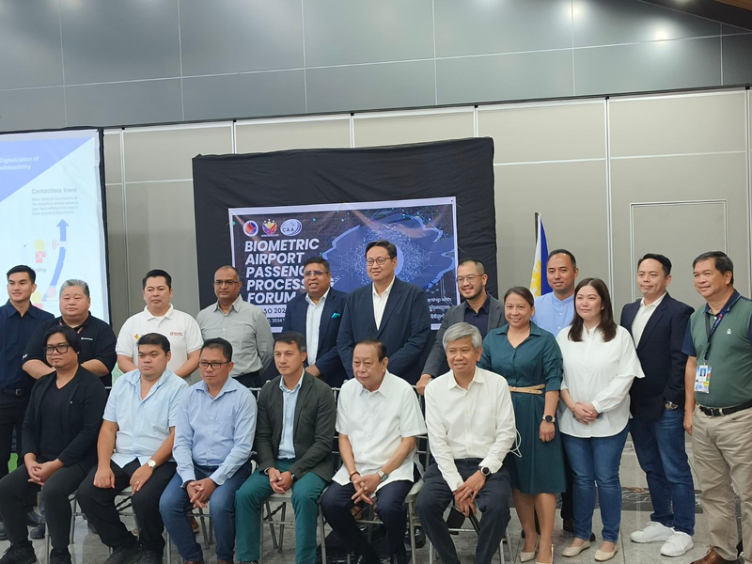
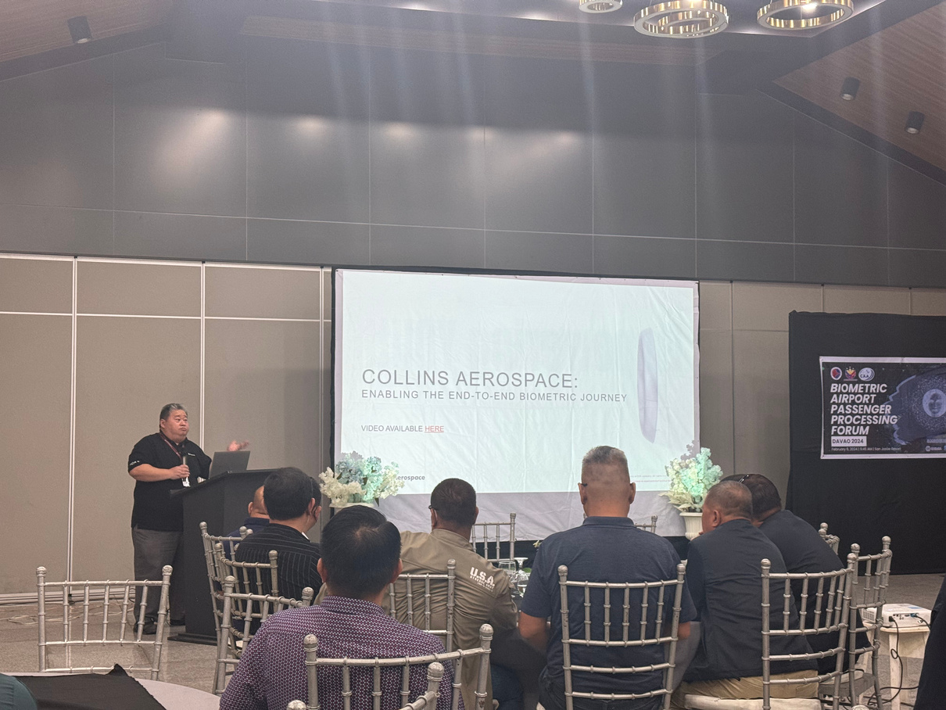
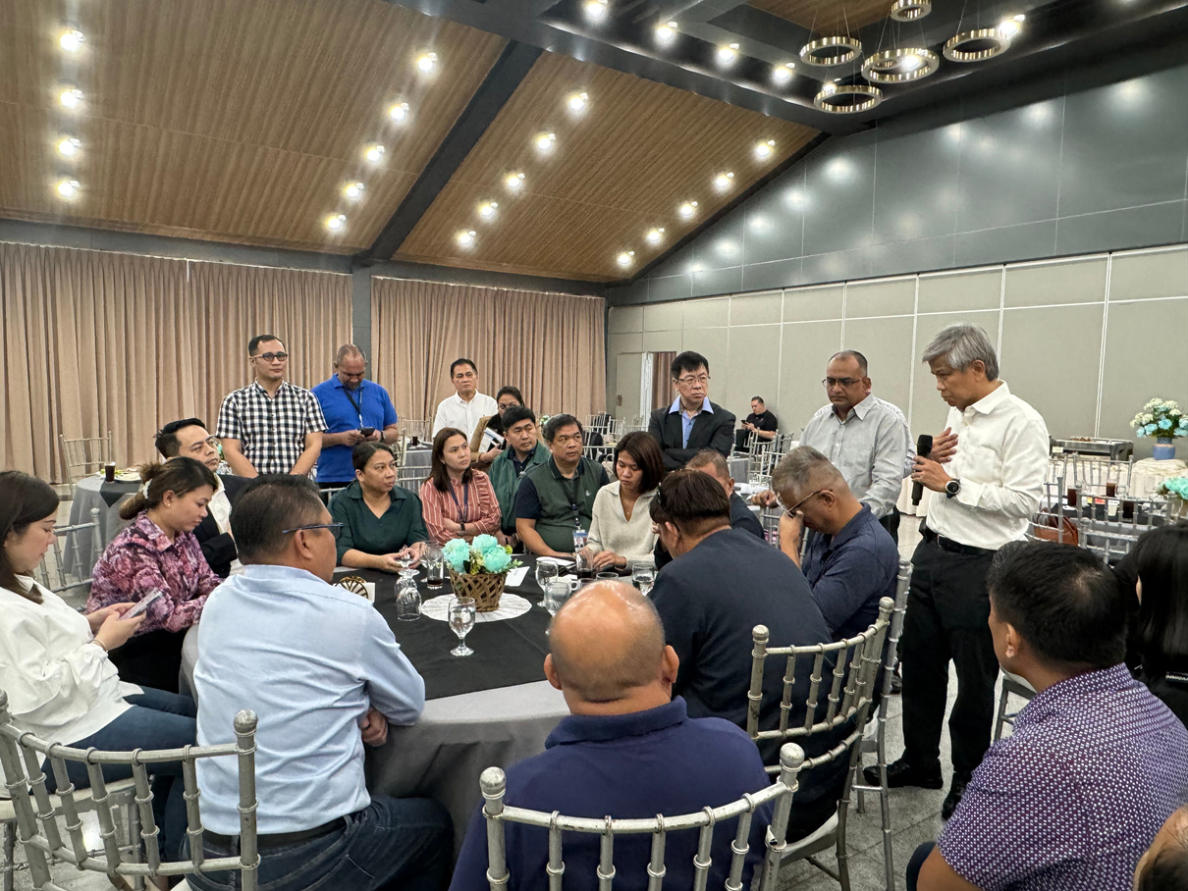
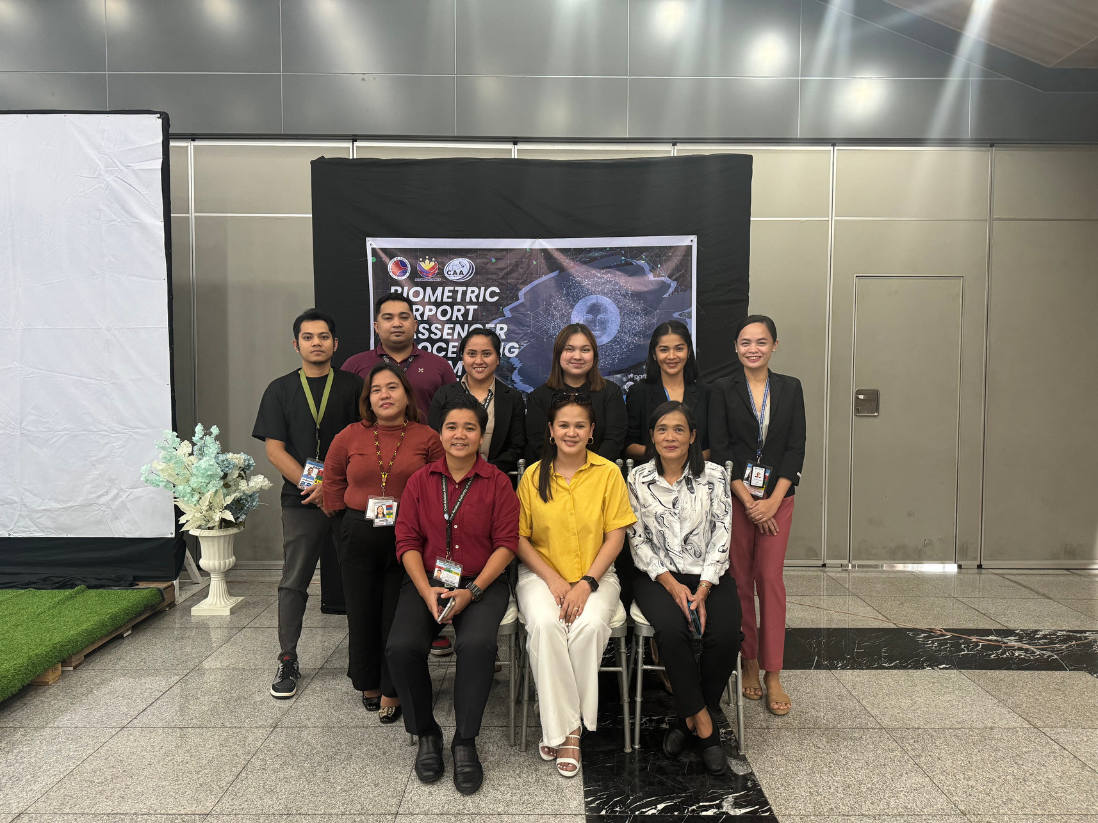
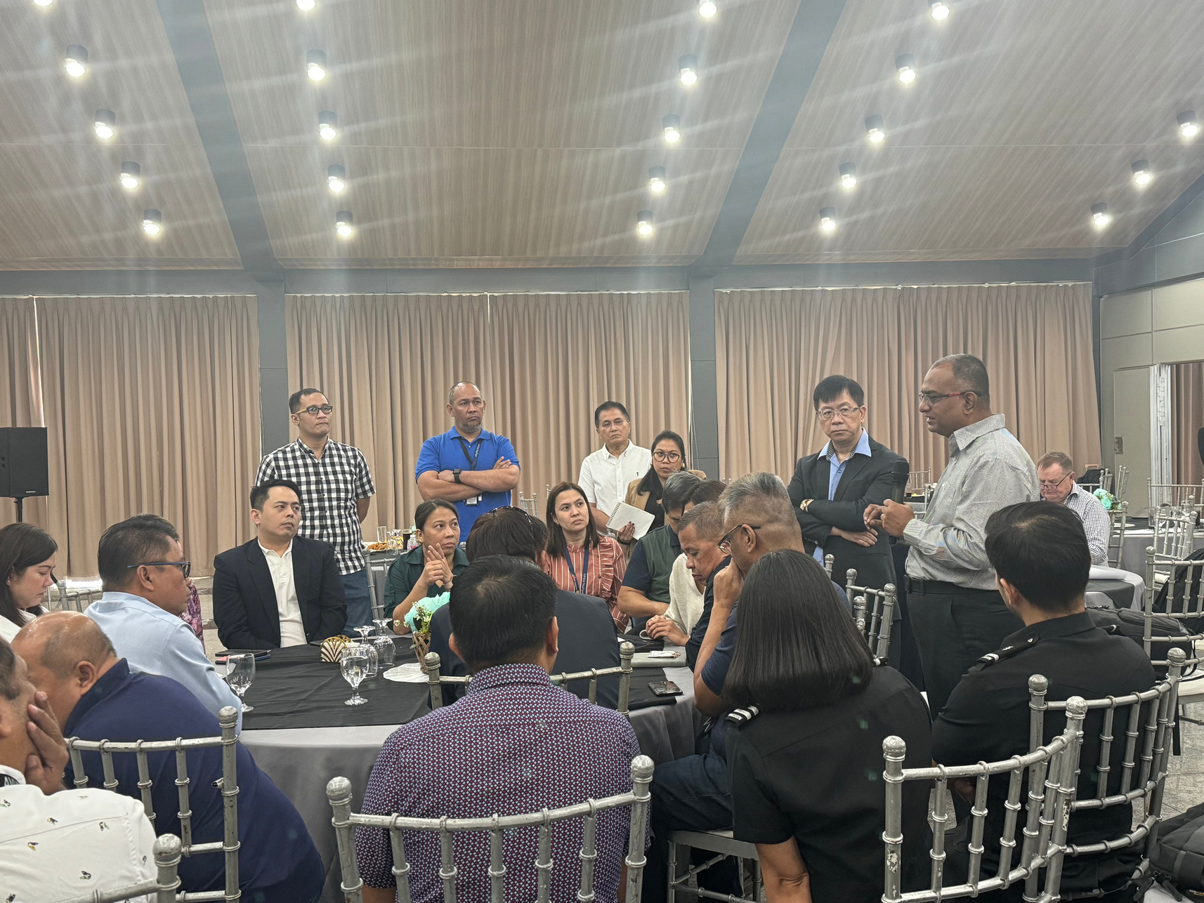
DOTr PLANS AND PROGRAMS
BIOMETRIC PASSENGER PROCESSING
ELECTRIC GROUND SERVICE EQUIPMENT (e-GSE)
AIRPORT COLLABORATIVE DECISION-MAKING (ACDM)
ADVANCED VISUAL DOCKING GUIDANCE SYSTEM (AVGDS)
Digitalization and Technological Innovations

Slide 10
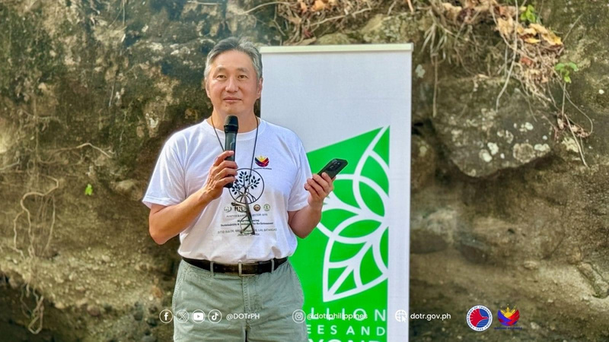





DOTr PLANS AND PROGRAMS
PARTNERSHIP WITH DE LA SALLE UNIVERSITY -
LASALLIAN INSTITUTE FOR THE ENVIRONMENT (LIFE)
PARTNERSHIP WITH INTERNATIONAL FINANCE CORPORATION FOR IFC EDGE GREEN BUILDING CERTIFICATION
Aviation Sustainability and Resiliency

Slide 11
#OnePHAviation
THANK YOU!

