Slide 1
PITCHING:
“Old School or New School”
John Vodenlich
Head Baseball Coach

Slide 2
TERRY AYERS 2024 HOF

Slide 3
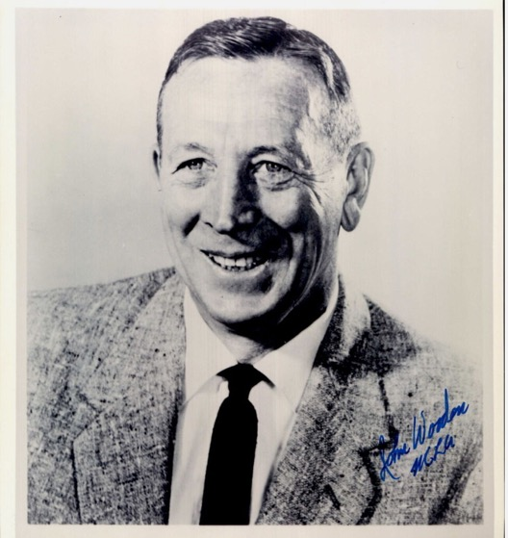
PREGAME COMMENTS

Slide 4
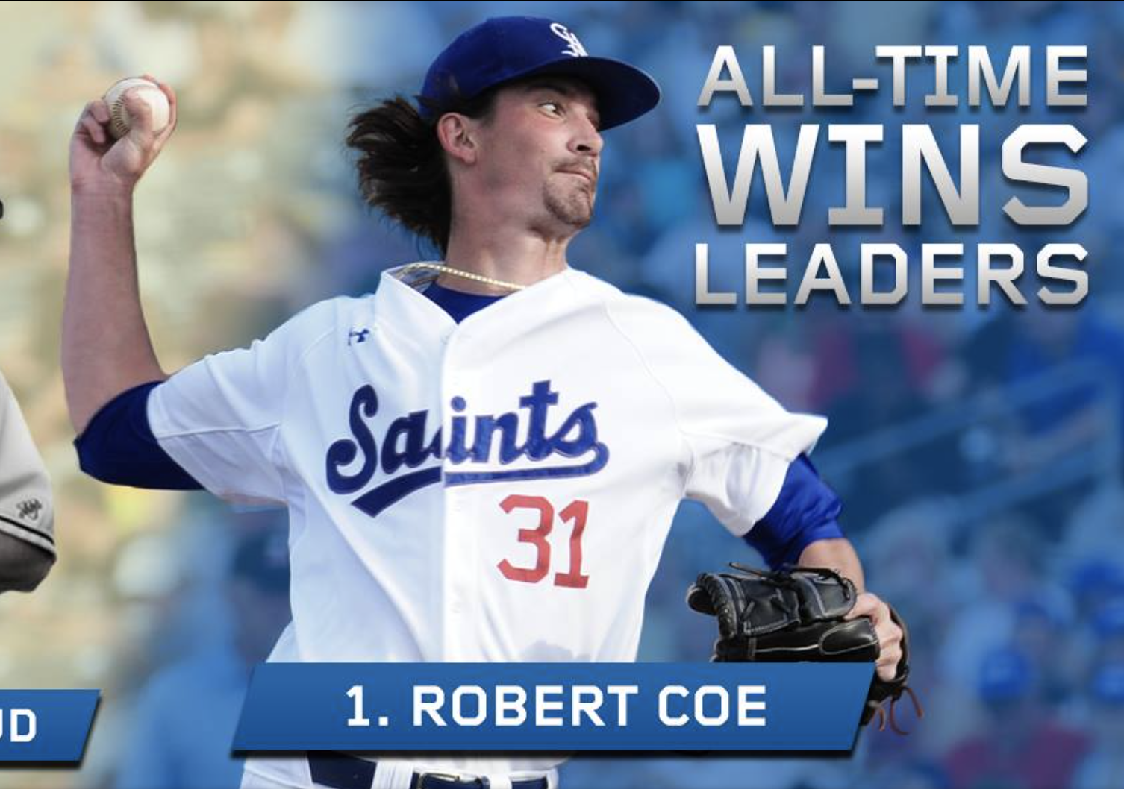
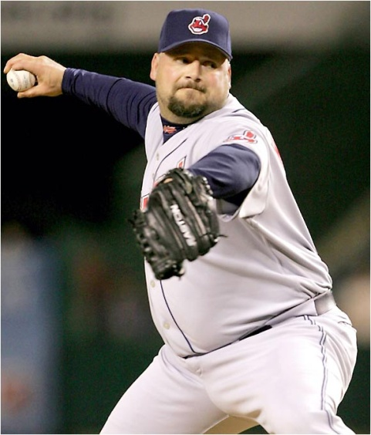
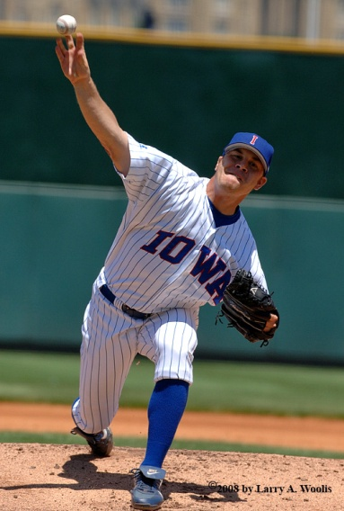
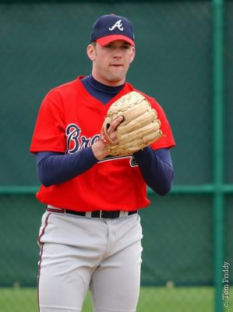
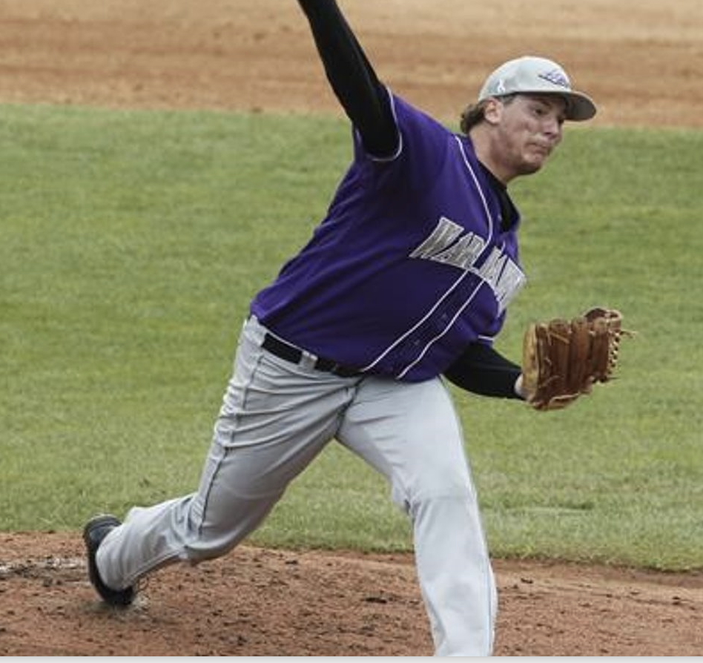
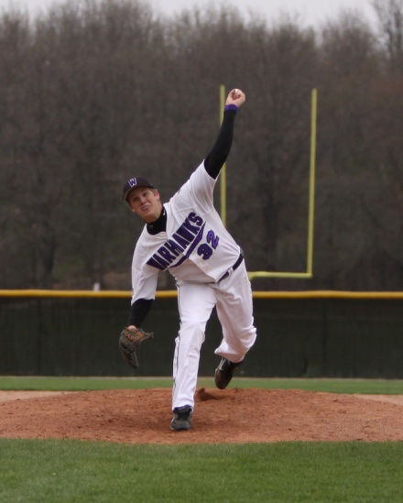
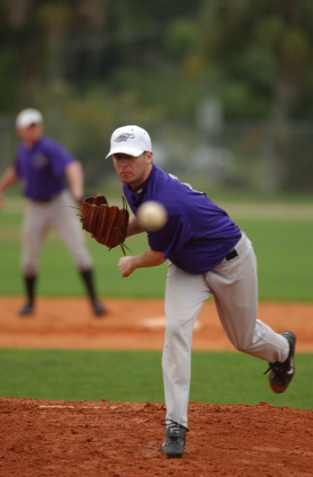
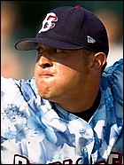
BUILDING THE PITCHER
Over 45 Warhawk players signed professional contractscontracts!

Slide 5
NEW SCHOOL TRAINING

Slide 6
OLD SCHOOL TRAINING
Mechanics: “Old school pitchers” had smooth deliveries with great balance. The Traditional windup was used in almost ALL cases.
Pitch types: “Old school pitchers” threw more curveballs with Vertical break and change-ups with the same motion as fastballs.
Pitching terms: “Old school pitchers” used terms "heavy fastball" and "hammer” for breaking ball". New school terms include "low spin rate fastball" and both “horizontal & vertical break”.
Bullpens: “Old school pitchers” threw Bullpens frequently and usually from game distance.
Command was considered the top priority (Warren Spahn).
“Feel” was emphasized and “Old school pitchers” self-regulated their load.

Slide 7
RECENT TRENDS

Slide 8
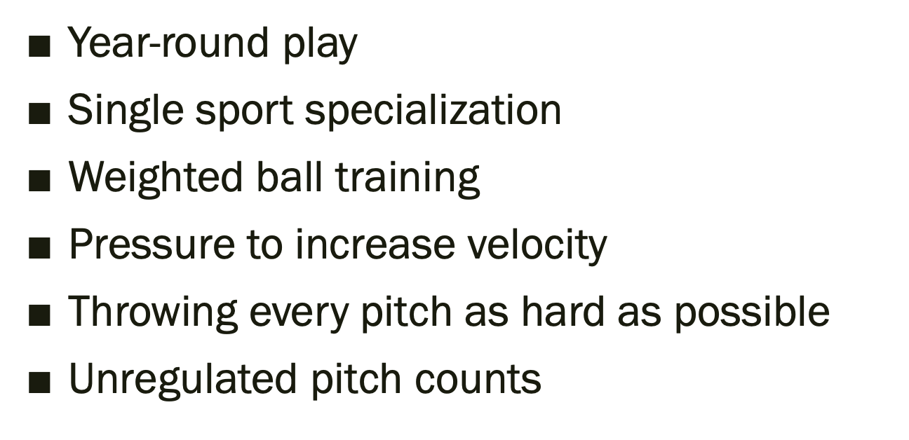
FACTORS LEADING TO INJURY

Slide 9
A BLENDED APPROACH
Talent-Athleticism matters - Chicken salad
My Philosophy About Development of Pitching

Slide 10
“IN SCHOOL” APPROACH
Execute a quality pitch with FULL commitment everytime (Process)
Ultimate goal - Get hitters out (Outcome Based)
COMMAND
DECEPTION
VELOCITY
REPEAT - RECOVERY

Slide 11
BASIC CONCEPTS
1. Momentum
P = m * v
2. Leverage
Positional Advantage
Example: Car

Slide 12
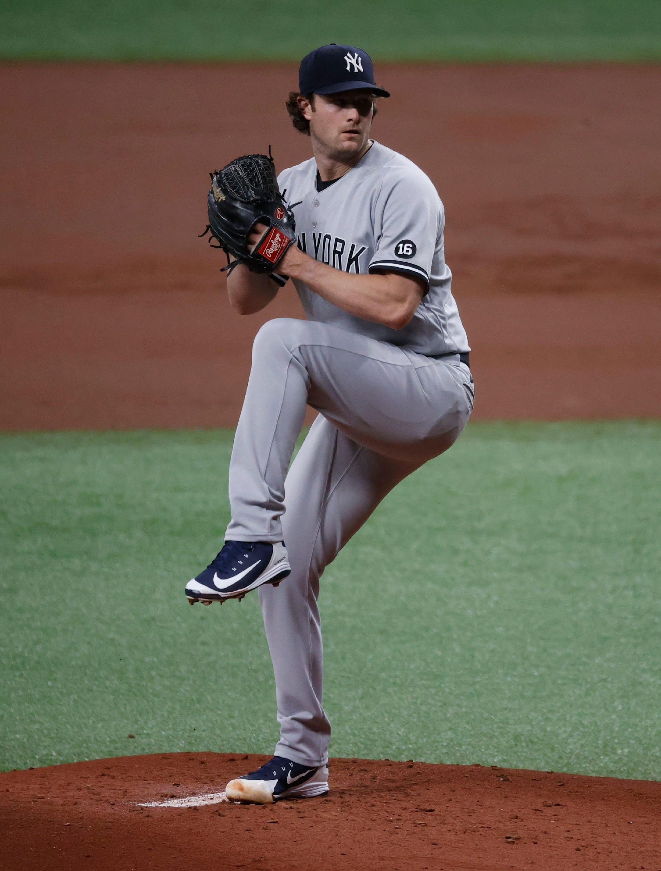
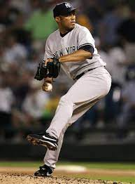
Creating Momentum
Start at the Top - The Timing of the Separation is the key!
Front hip starts the glide down the slope
Hands separate as lead leg works downhill
HIP – HINGE - HANDS
Stride is LONG & FAST

Slide 13
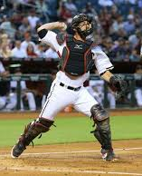
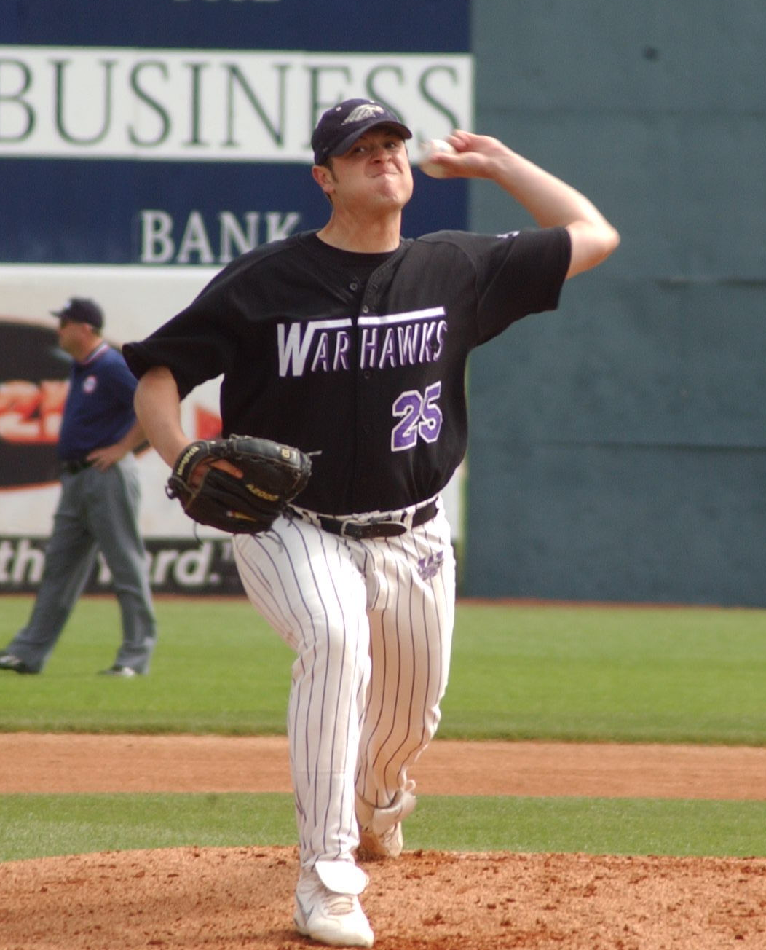
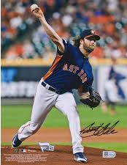
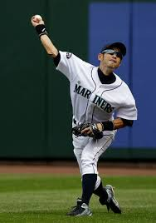
Understanding Leverage
Mechanical Advantage
Arm Path Leverage
Release Point Leverage

Slide 14
AAA PITCHING ABSOLUTES
Arm Action (Path)
Alignment – Posture (Head, Foot & Glove)
Adjustable Release Point
Putting it Together (Proper Movement – Proper Sequence)

Slide 15
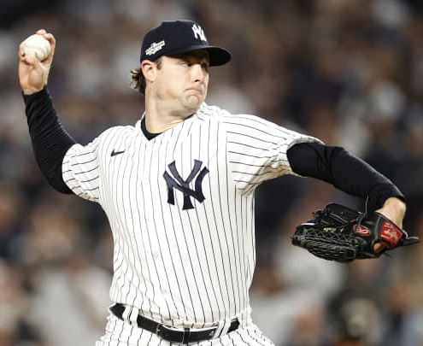
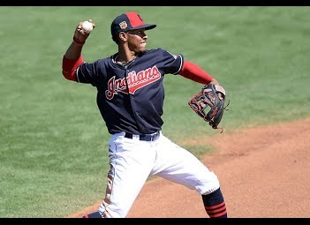
Arm Up at 90 Degrees
Arm Action (Path)
Arm is up at weight foot strike
Shoulders and hips should remain closed as long as possible

Slide 16
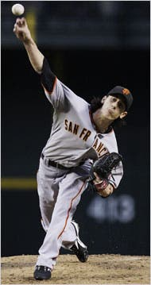
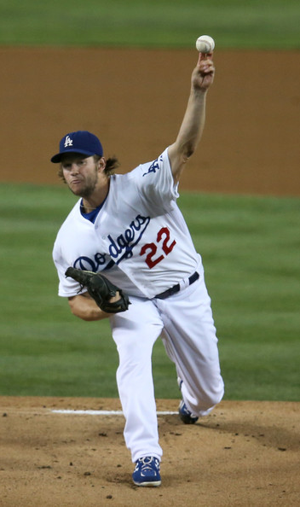
Alignment

Slide 17
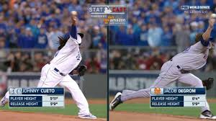
Release Point

Slide 18
PITCHING ABSOLUTES

Slide 19
PROGRAM ELEMENTS –
Activation (Warm-Up)
Preliminary Activities (Prelims)
Throwing Progression (Long Toss)
Target Practice
Post Performance Recovery

Slide 20
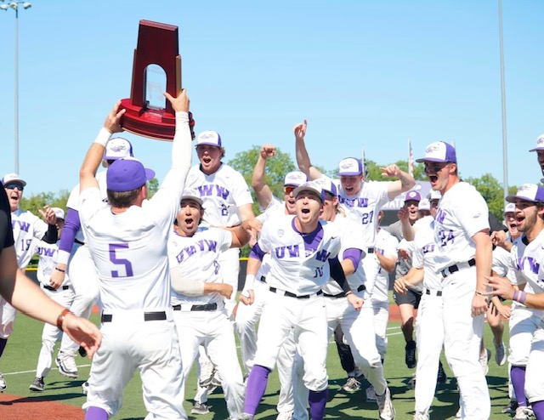
FINAL THOUGHTS
Activation - Warm-Up is just that.
Mobility & Functional strength are important.
Strength does NOT replace EFFICIENCY & INCONSISTENCY.
You get better at “doing something” by “doing something”.
Throw More…Pitch Less (SS not on Pitch Count).
You CAN Control the factors of LOAD – Repetition, Intensity, Distance by using Progression.
What do you VALUE you should EMPHASIZE.
AAA Mechanics

Slide 21
QUESTIONS

