Slide 1
When Playing Small Ball Turns Into Big Innings
Zach Hobbs
McCracken County High School
Paducah, Kentucky

Slide 2
The Stang Mentality
BE INTENSE
COMMIT TO TEAM
SACRIFICE YOURSELF
EMBRACE IT
PLAY FAST, PLAY HARD, PLAY LOOSE

Slide 3
The Stang Mentality
6. BE EXTREMELY COMFORTABLE BEING
UNCOMFORTABLE
7. PUNCH THE CARD, GO TO WORK
8. CHASE IMPOSSIBLE
9. FIGHT TO THE LAST OUT

Slide 4
Create Chaos
We want to speed the game up for our opponents. We want to CREATE CHAOS. Offensively, we want to be the aggressors. Be fearless, be aggressive. (But don’t be reckless.)

Slide 5
Create Chaos
How do you create Chaos?
Throw baseball rules out the window
Aggressiveness on the base paths (not reckless)
Bunting/Fake Bunting/Stealing/ Delay / Hit and Run
Speed up our opponents (mentally and physically)

Slide 6
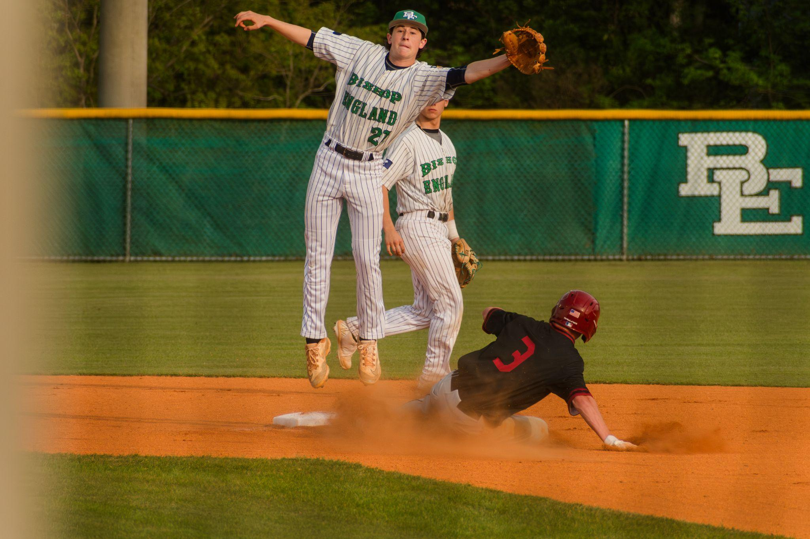
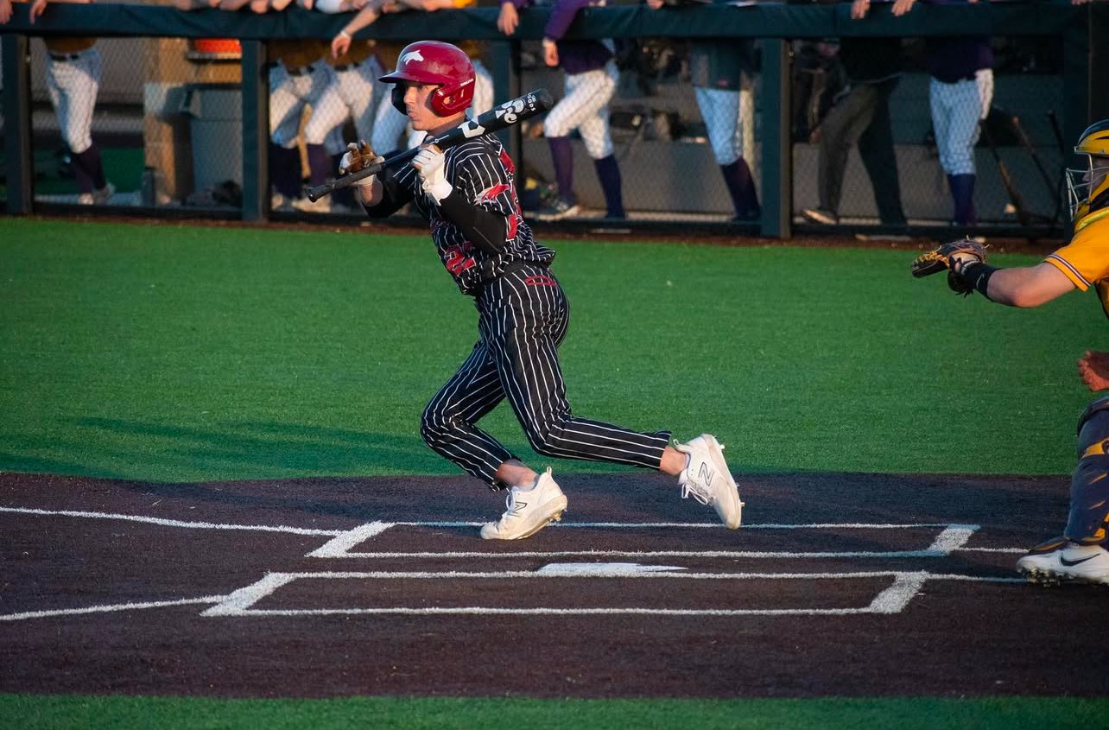
Create Chaos

Slide 7
Developing good bunters and aggressive baserunners
Baserunning is the most undercoached fundamental
Bunting is not being developed in Youth Baseball

Slide 8
Correlation between Small Ball and Success in Our Program
We average 36 Sacrifice bunts per season
Net 84 stolen bases per season
In 2023, the only season we did not reach the final 4 in the last 10 seasons, we only had 15 sacrifice bunts.
Did we call/attempt less or did we not execute

Slide 9
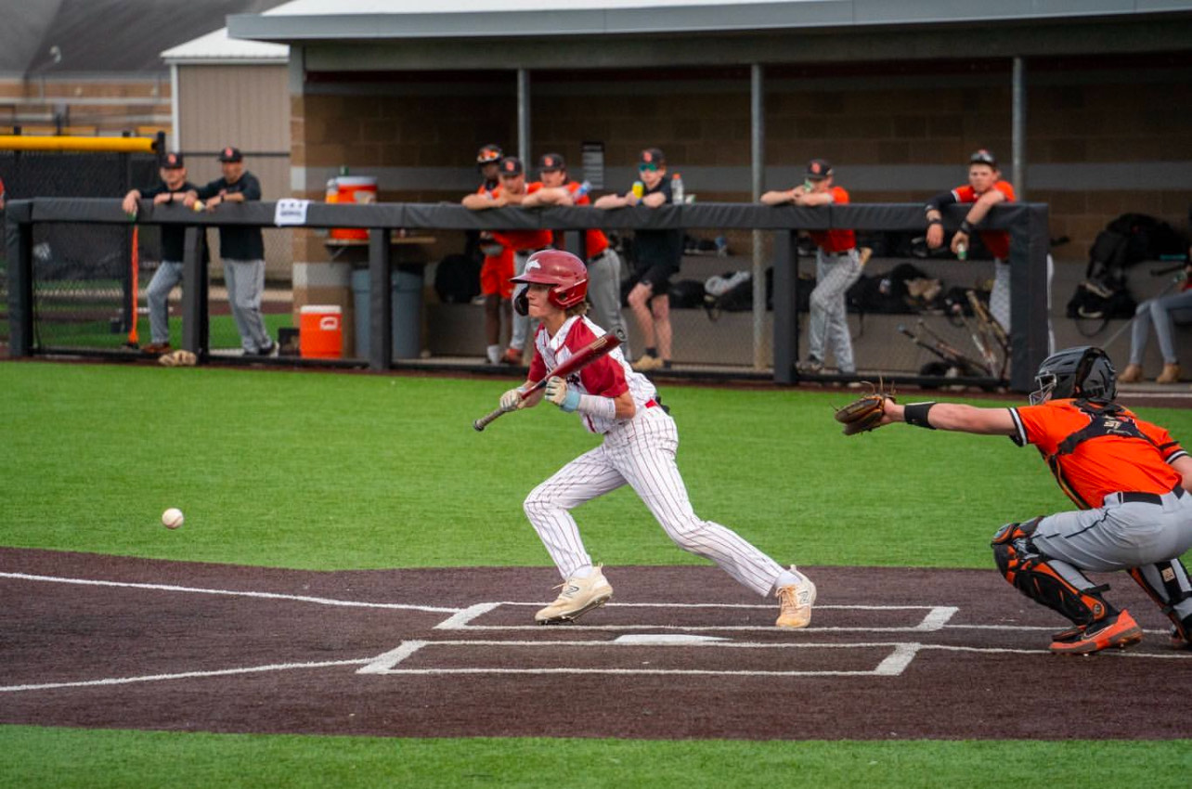
Why bunt?
2.5% of all at bats in the history of our school result in Home Runs or Triples
29% of all at bats in the history of our school result in Singles or Doubles

Slide 10
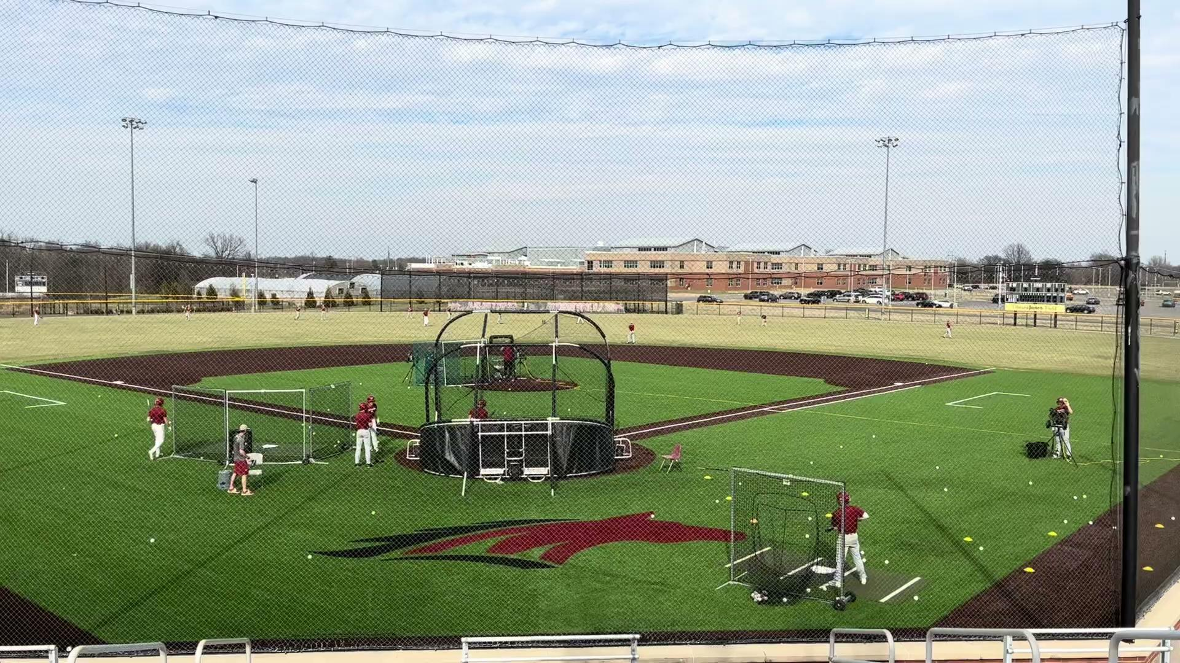

Slide 11
Opportunistic Bunting
We don’t view bunting as an automatic out
Emphasize placement of bunts when possible
Runner at 1st - Bunt to 1st base side
Runner at 2nd - Bunt to 3rd base side
Runners at 1st and 3rd-Great time to apply pressure (Safety squeeze/ fake bunt and steal)

Slide 12
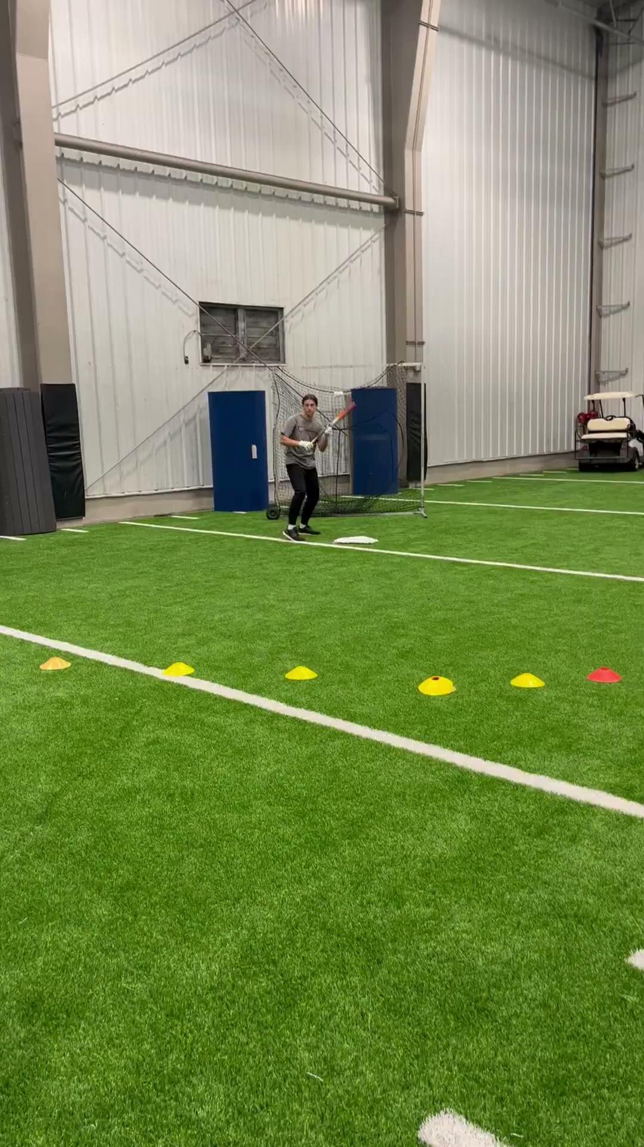
Bunting Drills
Barrel Hold
Reset to stance each pitch
Maintain barrel angle and hold until ball stops rolling

Slide 13
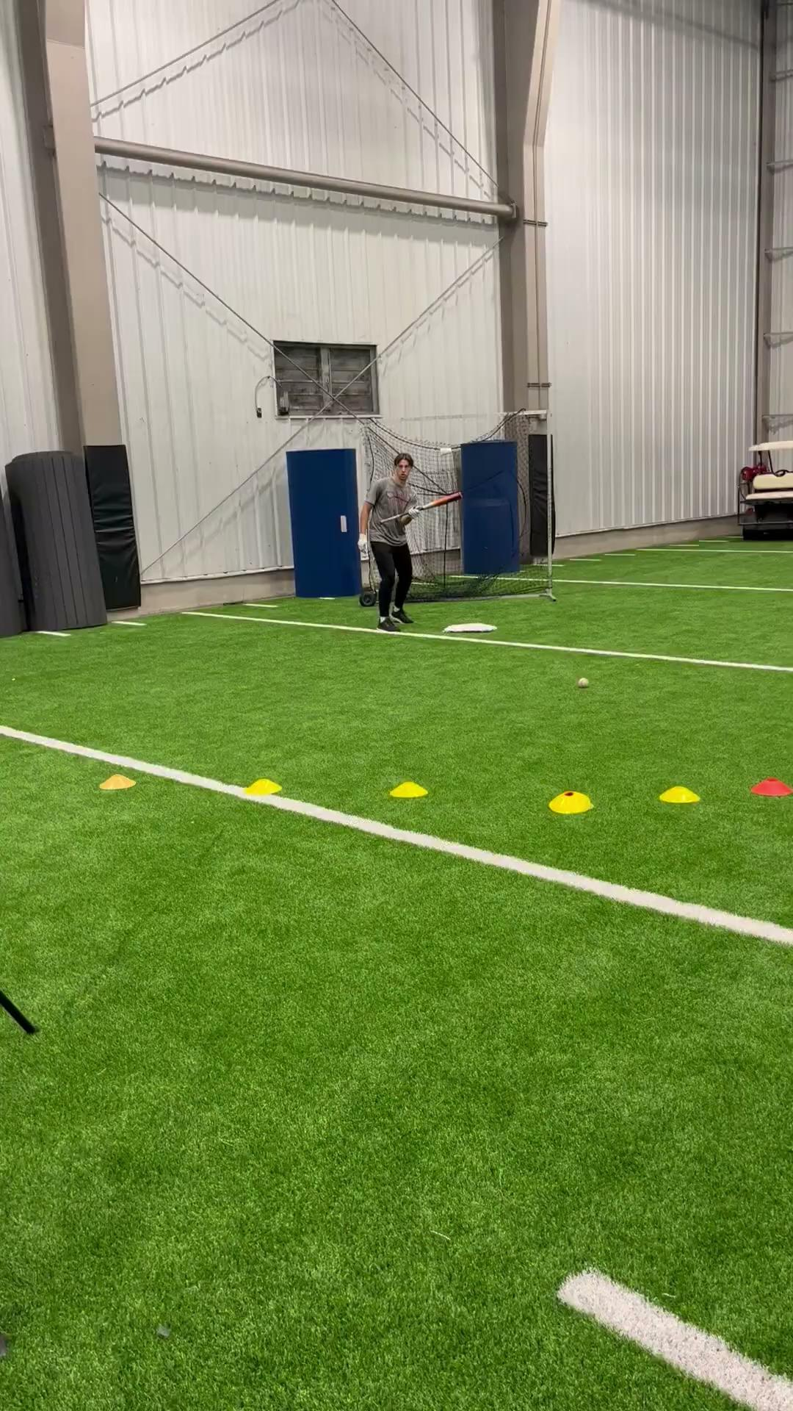
Bunting Drills
Rest to Stance every attempt
Top hand only
Forces top hand up the barrel for better control and forces hitters to get eyes over the barrel

Slide 14
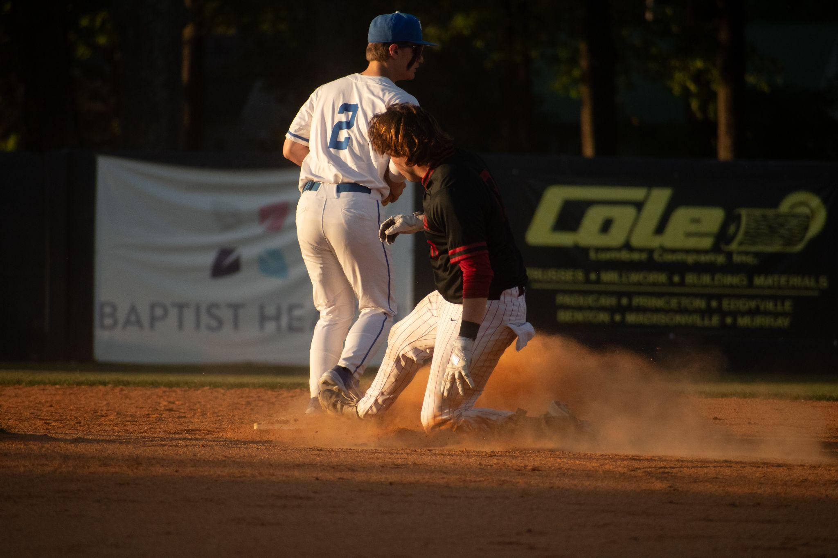
Baserunning
Must teach fundamentals base running rules
Have to teach and reinforce aggression daily
Short and direct drill progressions

Slide 15
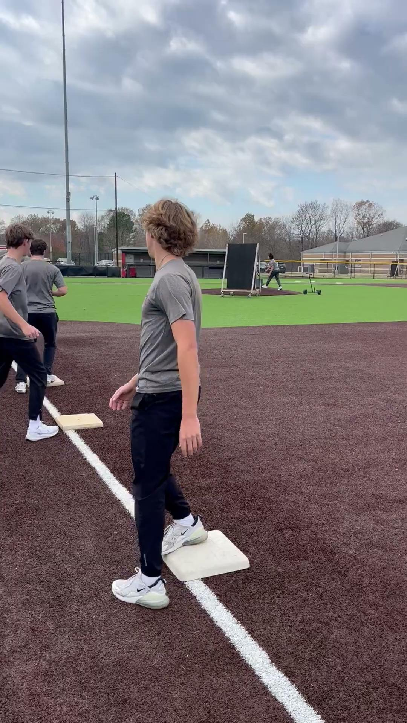
Baserunning Fundamentals Drills
Dirt Ball Reads
See ball down break for second/see it up read

Slide 16
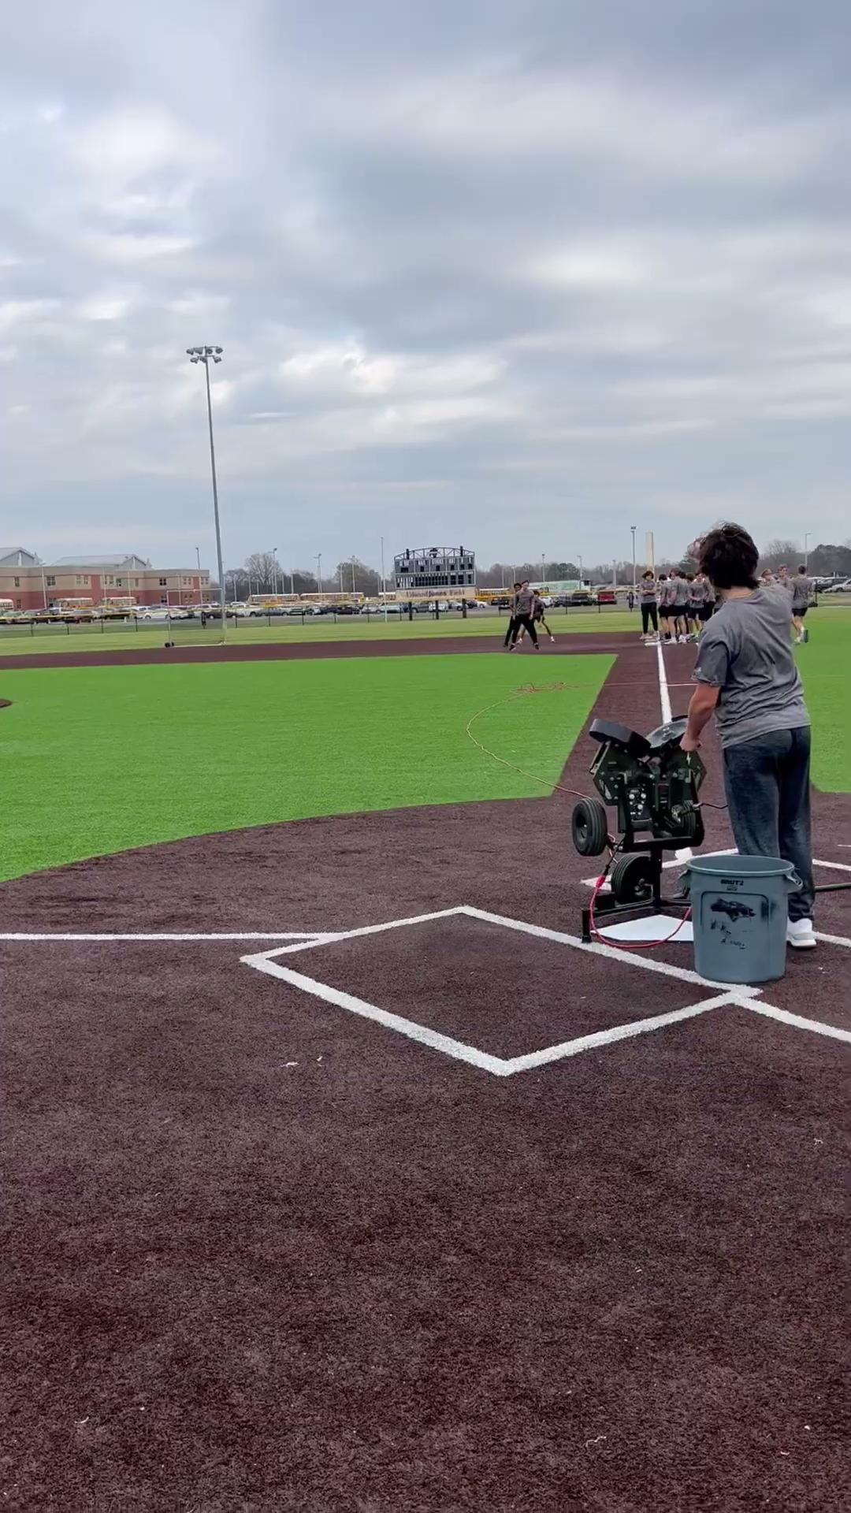
Baserunning Fundamental Drills
Fundamental Baserunning Reinforcement
Lots of options to change scenarios

Slide 17
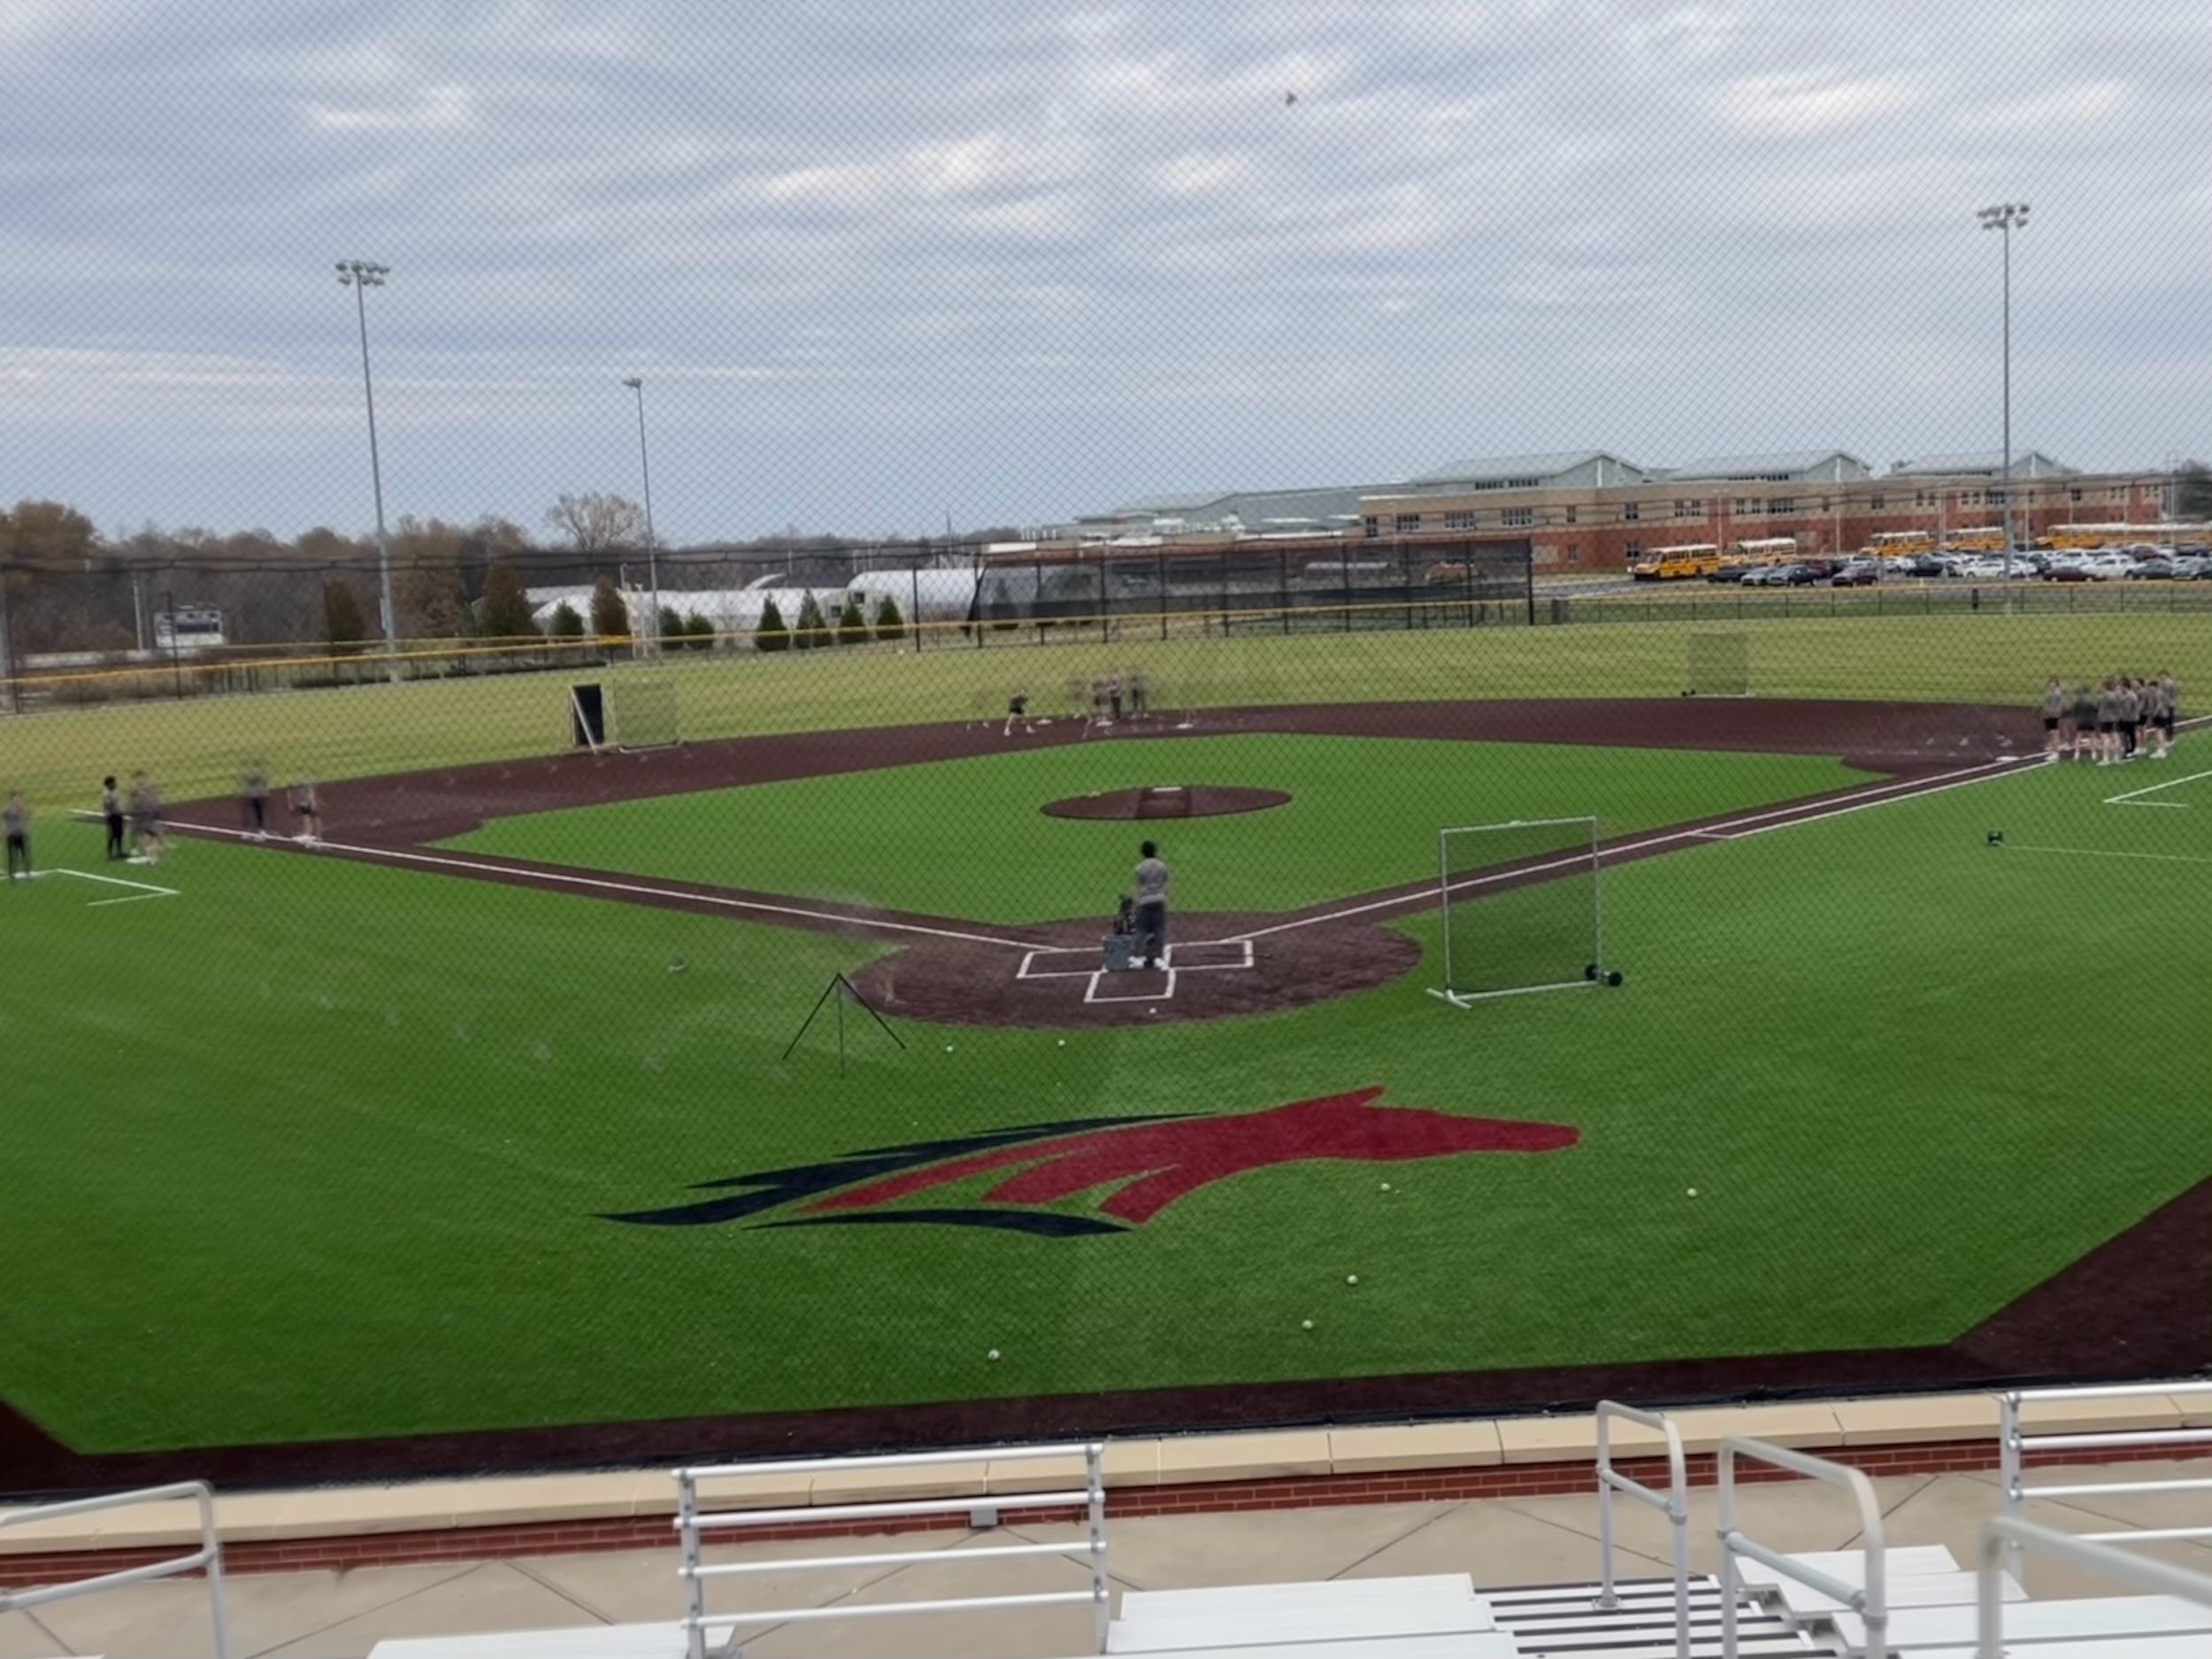
Fundamental Baserunning

Slide 18
Player Choice and Freedom
Give players the ability to bunt and steal on their own
Encourage them in inner-squads to see how aggressive they can be
If a player executes a drag or sacrifice bunt in inner-squads put them on deck for another AB
Trust them-Hard for coaches
Buy in-Hardest Part

Slide 19
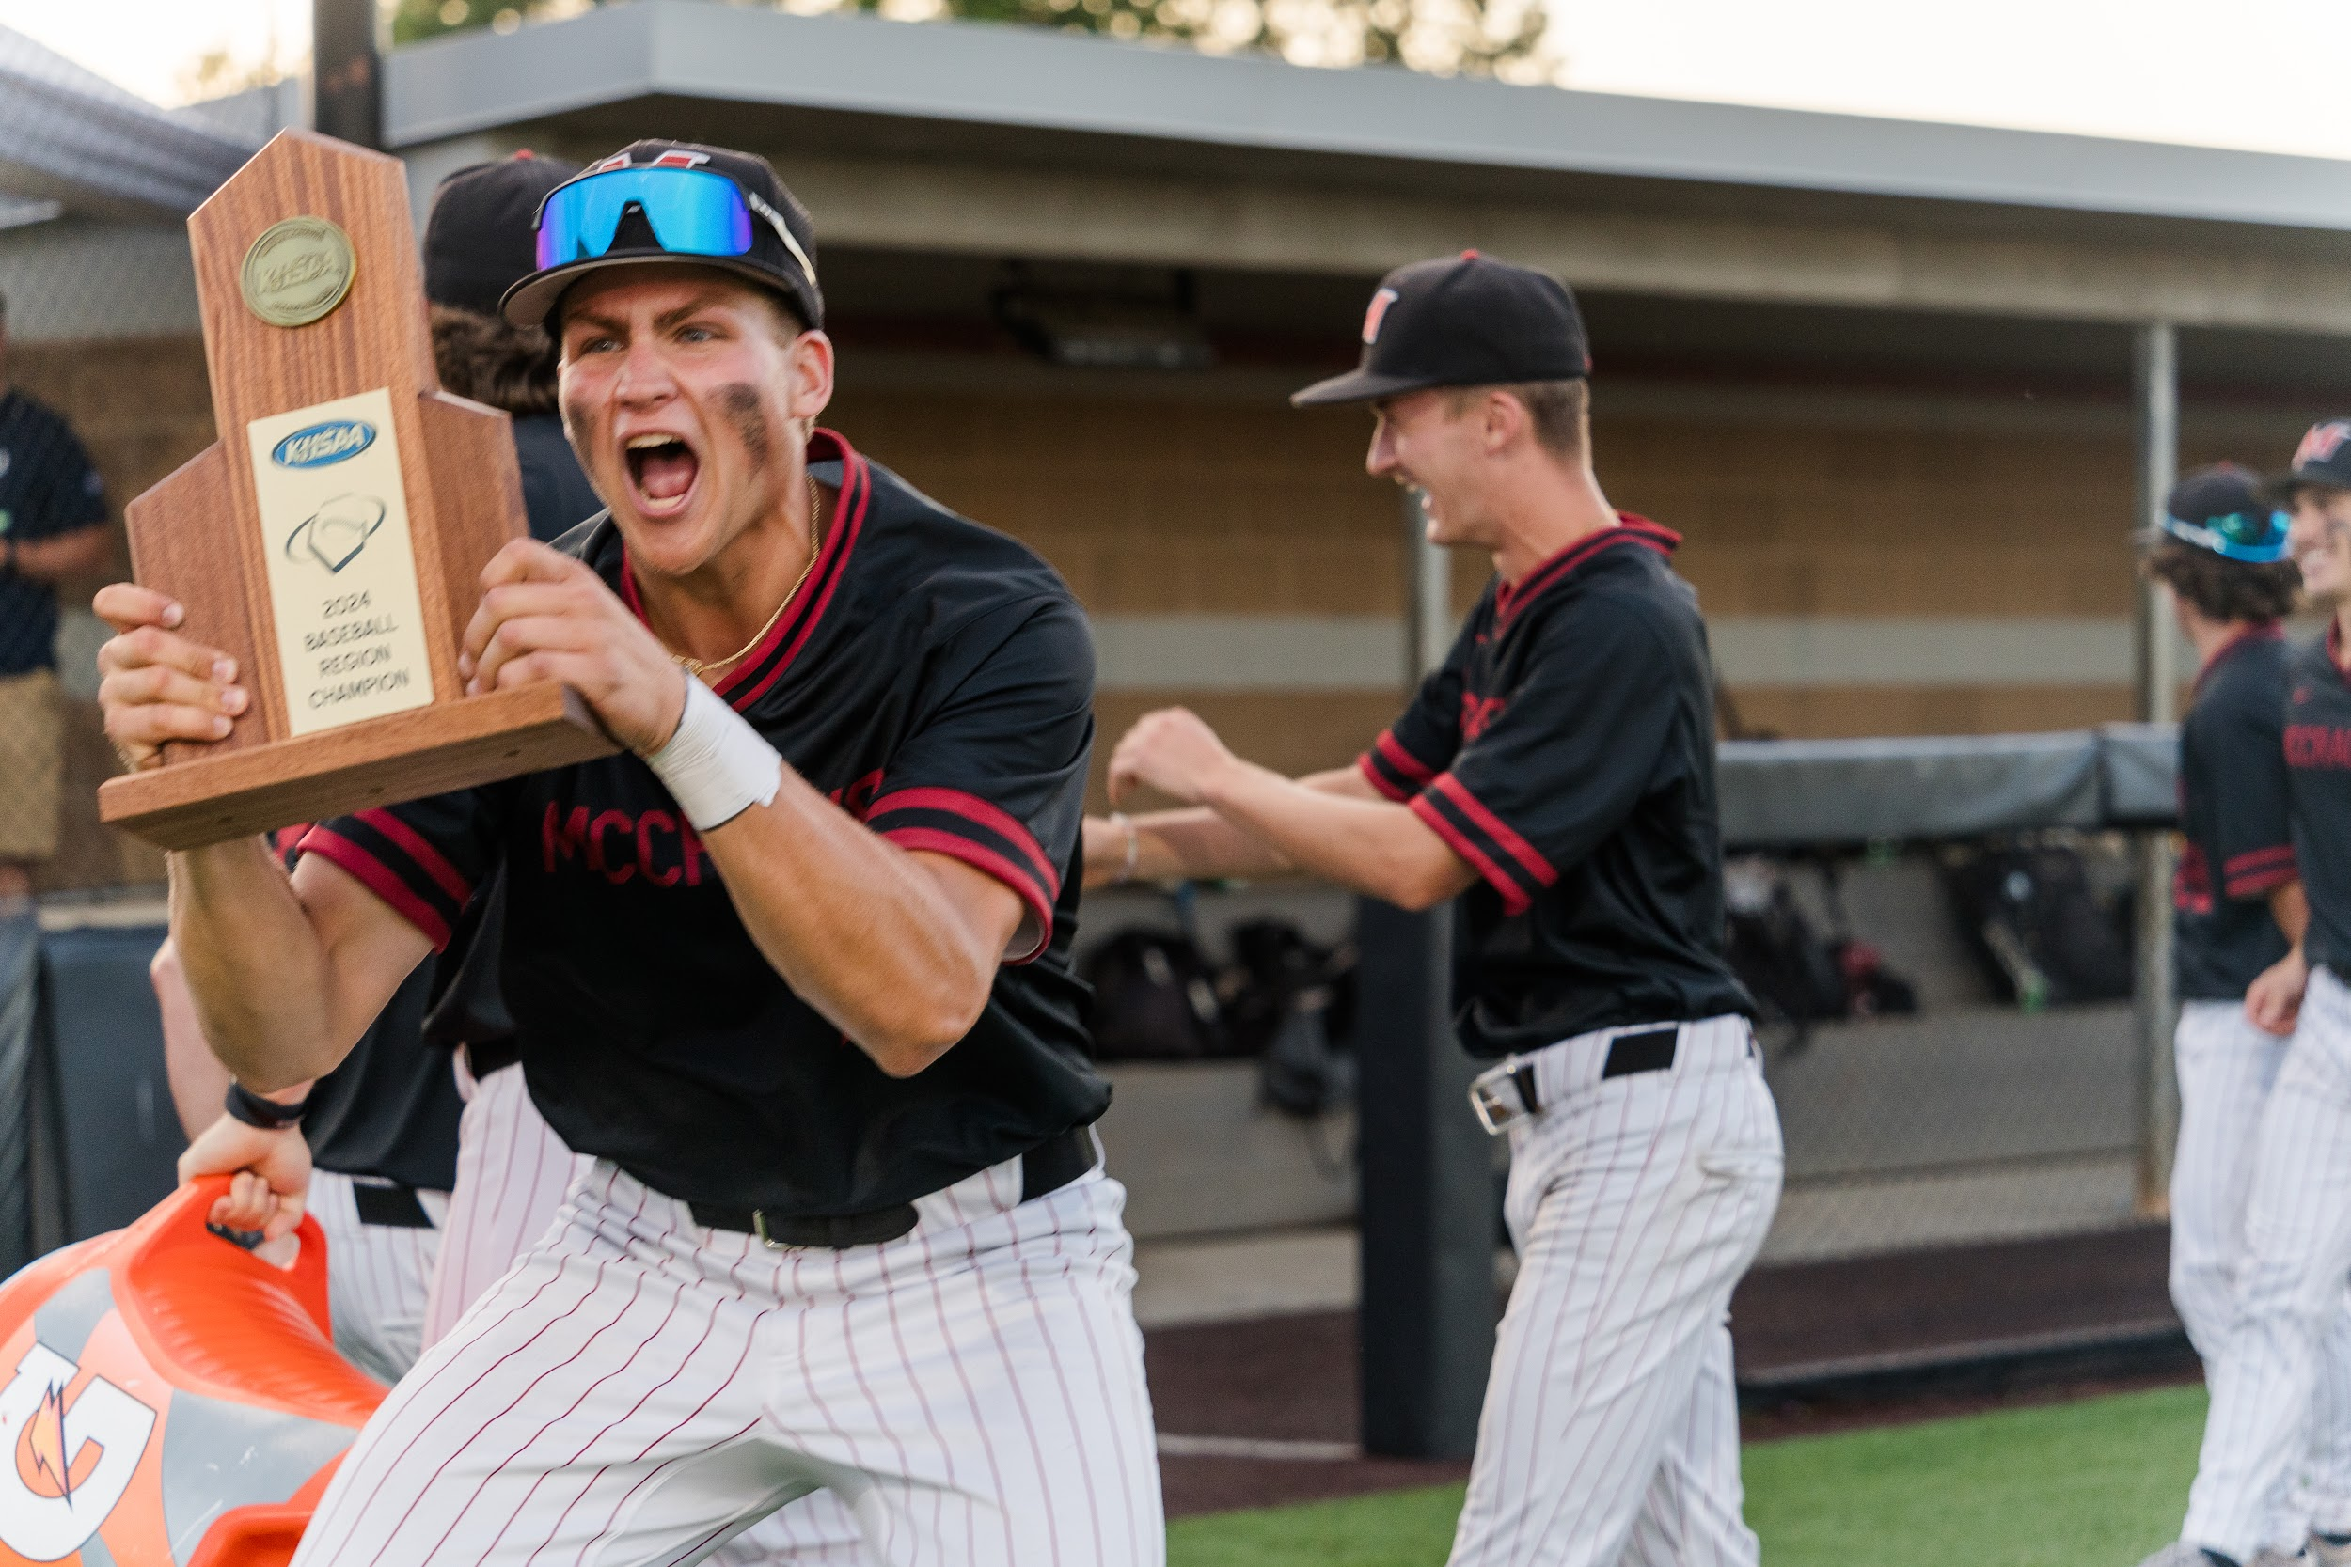
Player Creativity
Let the players be creative when creating competitions
Let them be kids

Slide 20
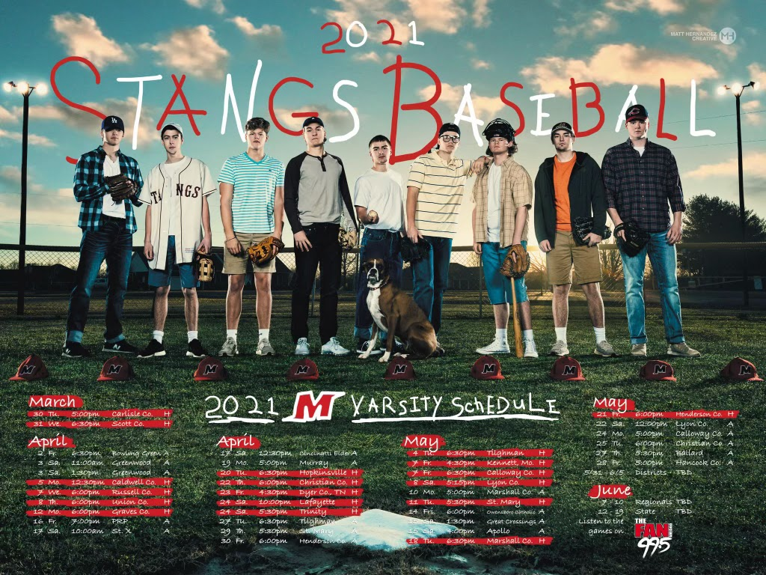
Player Creativity

Slide 21
Thank You!
Zach Hobbs
McCracken County High School
zach.hobbs@mccracken.kyschools.us
270-929-6828

