Slide 1
THERE IS NO “SWITCH”
MATT DENNY
CASTEEL HIGH SCHOOL
DENNY.MATT@CUSD80.COM
602.373.6934

Slide 2
DOWNLOAD ENTIRE POWERPOINT BY SCANNING QR CODE

Slide 3
INTRODUCTION
So honored to be here (I’ve learned so much from these clinics)
Thankful for NHSBCA for asking me to speak today
I’m looking at better coaches than myself
Don’t believe this is anything revolutionary but has helped us be successful in playoffs or big games
None of these things are talent-based
Playing / Coaching Background
My background is why I LOVE these things
You MUST create a these two things:
COMPETITIVE CULTURE - (we are fighting travel ball)
Some years they have more and some you have to create
TRUST – (this usually doesn’t happen quickly)
Constant and consistent decisions for the team INCLUDING accountability
REGARDLESS OF TALENT LEVEL EACH YEAR

Slide 4
PLAYOFFS!!

Slide 5
WHEN DOES IT START?
Literally the day the season ends
After last game I meet with seniors first and then underclassmen (look at what we need to fill)
Quick assessment of strength or weakness (need to work either way) (what do we lose, can you fill those shoes?, get them hungry to step up)
Creating this mentality is not something you turn on in the Spring or State Playoffs
It has to be created through dialogue, honesty, and accountability, and TRUST.

Slide 6
HONESTY AND ACCOUNTABILITY
What does it mean to be accountable?
If you fail WE may lose
Own it and let your parents know (It was my fault mentality)
Accountability happens before mistakes (prepare with accountability)
Talk about rival schools and the best schools A LOT (Hamilton, Corona, DV)
Why do we do this? (They are better than you)
Get it out (Elephant in the room)
Bad teammate
Pitcher with bad command, hitter who can’t hit a breaking ball
Makes us more aware of what to work on so we don’t get exploited
Family dinner talk (we don’t hide things)
**It’s okay to be the destroyer of illusions**

Slide 8
USE VOCABULARY TO CREATE CULTURE
POUND THE ROCK
ADVERSITY = OPPORTUNITY
GETTING ON BASE IS COOL
IF WE DON’T PLAY WELL; WE LOSE
ETC. ETC.
The list is endless but the point is we refer to these ALL THE TIME.
-Our players start to use them on their own to hold each other accountable
-When they believe these are cool you have created the culture you need
-

Slide 9
TALK ABOUT NEGATIVE & POSITIVE
We talk EVERY game (Fall, Summer, Spring) about negative & positive game changing plays that will end or extend our season. (what if this happens in state tournament) – COACHES INCLUDED
Nothing is sugar-coated during this time regardless of player
It helps players/teams deal with things they are struggling with
Our goal is to eliminate these issues before the spring but more importantly come playoff time
This takes time but it necessary for development (LIGHTS OUT STORY)
It’s that important
Ex.
3rd inning (2-0 count double play ball on curve ball)
Leadoff walk with bad body language
Missed sign in 4th inning that lead to poor execution
Immature talk in the dugout
The game is not the time to talk about these things most of the time (after game is better)

Slide 10
ASSISTANT COACHES (DELEGATE)
We need 10 eyes (5 coaches) on the training or game
Games = write it down if I miss it, cover it
Training = Fix it immediately
Need to have head coach respect
Need to be head coaches in the summer/fall
“Billy’s attitude is terrible or doesn’t hustle”
-DON’T COME TO DADDY, YOU ARE GOING TO CUT YOUR OWN LEGS
This accountability during games and training takes some time to get used to
-90’S / WINNING PLAYS/ CATCHER TALLY’S / QAB’S
Treat your assistants as if they are head coaches in front of your players
Give them leeway to handle discipline for bad work ethic and attitude

Slide 11
ALL INSTRUCTION W/ PRESSURE & PURPOSE
Chaotic training (don’t abandon this, even if it looks terrible)
1 step backwards might be 2 steps forward
Notice/Reward the little things in training
Train fast w/ no down time (don’t get off task too much)
Playoffs speed up and we try to train faster than that
Steal reps when not getting reps (MATURE TEAM)
Infielders ball not hit to them (spray paint / flatten hula hoop
Lose my mind for bad cage waiting reps, bad OF angles or effort
MILLION DOLLAR CHALLENGE (what does that look like?)

Slide 12
PRACTICE?

Slide 13
TRAINING PLANS (Practice)
Plan adversity and difficulty (sometimes)
It’s okay to let them know non “feel good” days
Approach
Cali approach / velo approach
2013 story (Nogales) – ran into a buzz saw
Having plan B allows us to be more confident and loose with plan A
Players know there are multiple plans
Everyone has a plan until your popped in the mouth (what next?)

Slide 14
COMPETITITVE BP
If you fail you are done (sometimes)!!
Chart everyday (winner gets different shirt)
DON’T CHASE POINTS
We treat our BP like a game (not so much in Fall-developing)
Infield errors go in trash can labeled “next play”
Kenyon story -- 2016 error in 1st / big stones / next play coach Wink”
Defense during BP for +/- points (watch the effort and fun go way up)
Error, bad route, bad effort, lazy pre-pitch (really need asst.)

Slide 15
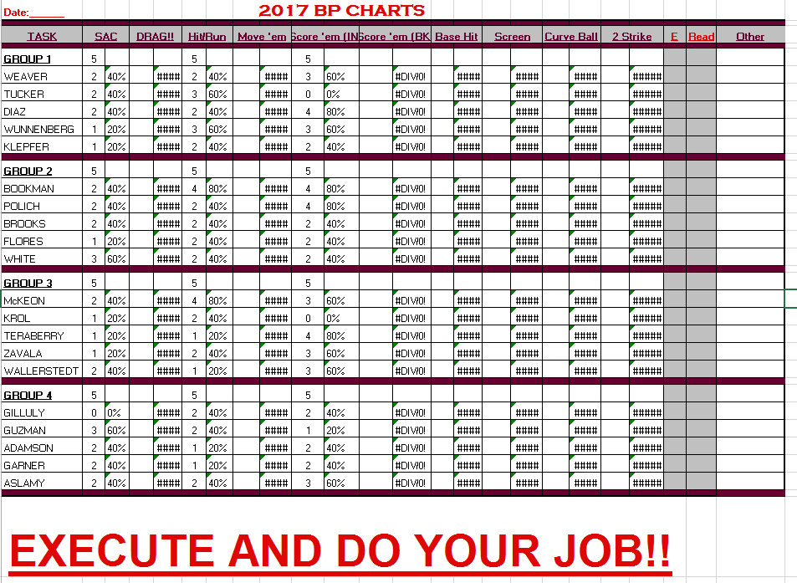
COMPETITITVE BP – REGULAR BP

Slide 16
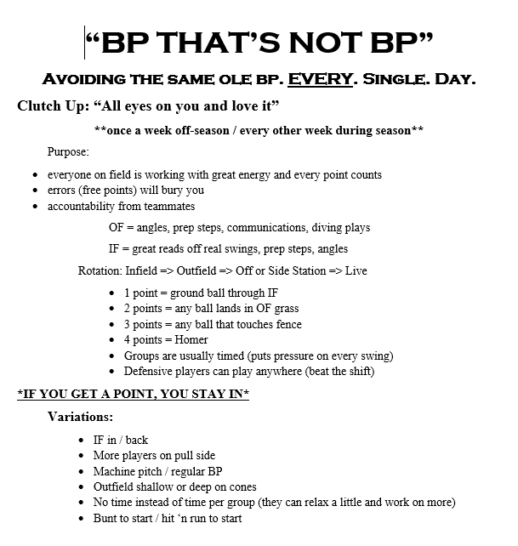
COMPETITITVE BP

Slide 17
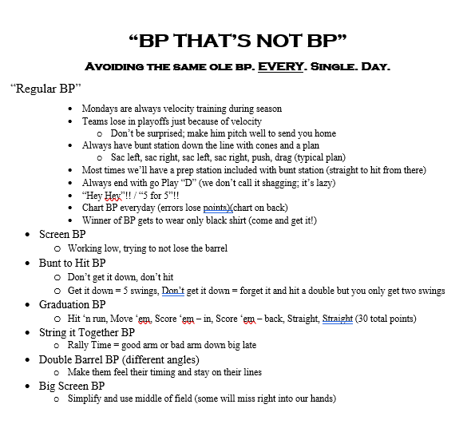
COMPETITITVE BP

Slide 18
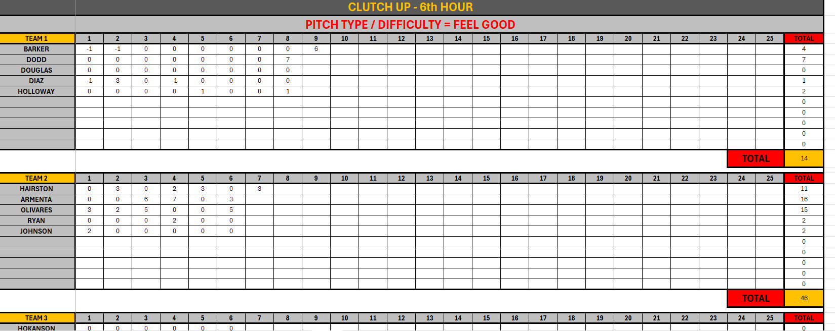
COMPETITITVE BP – CLUTCH UP (GREAT FOR DEFENSE)

Slide 19
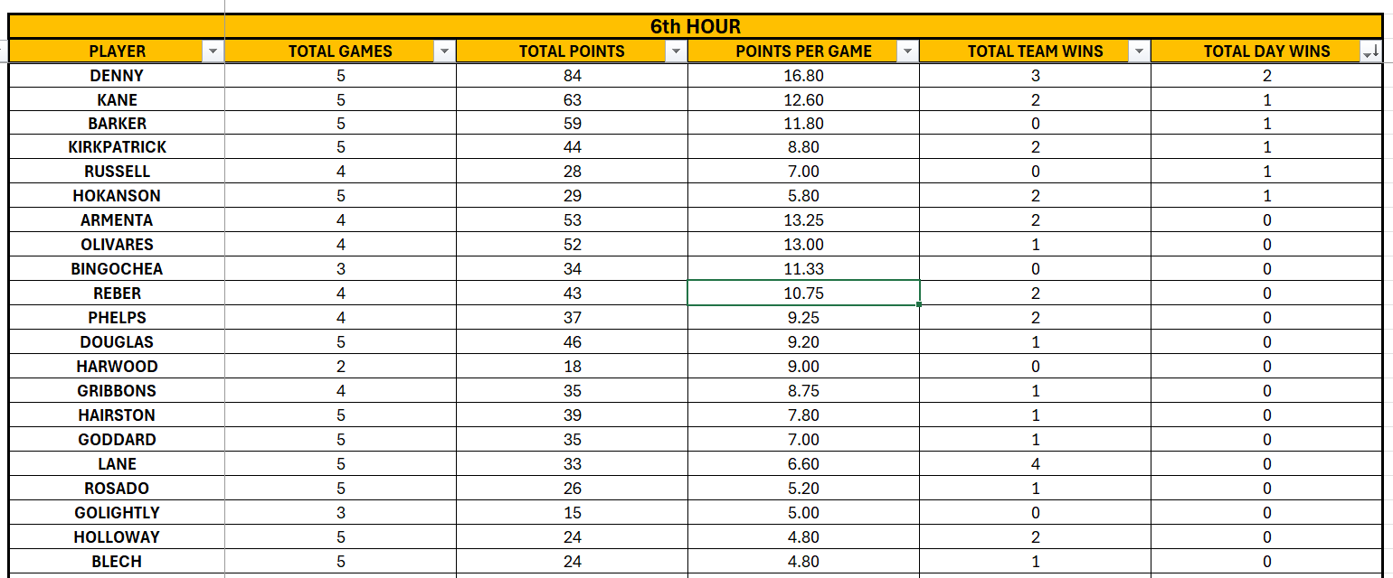
COMPETITITVE BP – CLUTCH UP (GREAT FOR DEFENSE)

Slide 20
BP
https://www.youtube.com/watch?v=MBWjgaJu8S0

Slide 21
BP THAT AIN’T BP

Slide 22
“SEE-YA” DRILL

Slide 23
EVERYTHING is competitive
Catch Play (rules, games) 2012 = 73%
Baserunning (cone grab, get fired up, embarrass the loser)
Weightroom (that guys lifts more than you?, walk away)
Picking up baseballs (acknowledge the effort)
First one ready to hit (first guy ready to hit is most eager to hit)
BP (defense during BP-we don’t call it shag)
Yell out “we lose” during defensive mistakes during BP
We try to declare a winner in almost everything we do.
Salute the king (next slide)

Slide 24
7’s - INFIELD DRILL VIDEO

Slide 25
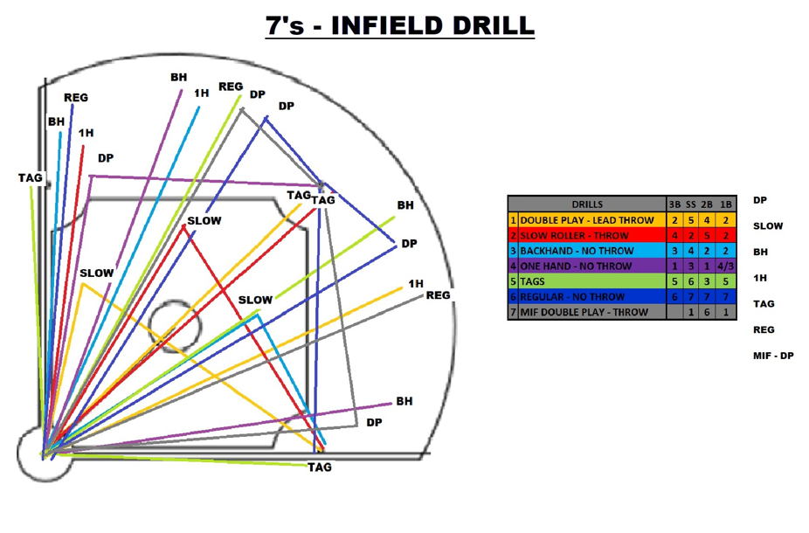
INFIELD DRILL “7’s” OR “CHAOS” DRILL *NEED 3 FUNGOS OR MACHINES*
LOOKS COMPLICATED BUT THAT’S THE POINT AND THEY GET BETTER. WE BELIEVE IT HELPS THEM SLOW THE GAME DOWN.

Slide 26
SALUTE THE KING
How this looks? (very strict on how this looks)
Shouldn’t be happy
Look him in the eyes
Being the King should have a look to it (you are a scrub)
They have to say “You’re better than me today.”

Slide 27
SALUTE THE KING VIDEO

Slide 28
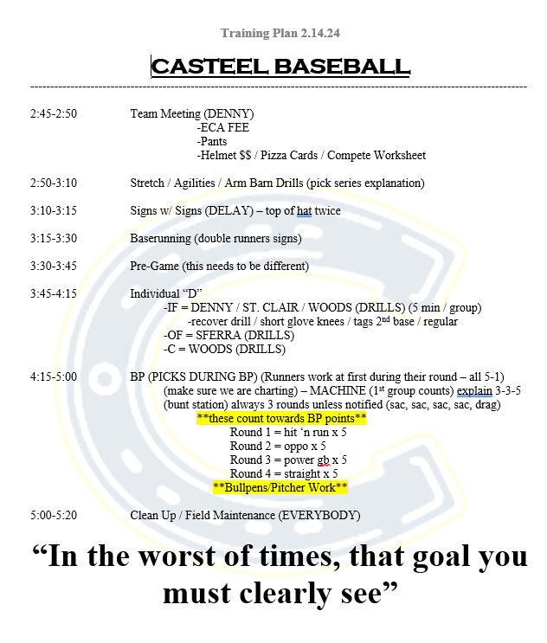
TRAINING PLANS

Slide 29
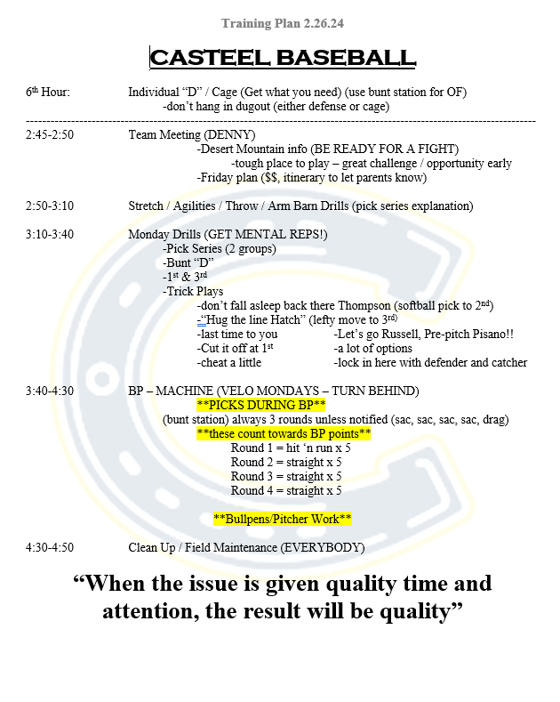
TRAINING PLANS

Slide 30
QUOTE OF THE DAY
Forces you to think about the pulse of the team
Humbled / stroked / bad teammate / bad loss / nerves
Always ask them to translate what it means for us RIGHT NOW
Gives the players a good mindset before the day starts
Re-groups their thoughts from distractions to what’s important for our team
School
Girlfriend
Non-baseball items

Slide 31
TEAM MEETING
Team Meeting – EVERYDAY (Why?)
Won’t feel different during playoffs (NO SWITCH!!)
It can’t feel bigger because of playoffs! (there is enough juice already!!)
Can Explain Important Items (especially late in the year)
Scouting Report
After Spring Break late in the year our training sessions are lighter
BUT MORE IMPORTANT WITH MORE FOCUS

Slide 32
RESPONSIBILITIES
Coach
Hold EVERY player accountable for everything
Be real with criticism (ALWAYS)
Don’t give in!!
Stay calm and rely on preparation (talk about negatives after the game not during)
Player
Trust the process and the coach who provides the process
Don’t be sensitive and soft to criticism (it doesn’t mean we don’t love you)
Play for your team and program (it’s obvious to coaches who does not)
Parent
Stay out of playing time and baseball issues
Be supportive and let your son explain the situation first
Administration
Tell the parents we will not discuss playing time (this will eliminate most of the issues)
Trust the Coaching staff and their decisions
**LIVE BY THE SAYING “I’M CRITICISING THE ACTION NOT THE PERSON”**

Slide 33
INTIMIDATE W/ RELENTLESSNESS
Always doing something when opponent shows up (not flip, grab ass games)
Don’t waste time in dugout
Sprint everywhere (you need to practice it in Summer and Fall)
My favorite characteristic and I’ll tell the players how important it is to me
Sprint on BB’s (it tells them you are going to steal & get good read on BID)
Catch Play, Getting off the bus, Pre-Game is VERY important to us
Pitchers need to work quick and wait for hitter to get in the box with intimidating body language
***WE NEED TO BE UP 2-0 BEFORE THE GAME STARTS**

Slide 34
PREGAME VIDEO

Slide 35
FEAR IS A LIAR
You need to create the desire for every player to want that pressure
Fear/Intimidation is a choice
We talk about pressure, fear, intimidation and have a plan to deal with it
Everyone is nervous; who deals with it better
When it hits us it’s not a surprise because we knew it would and we’ve already talked about the plan
Perception (opportunity to succeed or afraid to fail)

Slide 36
PLAYOFF MENTALITY
RELY ON PREPARATION
CONFIDENCE THROUGH PREPARATION

Slide 37
WE ONLY NEED TO BE BETTER FOR
2-3 HOURS.

Slide 38
THE MOST TALENTED TEAM DOES NOT ALWAYS WIN.
This is a great quote for favorite and underdog

Slide 39
IF WE DO NOT
PLAY WELL WE LOSE.
This is a great quote for favorite and underdog

Slide 40
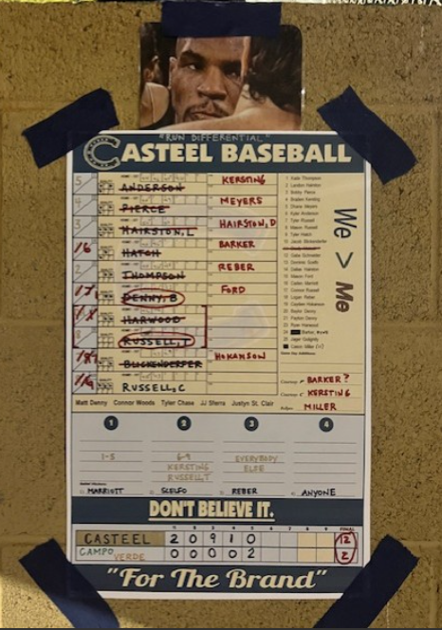
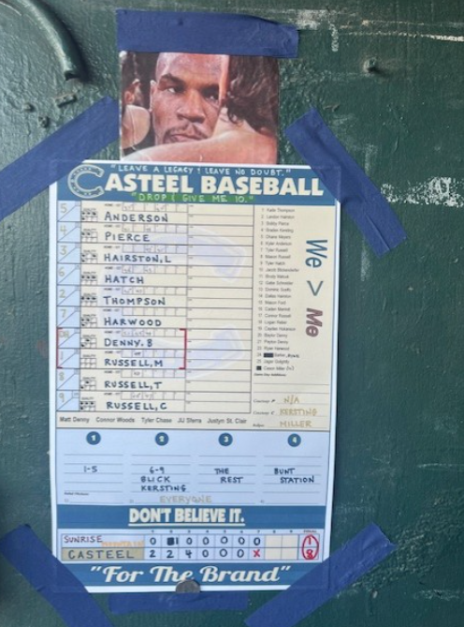
Quote on Dugout Card
“
“Run Differential” “Leave a Legacy; Leave no doubt”
“Drop and Give me 10”

Slide 41
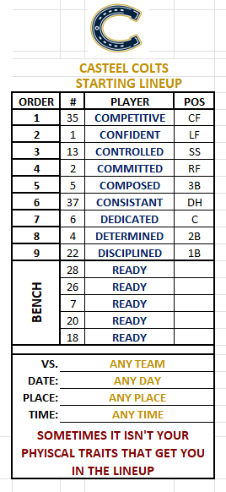
NONE OF THESE ARE PHYSICAL

Slide 42
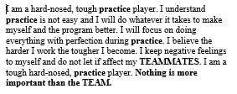
PLAYER HAT CARDS

Slide 43
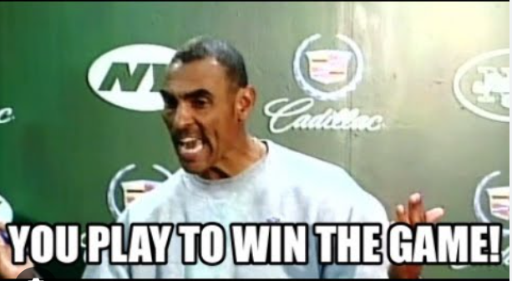
WINNING OR DEVELOPING?
You can do both!!

Slide 44
THERE IS NO “SWITCH”
MATT DENNY
CASTEEL HIGH SCHOOL
DENNY.MATT@CUSD80.COM
602.373.6934
Please Email or text me if you have any questions about our process.

