Slide 1
Future Proofing for Digital Disruption
ISACA KENYA GRC CONFERENCE 2024
Mercy Omollo, President ISACA Kenya Chapter

Slide 2
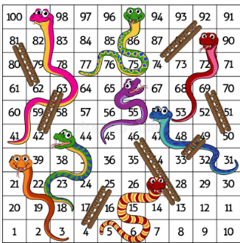

Slide 4
The Role of GRC in futureproofing Disruption
Designing robust and resilient risk management systems involves a complex set of activities and judgment calls.
Probability x Impact = High/Low
The most robust and well-designed risk management system in the world won’t work if your people don’t have the right mindset and your culture isn’t aligned with your organizational values.
Recognizing digital disruption and innovation as a business objective
Build a digital trust-preserving culture
Measure the value of digital resiliency and trust dynamically

Slide 6
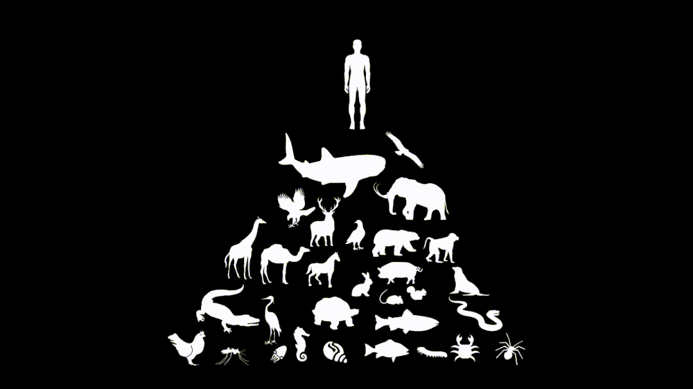
The Role of GRC in futureproofing Disruption
How do you design a resilient risk management system that will futureproof your business?
Risk Management in the Era of Disruption | Yes | No
RM as an Experience | X
2nd & 3rd Line Teams Only |  | X
Cross function multidisciplinary teams | X
Risk Appetite vs Strategy | X
Balance compliance vs innovation | X | X

Slide 8
The pursuit of digital trust is not a static endeavour; it's a dynamic and ever-evolving challenge that requires our continuous commitment and collaboration.
It's about ensuring that the systems we build, the data we handle, and the technologies we create are fortified against the evolving threats of our digital age.
Digital trust professionals!

