Slide 1
Sustainability & Trust
ESG Reporting
October 28th 2024- 1st Nov 2024
Steve Magati
GRC 2024

Slide 2
Climate & Sustainability is a Complex Ecosystem
Researchers
Influencers
Innovators
Businesses
ESG Advocacy Organizations
Emissions sources
Agriculture & Land Use
Investors
Policy & Standard Setters
Building & Infra-structure
Energy
Governments
Regulators & Standards Setters
Industrial
Transport
Waste
Media
Multilateral Organizations
Individuals
GRC 2024

Slide 3
Current Trends in ESG
The hot topic items
Diversity & Inclusion
In addition to boardroom diversity, the focus for companies and investors will shift toward diversity across the organization, to include the general workforce.
Policies on equal pay, equal opportunity, and corporate culture will also
come under more intense scrutiny.
Climate Change: Net Zero
Climate change will be a dominant theme, as governments across the
globe introduce more climate-related regulations.
3
1
ESG Disclosures
Disclosures on ESG factors will become standardized and widespread by the end of the decade. Pressure from investors will serve as a major catalyst for change.
2
Executive Remuneration
Expect companies to re-design their rewards programme to achieve sustainable performance. This includes Incorporating ESG KPIs in determining rewards
4
GRC 2024

Slide 4
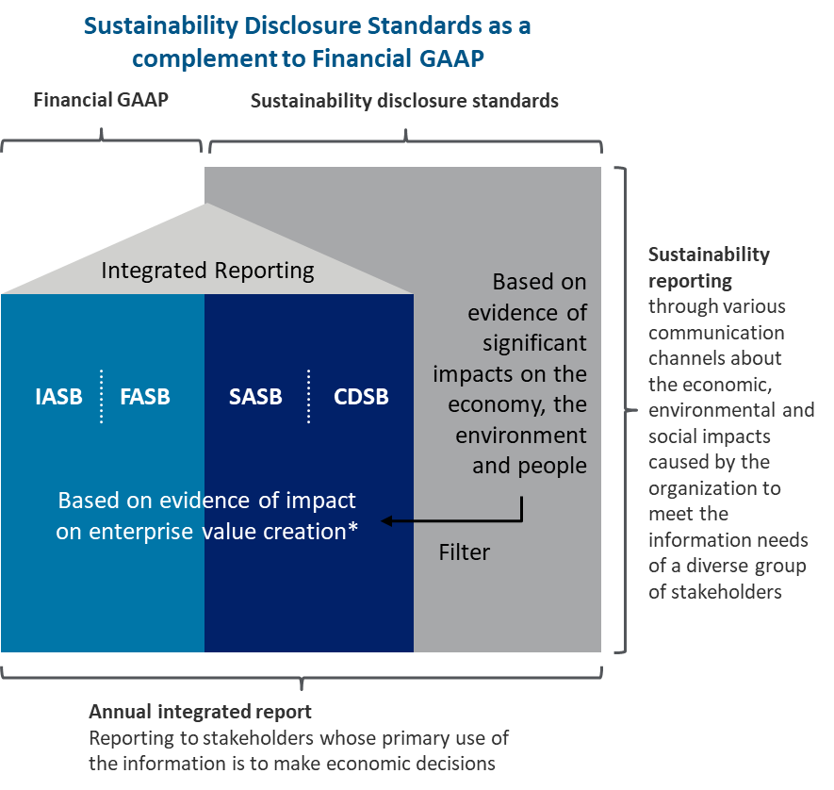
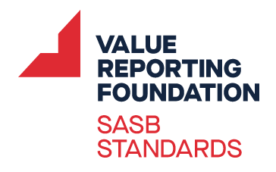
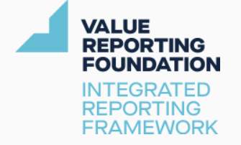
ESG Reporting | Overview of the key sustainability / ESG reporting frameworks globally
The following are ESG disclosure standards and frameworks, which are rapidly accelerating towards harmonization and convergence, despite aiming at different audiences
Joint Statement by Five Standard Setters (Sept 2020)
Sustainability Reporting Standards
Climate Disclosure
Frameworks and Standards
GRI
WEF-IBC Recommendations for 21 core metrics and 34 expanded metrics
Selected from above standards and frameworks
Integrated Reporting Framework
Source: Joint Statement
GRC 2024

Slide 5
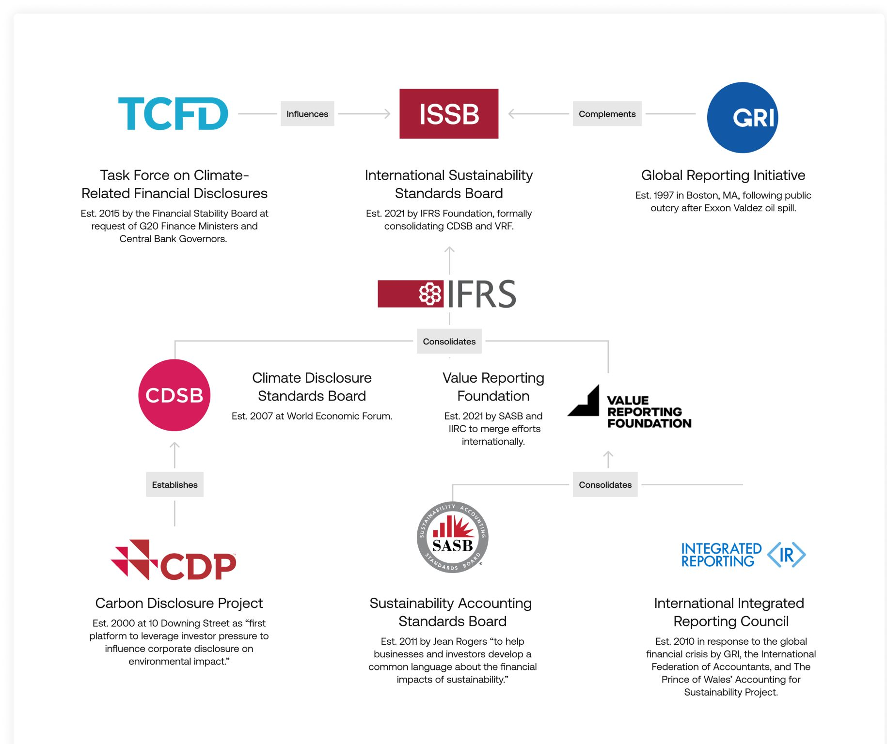
ISSB | IFRS Sustainability Disclosure Standards
On June 26, 2023, the International Sustainability Standards Board (ISSB) issued its inaugural standards on IFRS sustainability (S1) and climate (S2) that will accelerate regulatory efforts on sustainability, provide a common framework for reporting, and improve the usability and transparency of sustainability disclosures.
STANDARDS & FRAMEWORKS CONSOLIDATION
GRC 2024
Notes:
Tentative adoption timelines for IFRS disclosure standards in the region:
Kenya : 01 Jan 2027
Tanzania : 01 Jan 2025
Uganda : TBD
Reporting frameworks prior to the June 2022 consolidation
International Integrated Reporting Council (IIRC) focused on the development of Integrated Reporting for publicly listed companies
The Sustainability Accounting Standards Board (SASB) identified the subset of environmental, social, and governance issues most relevant to financial performance to help companies disclose financially material sustainability information to investors
Value Reporting Foundation (VRF) was formed by the merging of the IIRC and SASB in June 2021 to support business and investor decision-making with three key resources: Integrated Thinking Principles, Integrated Reporting Framework, and SASB Standards
The Climate Disclosure Standards Board (CDSB) developed a framework for reporting environmental and climate change information in mainstream corporate reports
IFRS foundation to assume TCFD monitoring duties The Financial Stability Board (FSB), which oversees the TCFD, acknowledged that the ISSB standards mark the culmination of the TCFD’s work since its establishment in 2017. The FSB has now requested the IFRS Foundation to take over monitoring companies’ progress in disclosing climate-related information, a responsibility previously held by the TCFD.

Slide 6
ESG Reporting| ESG reporting is gradually maturing – what does the future state look like?
Continuous focus on improving the quality and consistency of ESG disclosures will enhance transparency and comparability
Analysis of ESG disclosures by investors are analysing will be like how they assess financial information - performance on ESG metrics are increasingly understood to affect financial performance.
Improved quality and consistency of ESG disclosures will enhance transparency, which will enable and enhance investing decisions and potentially reward more sustainable businesses and strategies by unlocking capital.
While voluntary sustainability reporting has historically taken place outside of the annual report, the market has shifted to greater emphasis on the financial relevance of ESG performance.
Clear and sustained interest from investors, policymakers, regulators and other stakeholders for disclosure of ESG information in the annual report.
Assurance on ESG information will be the norm
Using a recognised standard(s) for disclosure of ESG information and obtaining sustainability assurance will improve the quality and consistency of ESG reporting.
Frameworks provide principles-based guidance that help companies identify ESG topics to cover and determine how to structure and prepare the ESG information they disclose.
Standards provide specific and detailed requirements that assist companies in determining what specific metrics to disclose for each topic.
GRC 2024

Slide 7
Overview of Reporting Process
SUSTAINABILITY REPORTING JOURNEY
ESG reporting Leader
Disclosure preparation and/or review
Assurance readiness
Limited or reasonable assurance
Disclosure gap readiness assessment
Complex accounting and reporting
Integration in internal audit plans
Materiality assessment/stakeholder engagement
Governance
Data and process management and controls
GRC 2024

Slide 8
ESG Action| End-to-end Journey
Activate
Design
Understand
Governance
& Risk Management
Measurement, Reporting & Assurance
Strategy Framework
Metrics & Targets
Roadmap & Planning
Capability
Gap Assessment
Resilience Assessment
Materiality Assessment
Accountability is defined at all levels and should be aligned to reporting frameworks
Disclose progress on scorecards, KPIs and targets and strategic analysis
Navigate trade-offs and design a strategy framework around core pillars
Develop a sustainability scorecard
Integrate ESG into operational and financial policies, procedures and processes
Build awareness and enhance capabilities at the Board, Management and across staff
Understand your business model and current sustainability maturity
Model and quantify ESG impacts under divergent, plausible futures
Map stakeholders and determine the sustainability issues that matter
Awareness building, socialisation & communication
How you benefit from each step:
Understand your business model and how you are performing on sustainability
You will know what your stakeholders care about
You decide what your business needs to focus on
And how to
measure progress
You have a plan
to get there
You enable strategy to be implemented
You know who is accountable for sustainability
Tell your ESG story
GRC 2024

Slide 9
ESG Journey: End-to-end Approach
The ESG journey can be applied at a company-wide level or for specific material topics that need to be addressed, such as benchmarking, footprinting, or strategy, KPIs, and goals development
ALIGN PROFITS & ESG
TRANSFORM OPERATIONS
REPORT ON PROGRESS & IMPROVE
Establish ESG as a part of corporate strategy and governance
Set ESG strategy ambitions, develop a plan to integrate ESG across your enterprise, and establish corporate governance
Develop ESG roadmap
Develop and implement a cohesive, enterprise-wide approach to achieving your ESG transformation goals
Tell your story
Clearly and effectively communicate your ESG progress to your stakeholders
Understand needs & risks
Identify critical risks and opportunities through Climate and ESG assessments and analytics
Refine operations and processes
Activate your ESG transformation agenda across your value chain
Measure & improve
Track progress across ESG metrics and identify areas for continuous improvement
GRC 2024

Slide 10
Our Perspective
We recommend companies to apply the following principles:
Lead with ambition
Be informed.
Be intentional.
Prioritize your stakeholders
Plan to drive forward
Aligning your internal audience is critical. Clarifying your purpose and core sustainability goals will help you meet targets from day one. An “Everybody in” mindset will yield improved results and amplify your message.
The sustainability disclosure landscape is quickly evolving. What was once “nice to have” is now expected, if not demanded, by the capital markets and other crucial stakeholders – including regulators. Your approach to reporting can be a signal to the market that you are ahead of the curve.
Companies should ground their strategy for creative design and storytelling on the value the company brings to its stakeholders – poly-cultural engagement with its customers, employees, capital markets, NGOs, policymakers, and others.
Agility and innovation are critical for quality and timely reporting. While there is importance in establishing roles & responsibilities, timelines & dependencies, and identifying key stakeholder groups, being able to adapt to the growing sustainability landscape is essential. A well grounded but flexible plan will get you there.
GRC 2024

Slide 11
Architecture of ISSB Standards
Focus on investor audience and enterprise value
Governance
Strategy
Risk management
Metrics &
targets
General requirements standard
Thematic/Cross-industry requirements
Industry-based requirements
Objective
Scope
Conceptual Foundations
Core Content
General requirements
Judgement, uncertainties & errors
Common thread: Core content from TCFD
Core elements used across IFRS Sustainability Disclosure Standards
GRC 2024

Slide 12
GRC 2024

