Slide 1
Creating Social-Emotional Supportive School Environments
European Branch – American Counseling Association
Learning Institute
July 12, 2024
Carol Dahir, Ed.D.
New York Institute of Technology
cdahir@nyit.edu

Slide 2
I have no doubt that the survival of the human race depends at least as much on the cultivation of social and emotional intelligence, as it does on the development of technical knowledge and skills. Most educators believe that the development of the whole child is an essential responsibility of schools, and this belief is what has motivated them to enter the profession.
Linda Darling-Hammond, Handbook of Social and Emotional Learning: Research and Practice, 2015

Slide 3
Learning Objectives
Today we will:
Examine current challenges to students’ feeling safe and secure in our schools.
Explore how social/emotional learning contributes to a positive learning environment.
Recognize factors in the school environment, school climate, and school culture, that influence and impact students’ success.
Identify the steps necessary to incorporate social/emotional learning as into a comprehensive school counseling program.
Problem solve your school’s needs.
Explore the connection between SEL and sexual violence prevention

Slide 4
The Urgency and the Reality
The COVID-19 pandemic and recent and ongoing attention on long standing racial injustice and social unrest, have resulted in significant stress, trauma, grief, and loss for students and their families, across the U.S. and across the globe.
Now more than ever before students/children/youth need counseling and mental health support!

Slide 5
What Have You Seen in Your Setting This Past Year?
Let’s Share ………..
These realities require us to focus on the humanity and lived experiences of our schools & communities with a focus on resilience and bridging social capital.

Slide 6
What is Mental Health?
Mental health is a state of mental well-being that enables people to cope with the stresses of life, realize their abilities, learn well and work well, and contribute to their community (World Health Organization, 2022, June) .
https://www.who.int/news-room/fact-sheets/detail/mental-health-strengthening-our-response

Slide 7
A Few Statistics on Youth Mental Health
Nationally:
2011 2021 increased reports of feelings of sadness and hopelessness for teen boys from 21% to 29% and for teen girls 36% to 57% (CDC, 2022)
Self Harm Practices:
Increased from 16 to 22 % for youths who were seriously considering suicide
Black youths experienced an increase in suicide attempts increasing 37% between 2018 and 2021.
Black transgender and nonbinary young people also reported higher rates of all indicators of poor mental health compared to their Black cisgender and LGBTQ peers. (Naviaget360.com, 2023)

Slide 8
Statistics on Youth Mental Health
Prevalence of Mental Health Disorders Mental health conditions, such as depression and anxiety disorders, affect approximately 10-20% of children and adolescents worldwide.
Impact of Mental Disorders: Mental health disorders are a leading cause of disability among young people. They can significantly impact educational attainment, employment opportunities, and overall quality of life.
Access to Mental Health Services: Access to mental health services for children and adolescents is inadequate globally. Many young people do not receive the mental health care they need due to stigma, lack of resources, and insufficient prioritization of mental health in health systems.
World Health Organization, 2022

Slide 9
Statistics on Youth Mental Health
.Impact of COVID-19: The COVID-19 pandemic has had a profound impact on youth mental health, exacerbating existing conditions and increasing stress and anxiety levels among young people due to factors like social isolation, disruption of routines, and uncertainty.
Risk Factors: Common risk factors for youth mental health problems include exposure to violence, abuse, neglect, poverty, and the impact of the digital environment (such as cyberbullying and excessive screen time).
World Health Organization, 2022

Slide 10
Why Don’t Students Feel Safe Post Pandemic?
Some YOUTH reported having anxiety regarding academic and athletic performance.
Patterns established during the pandemic, such as use of substances, high levels of social media use, etc., were difficult to shake after returning to school.
Youth shared that teachers were often unable to recognize their academic stress and mental health challenges because they were primarily focused on making up the lost learning from the pandemic.
https://healthymindshealthykids.org/hmhk-publication/?post_type=press_and_media&post_id=16792

Slide 11
CHANGE IS ESSENTIAL:
No child is left out or behind in an inclusive environment

Slide 12
Inclusiveness: All Means All
Race
Color
National Origin
Ethnicity
Religion/Religious Practice
Socio-economic status
Language
Family configuration
Ability
Disability
Sexual Orientation
Gender
Sex
Size (height, weight)
Housing
What’s missing?

Slide 13
Creating Safe Spaces
School-age children may experience problems with grade failure, suspension, and problems with their peers as a result of teasing and stigma.
How can a school/agency wide SEL program help students feel safe and secure in your environment?

Slide 14
“Social-emotional learning (SEL) is every bit as critical to students’ success as their mastery of purely academic content and skills.”
National Association of State Boards of Education (Oct. 2013, p. 1, From Policy to Practice: Social-Emotional Learning )
How Can SEL Support the MH Issues Students/Youth Face?

Slide 15
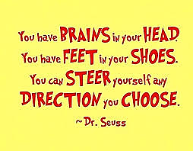
4 strategies to increase our SEL skills and outcomes for our youth/children
Understand the rationale
Know the research
Advocate
Be data-driven/outcome driven

Slide 16
Understand the Rationale for their Concerns
Marginalization based sexual orientation, poverty, color, religion, and so on
Developmental challenges of children and youth
Uptick in school community/
violence, mental heath issues, risky behaviors, lack of civility, etc.
Increasing stressors (school, home, society, culture)
Increased concerns with bullying and peer interactions

Slide 17
Know the research
Students who feel emotional stressors at school, such as bullying, discrimination or isolation, will not be able to effectively take part in the learning process.
When “schools become an increasingly difficult and unpleasant place to be…for many students, it’s just easier to shut down and drop out”
(Bluestein, 2002)

Slide 18
Thomas’ Story
Thomas is a 9th grade student who has been dropping hints about his history of being bullied in middle school since the first day of school. He e-mails his school counselor at the beginning of the year to tell her that he is in most of his classes with some of the students who bullied him. He requests that she change his schedule. A few weeks later, he e-mails her again to tell her that they continue to harass him and push him in the halls. Some weeks go by, until Thomas finally visits the counselor’s office to tell her that they are still at it and requests a change of schedule.
How do we help Thomas feel safe again?
How would an SEL school climate help?

Slide 19
Know the research
Students of color, students with disabilities and learning differences, English language learners, lesbian, gay, bisexual, transgender and questioning or queer (LGBTQIA+) youth, and others continue to face challenges such as disproportionately low achievement rates compared to the general student population, and/or disproportionately higher discipline rates for the same or similar offenses (Annie E. Casey Foundation, 2017; Gregory & Fergus, 2017).

Slide 20
Know the research
SEL programs and activities largely:
Decrease maladaptive social behavior and
Improve decision-making, conflict negotiation, healthier relationships with peers, teachers, etc.
Foster social and emotional competence in children and youth
(Annie E. Casey Foundation, 2017; Gregory & Fergus, 2017). ).

Slide 21
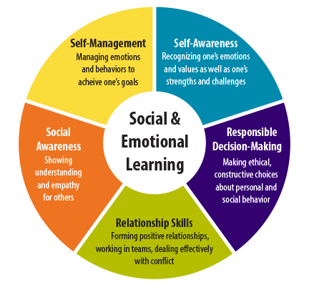

Slide 22
Be an Advocate
MODEL
Demonstrate good relations with your colleagues
Be civil, kind, respectful, tolerant, empathetic, patient, open to feedback
EXAMPLES?

Slide 23
Be an Advocate
MODEL
Farinde-Wu, Glover, & Williams, 2017
Culturally Responsive Practices (CRP) which are effective in improving student academic performance and life opportunities across content areas.
Teaching and learning strategies within the context of a student’s cultural identity and experience.

Slide 24
Be a Advocate
MOTIVATE
Encourage colleagues to be SEL advocates.
Assist colleagues with developing and assessing SEL skills in students.
Design a K-12 SEL curriculum for school counselors and teachers to deliver.
EXAMPLES?

Slide 25
Be an Advocate
MOBILIZE
Become involved in school committees.
Be active in the school community (parent/family organizations, after school opportunities, CBOs.
Support teacher attempts to infuse SEL in the classroom (team-teach?)
EXAMPLES?

Slide 26
Be a Leader
Address Student Address Concerns with Administrators and Colleagues
Schools have the power “to turn a child’s life from risk to resilience,” (Benard, p. 63) and that power is in our hands!

Slide 27
Be a Leader
Address implicit biases, the unconscious stereotypes and attitudes we hold toward particular groups (Godsil, et al., 2017).
Unlike explicit biases, which are consciously held beliefs, implicit biases often exist without our knowledge, and can negatively impact the students we serve, despite our best intentions.
HOLD COURAGEOUS CONVERSATIONS
EXAMPLES?

Slide 28
Be a Leader
LEAD: for Changing Climate and Culture
CLIMATE: how students and staff feel about their school.
A school’s culture is why they feel the way they do.
CULTURE: why they feel the way they do

Slide 29
How can we collaborate with our colleagues create a more positive school environment, climate and culture?
How can we help our students
contribute to creating a more positive school environment climate and culture?
The On-Going Challenge

Slide 30
TOOLS to Help:
2021 ASCA Mindset and Behavior Standards
These are:
the basis for all components of the comprehensive school counseling program in the U.S;
a blend of academic, college and career readiness, and social
emotional development;
the foundation for individual, group, and school counseling;
a starting point for creating a curriculum developmental scope and
sequence; and,
delivered through all aspects of the program.

Slide 31
The ASCA Mindsets and Behaviors are…
Utilize School Counseling Standards
the basis for all components of the comprehensive program;
a blend of academic, college and career readiness, and social
emotional development;
the foundation for our school counseling curriculum;
a starting point for creating a school system/building scope and
sequence; and,
delivered through all aspects of the program.

Slide 32
Category 1: Mindset Standards School counselors encourage the following mindsets for all students.
M 1. Belief in development of whole self, including a healthy balance of mental, social/emotional and physical well-being M 2. Sense of acceptance, respect, support and inclusion for self and others in the school environment M 3. Positive attitude toward work and learning M 4. Self-confidence in ability to succeed M 5. Belief in using abilities to their fullest to achieve high-quality results and outcomes M 6. Understanding that postsecondary education and life-long learning are necessary for long-term success
Category 2: Behavior Standards School counselors provide culturally sustaining instruction, appraisal and advisement, and counseling to help all students demonstrate:
Learning Strategies | Self-Management Skills | Social Skills
B-LS 1. Critical-thinking skills to make informed decisions | B-SMS 1. Responsibility for self and actions | B-SS 1. Effective oral and written communication skills and listening skills
B-LS 2. Creative approach to learning, tasks and problem solving | B-SMS 2. Self-discipline and self-control | B-SS 2. Positive, respectful and supportive relationships with students who are similar to and different from them
B-LS 3. Time-management, organizational and study skills | B-SMS 3. Independent work | B-SS 3. Positive relationships with adults to support success
B-LS 4. Self-motivation and self- direction for learning | B-SMS 4. Delayed gratification for long-term rewards | B-SS 4. Empathy
B-LS 5. Media and technology skills to enhance learning | B-SMS 5. Perseverance to achieve long- and short-term goals | B-SS 5. Ethical decision-making and social responsibility
B-LS 6. High-quality standards for tasks and activities | B-SMS 6. Ability to identify and overcome barriers | B-SS 6. Effective collaboration and cooperation skills
B-LS 7. Long- and short-term academic, career and social/emotional goals | B-SMS 7. Effective coping skills | B-SS 7. Leadership and teamwork skills to work effectively in diverse groups
B-LS 8. Engagement in challenging coursework | B-SMS 8. Balance of school, home and community activities | B-SS 8. Advocacy skills for self and others and ability to assert self, when necessary
B-LS 9. Decision-making informed by gathering evidence, getting others’ perspectives and recognizing personal bias | B-SMS 9. Personal safety skills | B-SS 9. Social maturity and behaviors appropriate to the situation and environment
B-LS 10. Participation in enrichment and extracurricular activities | B-SMS 10. Ability to manage transitions and adapt to change | B-SS 10. Cultural awareness, sensitivity and responsiveness

Slide 33
TOOLS:
ISCA School Counseling Standards
Social- Emotional
Standard A: Students will demonstrate the dispositions, knowledge, and skills to develop and maintain positive relationships with self and others
Standard B: Students will make decisions, solve problems, set goals, and take necessary action to achieve personal goals
Standard C: Students will demonstrate personal safety skills
Global Perspective & Identity Development
Standard A: Students will demonstrate the dispositions, knowledge, and skills needed in order to be culturally competent global citizens
Standard B: Students will examine the complexity of identity development and the impact identity has on relationships with others
Standard C: Students will advocate for a world where all identities are affirmed and validated
Standard D: Students will demonstrate the dispositions, knowledge, and skills to manage transition effectively

Slide 34
TOOLS to Help:
ISCA School Counseling Standards
Academic
Standard A: Students will demonstrate the dispositions, knowledge, and skills that contribute to effective learning in school and throughout life
Standard B: Students will apply future-ready skills in preparation for a variety of postsecondary paths including college and career
Standard C: Students will make connections between school and life experiences
Career
Standard A: Students will research and anticipate potential career paths connected to abilities and personal interests
Standard B: Students will plan for future career aspirations and goals

Slide 35
WHERE DO WE BEGIN?
Look at your school/agency data
Identify standards based on student needs
Which activities/interventions align with these goals?
Collaborators?
What outcome are you hoping for?

Slide 36
Building An Action Plan

Slide 37
Agency/School Name:
Goal – Inclusive Environment:
Describe the Challenge:
Data that Identifies the Concern:
Systemic Focus
Identify school or system policies, procedures or practices that create or maintain challenges related to this goal.
List 1–2 strategies that could influence systemic change related to this goal.

Slide 38
ASCA/ISCA Student Standards (select two) that support the Inclusive Environment Goal
1.
2.
Identify Interventions that support achieving the Inclusive Environment Goal
Direct Services/Activities | Indirect Services
1. 2. 3. | 1. 2. 3.
Other ideas?
Identify Key Collaborators (position/role)
1. 2. 3. | 4. 5. 6.

Slide 39
Expected Outcomes at the End of the School Year
Baseline Data | Results Data – What’s Different Now
Reflection
How did the interventions help achieve creating a more inclusive environment? How could the interventions be improved (e.g., consider timing, number and type of services, student access and identified barriers)?

Slide 40
Michael/Michelle’s Story
When Michael returned from summer break this year, he had transitioned from identifying as a cisgender boy to identifying as transgender girl. The school counselor tells the staff that from the beginning of the school year, Michael would like to be called “Michelle” and he asks that you assist in making the transition smooth for her. Having known her as Michael only 3 months earlier, this is a difficult transition for the staff as well. The students seem to support Michelle, including encouraging her to use the girl’s room instead of the boy’s bathroom. Some of the staff however is not as supportive and a few refuse to refer to her as “Michelle” or “she.” During role call on the first day, Mrs. Johnson calls “Michael” instead of “Michelle.” The class stops and waits to see her reaction…
How do we help Michelle feel safe again? How would an SEL school
environment help?

Slide 41
Learned Helplessness
Many students attribute their poor performance to lack of ability. They limit their expectations and efforts as a means of self protection.
.

Slide 42
Using Multiple SEL Strategies
Mindfulness
Wellness
Character Education
Resiliency
ASCA Mindsets/Behaviors
ISCA Student Standards
Conflict Resolution
Growth Mindsets
Circles
Critical Consciousness
Cultural Responsiveness

Slide 43
Promote Opportunities for Youth to Assess their Assets and Their Social Identity!
Provide opportunities for youth to develop positive, realistic views of themselves as competent individuals who can and will succeed in college, career and life!
Enable opportunities for youth to build skills and then reflect on those skills. This provides support in them forming realistic positive views.

Slide 44
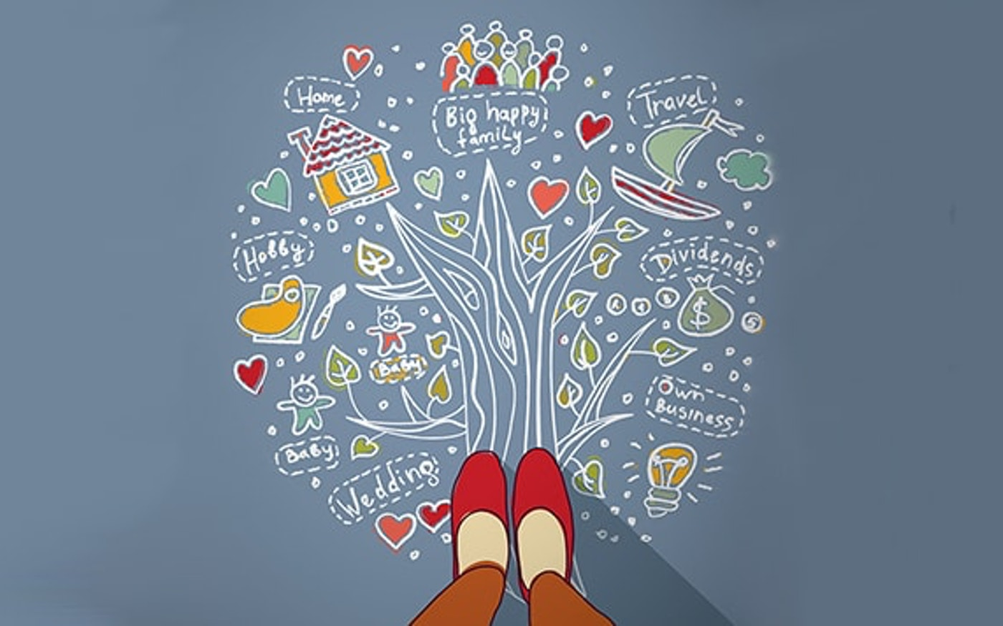
Who is the “Possible Me”?
Help youth to recognize and counter balance Hoped-For and Feared Selves.
Possible Me Trees (Oyserman), enables student to develop visual representations of their dreams and goals to promotes the hoped- for self. Students express their fears about these future-oriented goals to assist them in developing strategies for coping and reducing the probability of negative outcomes.

Slide 45
Empowering our students: Students tend to be more successful when they believe that success is internal and controllable, and that they have the power to influence it and to change it over time.

Slide 46
Liz’s Story
Jill and Nicole create a fake Facebook page of a boy and send a friend-request to Liz. When Liz accepts, they start a series of messages back-and-forth with her telling her she is cute and asking her to meet up. When Liz shows up, there is no one there. She waits for an hour but no one shows up. When she messages the fake boy’s page, Jill and Nicole send nasty messages telling her that when “he” saw her “he” thought she was “gross and fat” and left. Liz’s mother calls the school the next day to say that she has been crying all night and will not get out of bed. The day after that, is the same. Liz’s mother requests that the school set up a meeting of the parents.
How do we help Liz feel safe again?
How would an SEL school environment help?
c

Slide 47
Questions and Comments?
Presentation handouts here: https://bit.ly/counselingplan

Slide 48
References
Collaborative for Academic, Social and Emotional Learning. (2020). What is Social and Emotional Learning? http://www.casel.org/social-and-emotional-learning/.
Farinde-Wu, A., Glover, C.P. & Williams, N.N. (2017). It’s Not Hard Work; It’s Heart Work: Strategies of Effective, Award-Winning Culturally Responsive Teachers. The Urban Review. New York, NY: Springer Science+Business Media.
Godsil, R.D., Tropp, L.R., Atiba Goff, P., Powell, J.A., & MacFarlane, J. (2017). The Science of Equality in Education: The Impact of Implicit Bias, Racial Anxiety, and Stereotype Threat on Student Outcomes. The Perception Institute.
Gregory, A. & Fergus, E. (2017) Social Emotional Learning and Equity in School Discipline. The Future of Children, Vol. 27, No. 1, Social and Emotional Learning, pp. 117-136.
The Annie E. Casey Foundation. (2017). Race for Results: 2017 Policy Report | Kids Count. Baltimore, MD: The Annie E. Casey Foundation.

Slide 49
Resources
American School Counselor Association. (2019). National Framework for School Counseling (4th edition). Alexandra, VA: Author.
American School Counselor Association. (2021). Mindsets and Behaviors. Retrieved from https://www.schoolcounselor.org/asca/media/asca/home/MindsetsBehaviors.pdf
American School Counselor Association. (n.d.). Action plan closing the gap. Retrieved from https://docs.google.com/viewer?url=https%3A%2F%2Fwww.schoolcounselor.org%2Fasca%2Fmedia%2Fasca%2FASCA%2520National%2520Model%2520Templates%2FClosing-the-GapActionPlan.docx
International School Counselor Association
Zyromski, M. & Mariani, M. (2016) Facilitating Evidence Based, Data Driven School Counseling. Corwin
Bluestein, J (2002). Creating emotionally safe schools: A guide for educators and parents. Health Communications, Inc. www. Bci-online.com www.janeblueStine.com
Bernard, B. (2004). Resiliency: What we have learned. West Ed
www.Safeandcivilschools.com
Savitz-Romer, M. & Bouffard. S. M. (2012). Ready, willing, and able: A developmental approach to college access and success. Cambridge, MA: Harvard Educational Press.
Social and Emotional Learning Interventions under the Every Student Succeeds Act: Evidence Review. Research Report. RR-2133-WF https://eric.ed.gov/?id=ED581645

