Slide 1
UNITED REPUBLIC OF TANZANIA MINISTRY OF ENERGY
Policies, Strategies and Frameworks
Governing the Energy Transition in Tanzania
RENEWABLE ENERGY WEEK 2024
“RENEWABLE ENERGY FOR INCLUSIVE AND GREEN ECONOMY”
(JNICC)
Presenter:
Eng. Imani Mruma
Ministry of Energy
6TH JUNE 2024

Slide 2
Presentation Outline
The Organizational Structure
Institutional, Legal and Regulatory Frame work in Tanzania
Ministry structure
Roles for Renewable Energy Section
Energy Situation in Tanzania
Energy Resources & Reserves
Energy Transition Mechanism
Policy and Related Frameworks to Support Renewable Energy
Renewable Energy Projects Under Pipeline
Country Priorities on Renewable energy development
Conclusion

Slide 4
Institutional, Legal and Regulatory Framework Governing The Power Sector in Tanzania
Institutional
(Electricity & Renewable)
TANESCO: Responsible for power generation, transmission and distribution
REA: Responsible for provision of modern energy to rural areas
EWURA: Energy and Water Utilities regulator
TGDC: Geothermal promotion company
Institutional
(Oil and Gas)
TPDC: National Oil Company
PURA: Petroleum Upstream Regulator
PBPA: Petroleum Bulk importation Coordinator

Slide 5
Institutional, Legal and Regulatory ….cont,
Legal and Regulatory
The National Energy Policy, 2015
Power System Master Plan (PSMP), 2020
Rural Energy Master Plan (2022 – 2030)
Clean Cooking Strategy (2024 – 2034)
The Model Power Purchase Agreement, 2015
The Model Production Sharing Agreement, 2013;
The Standardized Power Purchase Agreement and Tariffs (<10MW) (2008);
The Electricity Act, 2008;
The EWURA Act, 2001;
Legal and Regulatory
The Rural Energy Act, 2005;
The Electricity Supply Reform Strategy and Roadmap 2014 - 2015
The Electricity (Market Reorganization and Promotion of Competition ) Regulations, 2016
Occupational Safety and Health Act, 2003
Environmental Management Act, 2004
Public-Private Partnership Policy, 2009
Public-Private Partnership Act, 2010 and its Regulations (2011)

Slide 6
Ministry Structure
DEPARTIMENT OF ELECTRICITY AND RENEWABLE ENERGY
ELECTRICITY SECTION
RENEWABLE ENERGY SECTION
ELECTRICITY DEVELOPMENT SECTION

Slide 7
Roles for Renewable Energy Section
Advise on appropriate policies and guidelines necessary for efficient energy utilization and development of renewable energy resources;
Promote and coordinate renewable energy and energy efficiency initiatives and activities at National, Regional and International levels
Facilitate development of new sources of electricity generation such as mini hydro, biomass, and solar photovoltaic for off-grid networks;
Undertake renewable energy resources assessment and prepare and update renewable energy resources atlases;
Develop and administer energy consumption monitoring, verification and reporting mechanisms/framework and procedures;
Facilitate industries’ competitiveness by promoting energy efficiency in industries to reduce production and operation cost;
Conduct research on renewable energy and energy efficiency and advise accordingly; and
Promote sustainable biomass production and utilization.

Slide 8
Energy Situation in Tanzania
Total installed grid capacity is approximately 2,138 MW
Natural Gas contributes 56.07%;
Hydropower (39.13%);
Biomass (0.49%) and F
Fossil Fuel other than NG (4.32%).
Off Grid is approximated 34MW
Access to Electricity = 78.4%
Connected to Electricity = 37.7%
The plan is to reach 5,000MW and electrifying all villages in rural areas by 2025.

Slide 9
Energy Situation in Tanzania…….cont,
Hydro Power
(39.13%)
Gas Power
(56.07%)
Installed Capacity
2,138 MW
Liquid Fuel Power
(4.32%)
Biomass Power
(0.49%)

Slide 10
Energy Resources & Reserves
Tanzania has abundant indigenous energy resources which include hydropower, natural gas, coal, geothermal, solar, nuclear, bio-energies, wind, hydrogen etc
RESOURCE | POTENTIAL | APPLICATION
Large hydro | 4,700 MW | 12% harnessed for power generation
Natural Gas | Enormous deposit | More than 55 tcf discovery, currently used for 615 MW power generation and some domestic applications
Small hydro | 500 MW | 5% harnessed for power generation
Biomass | Woodland and agricultural residues | Electricity generation from biomass in the country is more than 35MW, some of which is grid-fed
Solar | 200Wm⁻² | >6MW electricity installed capacity

Slide 11
Energy Resources & Reserves………….Cont,
RESOURCE | POTENTIAL | APPLICATION
Wind | Speed: 0.8 - 4.8 m/s Some area over 8m/s | Already > 100 MW capacity is lined in the Power System Master Plan 2009-2033
Geothermal | More than 5,000 MW | Not exploited
Coal | 1.2 – 5 billion tonnes | < 150,000t/year
Nuclear | Uranium deposits exists in Dodoma, Ruvuma and Singida Regions | Not exploited
Tidal/waves | Significant | Not exploited

Slide 12
ENERGY TRANSITION MECHANISMS Policy and Related Frameworks to Support Renewable Energy
National Energy Policy 2015
Strategies & Plans
Power system master plan (PSMP), (2020)
National Clean cooking Strategy, (2024-2034)
Rural Energy Master plan (REMP), (2022-2030)
National Renewable energy strategy and implementation roadmap, (2024-2034)
Tanzanian Energy efficiency strategy and its implementation action plan (2024-2034)

Slide 13
ENERGY TRANSITION MECHANISMS Policy and Related Frameworks to Support Renewable Energy …cont,
S/No | Strategies & Plan | Status
1 | Power System Master plan (PSMP), (2020) | Developed/On operation
2 | National Clean Cooking Strategy, (2024-2034) | Developed/On operation
3 | Rural Energy Master plan (REMP), (2022-2030) | Developed/On operation
4 | National Renewable energy strategy and implementation roadmap, (2024-2034) | Developed , on approval
5 | Tanzanian Energy efficiency strategy and its implementation action plan (2024-2034) | Developed , on approval

Slide 14
ENERGY TRANSITION MECHANISMS Renewable Energy Projects Under Pipeline
S/N | PROJECT DESCRIPTION | STATUS
1. | 150MW Kishapu-Shinyanga Solar PV Project | Construction of 50MW on phase (I) is ongoing, Phase (II) is on signing stage
2. | 100MW Manyoni Solar PV Project; 60MW Dodoma (Zuzu) Solar PV Project; 50MW Same Solar Power | Pre-FS Report completed
3. | 50MW Dodoma Solar Power Plant; 50MW Singida Solar Power Plant; 50MW Iringa Solar Power Plant; 100MW Singida Wind farm; 100MW Miombo Wind farm - Makambako | Negotiation of Power Purchase Agreement (PPA) And Implementation Agreement (IA)
4. | 200MW Wind power plant | Negotiation with Project Developers
5. | 150MW solar power plant | Negotiation with Project Developers

Slide 15
ENERGY TRANSITION MECHANISMS Renewable Energy Projects Under Pipeline…..cont,
S/N | PROJECT DESCRIPTION | STATUS
6. | Ngozi Geothermal Project-100MW | Detailed Surface Exploration for the project is completed. • ESIA Study for Drilling Program Completed and EIA Certificate obtained. • Resource confirmation program through exploratory drilling (3 slim wells) is ongoing
7. | Kiejo-Mbaka Geothermal Project- 60MW | The project is at resource confirmation stage.
8. | Songwe Geothermal Project- 5MW | The project is at resource confirmation stage.
9. | Luhoi Geothermal Project-5MW | The project is at resource confirmation stage.

Slide 16
ENERGY TRANSITION MECHANISMS Other Renewable Energy Projects Under Pipeline…..cont,
S/N | PROJECT DESCRIPTION | STATUS
10. | Julius Nyerere Hydro Power Plant (2,115MW) | 96% - completed 235MW connected to grid
11. | Rusumo (80MW) Hydro power plant | Completed, on operational, 27MW shared by Tanzania, Burundi and Rwanda.
12. | Kakono (87MW) Hydro power plant | In progress
13. | Malagarasi (49.5MW) Hydro power plant | In progress

Slide 17
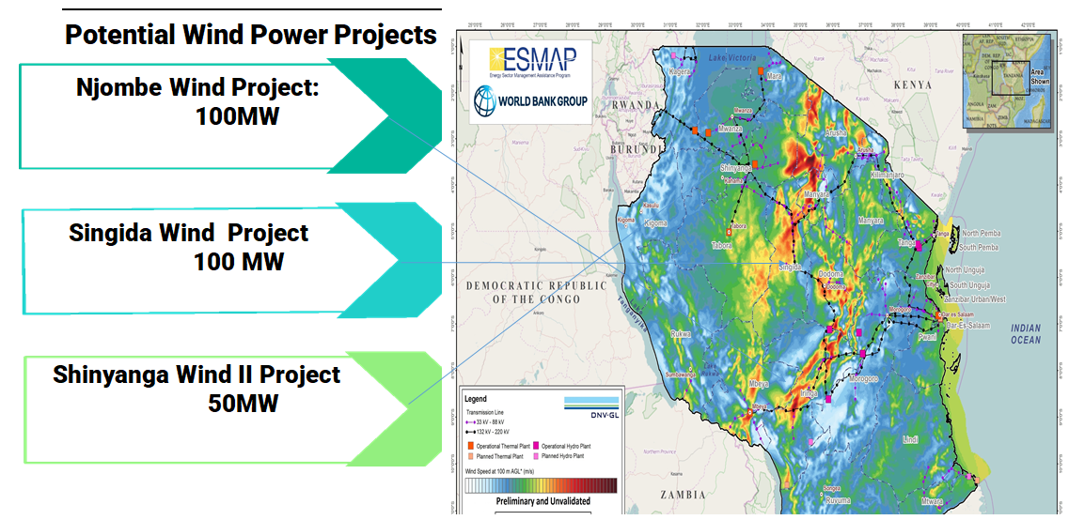

Slide 18
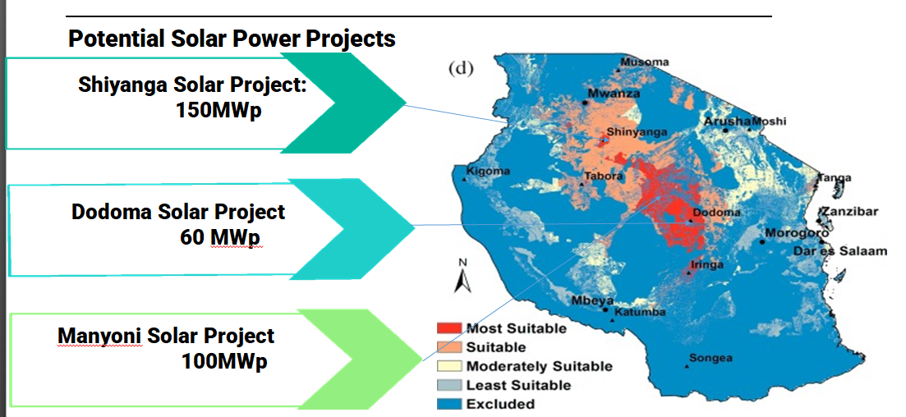

Slide 19
Country Priorities on Renewable energy development
National Energy Policy emphasize on power energy mix to access modern energy services and increase energy security by promoting the adoption of renewable energy and energy efficient technologies.
The county’s priority initiative is to effectively utilize available indigenous energy resources for Sustainable Power Generation.
The government of Tanzania has plans to increase power generation from renewable energy sources of hydropower, wind, solar, biomass, geothermal etc.
In the period starting 2023 to 2028 year, Government has set target to increase 847MW in the National Grid by using various renewable energy sources.
The fast-growing power demand in the country offers a good opportunity for both local and foreign investors to participate in the development of the Tanzanian power industry.

Slide 20
CONCLUSION
Tanzania has a vast supplies of renewable energy resources.
The current situation and the future electricity demand in the country calls for immediate investment in generation and transmission.
Several investment opportunities exist in the energy sector for private sector participation.
The Government of URT is fully committed to expedite implementation of priority energy projects and attract private investments.

Slide 21
ASANTENI SANA

