Slide 1
State of the State Breakfast
Sponsored by

Slide 2
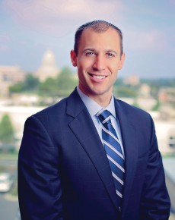
Keynote Speaker
Mike Preston
Arkansas Economic
Development Commission

