Slide 1
Proposed 2019 Officers and Directors
President
Tim Allen
Fort Smith Regional Chamber of Commerce
1st Vice President
Katherine Holmstrom
Arkansas Economic Development Commission
2nd Vice President
JD Lowery
Electric Cooperatives of Arkansas
Secretary/Treasurer
Ben France
Little Rock Regional Chamber
1st Congressional District
Mallory Darby
City of West Memphis, Economic Development
Bethany Hildebrand
Stuttgart Chamber of Commerce
2nd Congressional District
Lindsay Henderson
Conway Area Chamber of Commerce
Brad Henry
Arkansas Development Finance Authority
3rd Congressional District
Rob Ratley
OG&E
Patty Methvin
Harrison Regional Chamber of Commerce
4th Congressional District
Lance Howell
Malvern/Hot Spring County Chamber of Commerce
Gary Troutman
Hot Springs Metro Partnership
At Large
Steve Cox
City of West Memphis, Economic Development
Bill Rogers
Springdale Chamber of Commerce
Ex Officio
Randy Zook
Arkansas State Chamber of Commerce/AIA
Mike Preston
Arkansas Economic Development Commission
Mike Harvey
Immediate Past President
Northwest Arkansas Council
Shelley Short
Executive Secretary/Executive Director
Arkansas State Chamber of Commerce/AIA

Slide 2
2019 Board Rotation List
Rotating Off Board Members
Raymond Burns
Tara Cathey
Tamika Jenkins
Crystal Johnson
Nita McDaniel
Sue McGowan
Chung Tan
New Board Members
Steve Cox
Lindsay Henderson
Brad Henry
Bethany Hildebrand
Patty Methvin
Bill Rogers
Gary Troutman
Returning Board Members
Tim Allen**
Mallory Darby
Ben France**
Mike Harvey**
Katherine Holmstrom**
Lance Howell
JD Lowery**
Mike Preston
Rob Ratley
Shelley Short
Randy Zook
**2019 Officer

Slide 3
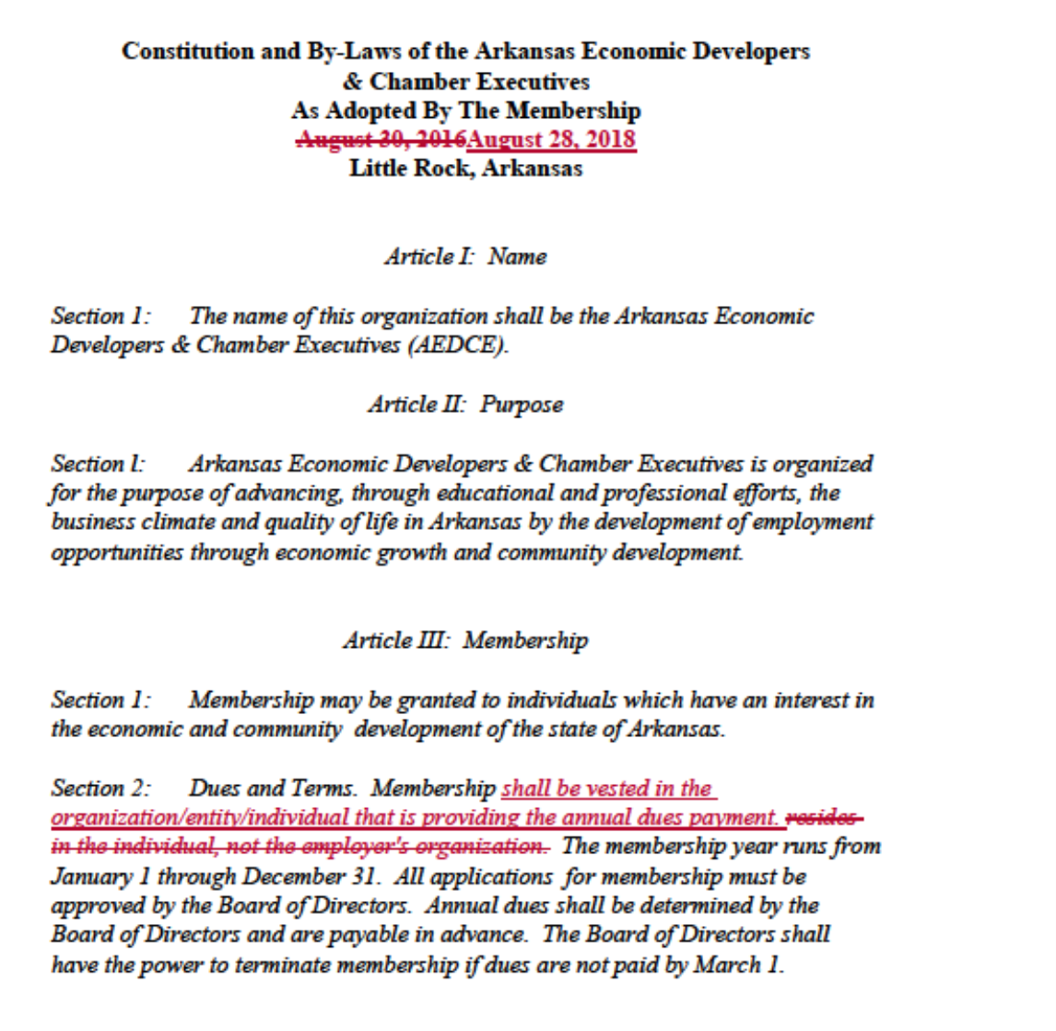
AEDCE Bylaws Revisions

