Slide 1
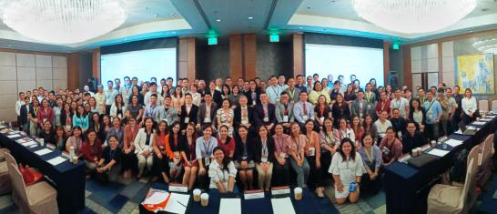
POST - EVENT REPORT
Plastics Applications in Food and Beverage Packaging Summit
24-25 September, 2019 Manila, Philippines
T
he Plastics Applications in Food and Beverage Packaging Summit (PAP 2019) held for the 2nd time in Manila, Philippines on September 24-25 gathered decision makers from the biggest F&B manufacturers in Philippines as well as the Contract Packaging Companies who met with
International experts from Plastic Packaging sector to discuss the future of Plastic Packaging Sector – from materials used, through technologies employed, to trends, legislation and most importantly – ways to create sustainable product life cycle.
Organizer
Media Supporters Conference Supporters
Business partners

Slide 2
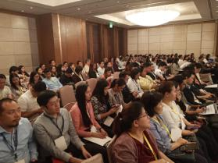
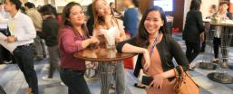
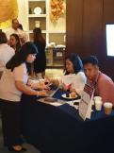
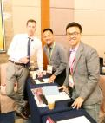
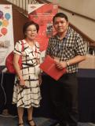
What PAP 2019 D elegates Said
2
PAP’s goal is to serve the Philippine F&B sector – big and small alike. We achieve this, by bringing local and international Experts and Suppliers to share their knowledge and solutions that can alleviate industry’s challenges and help your business grow.
Feedback provided through voluntary completion of the post PAP 2019 delegate survey and testimonials:
100%
97% positive impact on
90% helped to establish
said they learned something useful from the presentations
said they experienced
said the conference
their learning /enjoyment in the format of the presentation.
new alliances or build relationships with international industry peers.
190
Industry professionals visited the Summit
81
7
Countries were represented
Companies connected successfully with new partners
Gary Tu, General Manager of Everlon:
Everlon and Ringier work for many years together. We attend on average 5 conferences organized by Ringier Events a year, where we met many qualified potential clients and expand our customer database.
Barbie Dizon, Strategic Marketing Executive, ADParametrik Inc.:
Thanks to Ringier staff for a successful event. We appreciate your efforts, not a single frustration in sight!
Business partner
Business partner
Alvin Lavadia, Packaging Material Manager at Pepsi-Cola Products Phils. Inc.:
Very timely topics paired with great selection of subject matter experts (SMEs). Interactions between SMEs and participants were met accordingly. All these things were executed on an atmosphere conducive to education.
Jovy Chen, Sales Manager, Dase-sing Packaging Technology:
Great educational experience ! Very organized and insightful event! Definitely recommend for companies who want to enter the local market.
VIP Delegate
Business partner

Slide 3
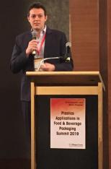
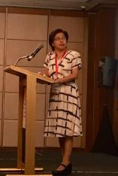
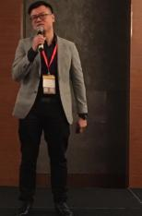
2019 Top Delegates & Experts
3
From the biggest to the smallest - F&B manufacturers and Contract Packaging Companies gathered to listen to our invited Industry experts:
Claudio Domasi – Sales Director at Frigel Asia Pacific Ltd
Ms Jovy Chen – Sales Manager at Dase-Sing
Mr Lim Seng Tat – Director at Altair Engineering

Slide 4
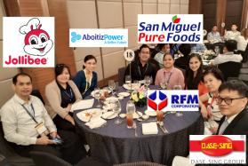
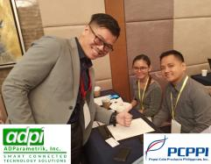
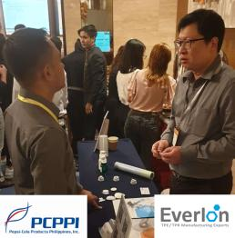
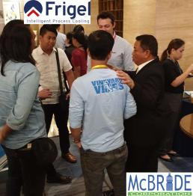
PAP 2019 Successful Networking
4
Our main goal and the value of attending Ringier’s International Business Summits is the opportunity to connect with Key Decision Makers from local Manufacturers.
Is it from the stage, during tea breaks or while enjoyig the 5-star luncheons, our guests have many opportunities to create valuable face-to-face connections and grow their businesses across Southeast Asia.

Slide 5
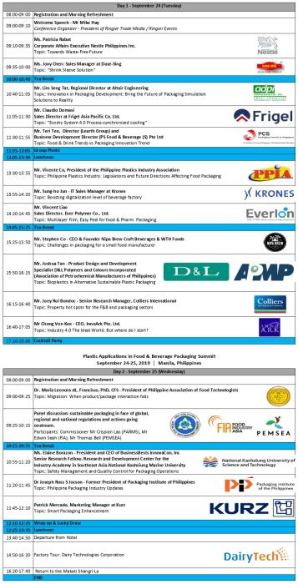
5
PAP 2019 Agenda

