Slide 1
A Changing Economic Landscape: Trade in Asia
Dr Deborah Elms
Executive Director, Asian Trade Centre
AmCham
October 22, 2021

Slide 2
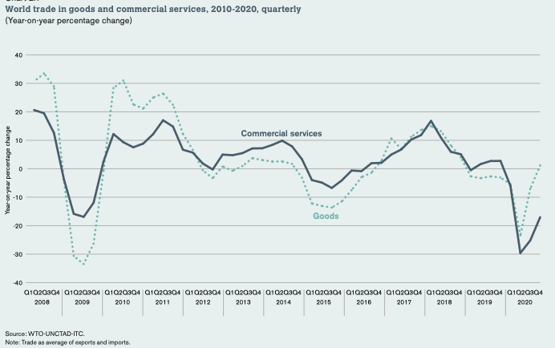
Significant Global Disruption
Biggest global “reset” to trade since WWII happening right now
Multilateral system not working
Hopes for outcomes (not even big outcomes) for the MC12 meeting this year are evaporating
Creaking global system allowing countries to act in previously “unthinkable” ways
US-China trade war as example…
Enter COVID-19..
Sudden, sharp shifts in both supply and demand
Global impact
Rapid reset for businesses
Governments under increasing pressure to protect local jobs (and still collect revenue) while keeping markets open

Slide 3
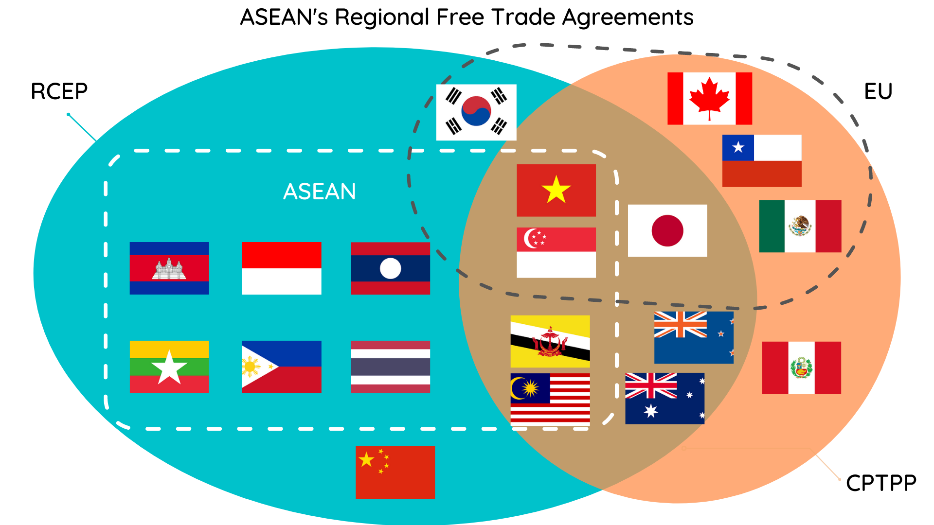
Different Asian Landscape in 2022 and Beyond
Asia leads the world in creating a network of trade deals that cover different partner markets, with a wide range of potential benefits
Four are especially key: ASEAN, CPTPP, EU deals and RCEP
RCEP=Regional Comprehensive Economic Partnership signing in late 2020
CPTPP=Comprehensive and Progressive Trans-Pacific Partnership, started for seven members in end 2018

Slide 4
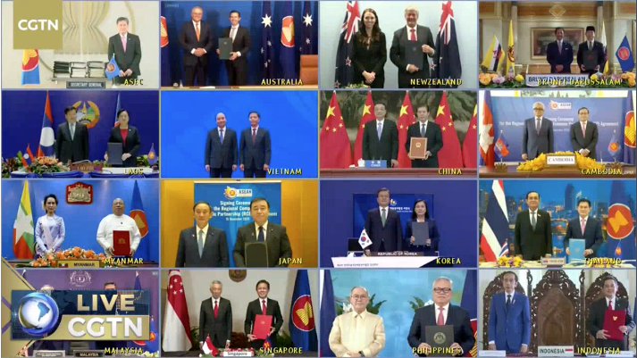
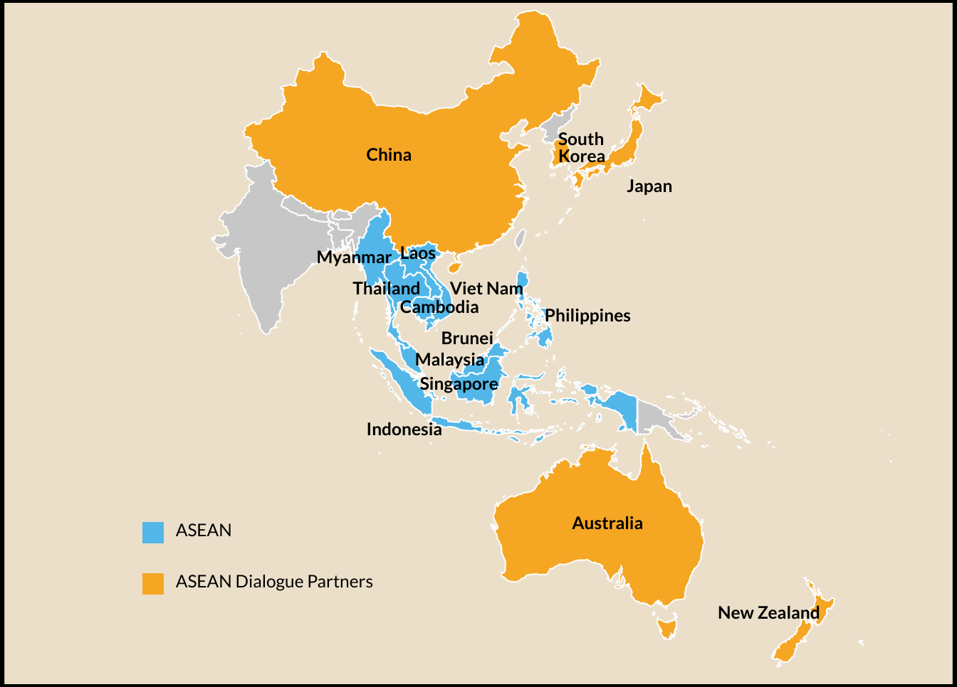
RCEP = 15 Members Across Asia

Slide 5
The Launch of RCEP
RCEP will enter into force when 6 ASEAN members (out of 10) and 3 (of 5) Dialogue Partners have completed their domestic procedures
Likely entry into force in January 2022
Not all 15 RCEP countries will be part of the first wave
RCEP is built using ASEAN’s own model agreements, including the ASEAN+1 agreements (like ASEAN-China)
Many of the commitments follow ASEAN’s approaches
Agreement to be opened to new member accession in 18 months
Led by a new RCEP Secretariat (details to be decided soon)
RCEP texts and schedules are already available for review
https://www.mfat.govt.nz/br/trade/free-trade-agreements/free-trade-agreements-concluded-but-not-in-force/regional-comprehensive-economic-partnership-rcep/rcep-text-and-resources/

Slide 6
Implications of RCEP
RCEP is not EU or CPTPP—but has 20 chapters
Services and investment included
Also some work on standards, legal, IP, e-commerce
Starts setting expectations of greater intra-Asian trade
Even firms that are not actually using agreement may rethink operations
RCEP was not China’s baby: was driven by ASEAN
But, once agreement comes into force, focus will shift to Northeast Asia
RCEP also provides platform for trade and economic discussions in the region
Led by new RCEP Secretariat, regular meetings scheduled
Could easily start drafting range of new trade rules for Asia
Important for companies to pay attention to how to add new issues to ongoing agenda

Slide 7
RCEP: Will Be Challenging to Use, Esp for Goods
Origin of RCEP: five existing ASEAN+1 trade deals
Big challenges getting to finish line: what members were willing to do in one setting, not willing to do in another, plus no agreements existed between Dialogue Partners
Tariff reductions will be complicated
Not all drop to become duty-free, many with long timelines
Bigger issue: complexity, 37 separate tariff schedules
Rules of origin (ROOs) very helpful
One ROO for each tariff line used by all member countries
Better trade facilitation: faster, easier processing of goods at customs
Will include same use of paperwork in all 15
New benefits likely for services and substantial increase in investment opportunities

Slide 8
Bottom Line
RCEP is likely to transform trade in region: “in Asia for Asia”
Will take time to phase in many of the existing tariff cuts
But the consistent rules of origin and PCO requirements will help firms by lowering compliance costs
Can start to create “Asian” qualifying goods for shipment across 15 major markets
Goods commitments coupled with changes coming in services, investment, and other elements in agreement
Agreement can be upgraded and improved over time:
More goods coverage
Faster tariff reductions
New rules to maintain consistency in Asia

Slide 9
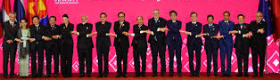
RCEP’s Strategic Importance
RCEP was not easy: 8 years, 29+ rounds, 11 ministerial negotiations, 4+ leaders sessions
Long-standing issues a challenge: some members not even willing to sit in same room outside RCEP
But 15 got agreement done, which is minor miracle
Once implementation starts, RCEP creates institutional platform to address trade and economics in Asia
Hasn’t been possible before
Could leverage RCEP platform to create new trade rules, standards, procedures
Was not part of original RCEP agenda but given post-Covid trends, likely to be critical in future

Slide 10
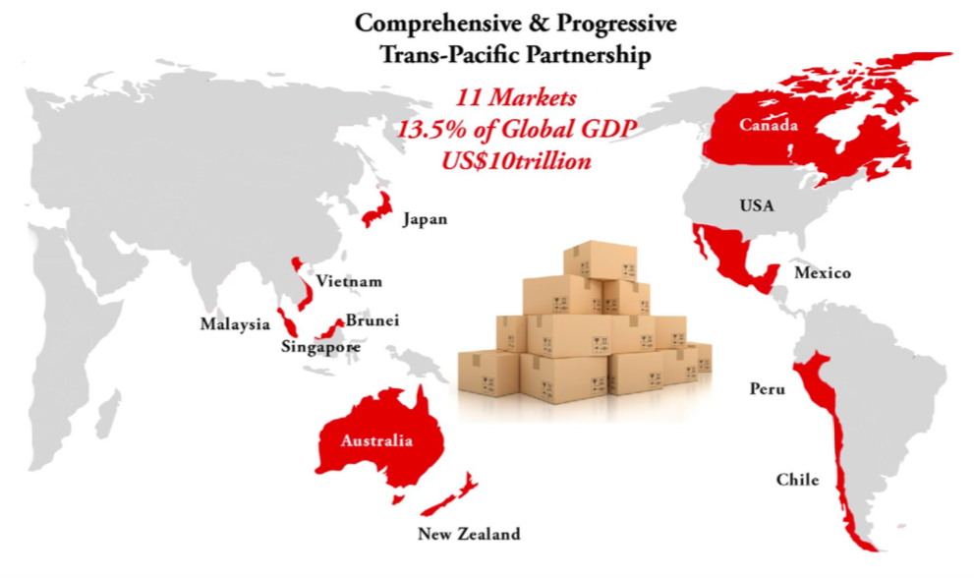
CPTPP Membership
In accession: UK
Asking to join: China, Taiwan
Note that Brunei, Malaysia and Chile have not yet activated the agreement

Slide 11
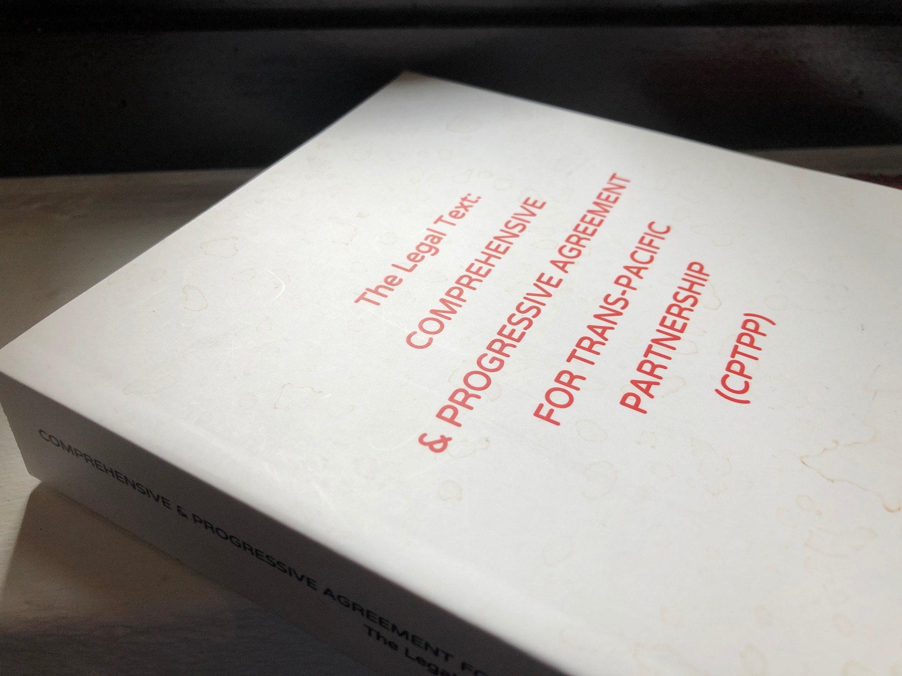
CPTPP
Comprehensive and Progressive Trans-Pacific Partnership (CPTPP) in force since late 2018 for 7 countries
Australia, Canada, Japan, Mexico, New Zealand, Singapore, and Vietnam
Tariff cuts now already on “Year 4”
(Except for Japan, which starts new “year” on April 1, 2021)
Peru just became full member in September 2021
Includes two members in ASEAN: Singapore and Vietnam
Brunei and Malaysia still have not ratified
Once they agree, in force in 60 days for them
Economic benefits already flowing to Vietnam (especially) from CPTPP membership
Accession underway for the UK
China and Taiwan have applied to join, Korea likely

Slide 12
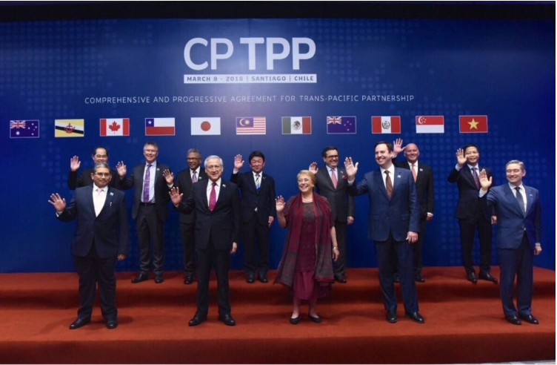
What’s Different About the CPTPP?
CPTPP is broader:
Covers markets for all goods (including agriculture), services, investment, government procurement, e-commerce with meaningful promises for opening
Tariff cuts nearly all currently at duty-free or zero tariffs for everything
All services, investment and other commitments active already
30 chapters included in agreement, 6000+ pages
CPTPP is deeper:
Has new rules for areas like intellectual property, food and food safety (SPS), standards (TBT), environment, labor, competition, customs, etc.
Shared norms:
Every member has same commitments (just longer time frames for some members to implement deal)

Slide 13
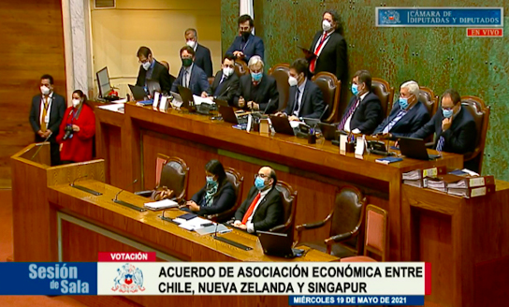
Don’t Forget Digital Trade Arrangements
ASEAN’s E-Commerce Agreement getting implemented
Existing Digital Economy Partnership Agreement (DEPA) with Chile, Singapore and New Zealand up for expansion
DEPA is a “modular” style agreement that aims to build consistency in the digital space by using similar commitments in different arrangements
Sign on to DEPA or use the modules in your own trade deal
Digital Economic Agreements (DEA) in place already between Singapore and Australia
Under negotiation with SG and UK, SG and South Korea
DEAs are meant to “bolt” onto existing free trade agreements so can be deeper commitments for digital plus benefits of underlying trade deal

Slide 14
For 2022 and Beyond
Trade has been badly disrupted
Traditional institutional mechanisms for managing trade have suffered
New structures emerging, including potential “coalitions” of players on specific issues (like Digital Economy Agreements), CPTPP, RCEP and other bilateral arrangements
Each of these have differing members, rules, provisions
New issues on trade agendas, including environment or sustainability, labor rights, digital rules of all sorts, technology standards, subsidies, and tax policies
Like to lead to continued fragmentation in trade and difficulty in building consensus at global level (especially)
Firms need to look harder to find competitive advantages in new opportunities

Slide 15
Questions?
Asian Trade Centre
Singapore
info@asiantradecentre.org
Tel +65 6536 3415 www.asiantradecentre.org
linkedin.com/company/asian-trade-centre

